Slide 1
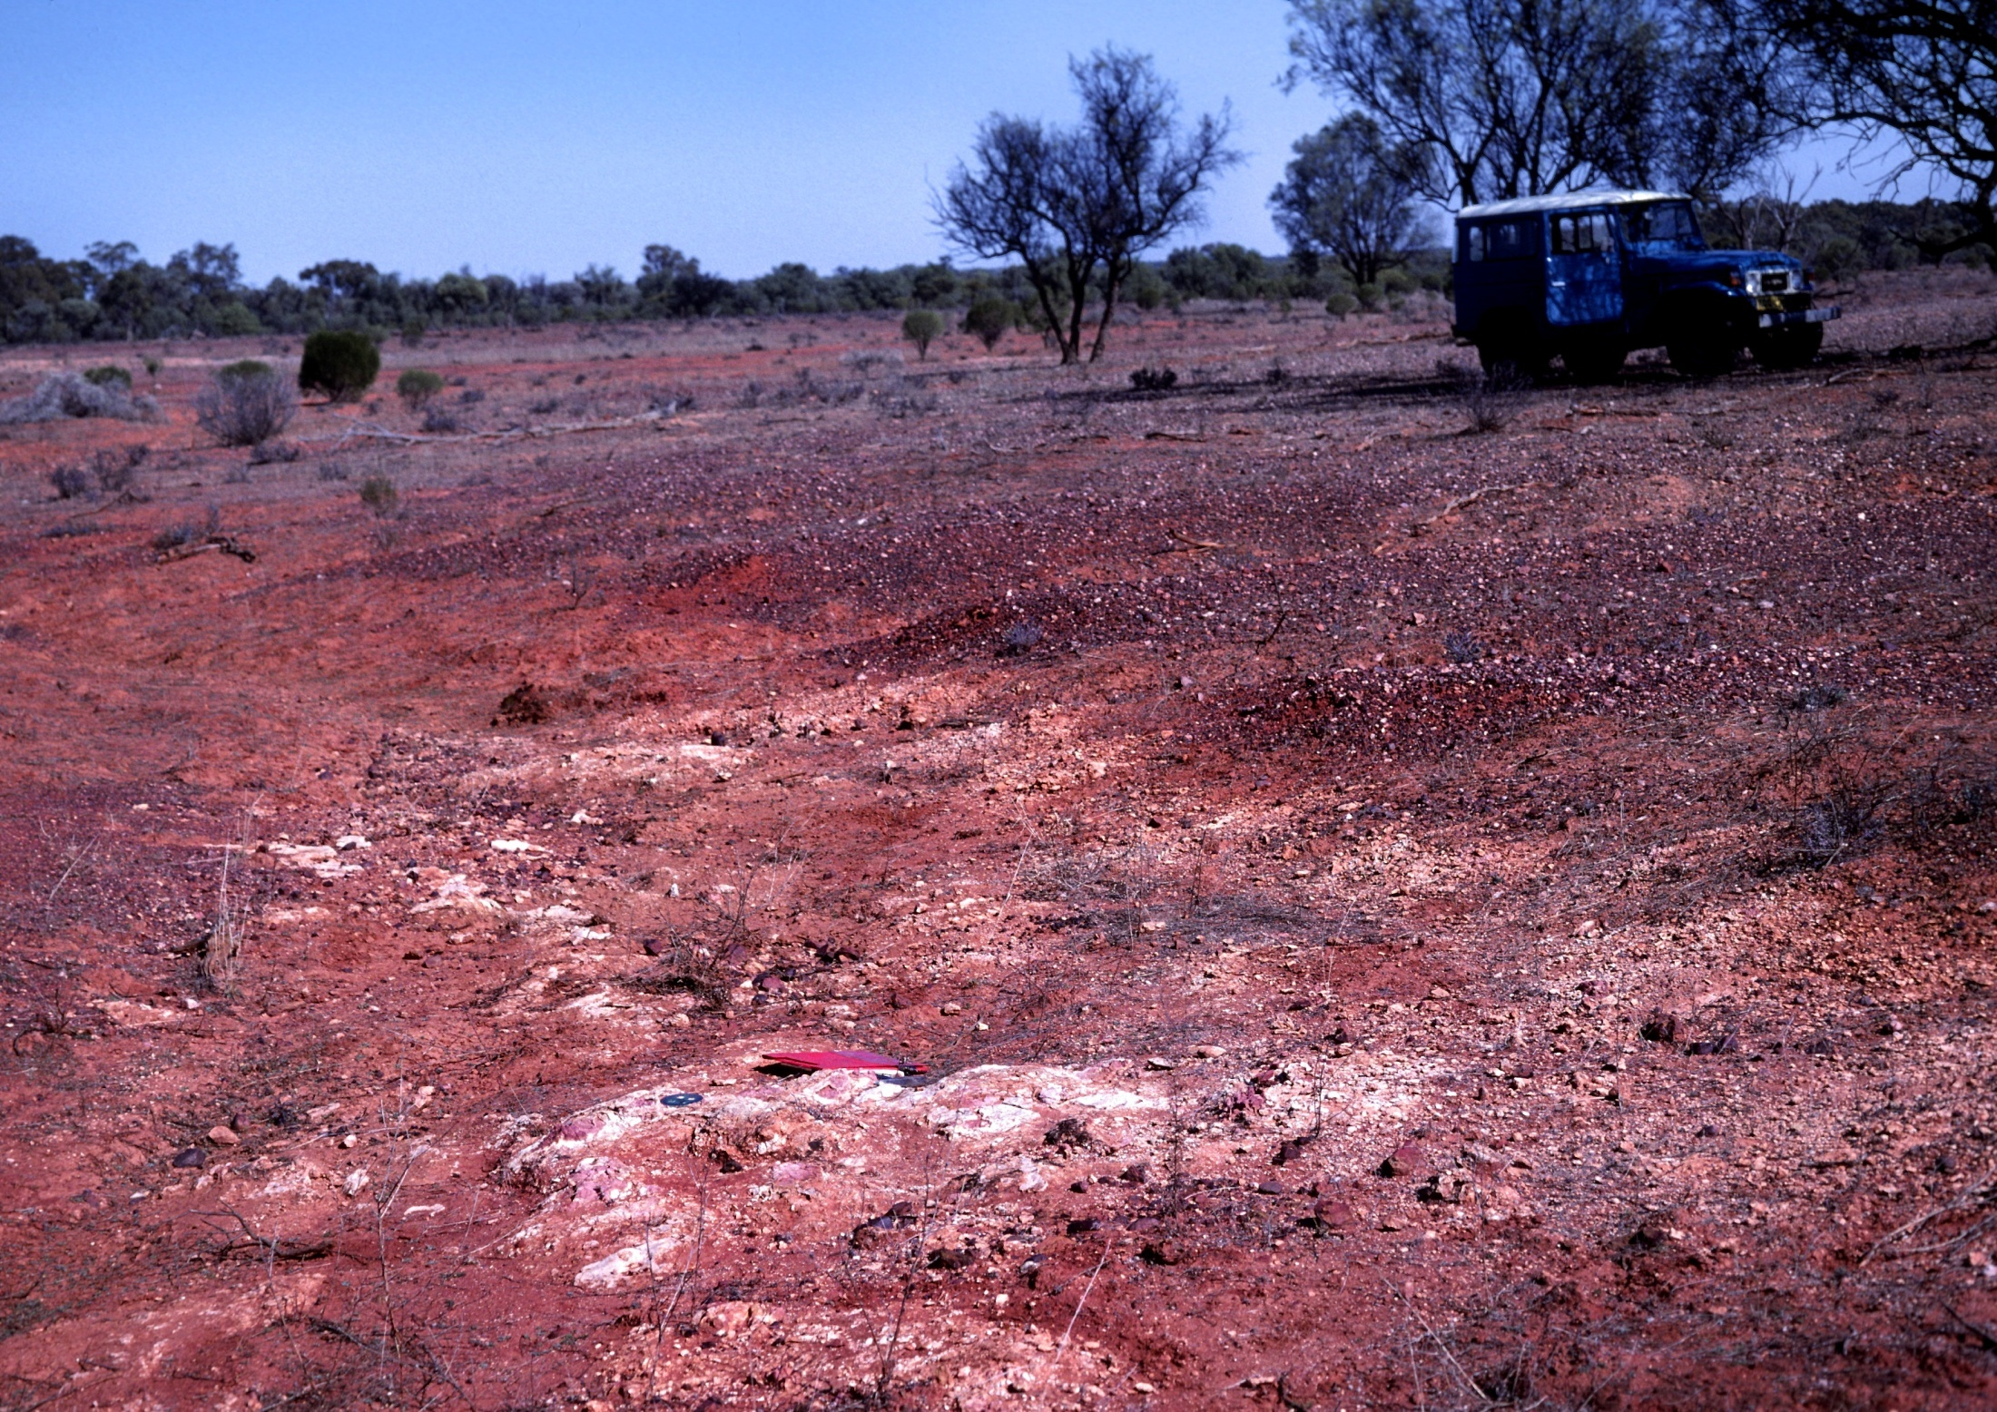
IN THE BEGINNING WERE THE
TASMANIDES:
THE TECTONIC FRAMEWORK OF
MINERAL DEPOSITS OF EASTERN
AUSTRALIA
Dick Glen

Slide 2
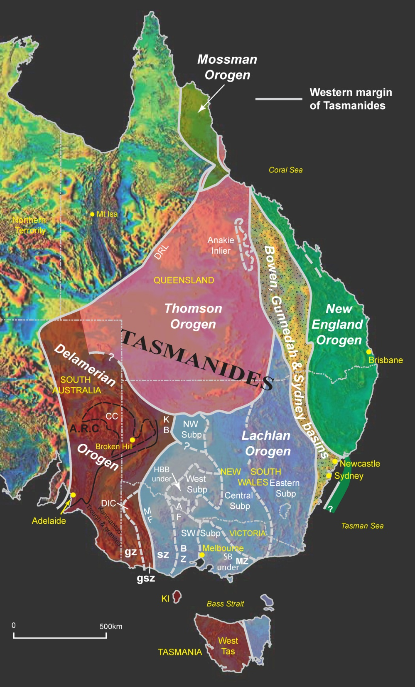
MOST BIG MINERAL DEPOSITS OCCUR IN CONVERGENT MARGIN SETTINGS
Evolution of the Tasmanides, focusing on the convergent margin history
look briefly at the crustal architecture
and implications for fluid flow
Glen 2013

Slide 3
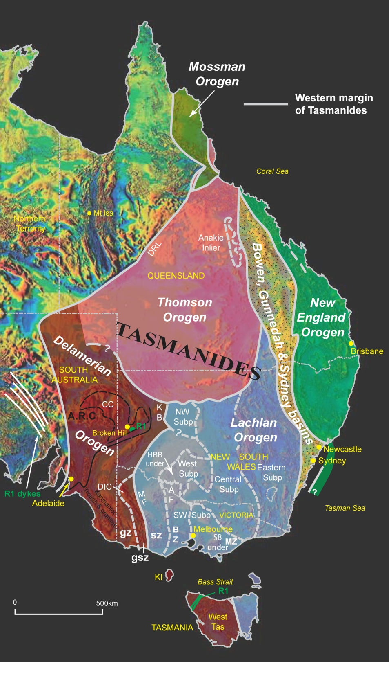
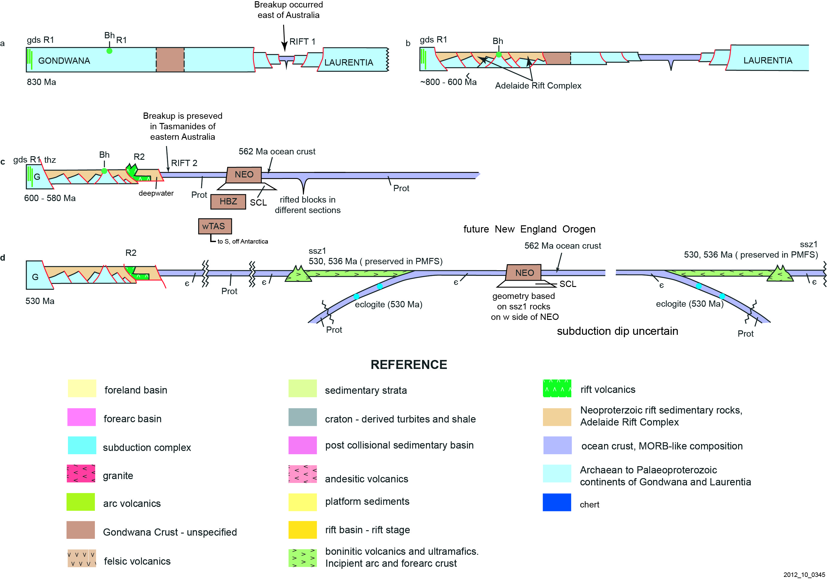
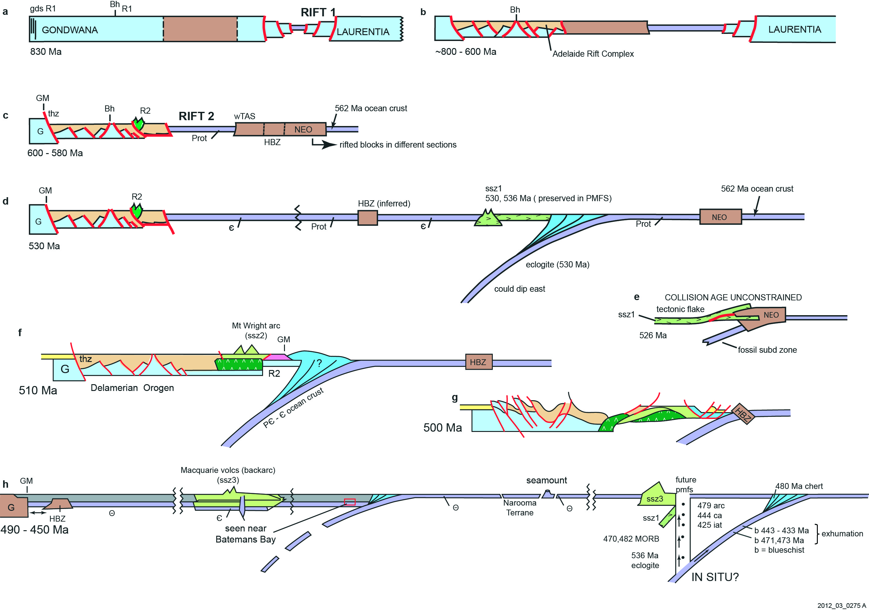
R1 rifting beginning
at ~ 830 Ma was located east of present day Australia.
Glen 2013

Slide 4

R2 rifting beginning at ~600 Ma was located within the Tasmanides.
Note local subduction
at southern margin of
Thomson Orogen
Glen 2013

Slide 5
Outcropping Precambrian
continental basement
Inferred Precambrian
continental basement
Glen unpubl

Slide 6
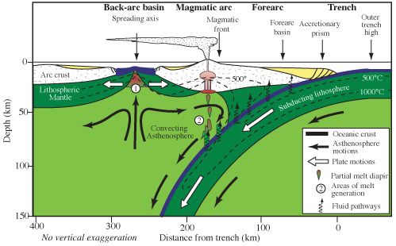
CONVERGENCE FROM ~535 TILL 100 Ma
Bob Stern

Slide 7
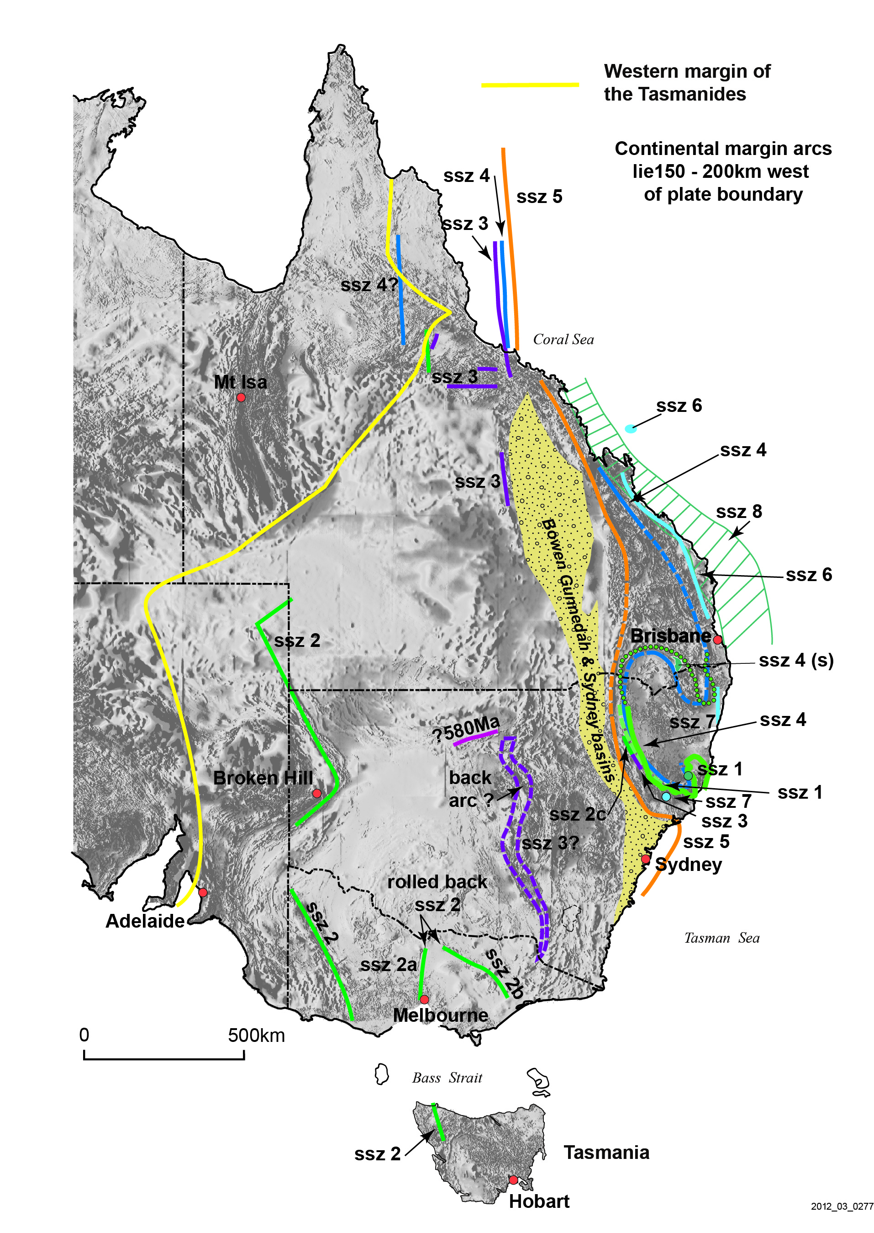
Glen 2013

Slide 8
SSZ1 - 540-530 Ma
Glen 2013

Slide 9
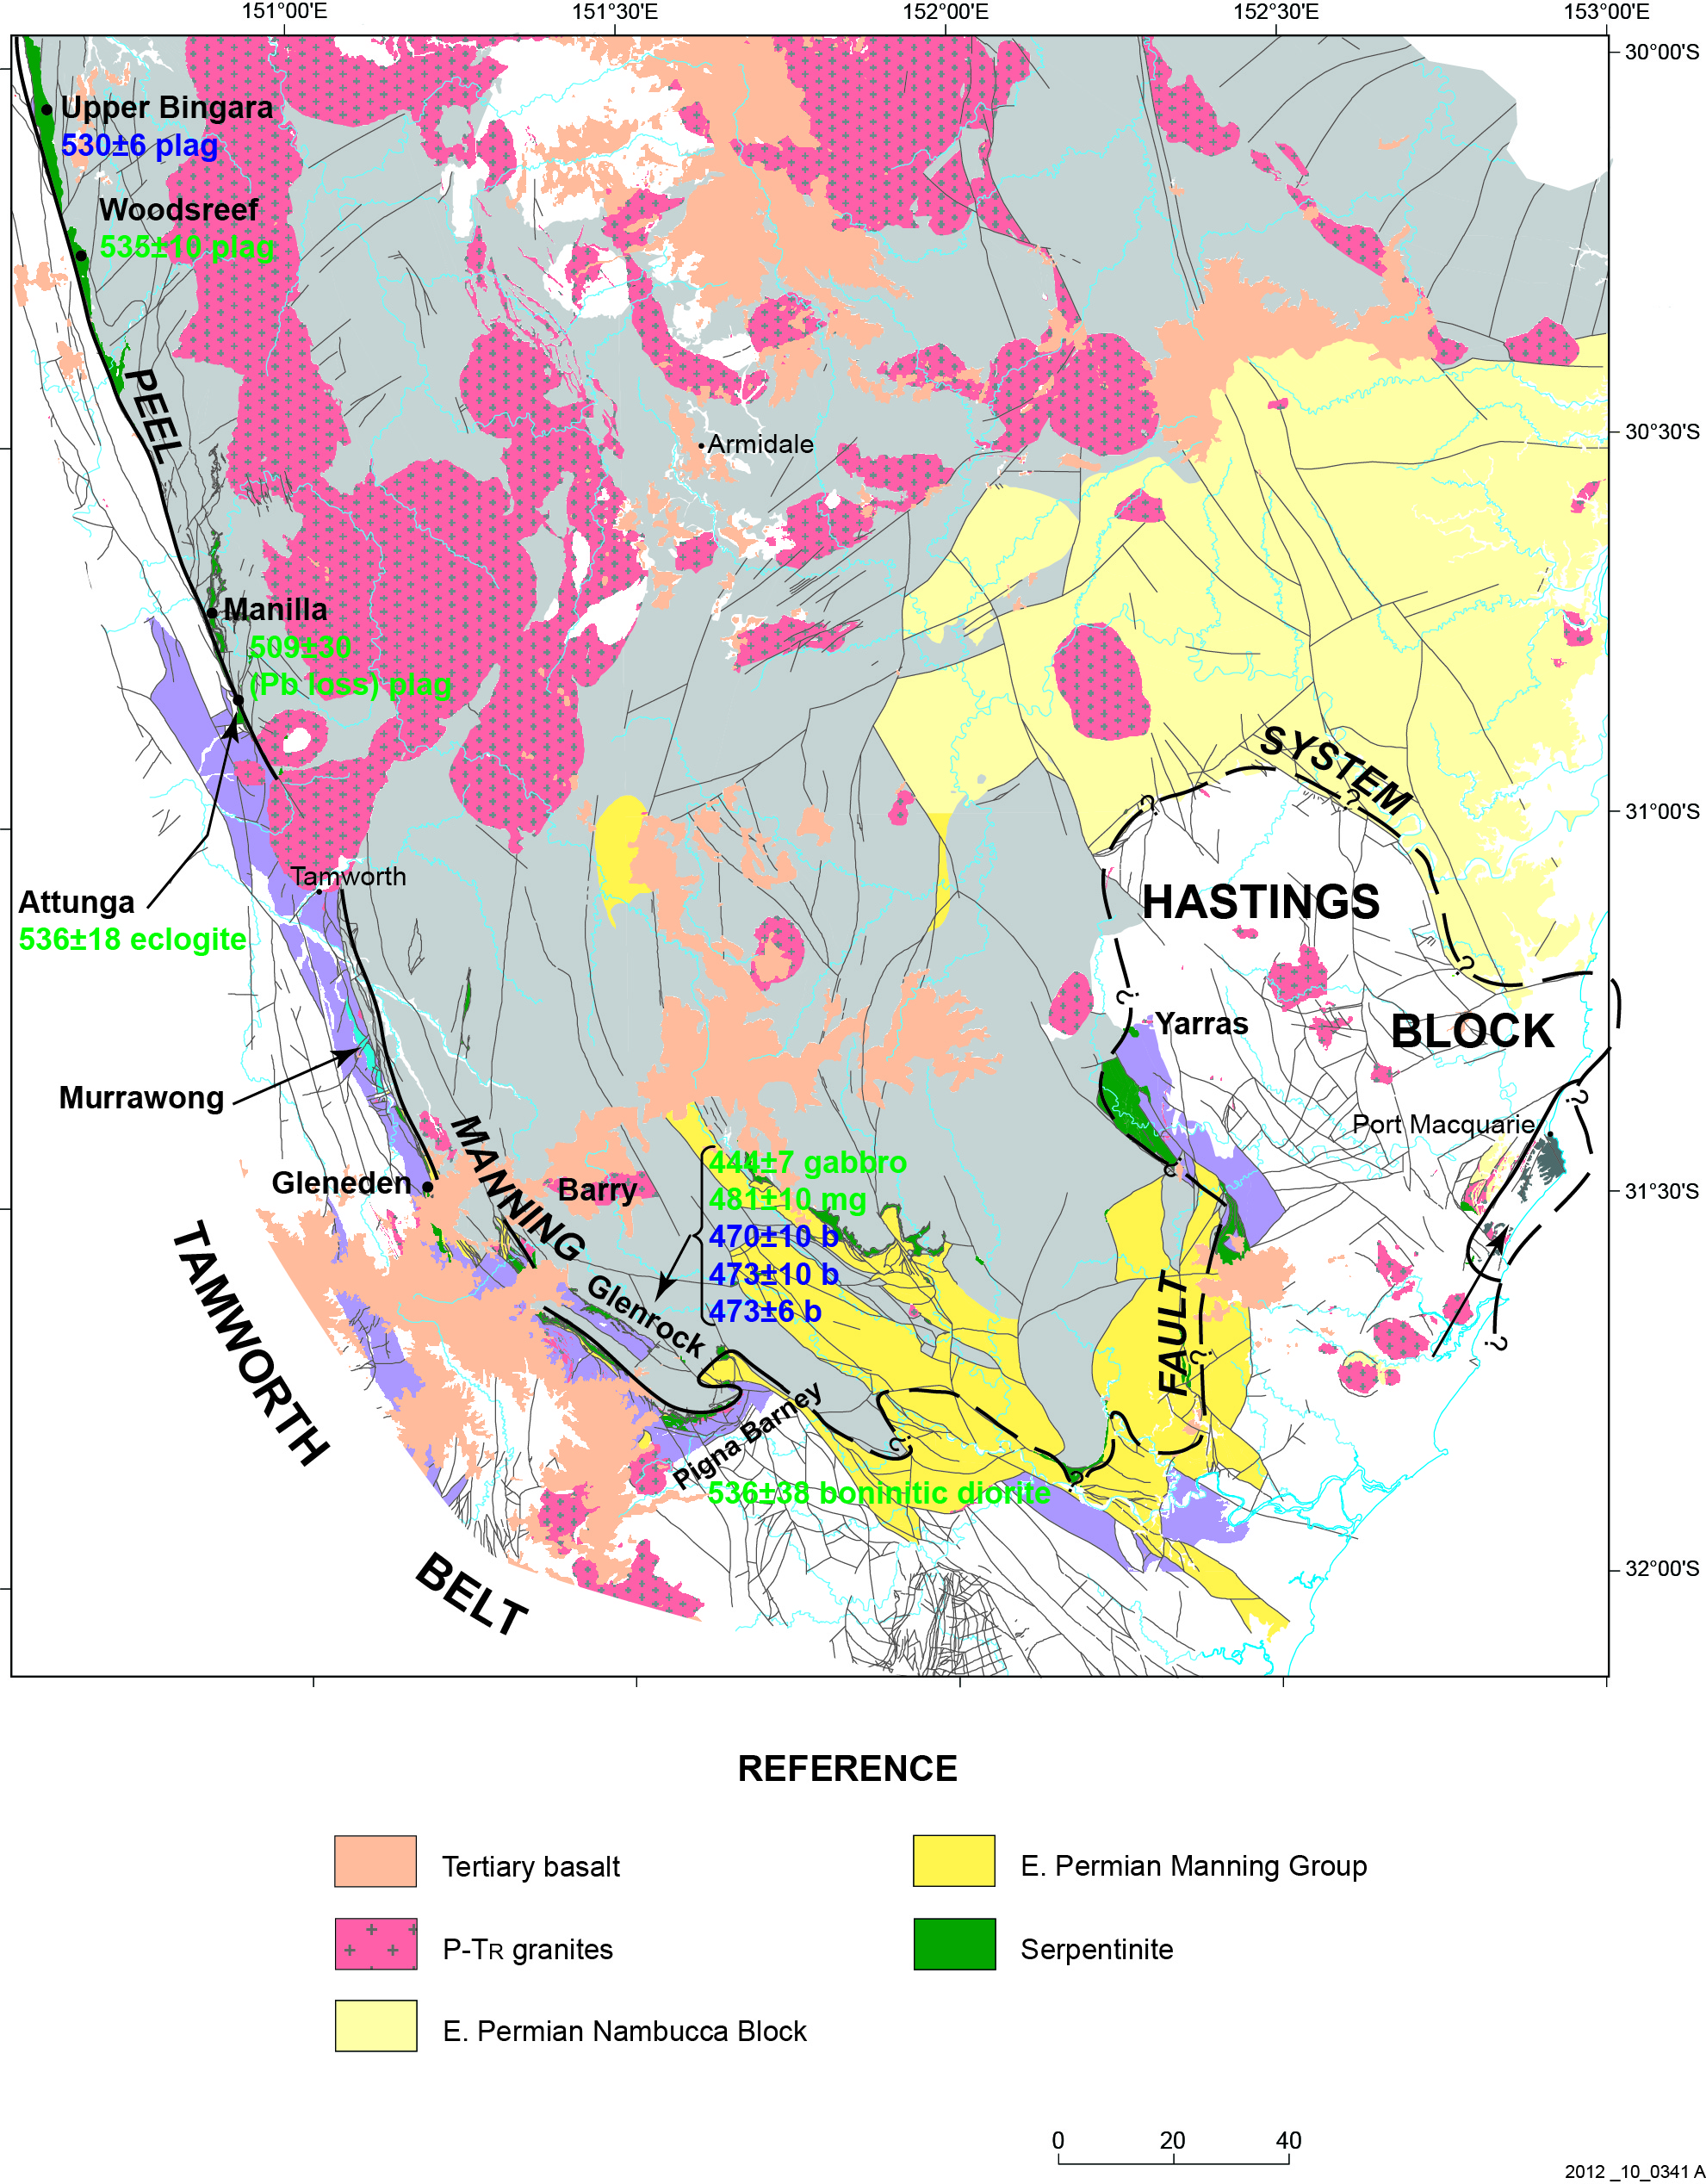
SSZ1 - 540-530 Ma
Glen 2013

Slide 10
SSZ1 - 540-530 Ma
Glen 2013

Slide 11
SSZ2 524-510 Ma, Mt Wright ‘Arc’ & MUC
Glen 2013

Slide 12
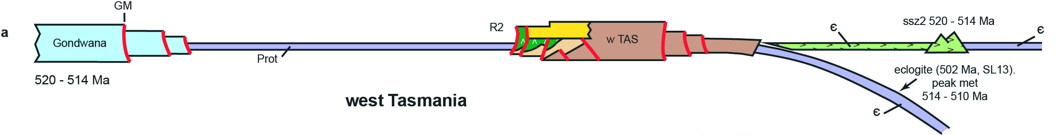
SSZ2 524-510 Ma, Mt Wright ‘Arc’ & MUC
Glen 2013

Slide 13
SSZ2a-c 524-510 Ma
Glen 2013

Slide 14
SSZ3 480-437 Ma, Macquarie ‘Arc’
Glen 2013

Slide 15
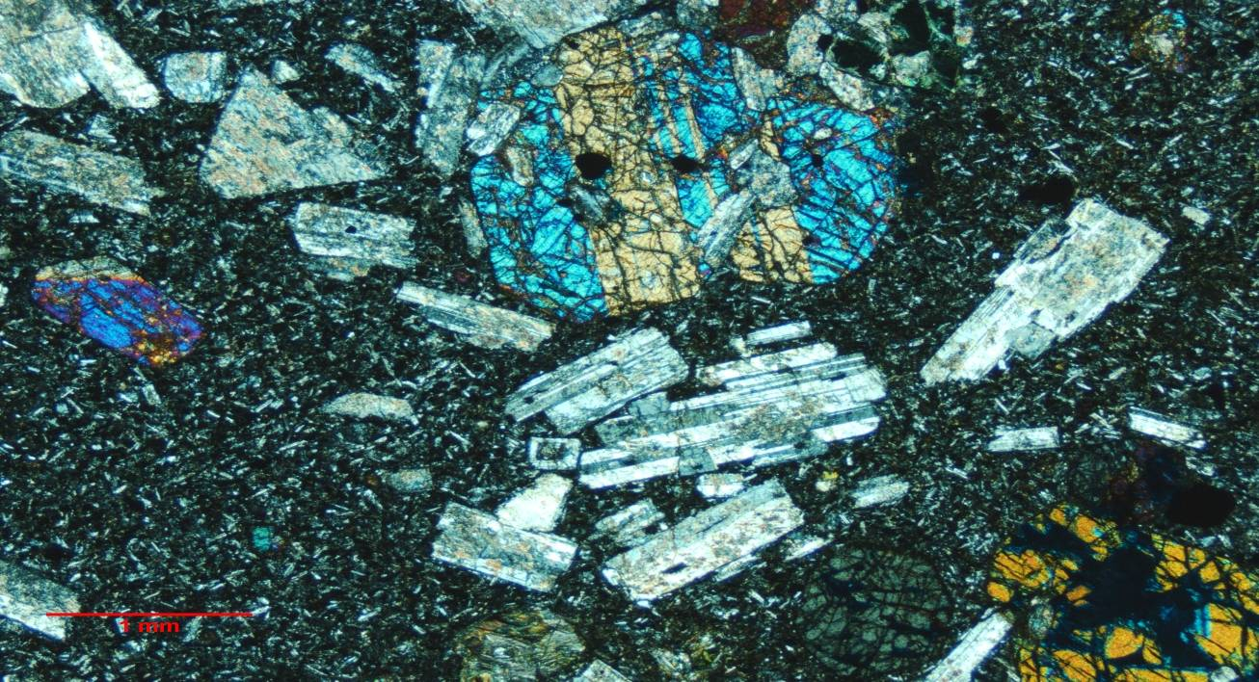
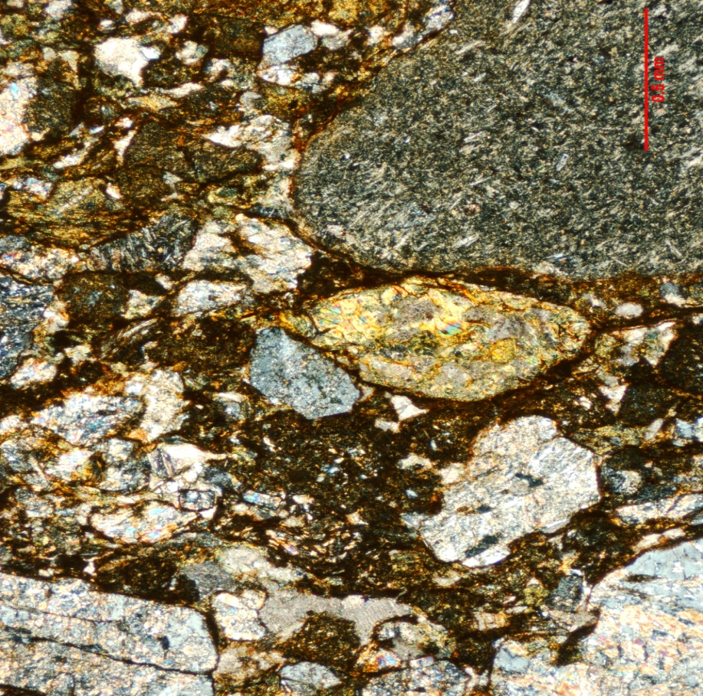
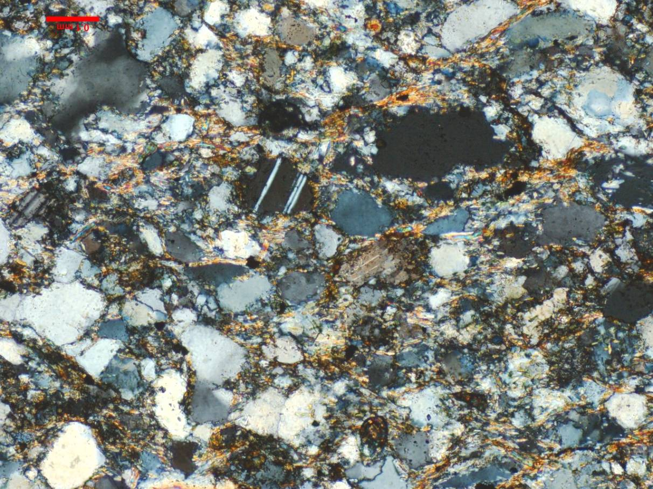
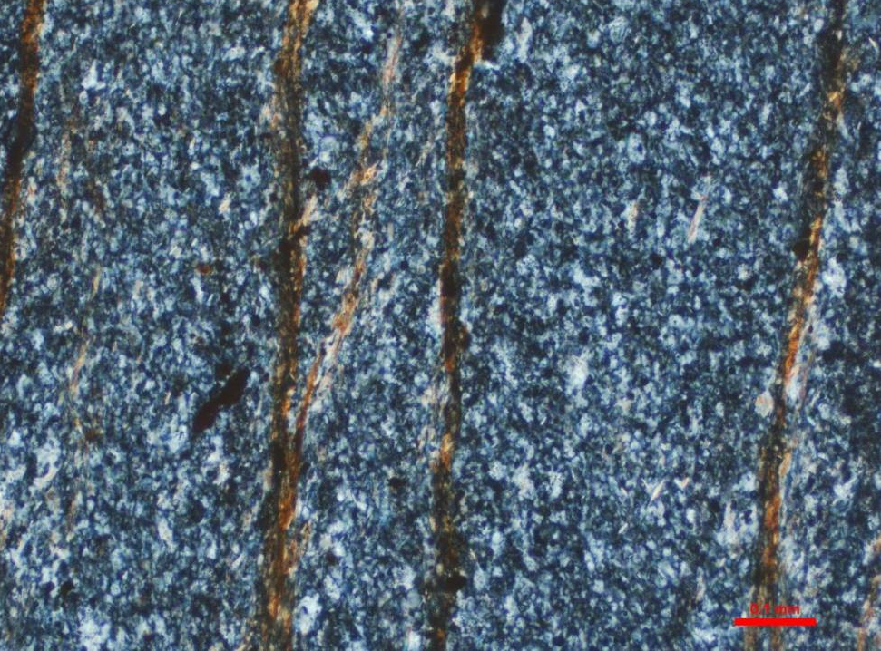
C. Simpson photos

Slide 16
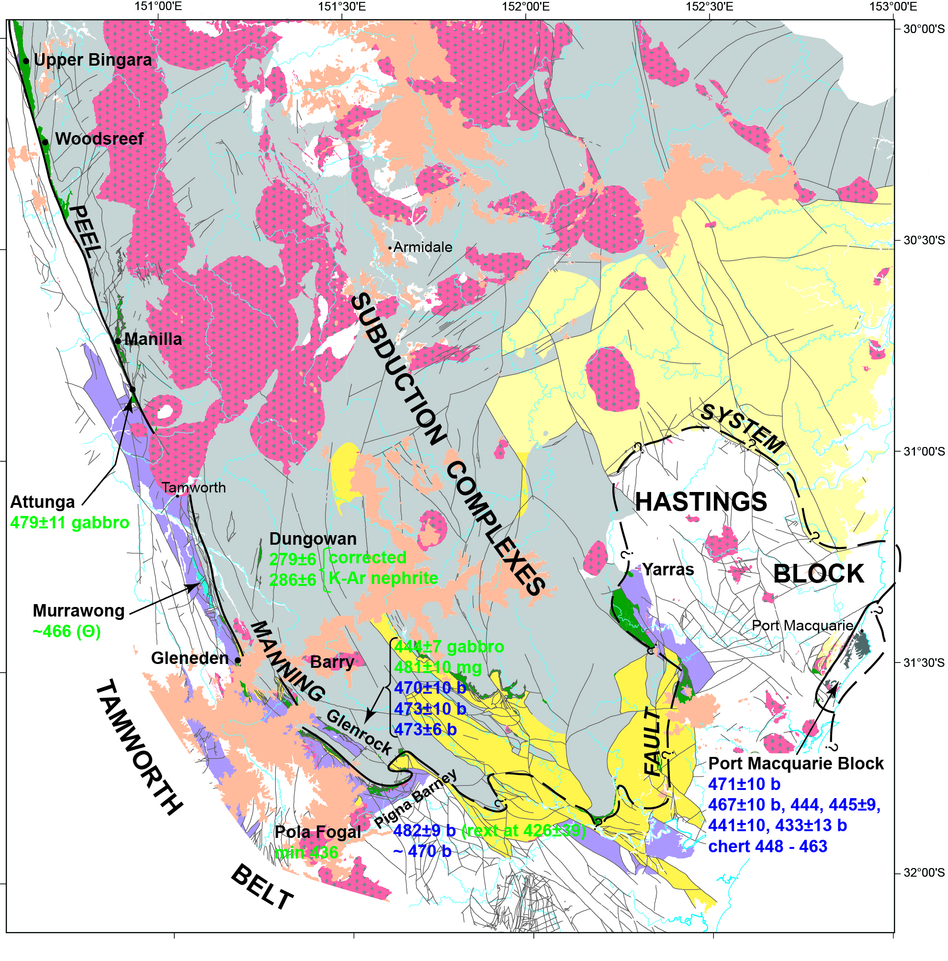
SSZ3 480-437 Ma, Macquarie ‘Arc’
Glen 2013

Slide 17
SSZ3 480-437 Ma, Macquarie ‘Arc’
Glen 2013

Slide 18
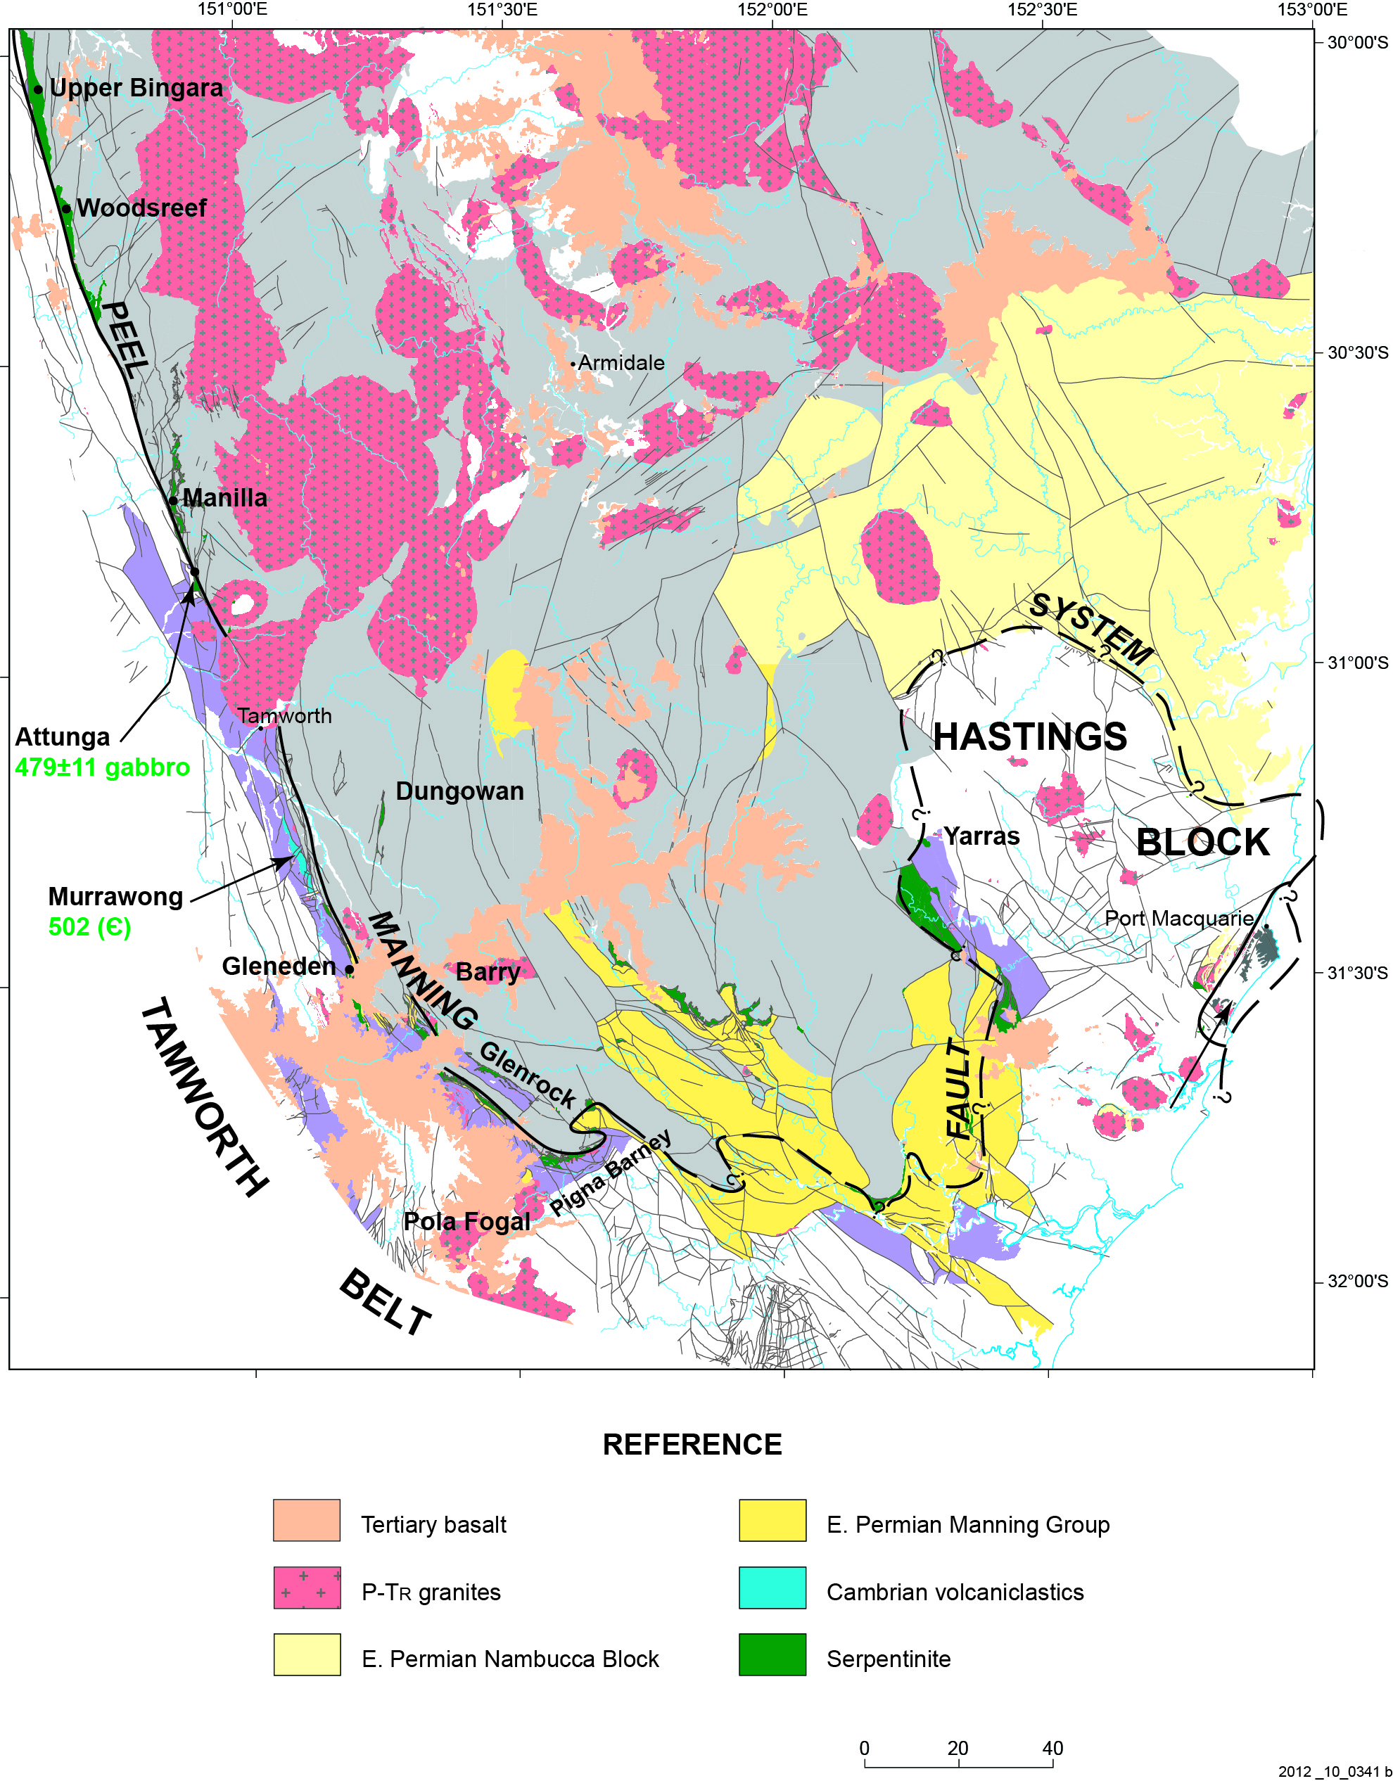
SSZ4
425-380 Ma,
Glen 2013

Slide 19
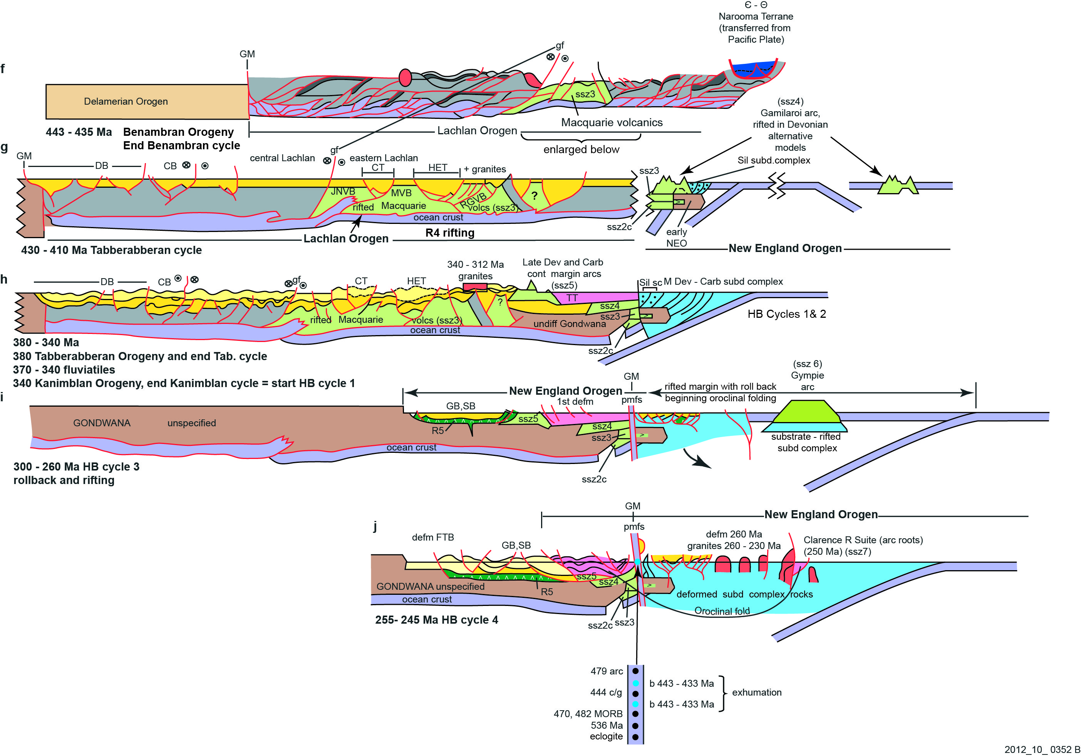
SSZ4 425-380 Ma, Calliope & Gamilaroi ‘Arcs’
Glen 2013

Slide 20
SSZ5 continental margin arc
in Yarrol Belt,
Connors Arch,
Auburn Arch
Baldwin & Currabubula arcs

Slide 21
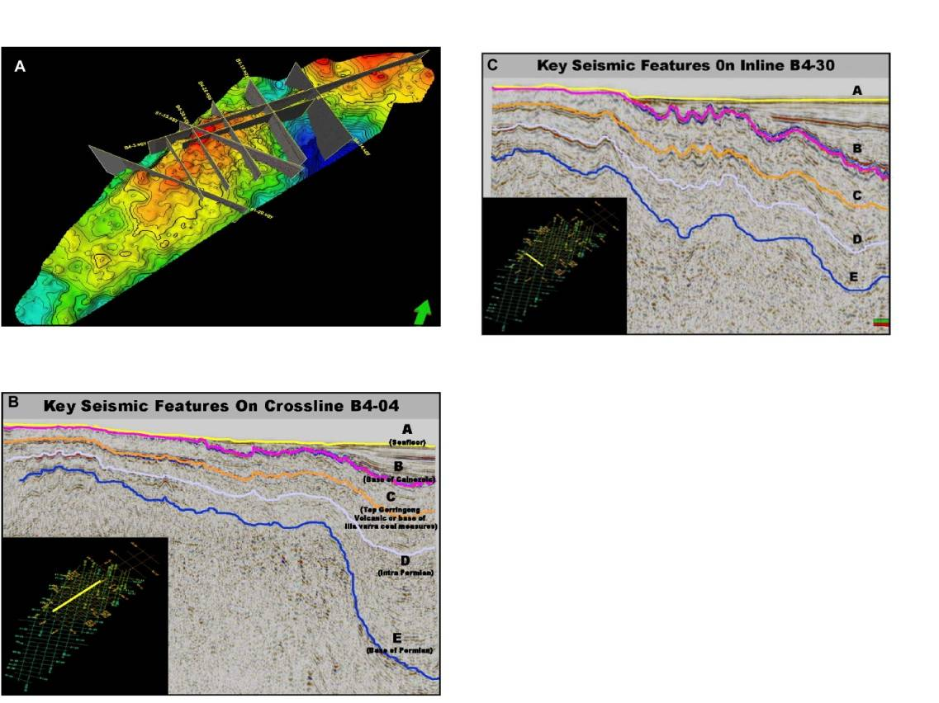
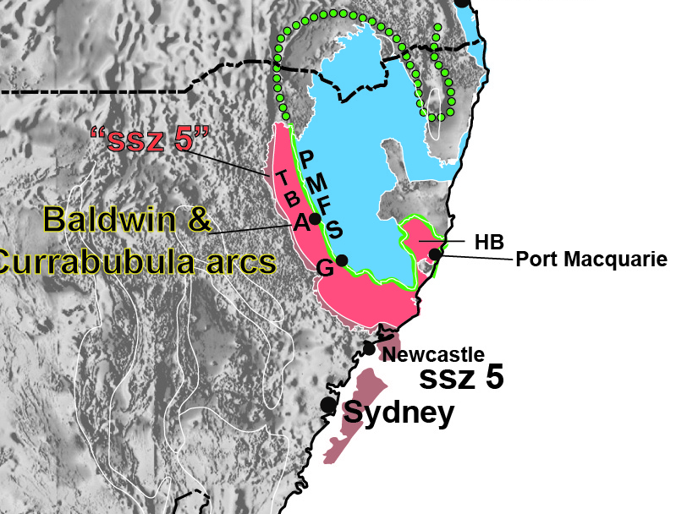
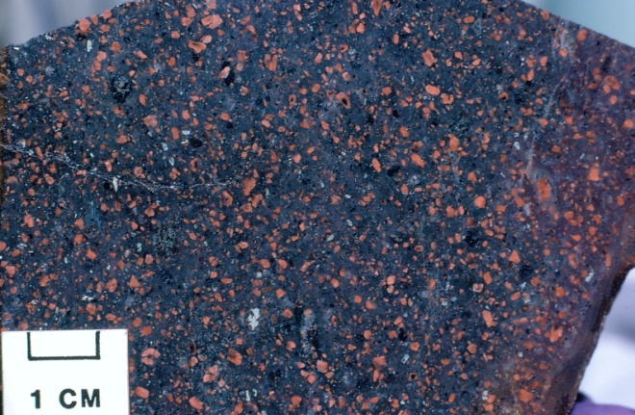
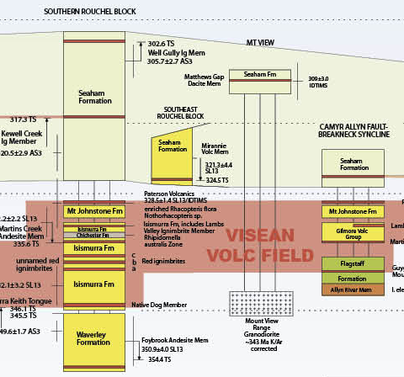
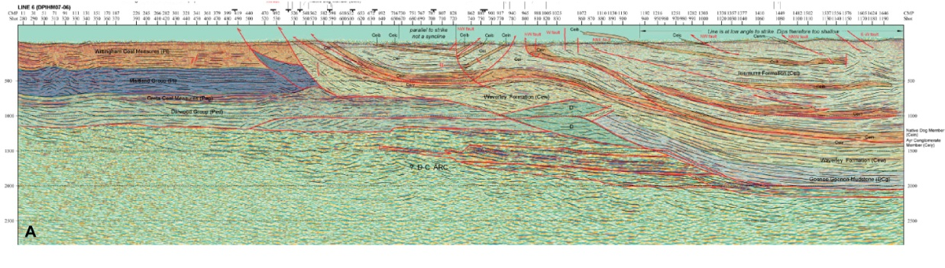
Photo M.Buck
Baldwin & Currububula arcs

Slide 22
SSZ5 continental margin arc
in Yarrol Belt,
Connors Arch,
Auburn Arch
Baldwin & Currububula arcs
Glen 2013

Slide 23
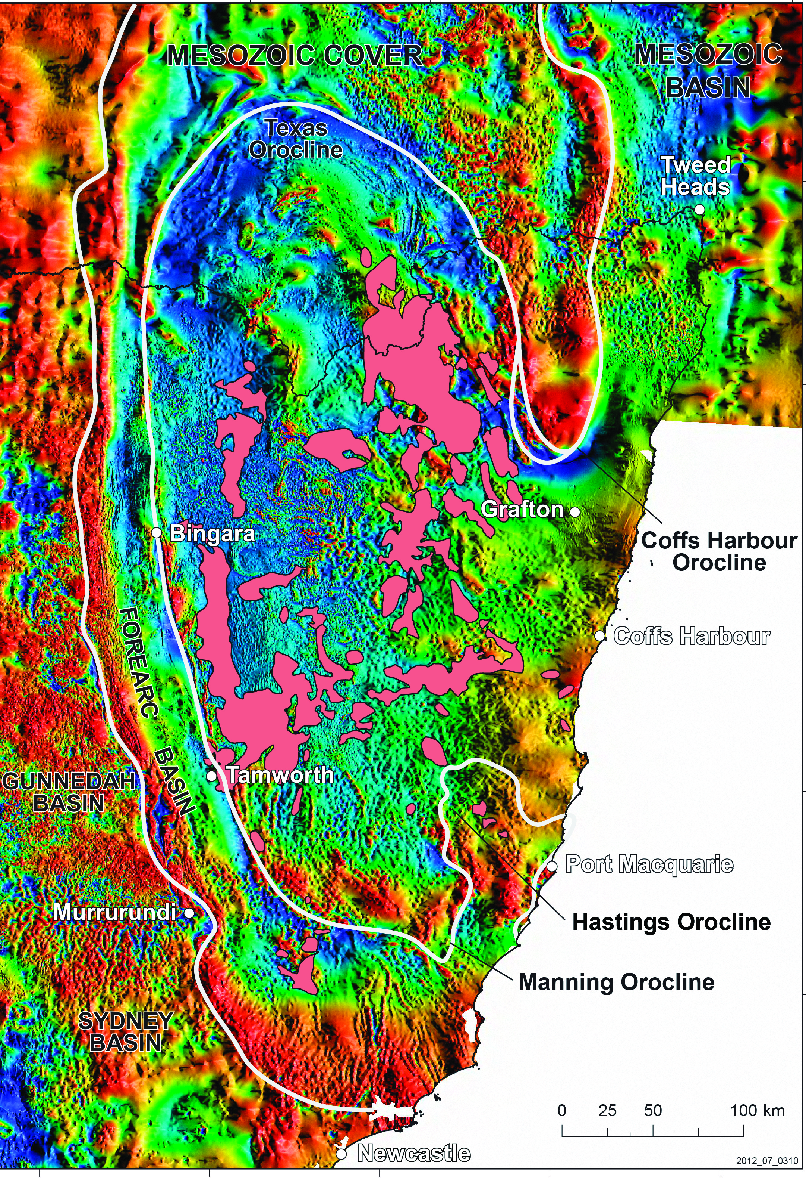
SSZ5 to SSZ6: ROLL BACK & OROCLINE FM
Glen & Roberts 2012
& unpubl

Slide 24
SSZ6 290-275 Ma Gympie Arc
Glen 2013

Slide 25
SSZ7 275-240 Ma, New England Orogen granites = ‘arc’ roots, Wandsworth Volcanic Group near Armidale, tuffs in GB & SB
Glen 2013

Slide 26
SSZ8 Whitsunday ‘Arc’
Basins contain > 1.4 x10 km³ Aptian-Albian volcanogenic sediments
seds. Bryan et al. 2009
Glen 2013

Slide 27
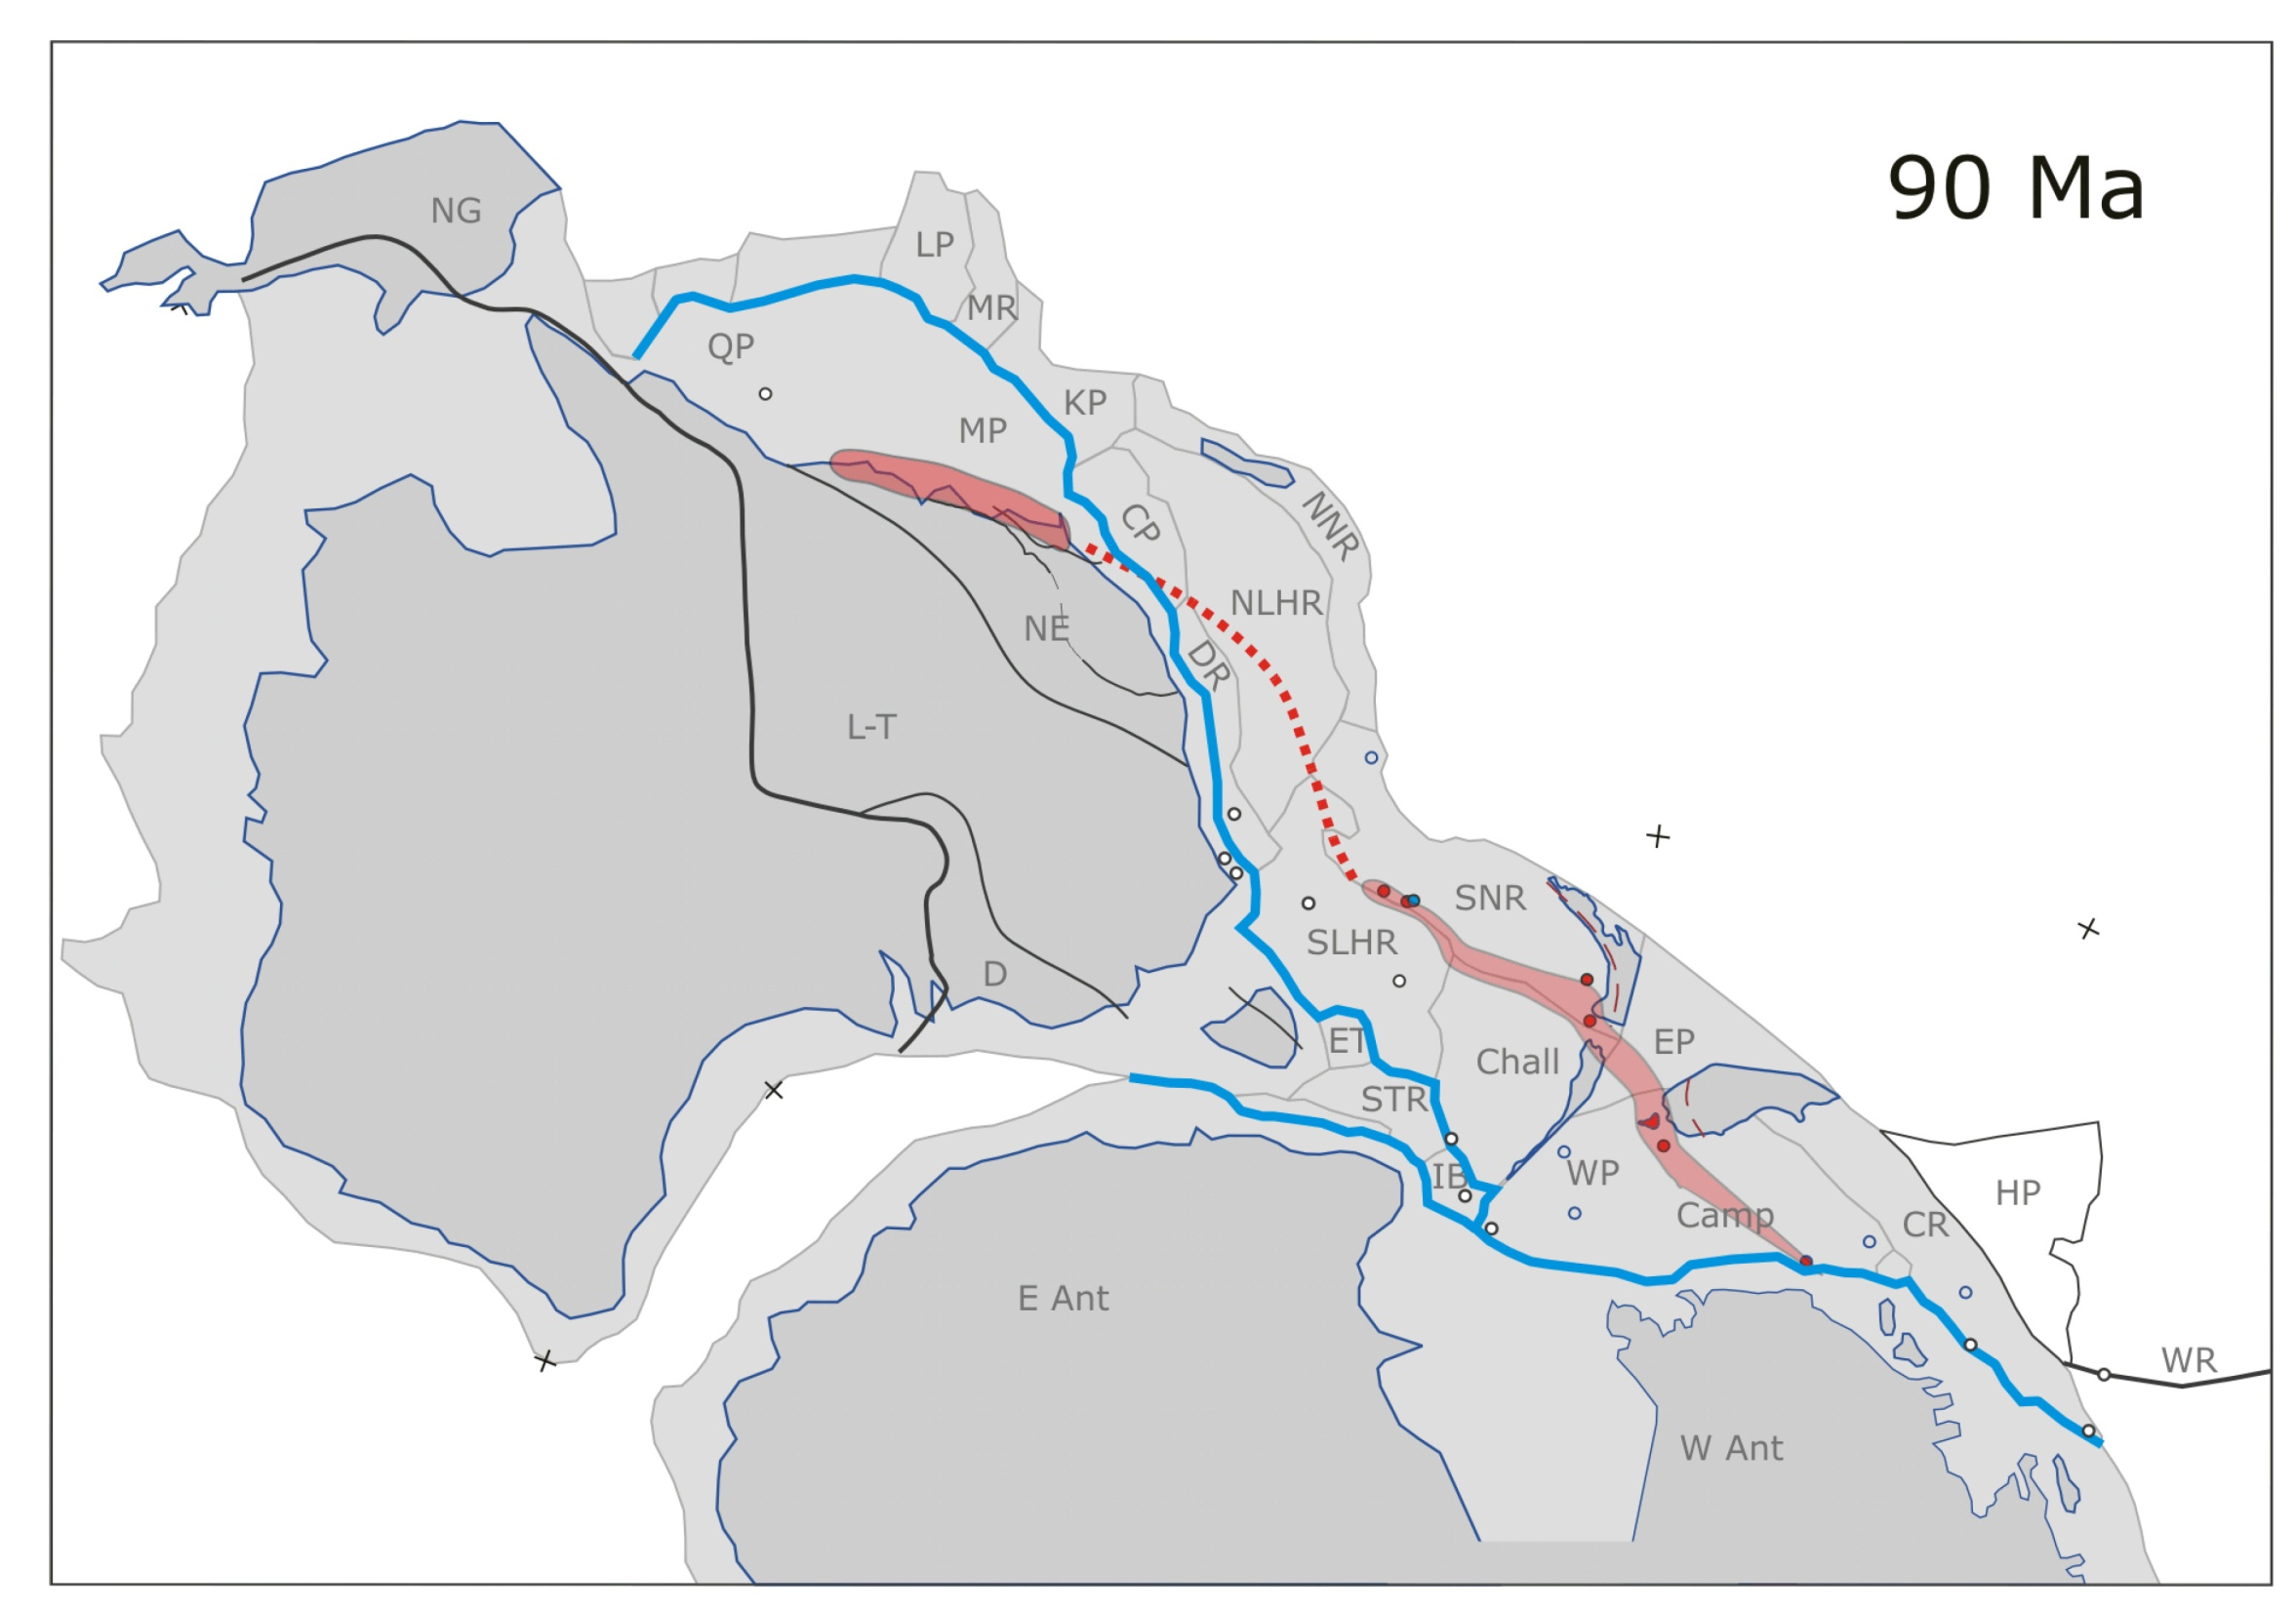
Mortimer 2010

Slide 28
ARCHITECTURE, ANISOTROPIES
AND FLUID PATHWAYS

Slide 29
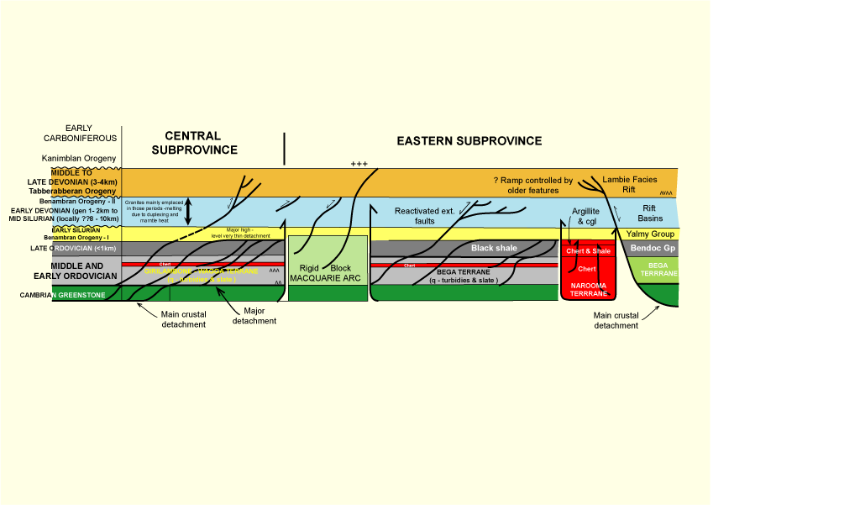
v
v
v
v
based on Glen 1991

Slide 30
v
v
v
v
PLUS INPUT FROM CAMBRIAN & ORDOVICIAN ENRICHED MANTLE
based on Glen 1991

Slide 31
LETS EXAMINE 3 DIFFERENT SETTINGS

Slide 32

1. CONSEQUENCES OF DIFFERENTIAL ROLL BACK
SSZ3-5
N PART Thomson Orogen
SSZ5-8
S PART Thomson Orogen
SSZ2
SSZ2A-2B
SSZ2C-7
SSZ2
based on Glen 2013

Slide 33
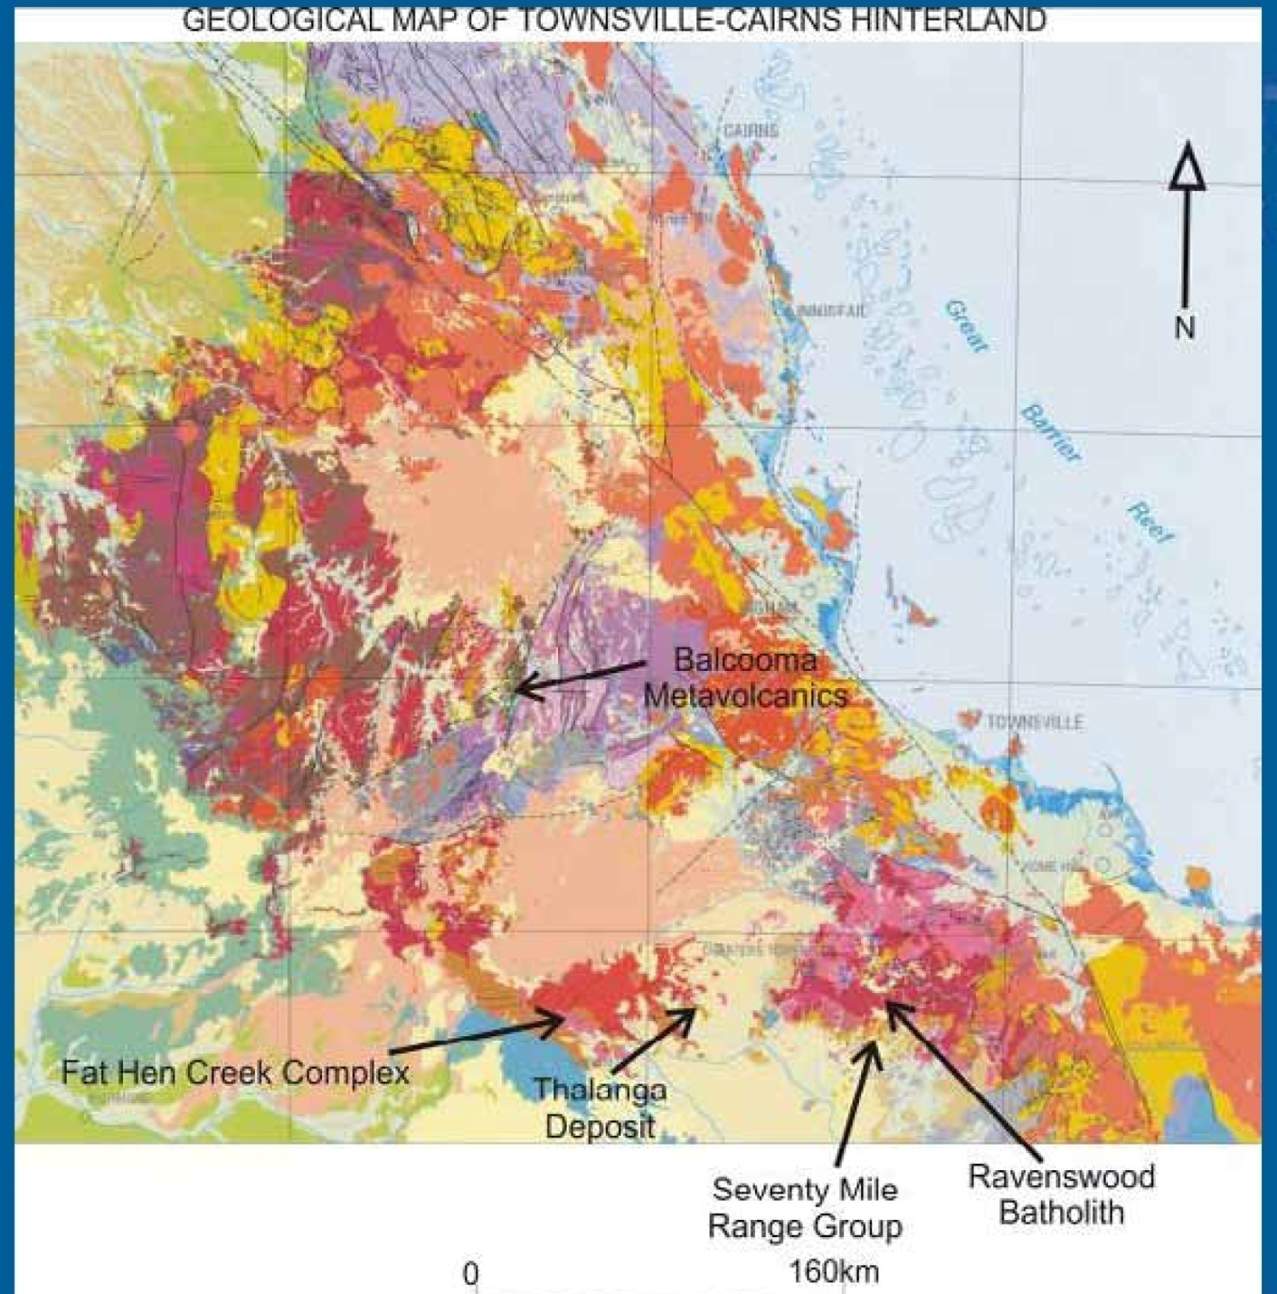
6million oz gold
(Solomon & Groves 2000)
L .Hutton GSQ

Slide 34
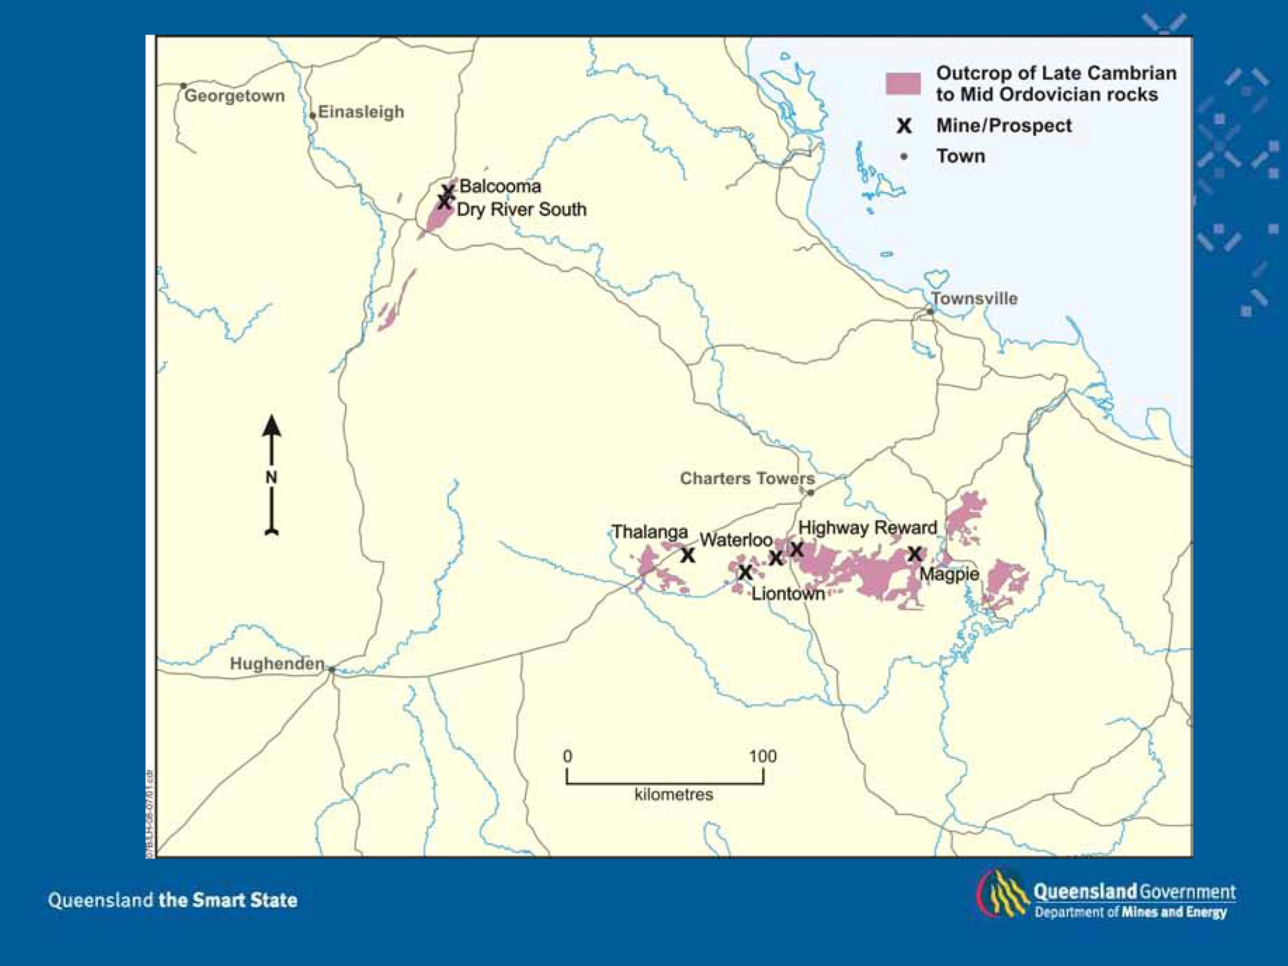
L .Hutton GSQ

Slide 35
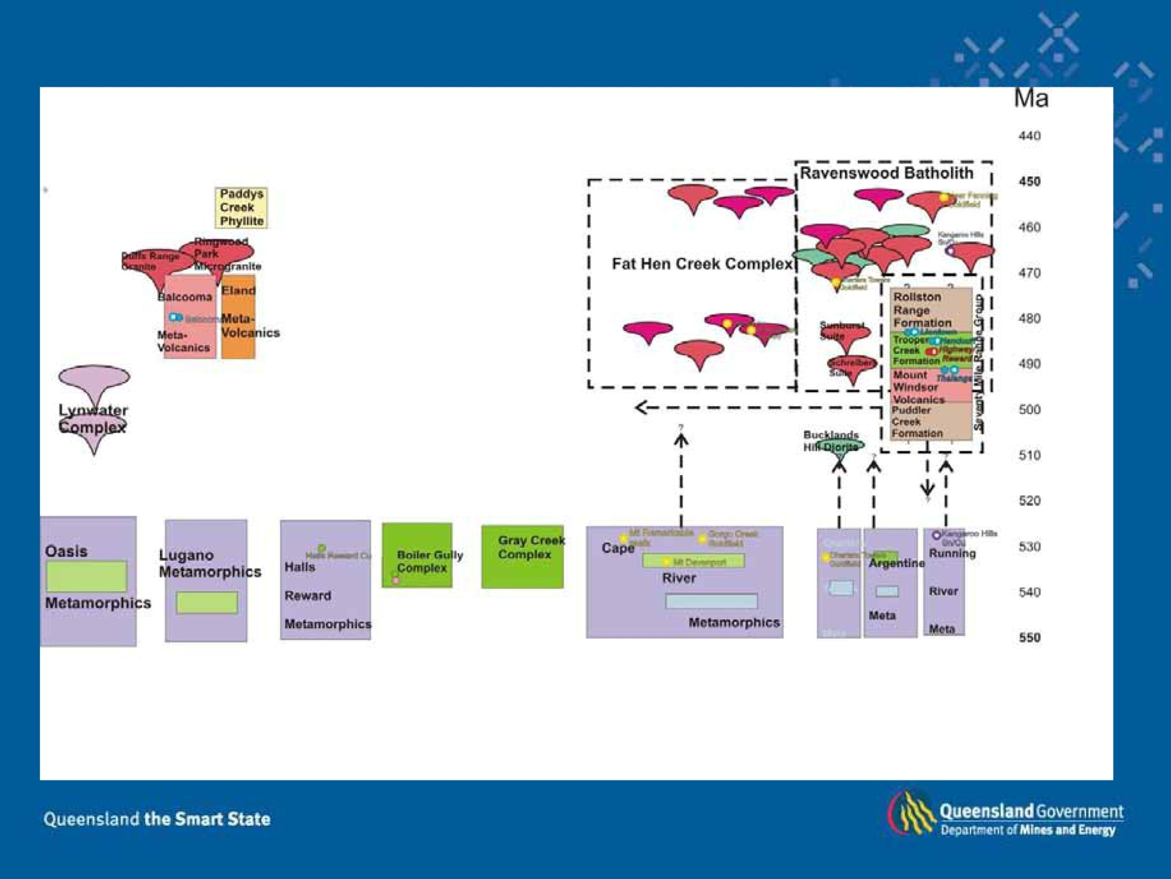
L .Hutton GSQ

Slide 36
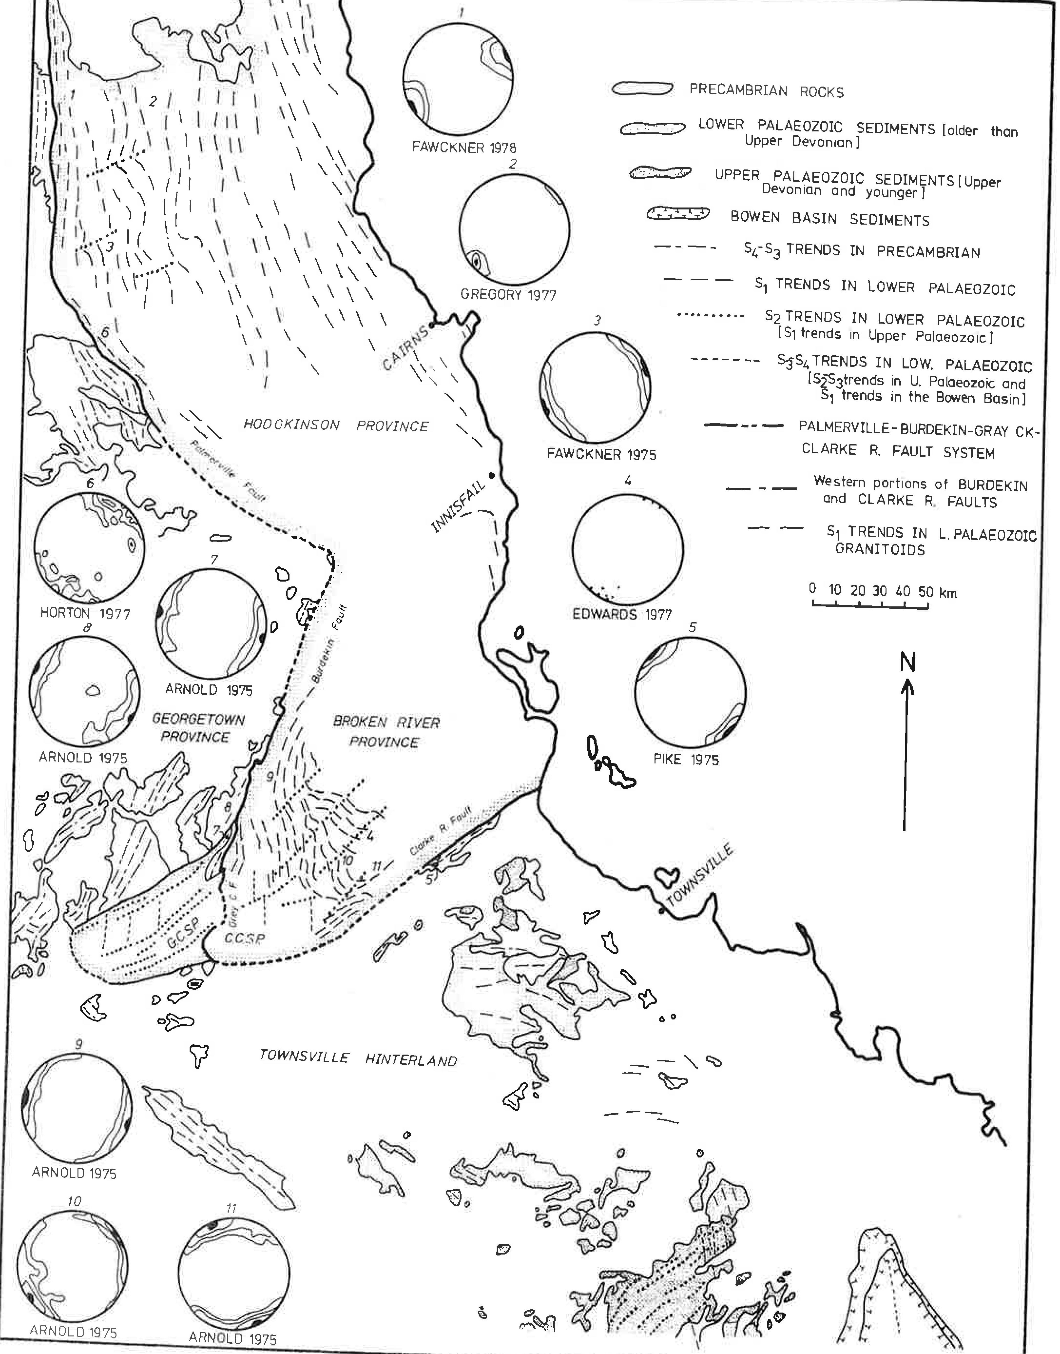
Bell 1980

Slide 37
SSZ3-5
Orocline
here
N PART Thomson Orogen
Barcoo Basin
NP to C
Barcoo Basin
NP to C
SSZ5-8
S PART Thomson Orogen
SSZ2
Orocline
here
SSZ2A-2B
SSZ2C-7
SSZ2
based on Glen 2013

Slide 38
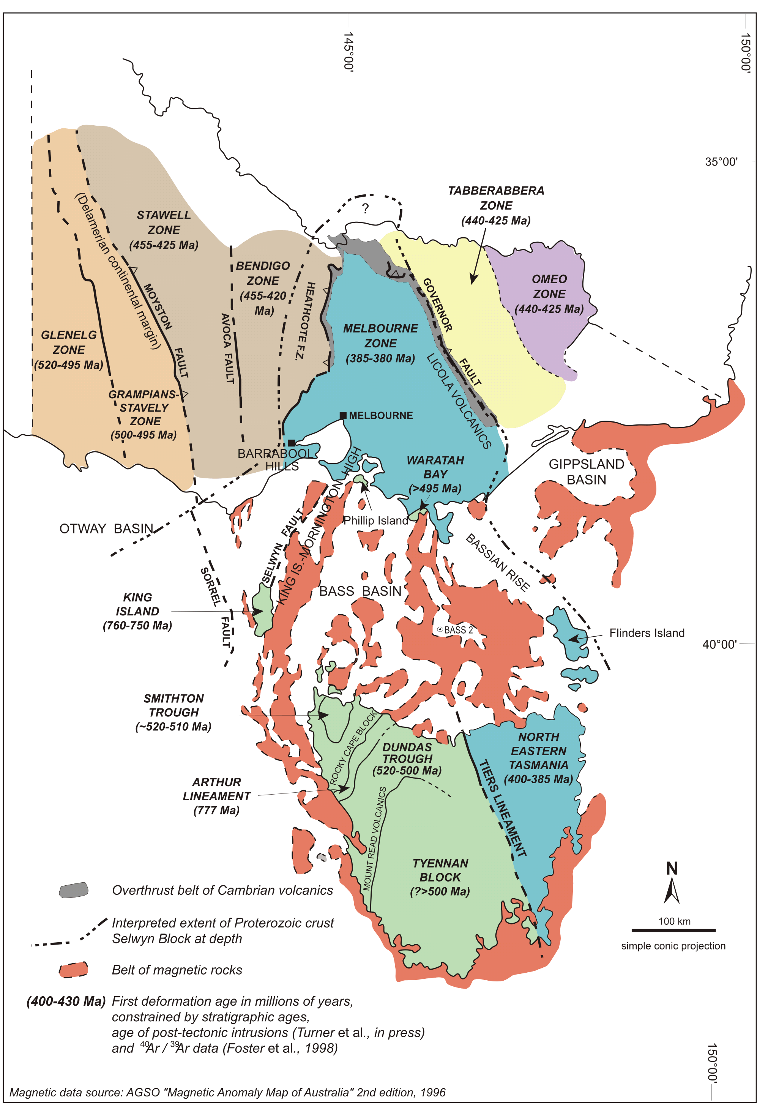
2. CONSEQUENCES OF OROGEN –PARALLEL ANISOTROPY
THE SELWYN BLOCK AND GOLD DEPOSITS OF VICTORIA
VandenBerg et al., 2000

Slide 39
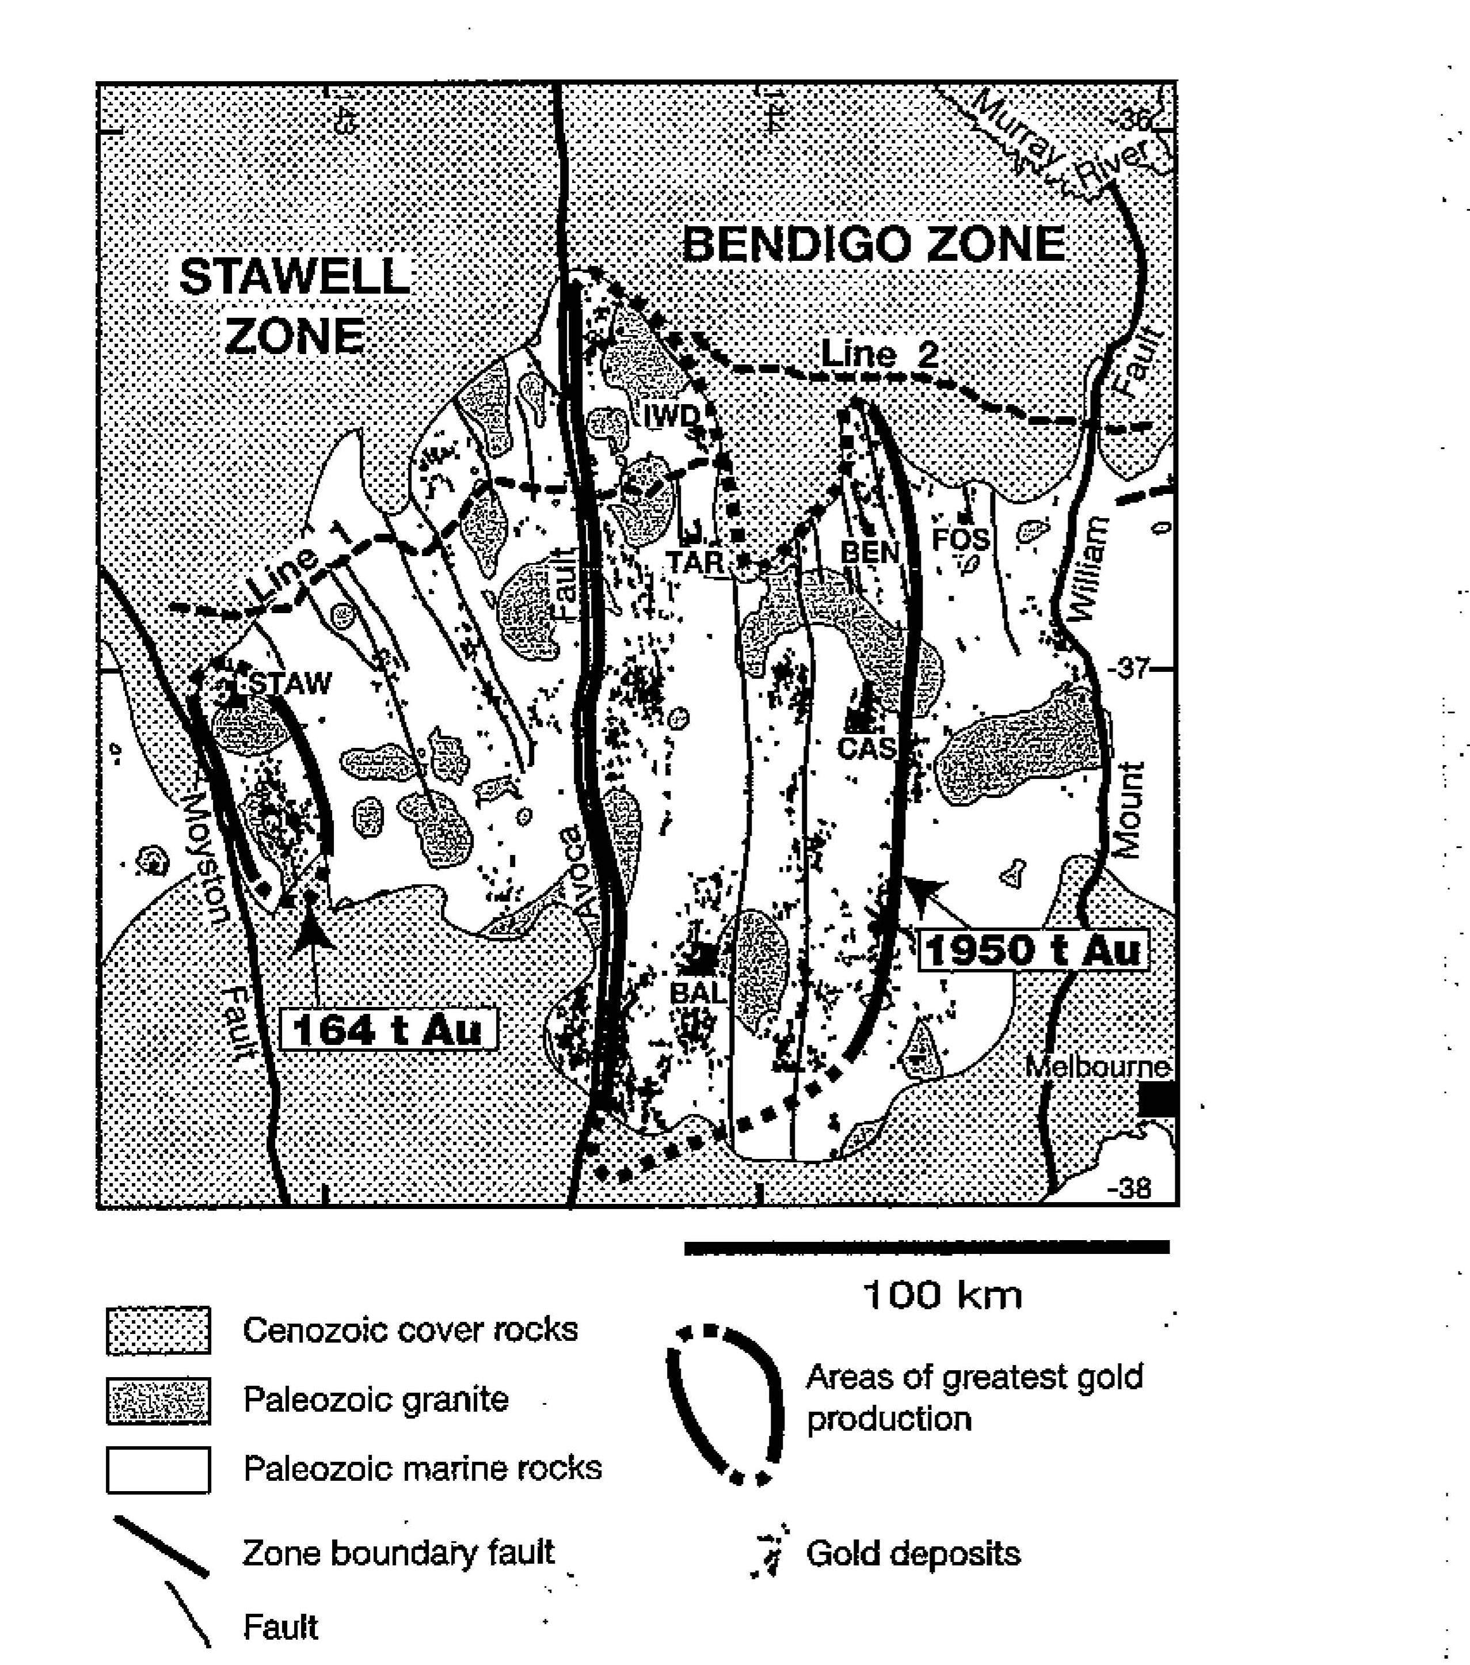
Willman et al. 2010

Slide 40
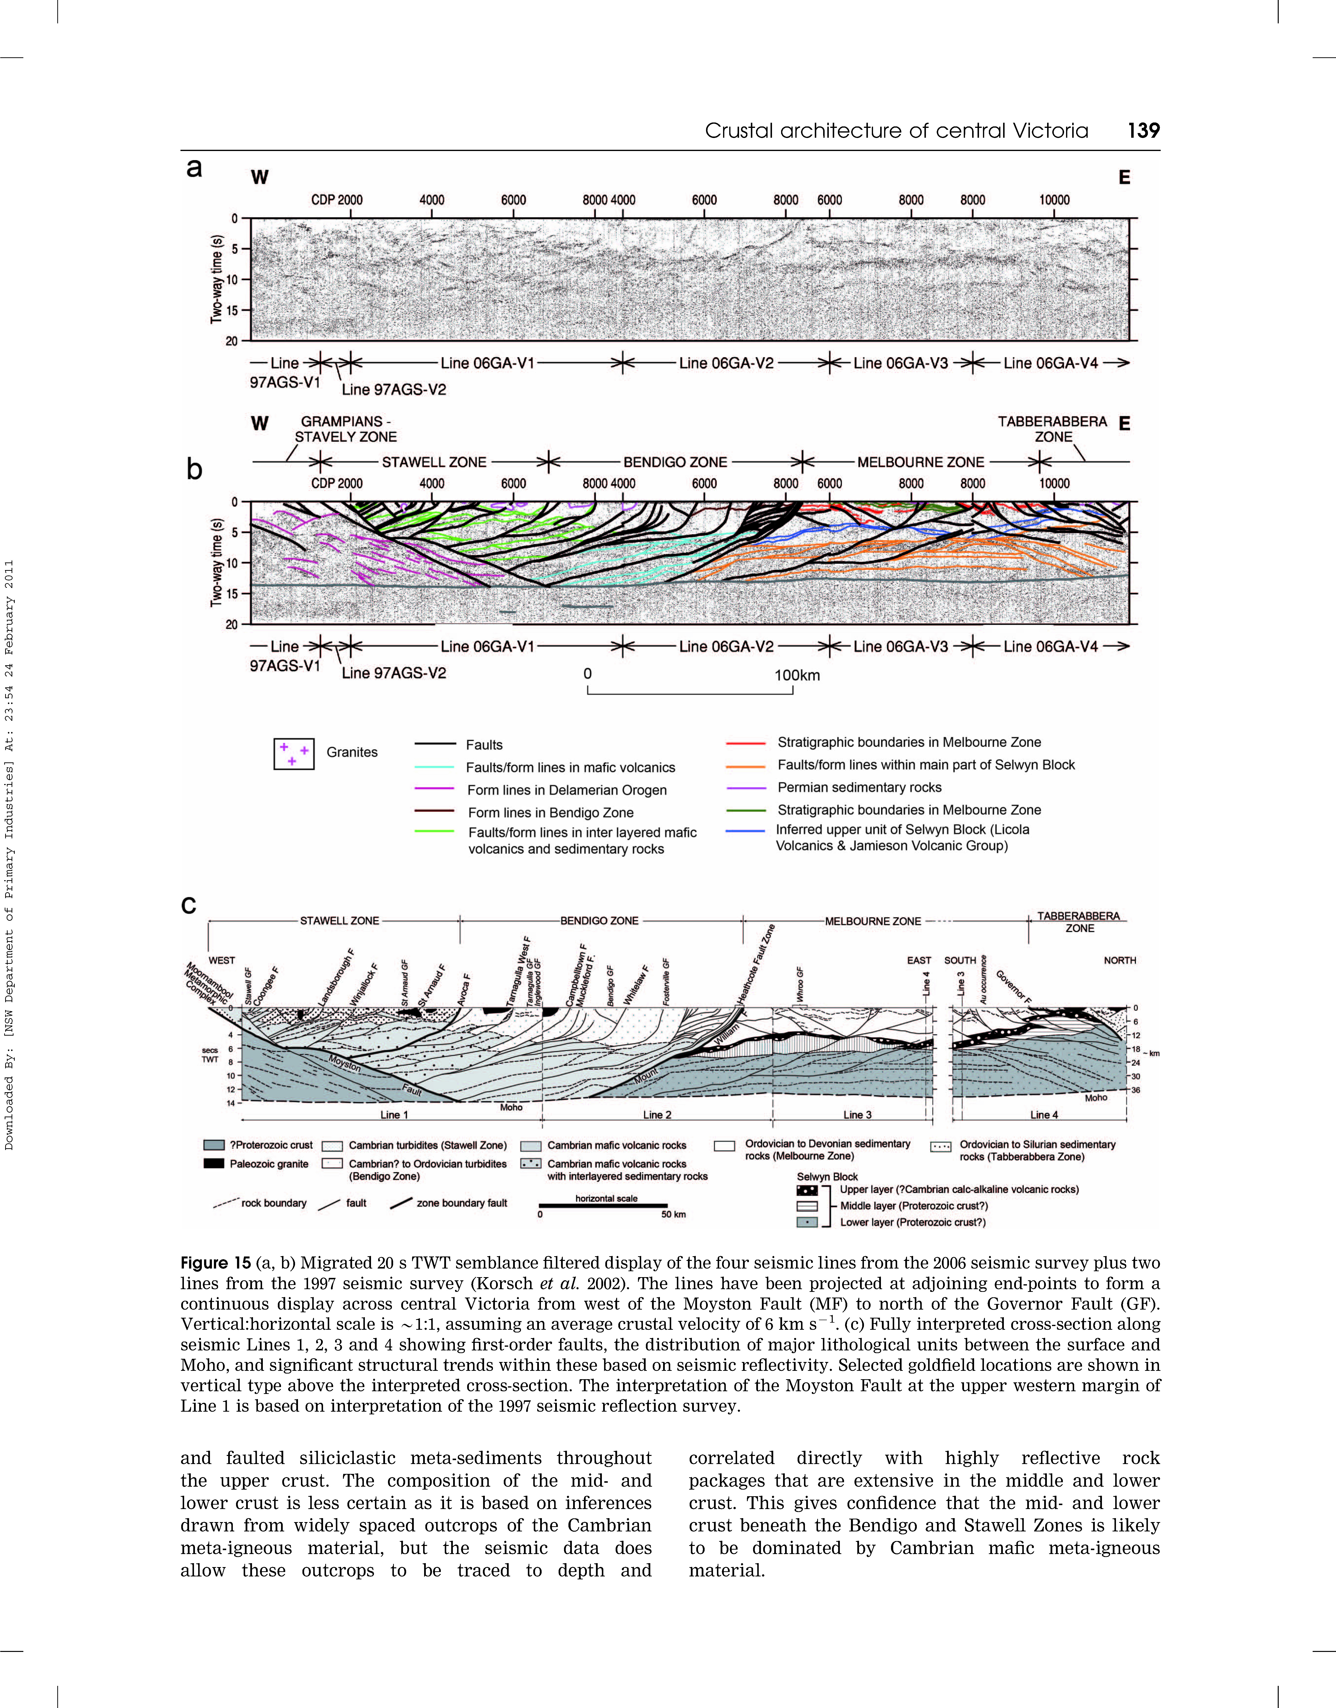

(200 t Au)
(2000 t Au)
(134 t Au)
(89 t Au)
Cayley et al. 2011,
Willman et al. 2010

Slide 41
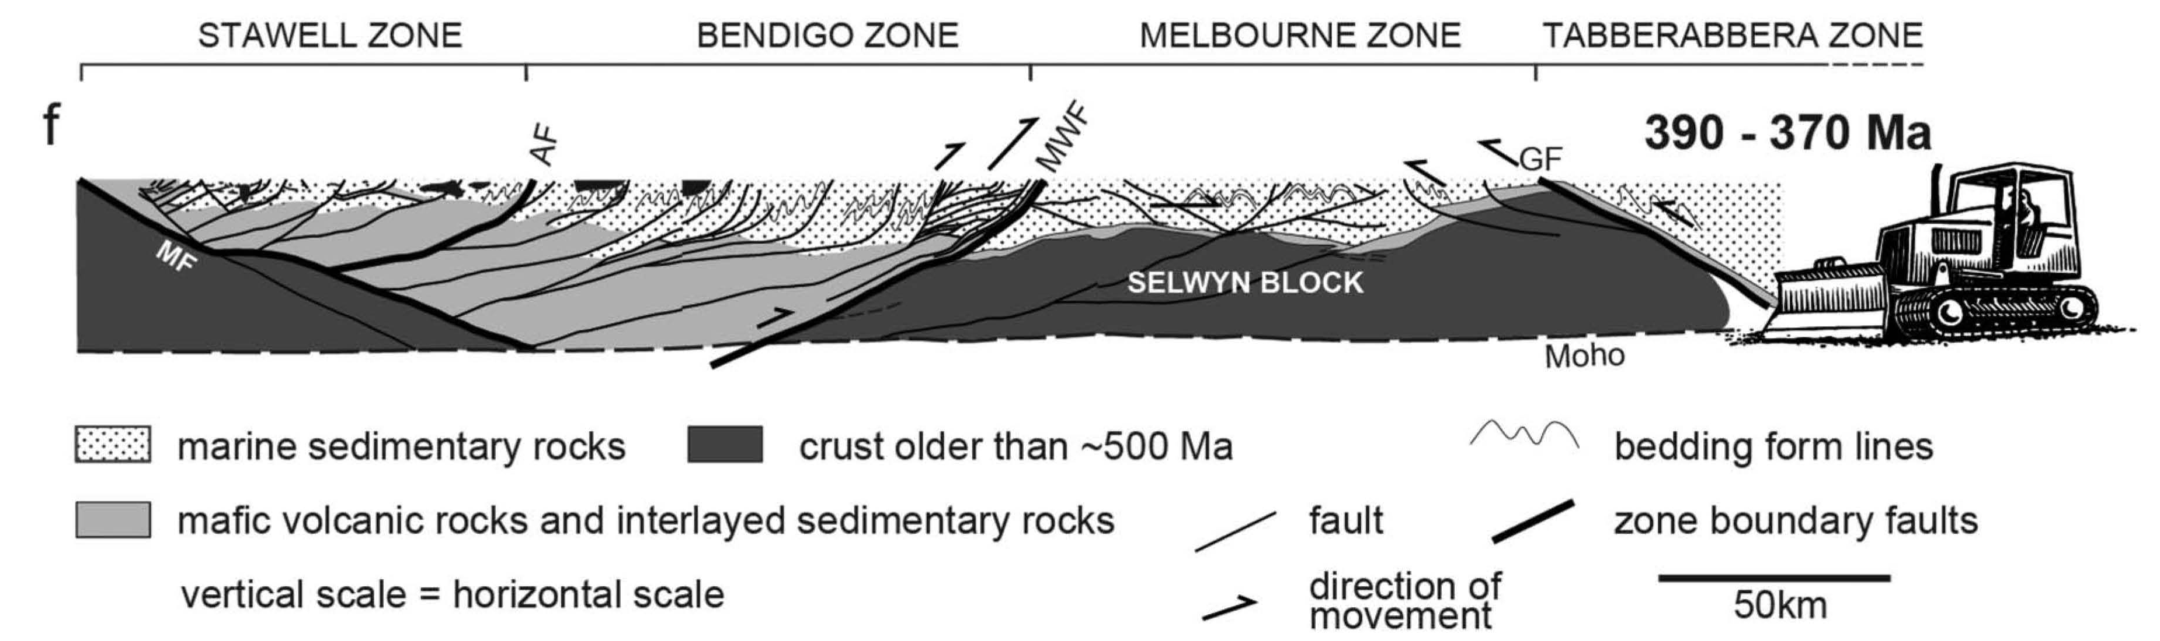
(200 t Au)
(2000 t Au)
(
440 Ma
Cayley et al. 2011,
Willman et al. 2010

Slide 42
OROGEN –PARALLEL ANISOTROPY
OTHER EXAMPLES
Outcropping Precambrian
continental basement
Inferred Precambrian
continental basement
Glen unpubl

Slide 43
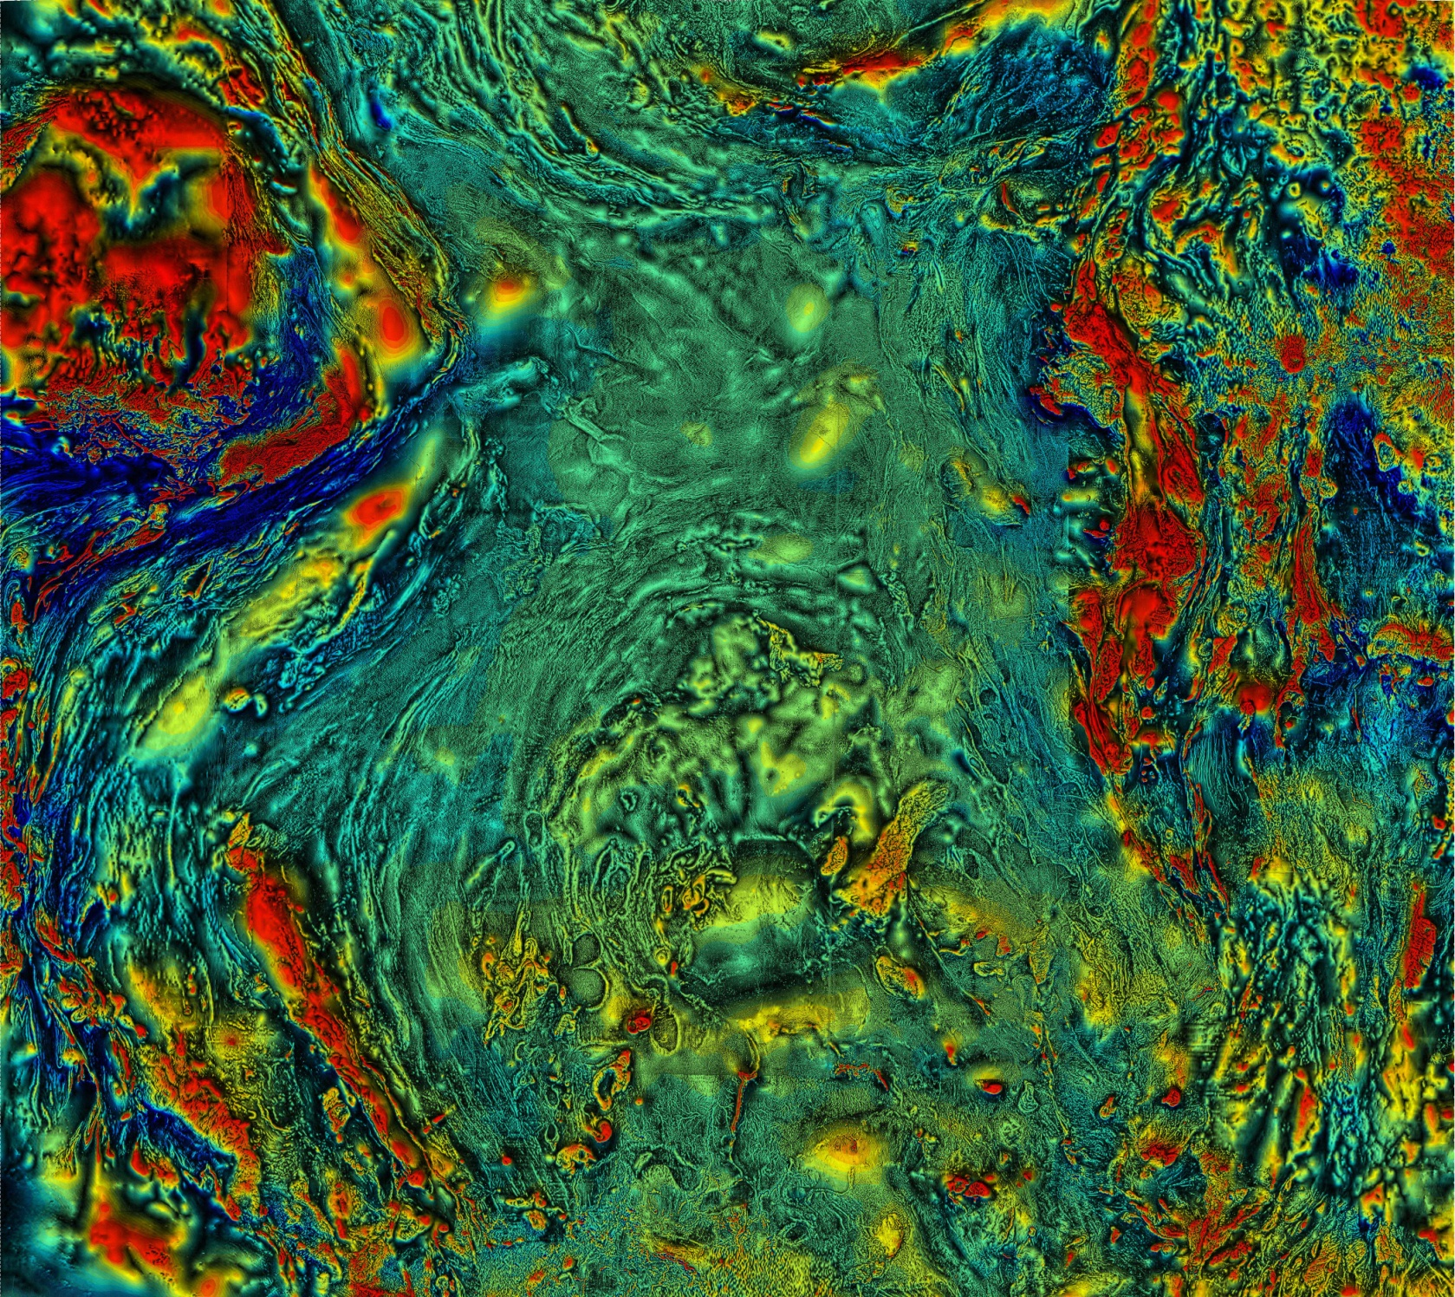
Booth Ft
Ivanhoe
orocline
Stawell
Zone
H_B Zone above
?rifted Willyama
basement
TMI image R. Musgrave,
based on Glen 2013

Slide 44
3. CONSEQUENCES OF OROGEN-NORMAL
CROSS STRUCTURES
In many ways the most perplexing since not predicted by plate tectonics theory

Slide 45
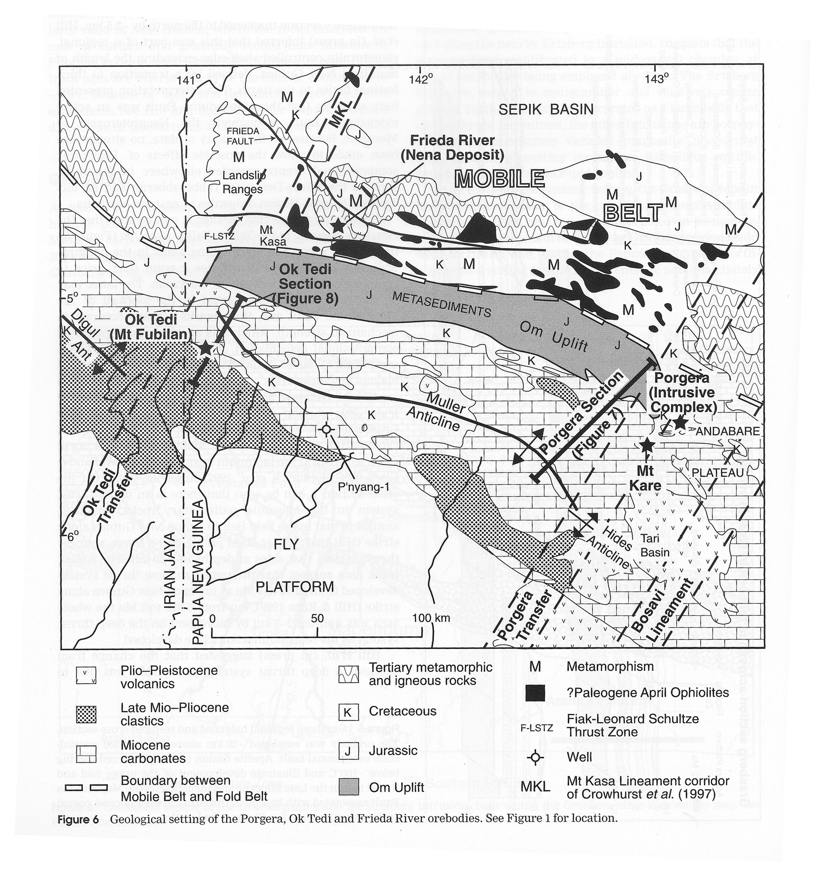
Hill et al 2002

Slide 46
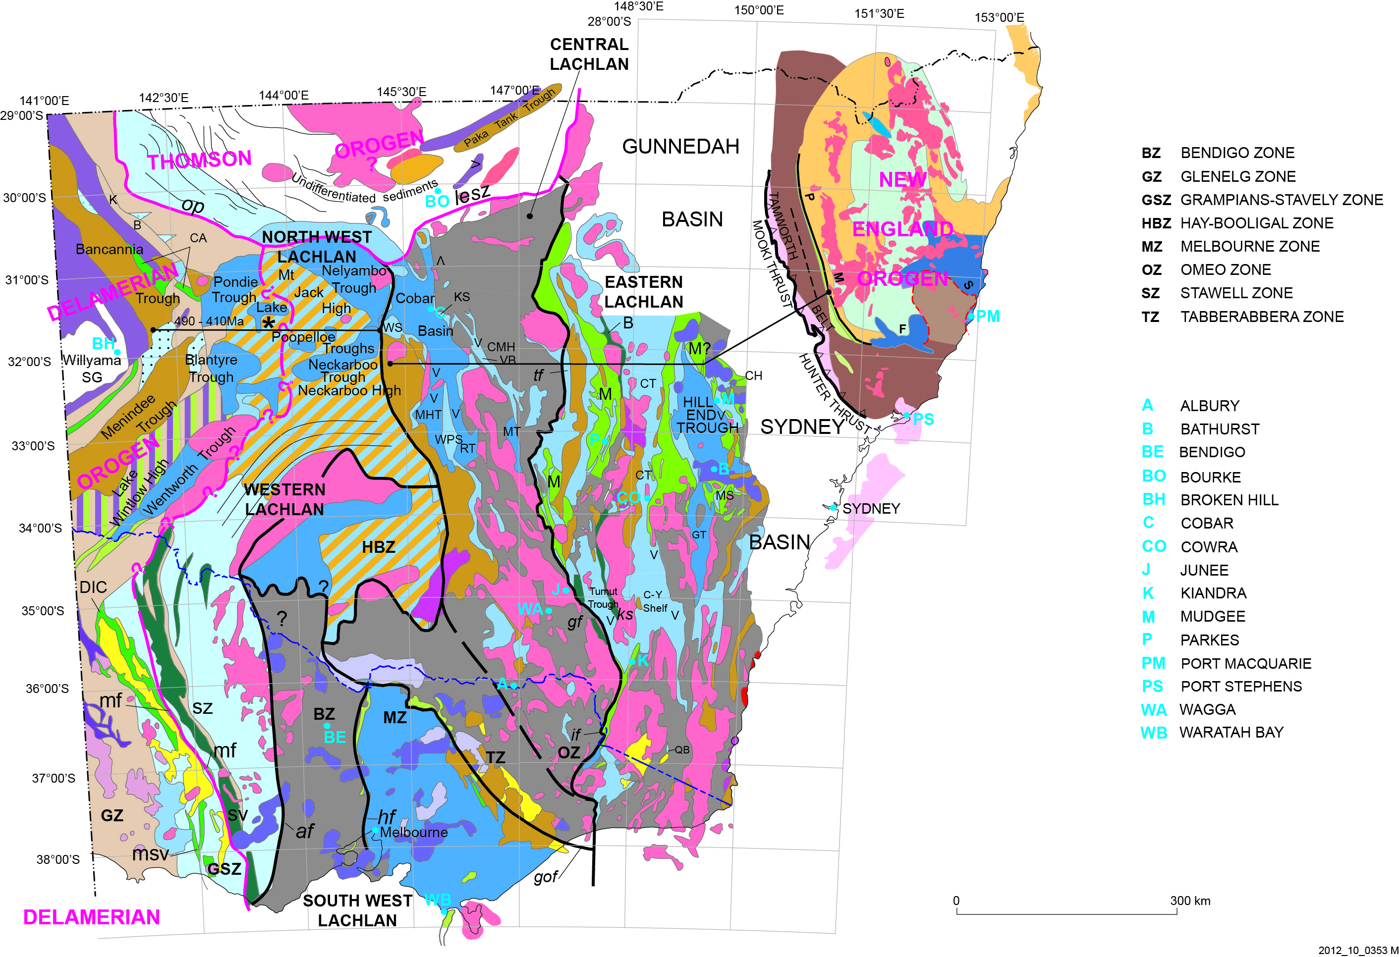
Glen & Walshe 1999
Glen 2005

Slide 47
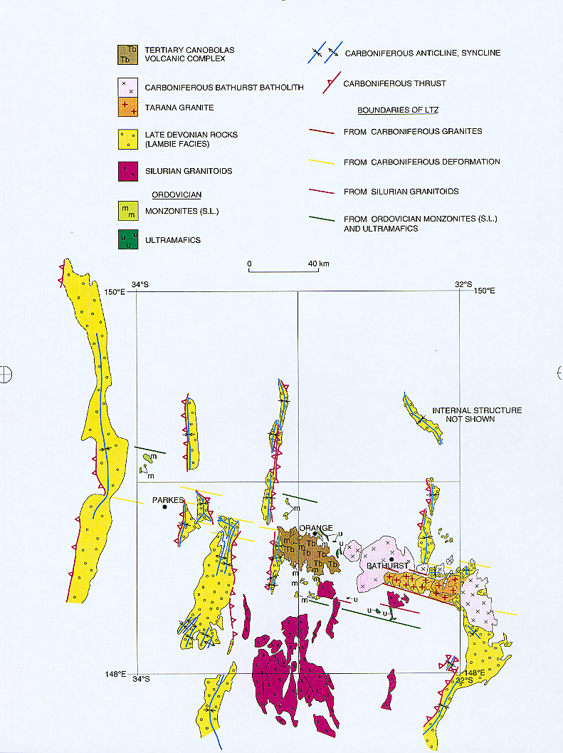
Glen & Walshe 1999

Slide 48
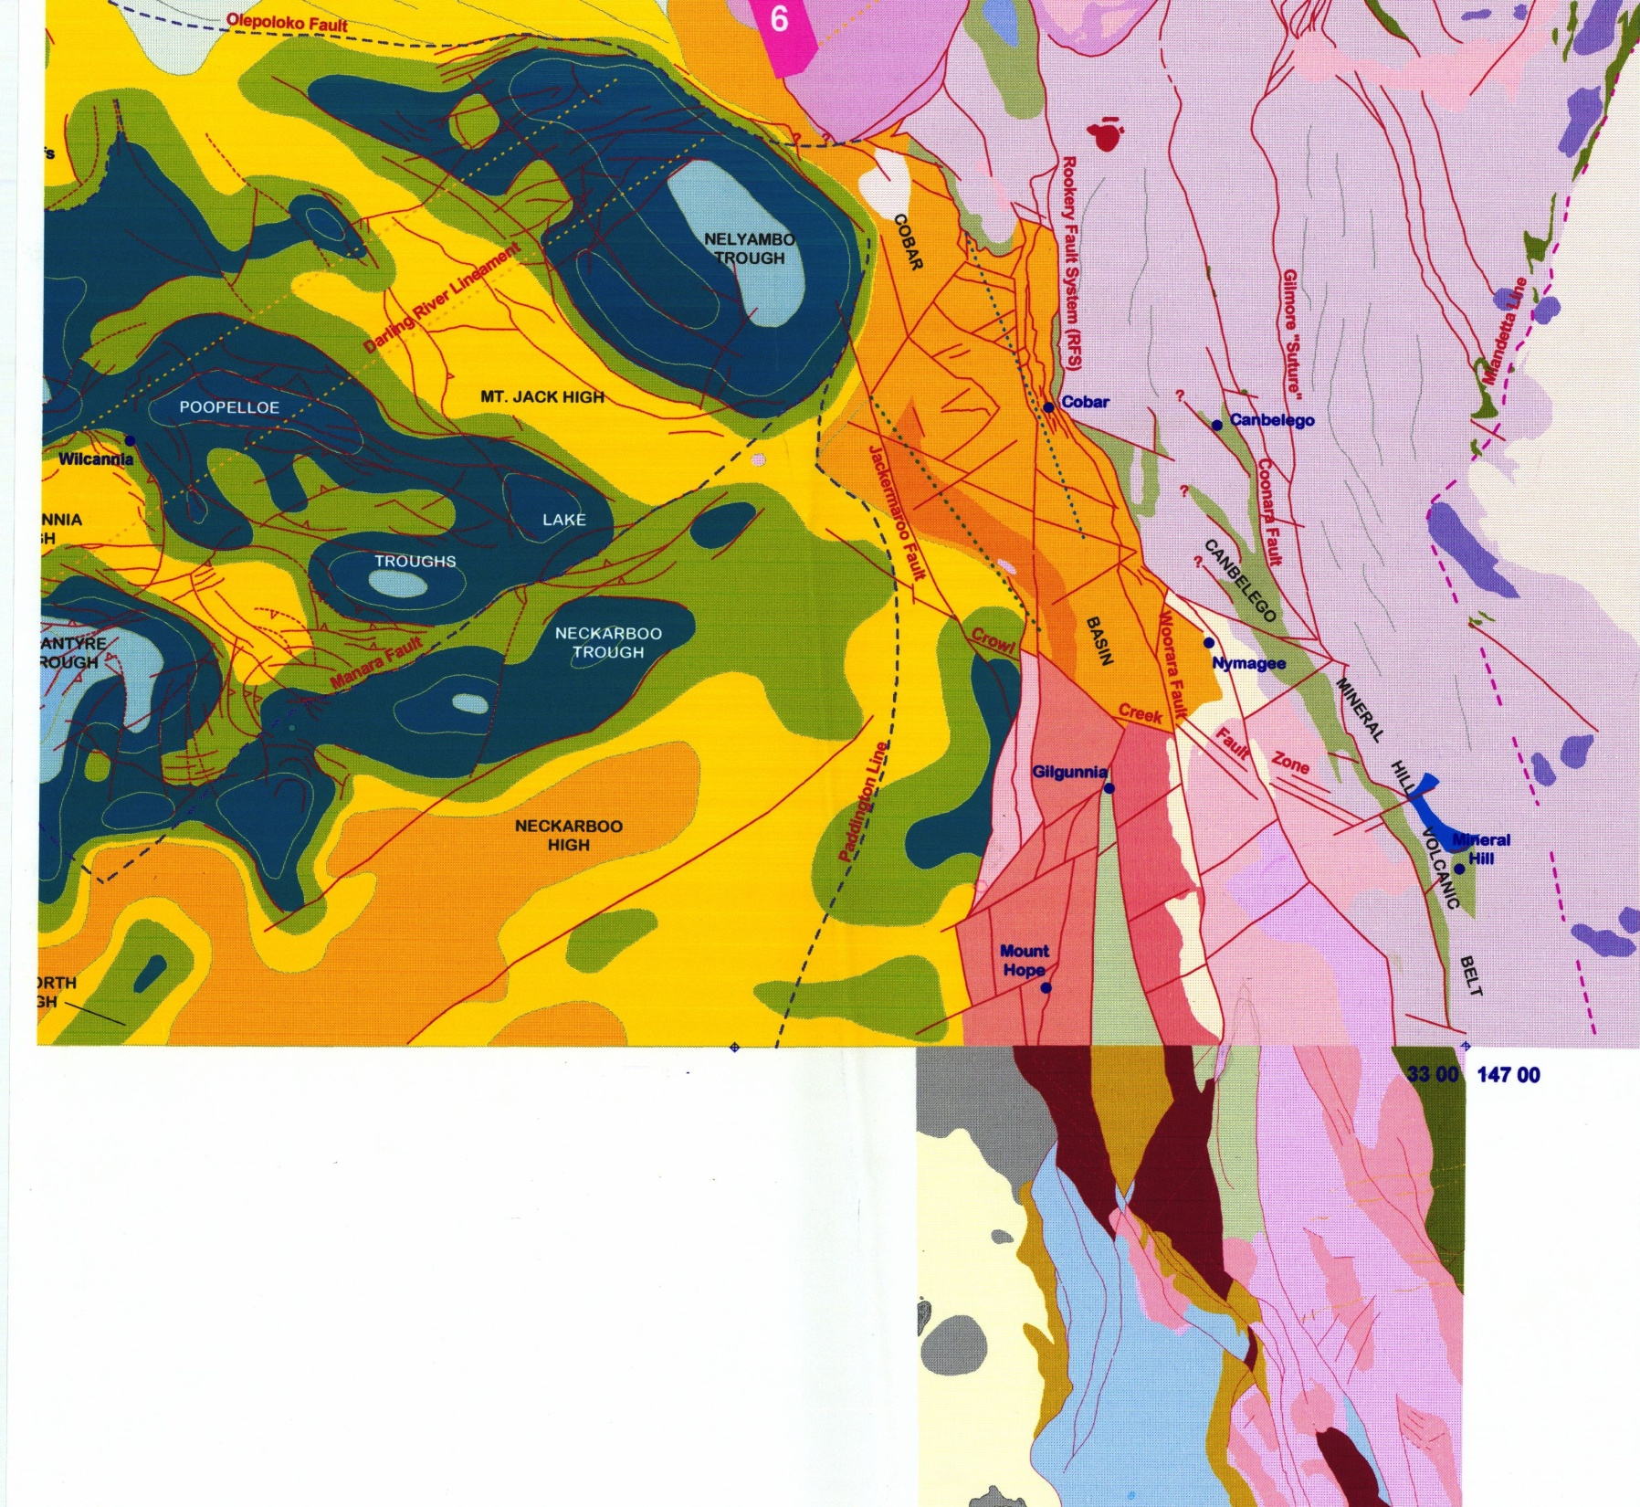
Glen et al. 1996

Slide 49
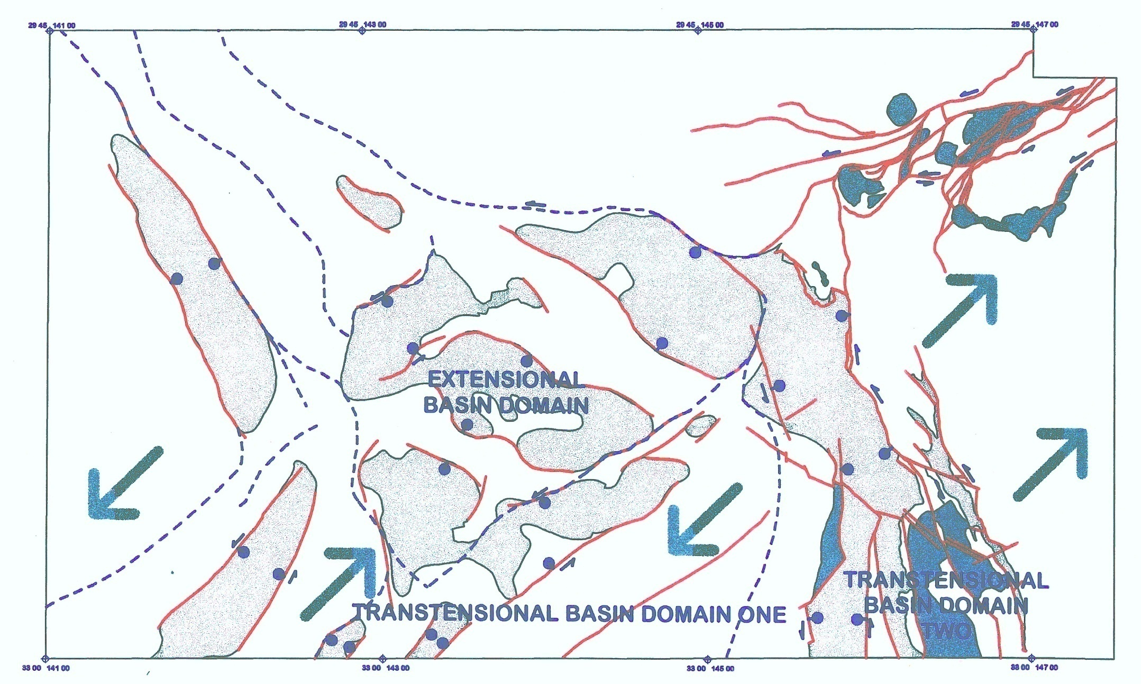
Glen et al. 1996

Slide 50
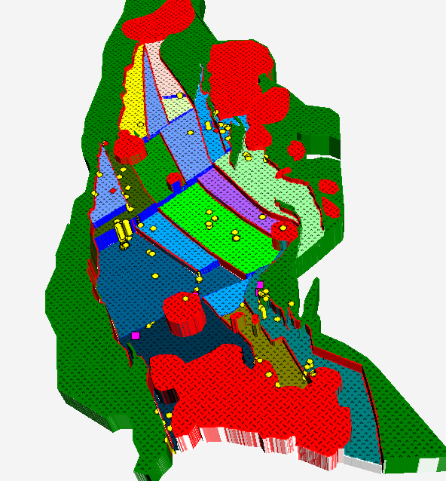
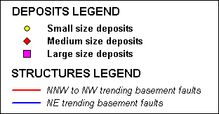
HET BASEMENT ARCHITECTURE
IN RELATION TO GOLD DEPOSITS
Windeyer
Stuart
Town
Hargraves
Significant link between basement and mineral deposits
Hill End
Lewis
Ponds
David et al 200x

Slide 51
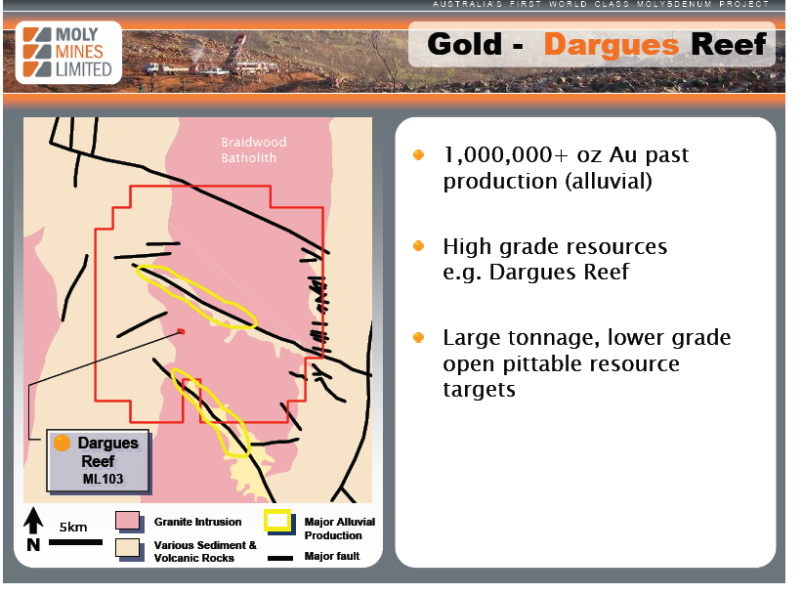
Moly Mines website

Slide 52
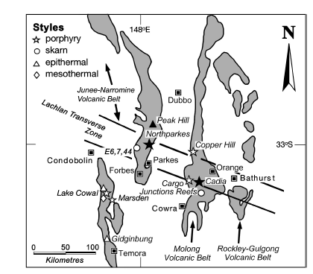

Slide 53
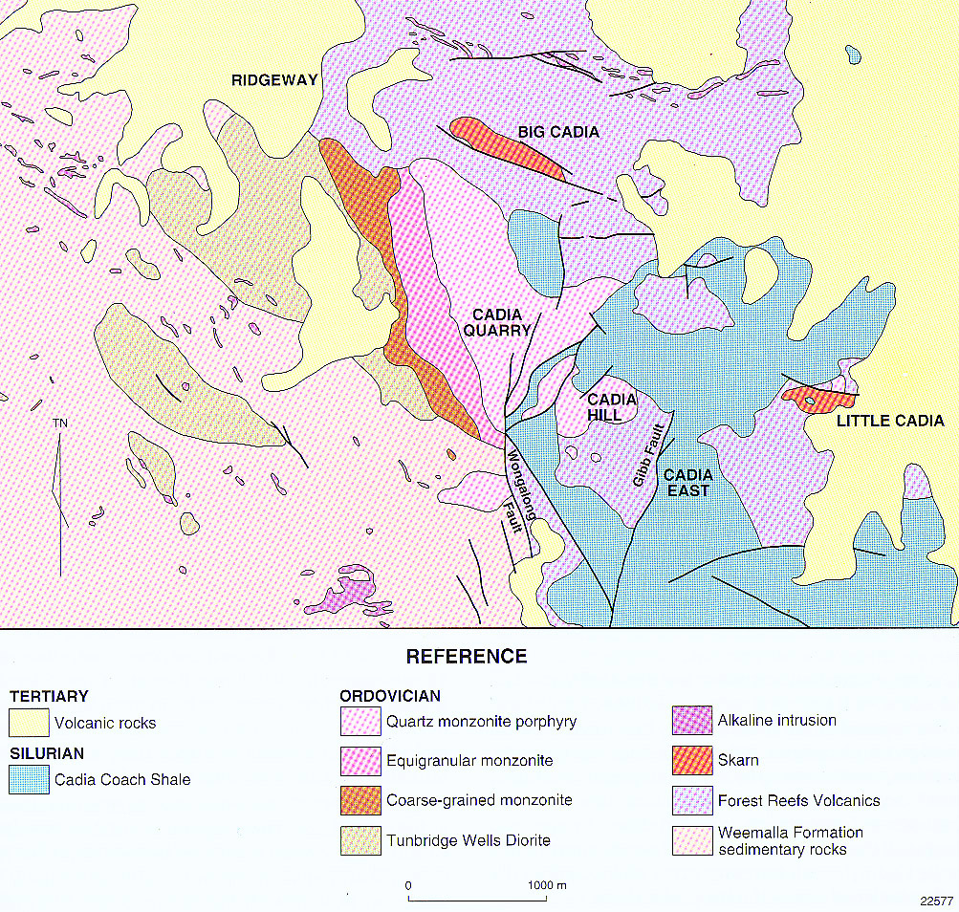
NEWCREST EXPLORATION

Slide 54
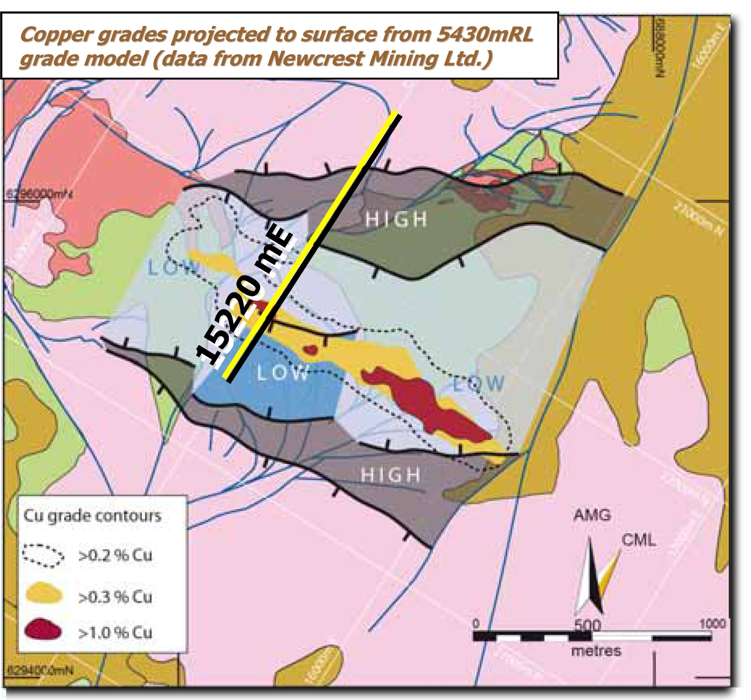

Harris et al 2005 SMEDG

Slide 55
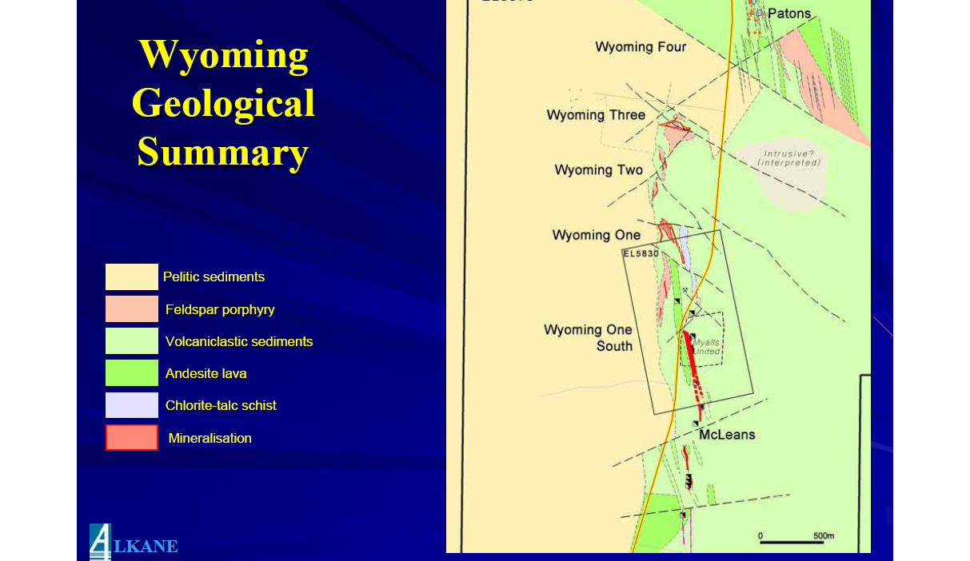
Alkane website

Slide 56
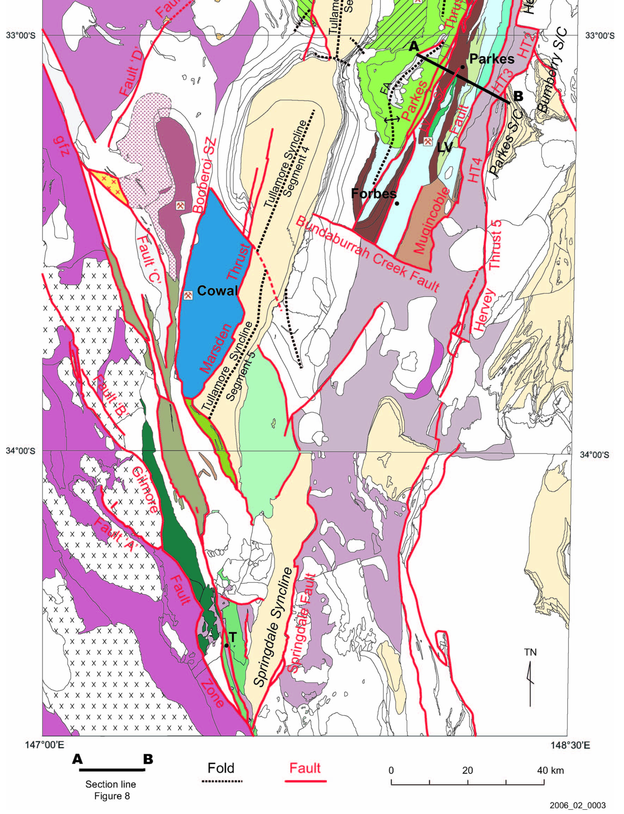
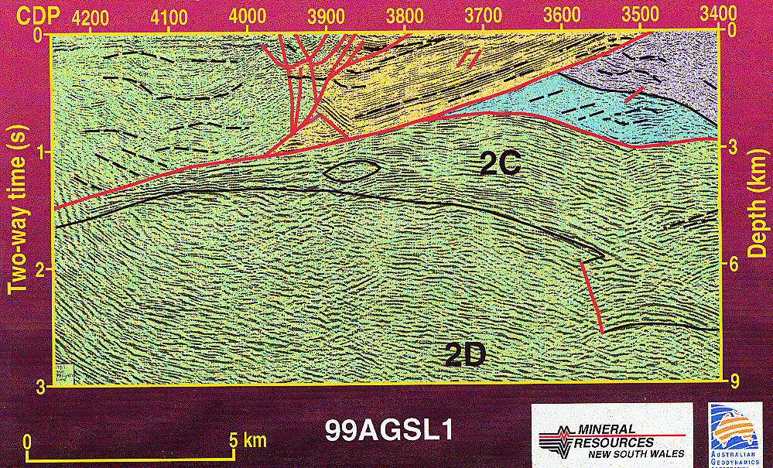
Glen et al. 2002
Glen et al. 2007

Slide 57
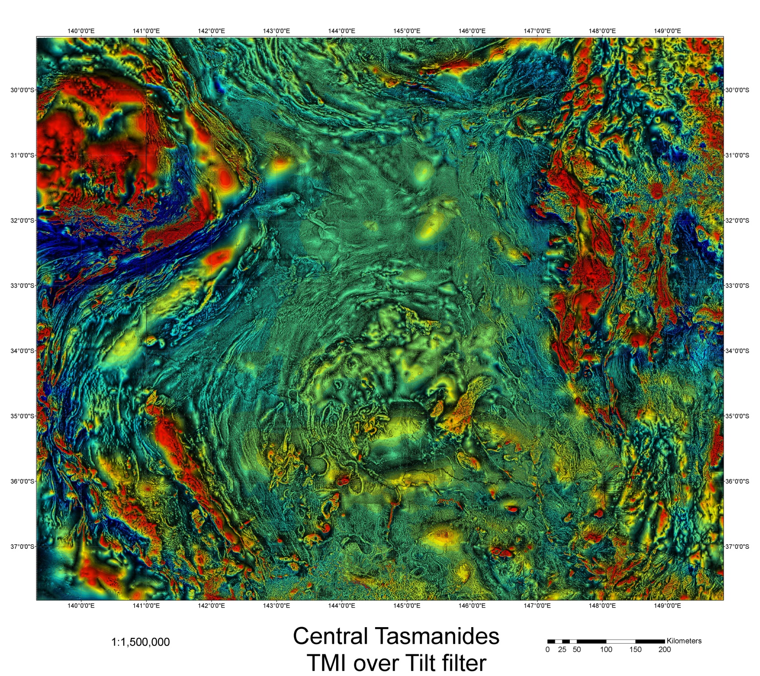

Slide 58
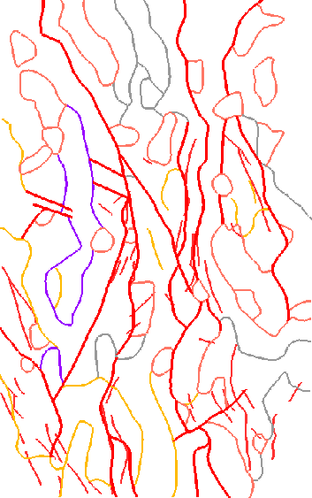
Enhanced 1VD
worms of Bouguer
gravity, all levels
“LTZ”
Lachlan Transverse Zone –problematic?
B.Murphy pmdCRC report

Slide 59
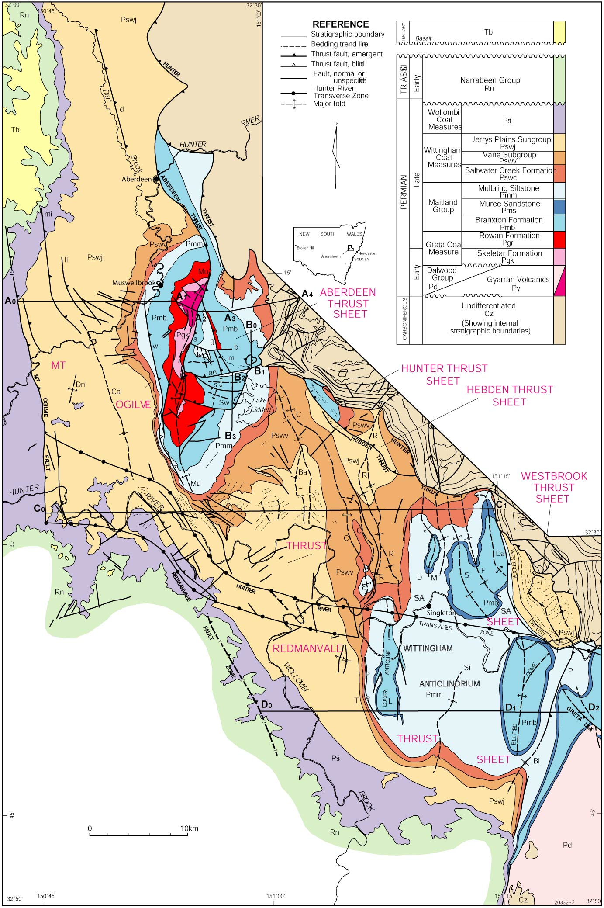

Glen & Beckett 1997

Slide 60
WRAP UP
THE TASMANIDES of eastern Australia preserve 400 million years of convergent margin history when ocean crust was subducted.
that means for 400 million years it was underlain by enriched upper mantle
that was undergoing periodic replenishment.
This upper mantle reservoir has been tapped by a series of supra-subduction zone elements such as arcs and backarcs.
Mineral–rich fluids ultimately derived from this reservoir have used pathways set up by the crustal architecture to get to the surface or near to the surface.
Both along- and cross-orogen anisotropies can focus such fluids to
form world class mineral deposits. The challenge is to find them when they may be invisible in geophysical datasets and not predicted by plate tectonic theory.

