Slide 1
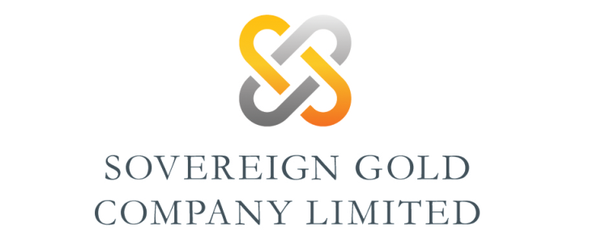
The HOBBS gold deposit at Mt Adrah: shaping up a major gold resource

Slide 2
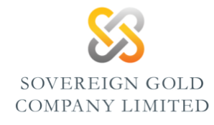
Disclaimer
Qualifying Statements
The information in this report that relates to Exploration Information is based on information compiled by Michael Leu a Member of The Australasian Institute of Mining and Metallurgy and the Australian Institute of Geoscientists together with Dr Andrew White, a Fellow of the Australian Institute of Geoscientists and Jacob Rebek and Dr Kris Butera, Members of the Australian Institute of Geoscientists.
Mr Leu and Jacob Rebek are qualified geologists and are directors of Sovereign Gold Company Limited.
Dr White is a director of Gossan Hill Gold Limited.
Dr Kris Butera is CEO and director Gossan Hill Gold Limited.
Mr Leu, Jacob Rebek, Dr White and Dr Butera have sufficient experience, which is relevant to the style of mineralization and type of deposit under consideration and to the activity, which they are undertaking to qualify as Competent Persons as defined in the 2012 Edition of the Australasian Code for Reporting of Exploration Results, Mineral Resources and Ore Resources. Mr Leu, Jacob Rebek, Dr White and Dr Butera consent to the inclusion in this report of the Exploration Information in the form and context in which it appears.
The material in this presentation (material) is not and does not constitute an offer, invitation or recommendation to subscribe for, or purchase any security in Sovereign Gold Company Limited (“SOC”) nor does it form the basis of any contract or commitment. SOC makes no representation or warranty, express or implied, as to the accuracy, reliability or completeness of this material. SOC, its directors, employees, agents and consultants shall have no liability, including liability to any person by reason of negligence or negligent misstatement, for any statements, opinions, information or matters, express or implied, arising out of, contained in or derived from, or for any omissions from this material except liability under statute that cannot be excluded. Statements contained in this material, particularly those regarding possible or assumed future performance, costs, dividends, production levels or rates, prices, resources, reserves or potential growth of SOC, industry growth or other trend projections are, or may be, forward looking statements. Such statements relate to future events and expectations and, as such, involve known and unknown risks and uncertainties.
Actual events and results may differ materially from those expressed or forecasted in forward-looking statements due to a number of factors. The principal important risk factors that could cause SOC’s actual performance and future events and actions to differ materially from such forward-looking statements, include, but are not limited to, continuing volatility in the capital or credit markets and other changes in the securities and capital markets, changes in market prices of SOC’s investments, the occurrence of one or more catastrophic events, such as an earthquake, hurricane, or act of terrorism, changes in laws or regulations, changes in income tax laws, and changes in general economic and market factors that affect the prices of securities or the industries in which it does business.

Slide 3
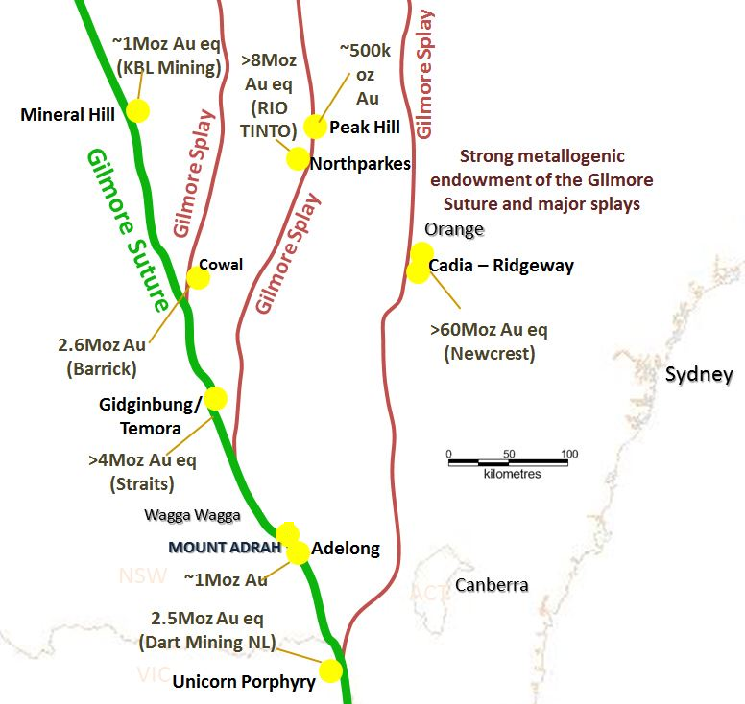
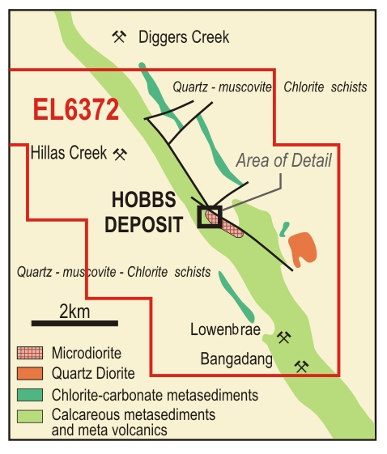
Hobbs: located on a jog on the Gilmore Suture, ~19km NW Adelong.
Ordovician metasediments and basic metavolcanics host a quartz monzodiorite stock at Mt Adrah.

Slide 4
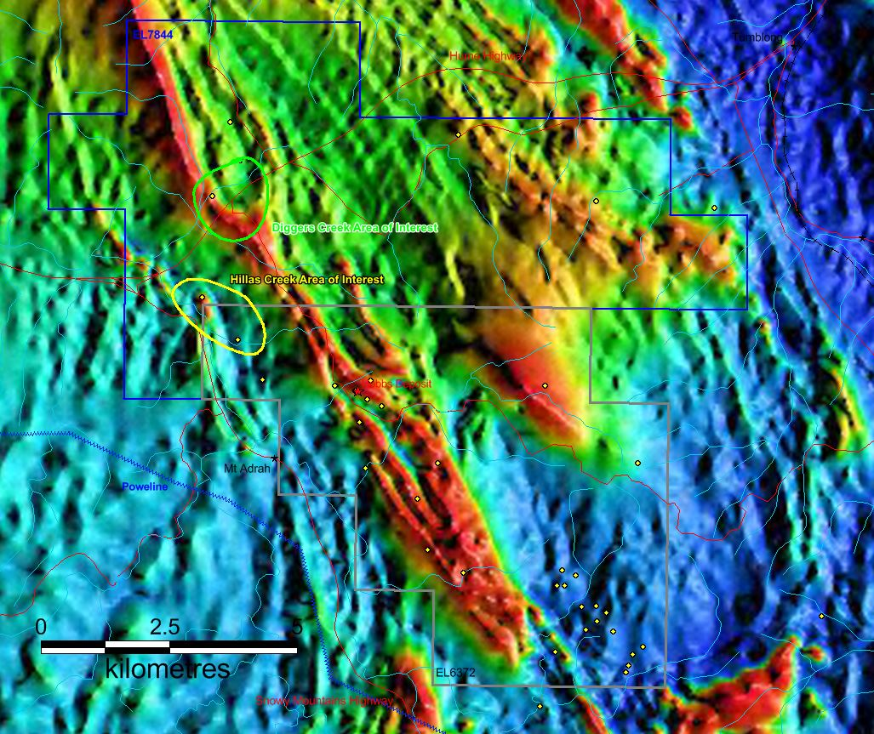
Hobbs gold deposit
Gilmore suture
RTP magnetics identify jogs on the Gilmore Suture.
Hobbs occurs near the margin of a major pluton, the surface expression of which is a diorite.
A magnetic low associated with the Hobbs pipe is partly obscured by the magnetics of a roof pendant of calcareous metasediments
Hobbs
Outline of pluton

Slide 5
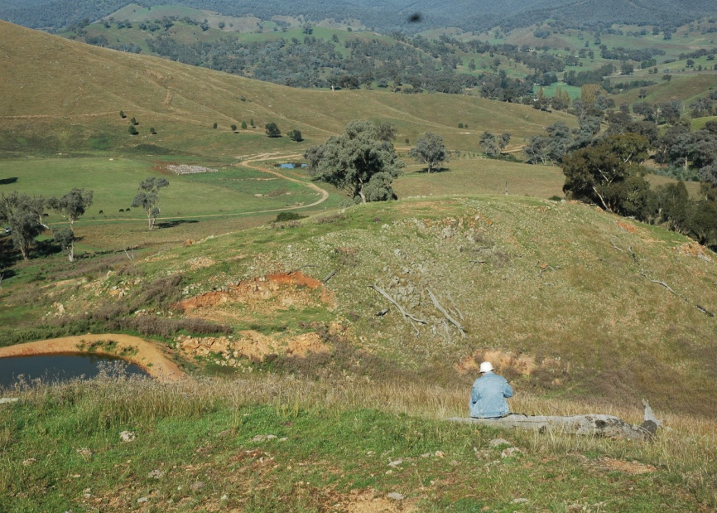
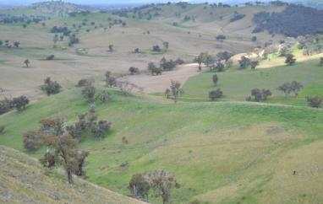
Hobbs gold deposit
Hobbs outcrop, looking west towards Snowy Mts Highway.
650m SE of Hobbs outcrop, small exposure of similar phyllic-altered monzonite, with fuchsite in surrounding skarn.

Slide 6
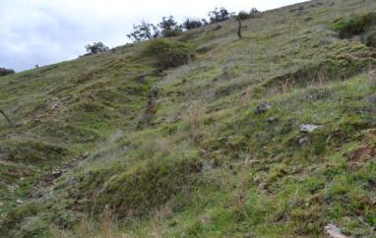
Hobbs gold deposit
Discovered in 1980 by Getty Oil Development geologist Roger Hobbs
Prospect was discovered while investigating arsenic soil anomalies in the search for copper skarns.
Held by several companies since, with access to the property a major issue for several years (since resolved).
Seen as an Intrusion Related Gold Deposit by Gossan Hill Gold Ltd (now a subsidiary of Sovereign Gold Company Ltd, ASX - SOC).
Old workings in metasediments
E of Hobbs outcrop.

Slide 7
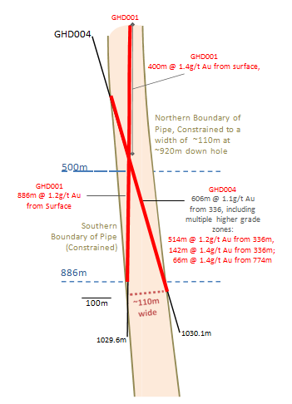
Hobbs mineralisation
Hobbs mineralisation is hosted in a pipe shaped zone of phyllic alteration within propylitically altered quartz monzodiorite.
On present data the pipe is oval in plan, ~110m wide and ~220m long.
The only mineral of value in the pipe seems to be gold.
The distribution of gold is remarkably homogeneous, although present data suggests that the global average grade is slightly higher (~1.4g/t) in the upper 4-500m of the pipe.

Slide 8
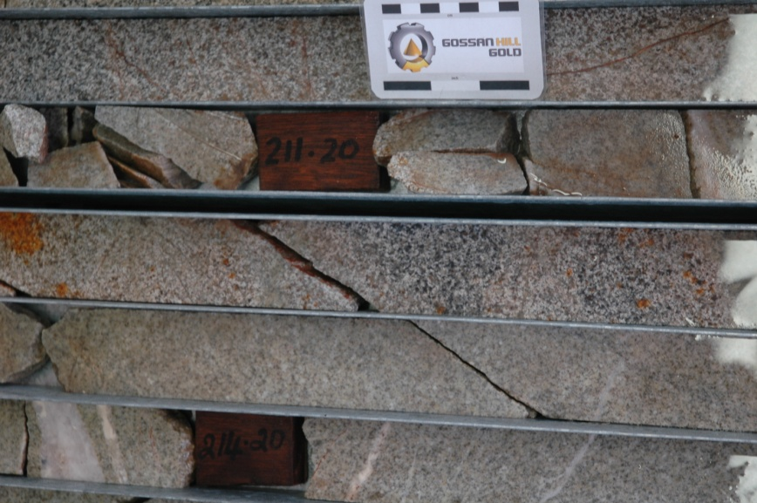
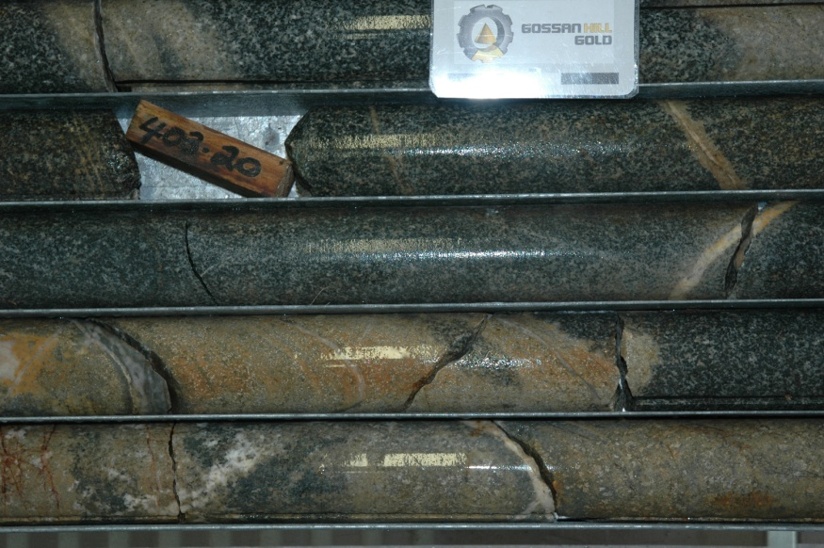
Hobbs mineralisation
Intensely altered quartz monzodiorite, replaced by quartz-sericite-chlorite-carbonate-arsenopyrite-pyrite-hematite-(epidote) assemblage.
Contact of phyllic altered pipe with propylitic altered monzodiorite is sharp, with minor vein-hosted phyllic alteration away from the pipe.

Slide 9
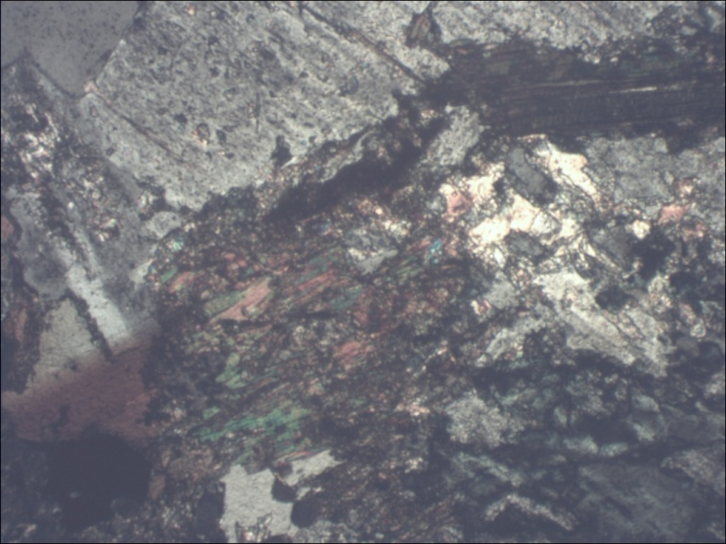
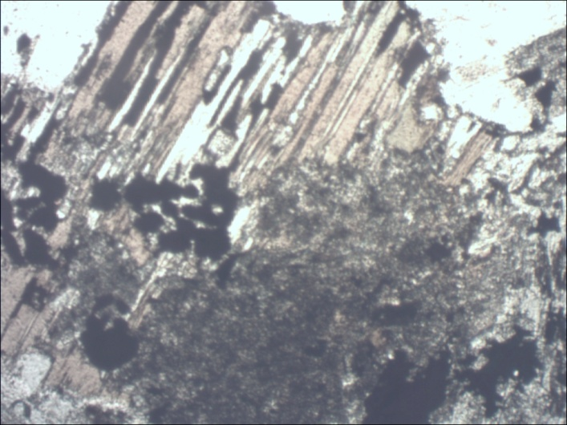
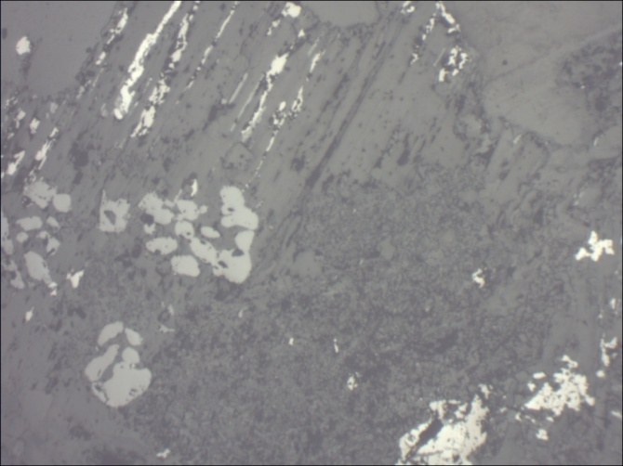
Hobbs: alteration of the quartz monzodiorite
Propylitic alteration
K fld.
plag
Chl after hbl
Biotite
Destruction of ?hbl, replaced by chlorite, sericite
Py
Hem

Slide 10
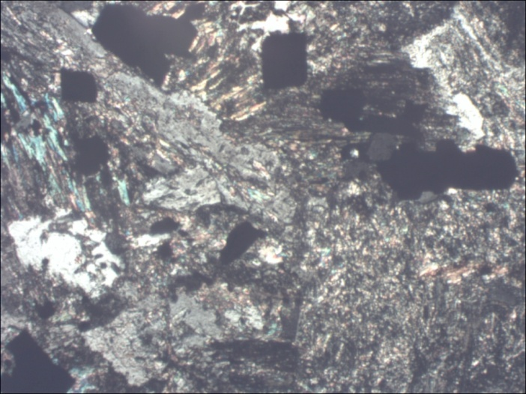
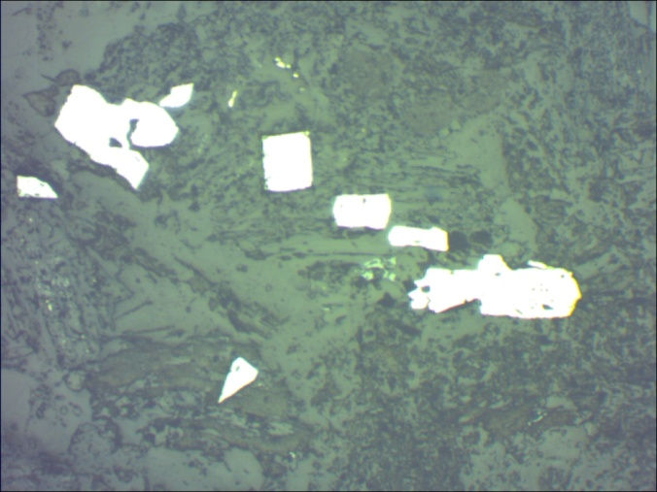
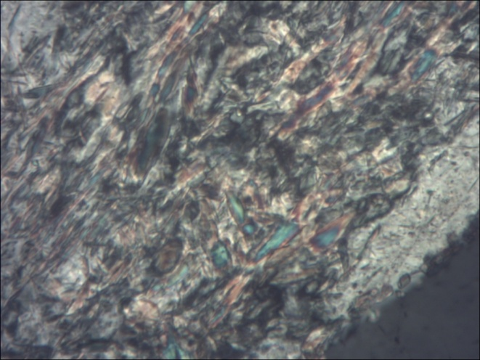
Hobbs: alteration of the quartz monzodiorite
Intense phyllic alteration
Almost complete destruction of feldspars, replacement of biotite by chlorite and hematite, growth of py, asp, and gold present.
Chl
CaCO3
Au
Py and asp
Almost complete replacement of zoned plagioclase by sericite and chlorite
Albite

Slide 11
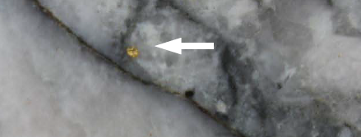
Hobbs mineralisation
At least 10% of the gold in Hobbs is free gold, some of which is in quartz veins.
The remainder is very fine, in arsenopyrite and pyrite.
Metallurgical testing to date indicates a high grade sulphide concentrate containing <10% As and >20ppm Au is readily obtained with a recovery of 95% of the gold.
Testing indicates the concentrate is amenable to BIOX® treatment and an overall gold recovery of >91% is achievable.
Free gold in quartz vein in core,
Hobbs deposit.

Slide 12
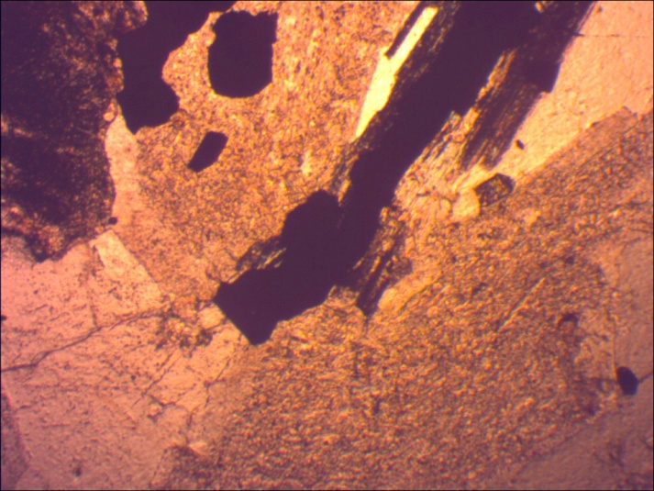
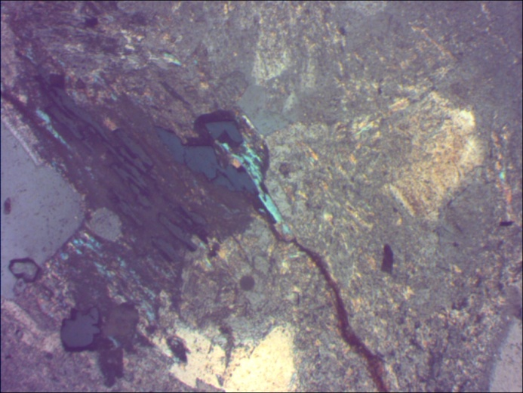
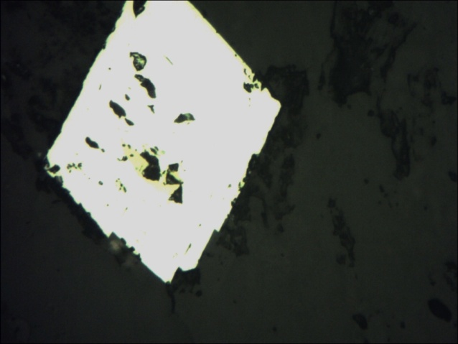
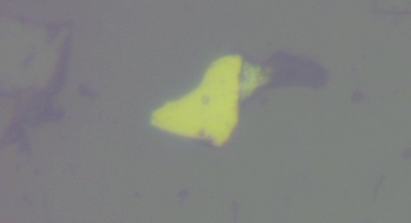
Hobbs mineralisation
The pipe is a crackle breccia with fracture spacing <10mm. Some sulphides occur along fractures, fractures are healed with chlorite, sericite, carbonate and red ?Fe oxide.
Au
Gold occurs in pyrite, arsenopyrite, quartz veins and altered feldspar.

Slide 13
Hobbs mineralisation
Hole GHD004 assay data show strong correlation between Au and As, K. Au:Fe relationship may reflect depletion of Fe during alteration of biotite and deposition of gold.

Slide 14
Hobbs mineralisation
Variography:
Directional variograms indicate low nugget effect (30%), 20m range of influence in x & y directions and down hole. Anisotropy has not yet been detected.
In other words, a remarkably homogeneous distribution (for a gold deposit).

Slide 15
Resources
Resource estimate at completion of GDH004.
Refer Announcement by Sovereign Gold Ltd 22-8-2013 (ASX Code SOC)

Slide 16
Hobbs: potential mining
The ore is a crackle breccia with fractures at ~5mm spacing.
Fractures are healed by sericite, chlorite and red oxide and the effect of fractures on mining method is being assessed.
Tests indicate that the ore may have a medium to high Bond Work Index (~18) but due to the abundance of sericite may be lower in practice.
SAG milling may therefore be appropriate.
Modelling indicates that provided sufficient ounces are present (>2.5Moz) to justify scale of mining, bulk underground mining, SAG milling and BIOX® treatment to recover >90% of the gold will be economically viable.
Recovered grade is higher than recovered equivalent grade at both North Parkes and Cadia East.

Slide 17
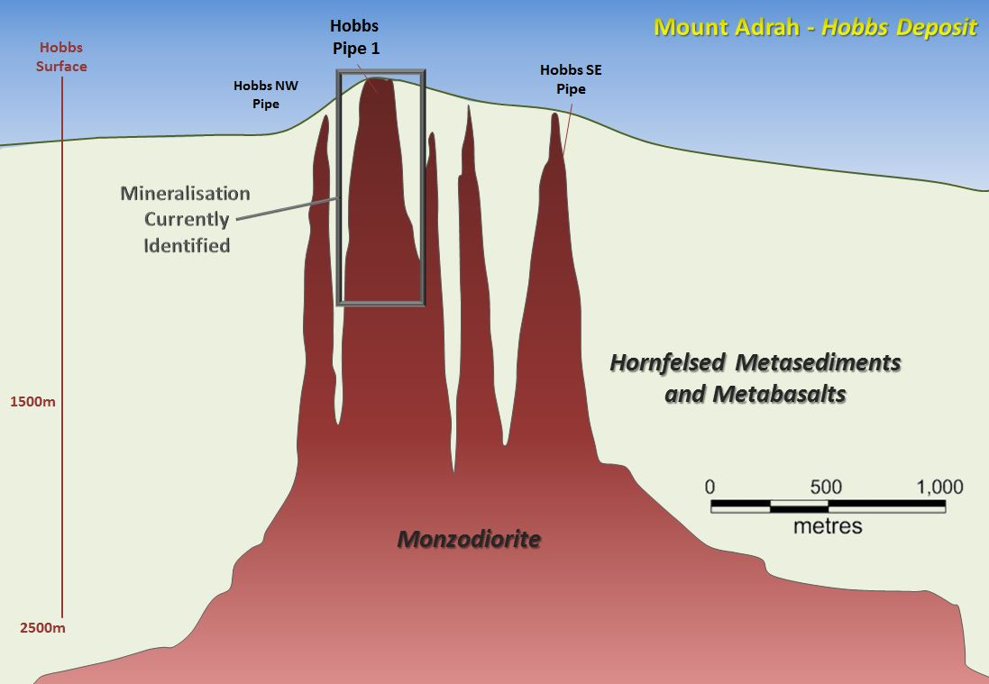
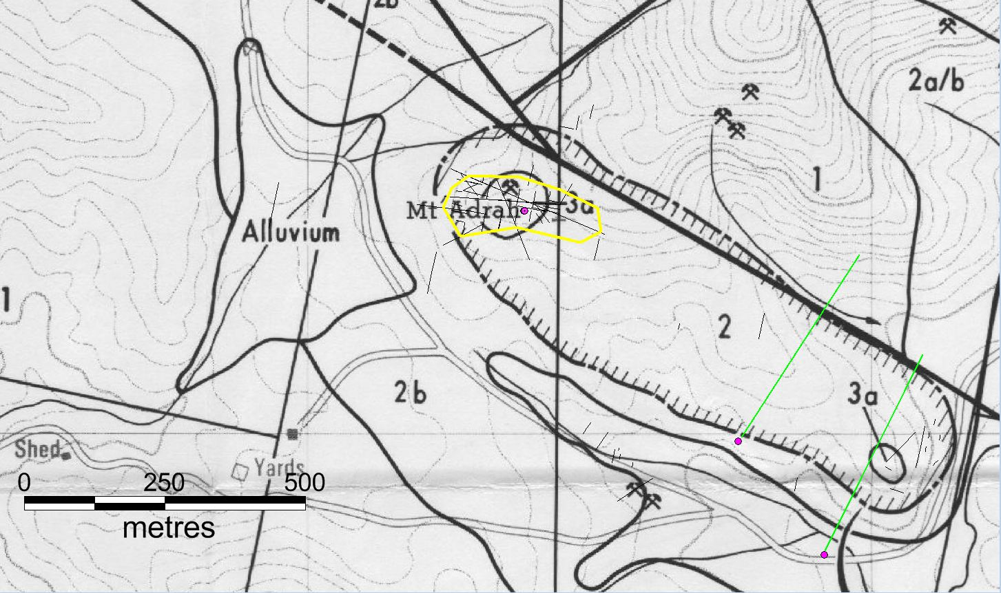
Other targets
  Geochemical and geophysical surveys have located multiple circular anomalies at Mt Adrah.
  Cartoon illustrates how we see the potential for more pipes based on soil geochemistry, geophysics and outcrops.
Plan view of Mt Adrah location showing extent of magnetic low.

Slide 18
Acknowledgements
This presentation includes ideas, data analysis and illustrations prepared by Kris Butera, Suresh Tripathi, Michael Leu and Henry Kinstlinger and the contribution of the Sovereign Gold Ltd team is very gratefully acknowledged.

