Slide 1
Here’s to Henty, a sparkling, full-bodied mine
Mines and Wines, Orange, 13th September 2013
Angela Lorrigan – G.M. Discovery and Growth, Unity Mining Ltd.

Slide 2
Disclaimer
This presentation has been prepared by Unity Mining Limited (“Company”). The material contained in this presentation has been prepared for information purposes only, and is not an offer, invitation or recommendation for subscription or purchase of securities in the Company.
This presentation may contain certain forward-looking statements regarding (i) estimated resources and reserves, (ii) planned production and operating costs profiles, (iii) planned capital requirements and (iv) plans, strategies and corporate objectives. Such forward-looking statements are not guarantees of future performance and involve known and unknown risks, uncertainties and other factors, many of which are beyond the control of Unity Mining Limited. The forward-looking statements are inherently uncertain and may therefore differ materially from results ultimately achieved. External and other factors may impact the Company and affect the forward-looking statements in this release since its preparation. Subject to applicable law and stock exchange listing rules, Unity Mining does not intend to publicly update any of the forward-looking statements or any assumptions on which any such forward-looking statement is made.
The Company estimates its Mineral Resources and Ore Reserves in accordance with the Australasian Code for Reporting of Exploration Results, Mineral Resources and Ore Reserves, 2004 Edition (“JORC Code”), which governs such disclosures by companies listed on the Australian Securities Exchange.
Competent Person’s Statement
Any information in this public report that relates to Ore Reserves, Mineral Resources or Exploration Results is based on, and accurately reflects, information compiled by Matt Daly in relation to Ore Reserves, Raul Hollinger in relation to Mineral Resources and Angela Lorrigan in relation to Exploration Results. Daly, Hollinger and Lorrigan are Members of the Australasian Institute of Mining and Metallurgy, and Hollinger is a Member of the Australian Institute of Geoscientists. Daly, Hollinger and Lorrigan are a full time employees of the Company and have more than five years experience in the style of mineralisation and type of deposit under consideration and to the activity which they undertaking to qualify as Competent Persons as defined in the 2004 Edition of the Australasian Code for Reporting of Exploration Results, Mineral Resources and Ore Reserves. Daly, Hollinger and Lorrigan have given prior written consent to the inclusion in this report of the matters based on their respective information, where applicable, in the form and context in which it appears.

Slide 3
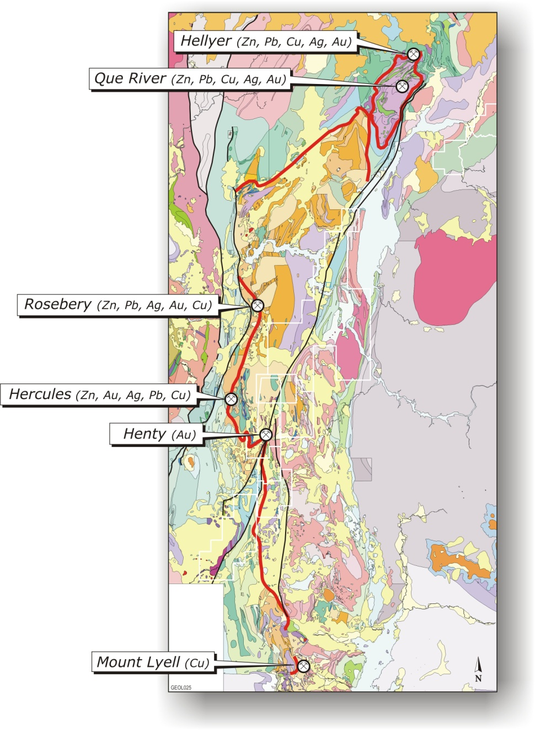
Some geological background – in good company
Henty Gold Mine
Hobart

Slide 4
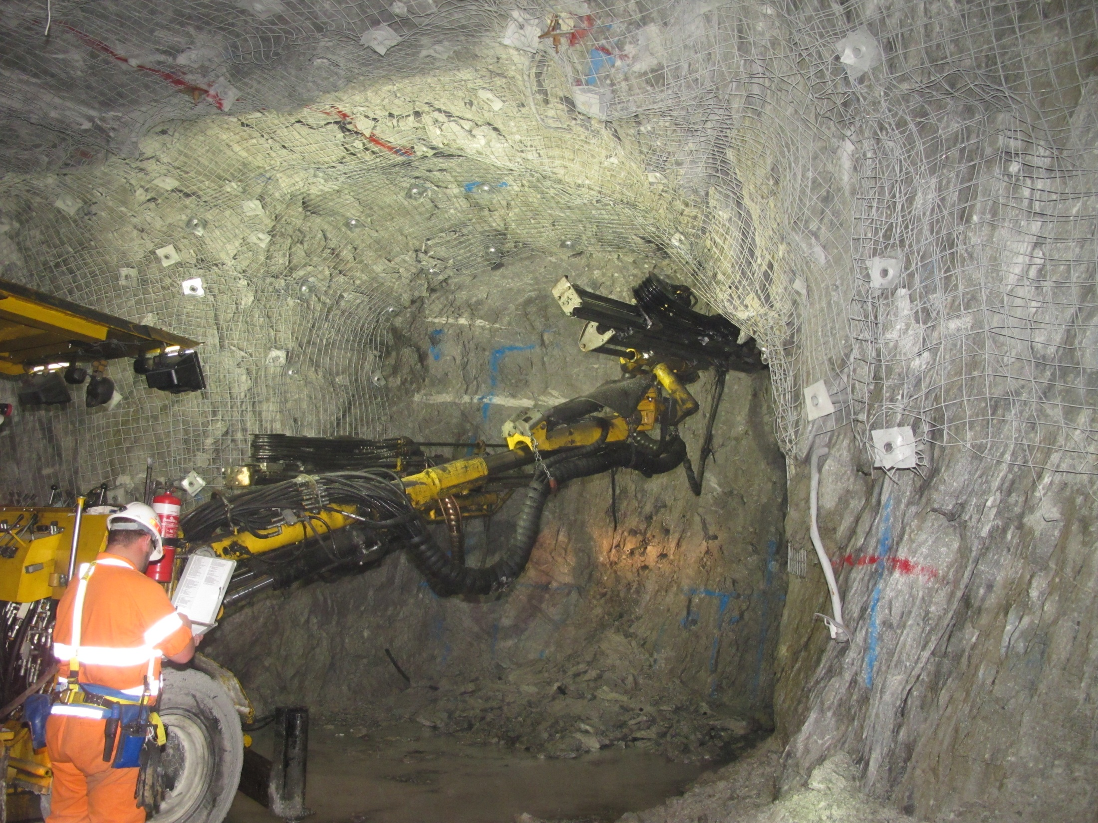
Some geological background – resources and reserves
Current reserves and resources (at June 30 2013)
Resources 1.8 Mt at 5.2 g/t gold 296,000 oz
Reserves 0.69 Mt at 5.4 g/t gold 121,000 oz

Slide 5
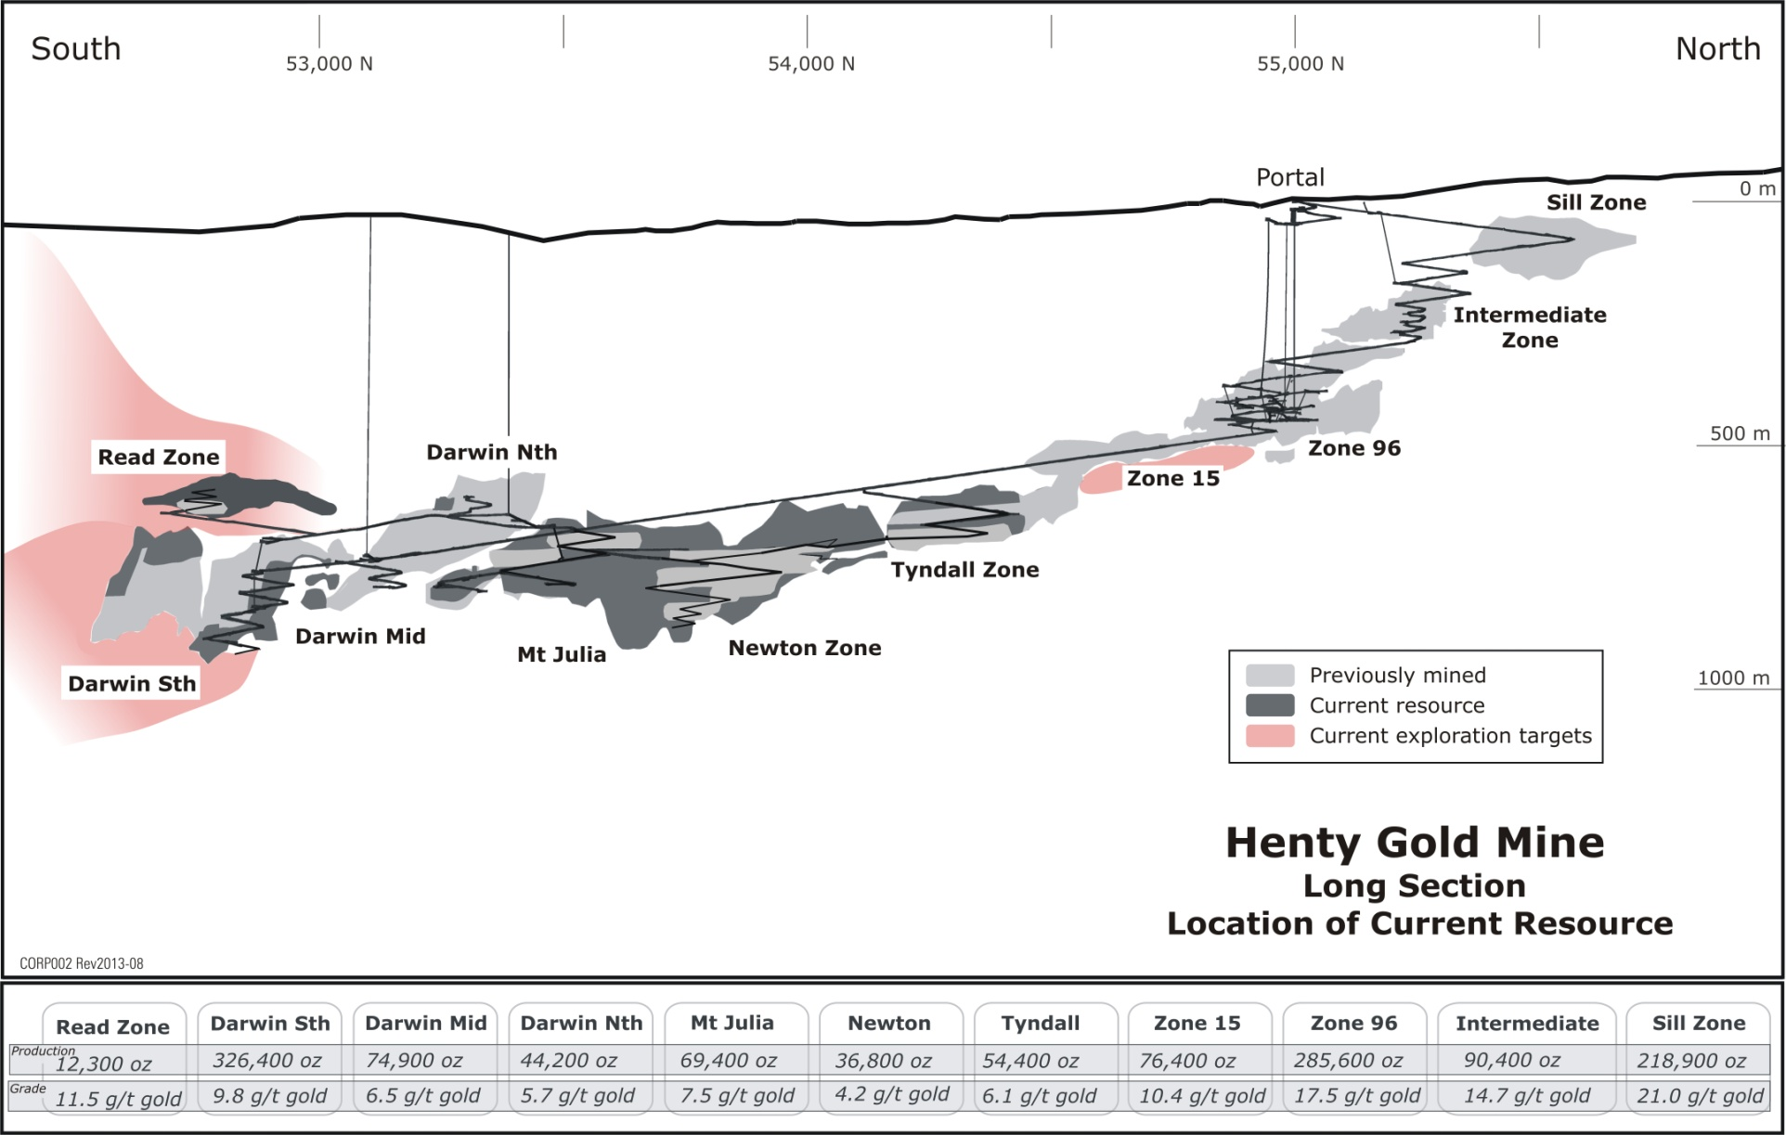
Some geological background – long section

Slide 6
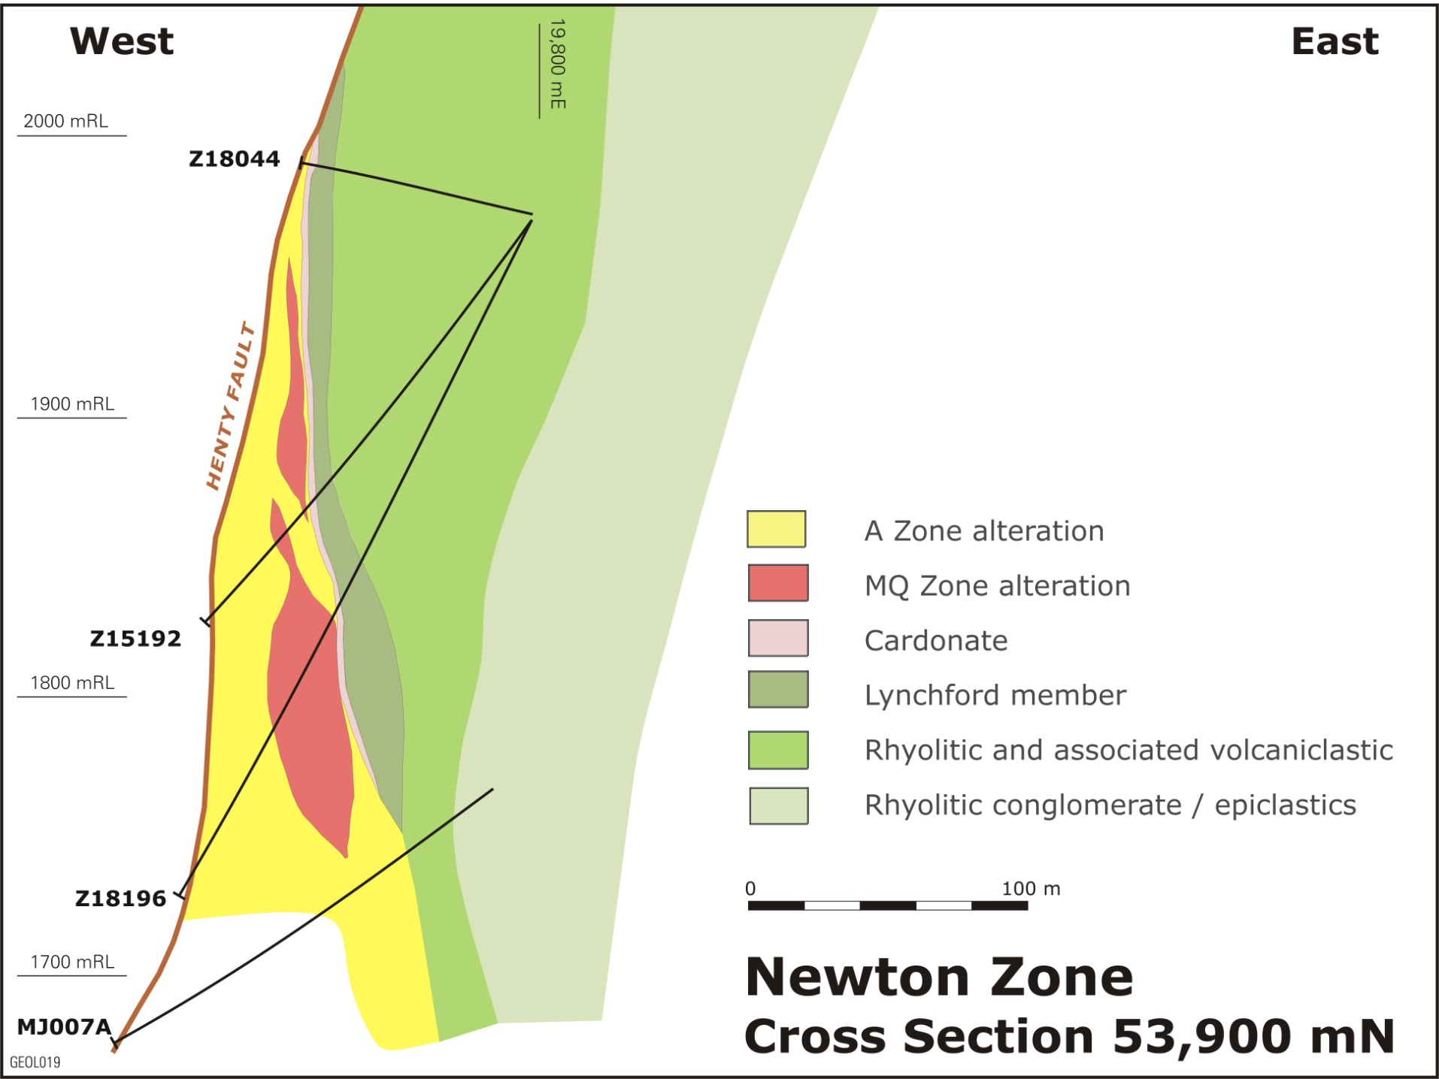
Some geological background – cross section
Carbonate

Slide 7
Geological background – rock types – meant to look like this:
mE
mE
379500
380000
Surface
500
mRL
Tyndall
Group
Mt Julia Rhyolite
(lava)
Central Volcanic
Sequence
South Henty Fault
Massive carbonate
Mt Julia
Rhyolite
Central
Massive sulphides
(py, gn, sp)
Volcanic
Complex
0
mRL
MJ029A
MJ023
MJ023A
Canal
MJ029
Zone
Tyndall Group
(mixture of
sediments derived
from volcanic material
and lavas)
-500
mRL
Enveloping “MZ” and “MV” alteration
“MQ” alteration and
most gold mineralisation

Slide 8
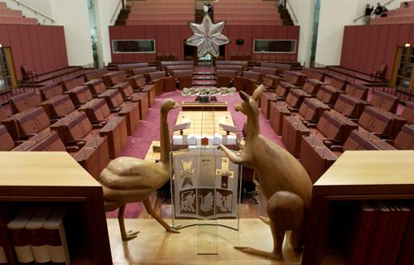
......but life doesn’t always work out how it’s meant to...
Wedding party
Sounds like the name of
the Liberal Party party
Fast car party
Big dinosaur party
Opposition
Government
Seating arrangements in the Australian Senate

Slide 9
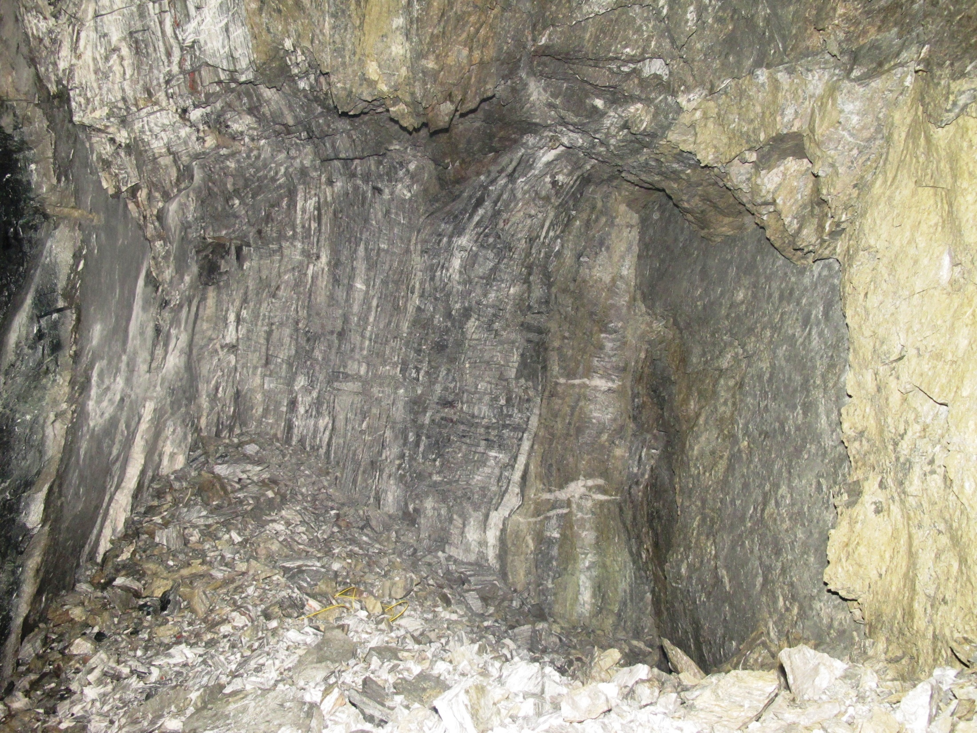
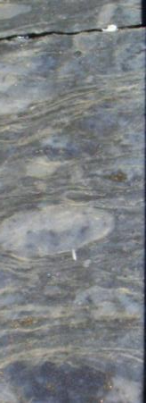
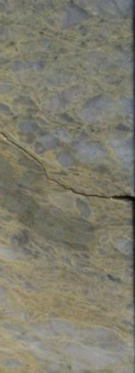
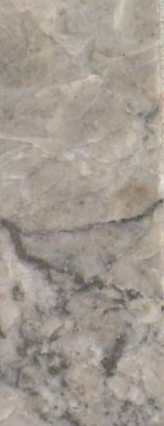
...the rocks really look like this!
MZ
MV
MQ
(the good
stuff)

Slide 10
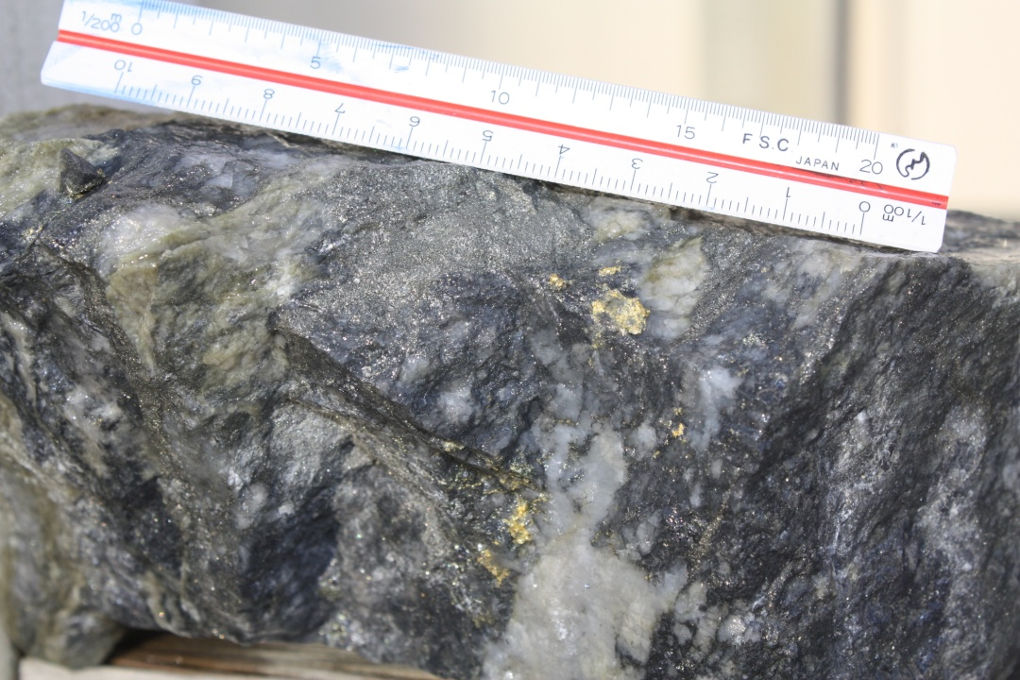
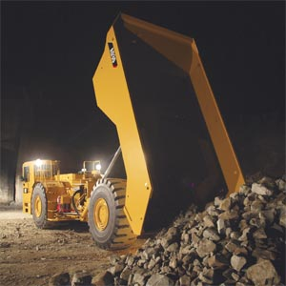
Sparkling and full-bodied
Sparkling due to grade
Full-bodied due to tonnes.

Slide 11
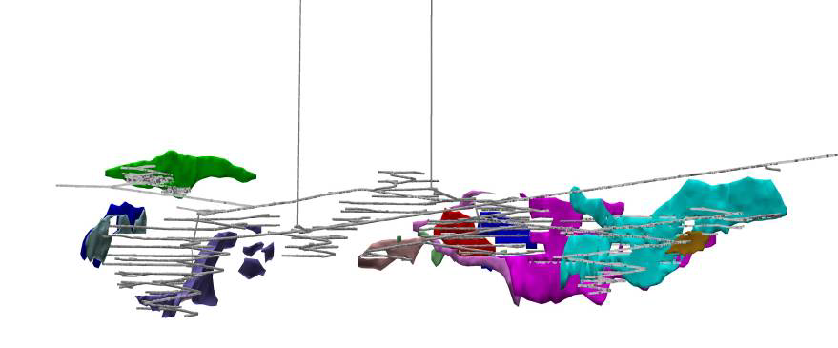
The Read and Newton Zones demonstrate this
Read: Average grade produced = 11.5 g/t gold
Newton: Average grade produced = 4.2 g/t gold

Slide 12
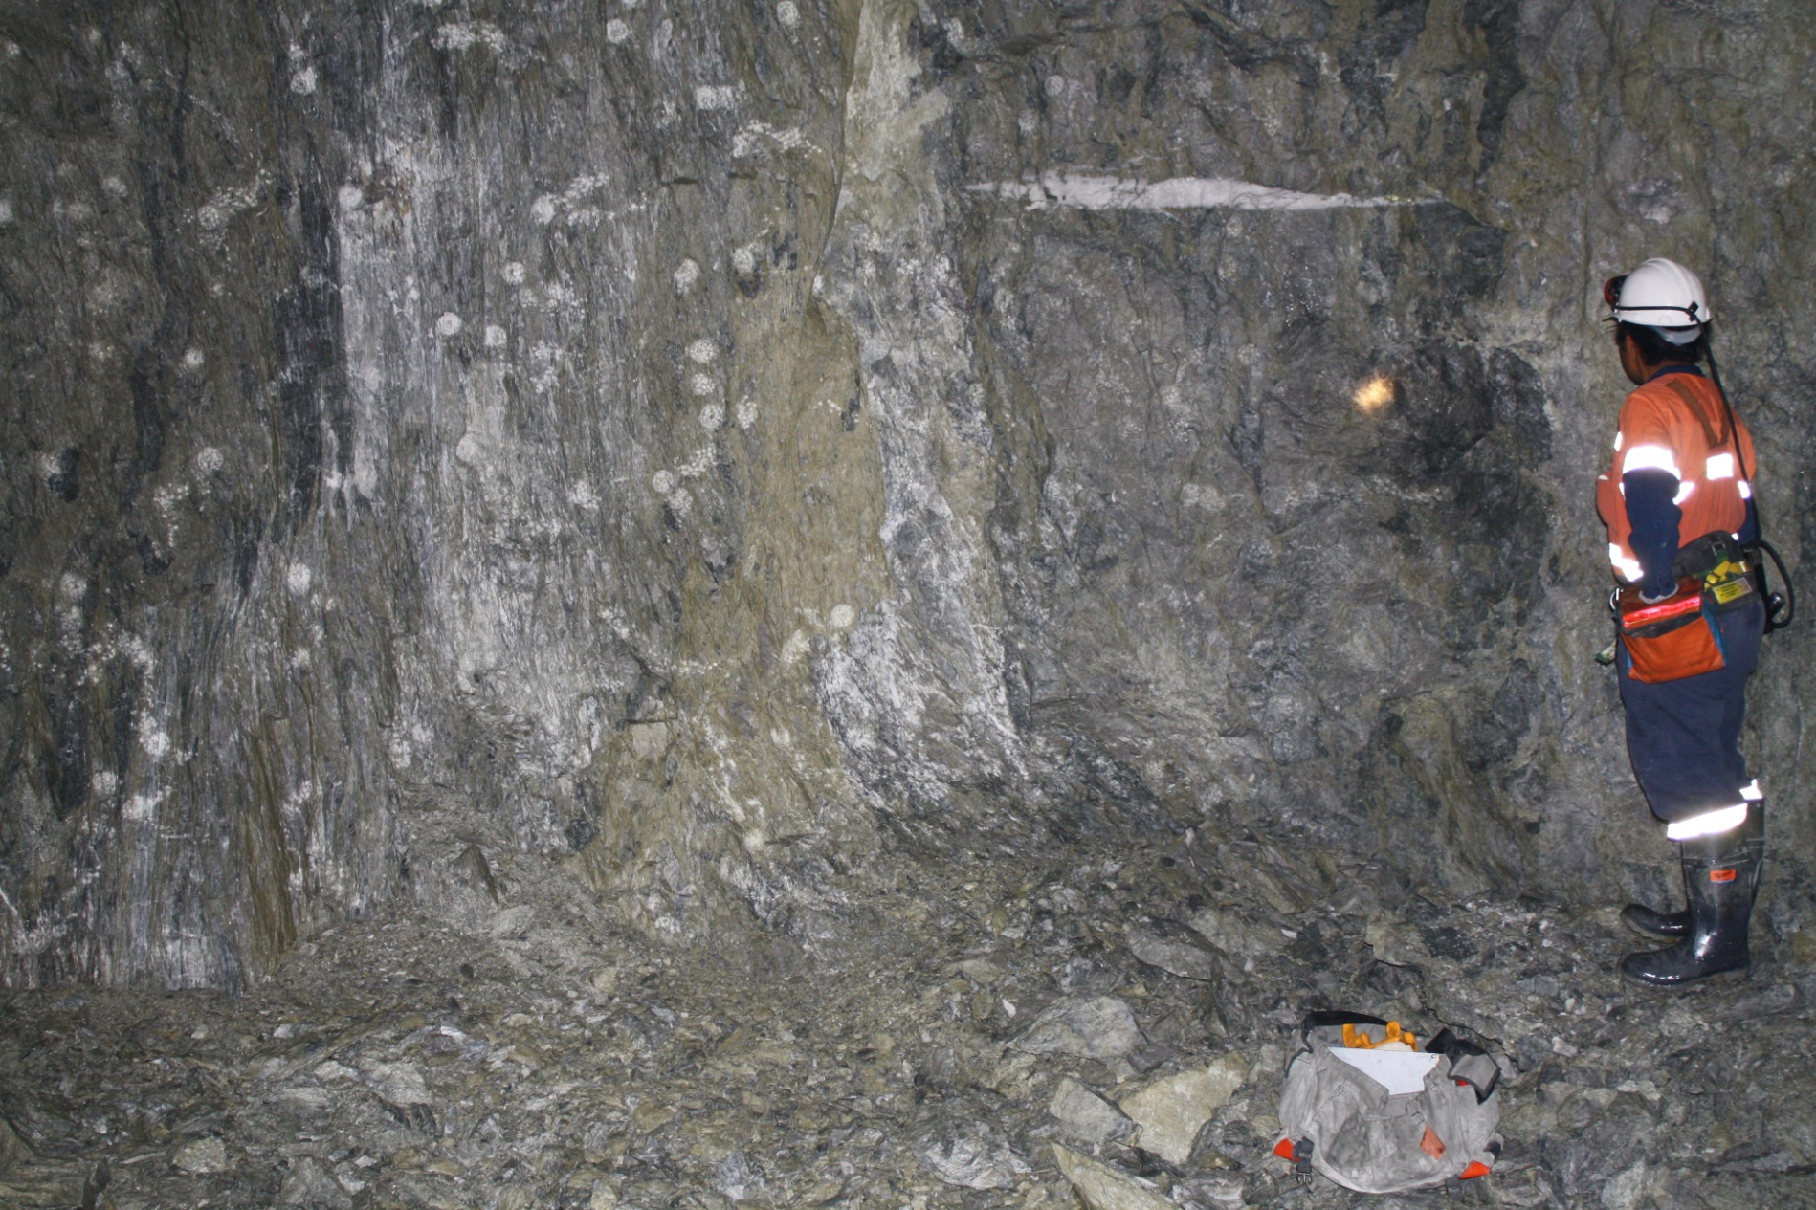
Newton heading

Slide 13
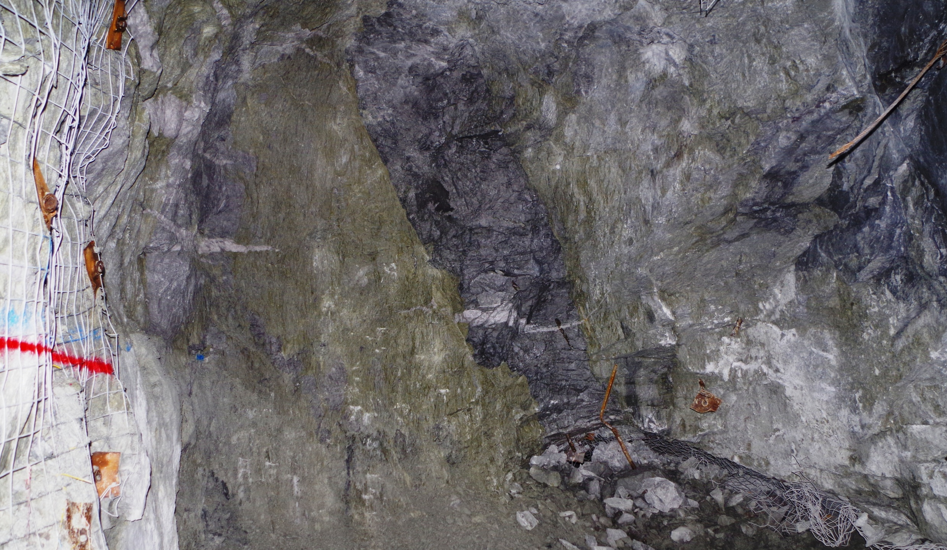
Read heading

Slide 14
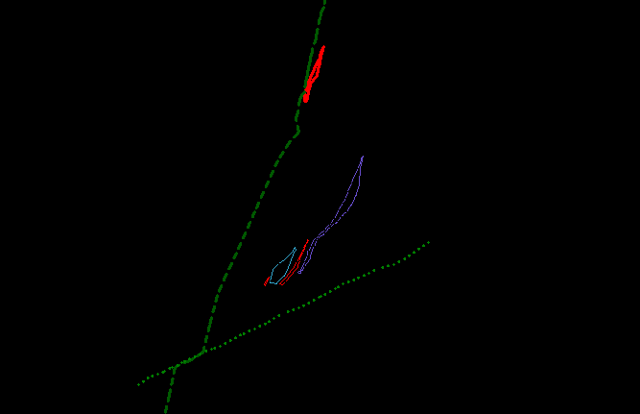
Cross sections
Read
Henty Fault
South Darwin
Newton

Slide 15
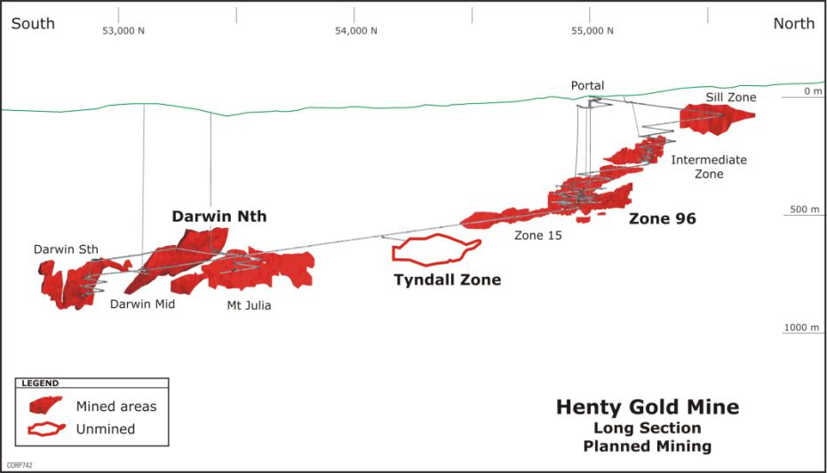
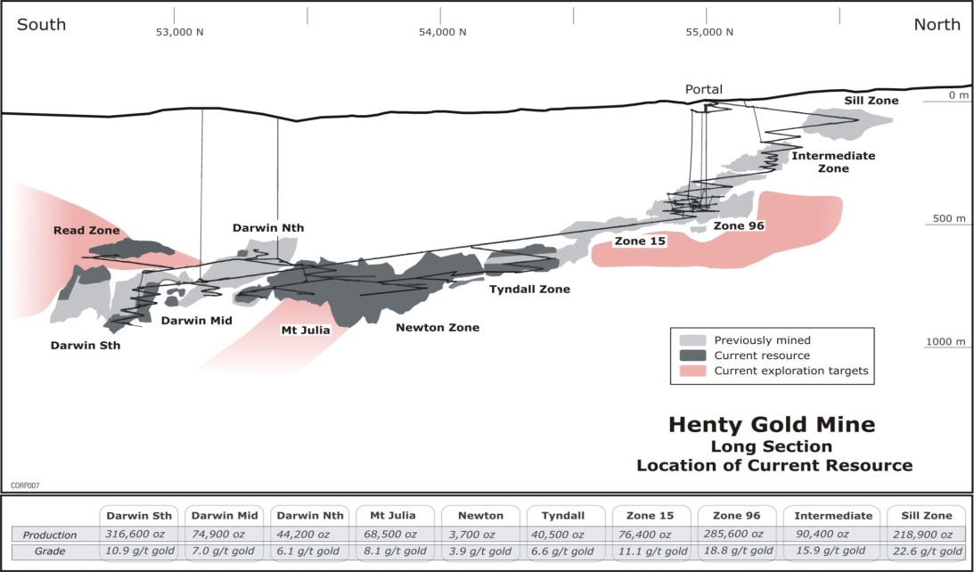
Exploration outcomes
July 2009......
165,000 mined ounces later...
July 2013

Slide 16
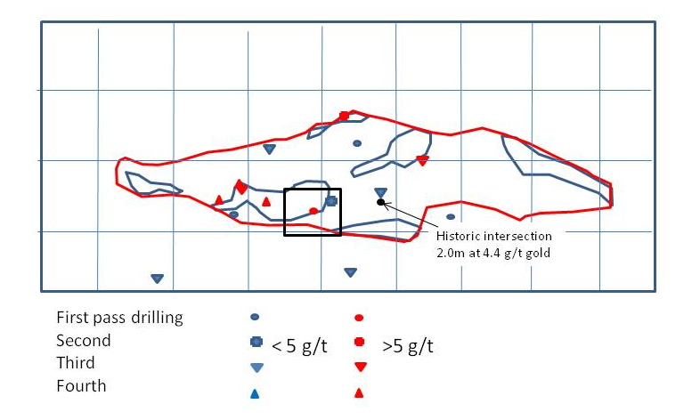
Understanding the scale of the mineralisation

Slide 17
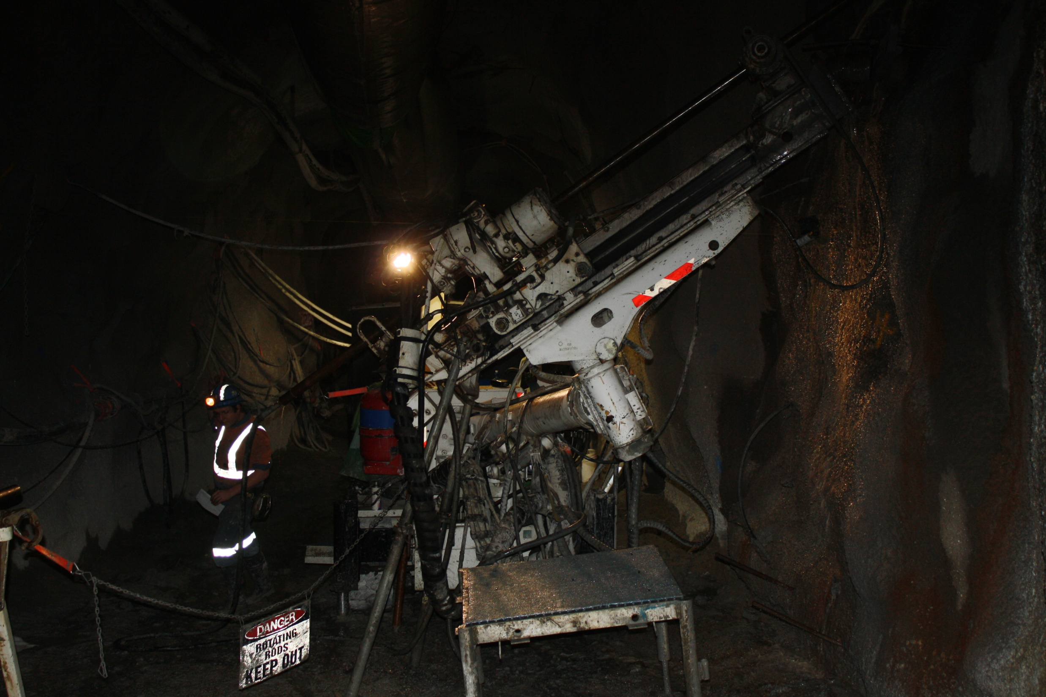
Commitment to drilling - Nessun dorma!
For most of the last 4 years have averaged
2 underground rigs and one surface rig at
$8-10M p.a.

Slide 18
Geochemistry – limited success

Slide 19
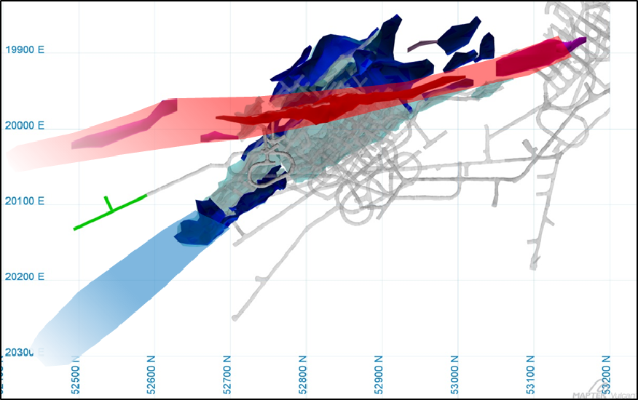
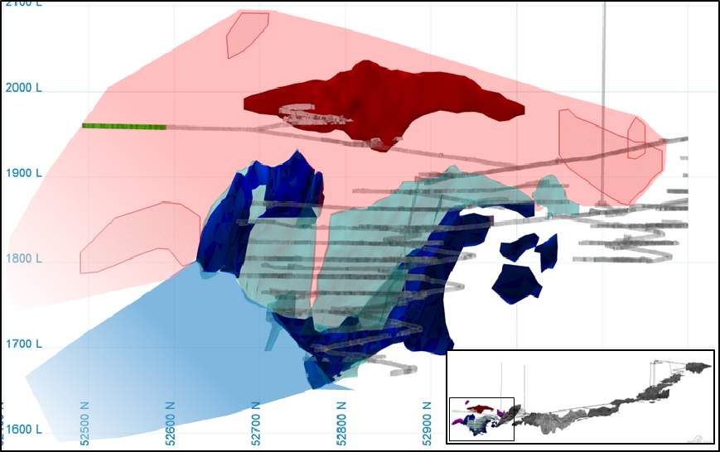
Lens orientation
Plan view
Long section

Slide 20
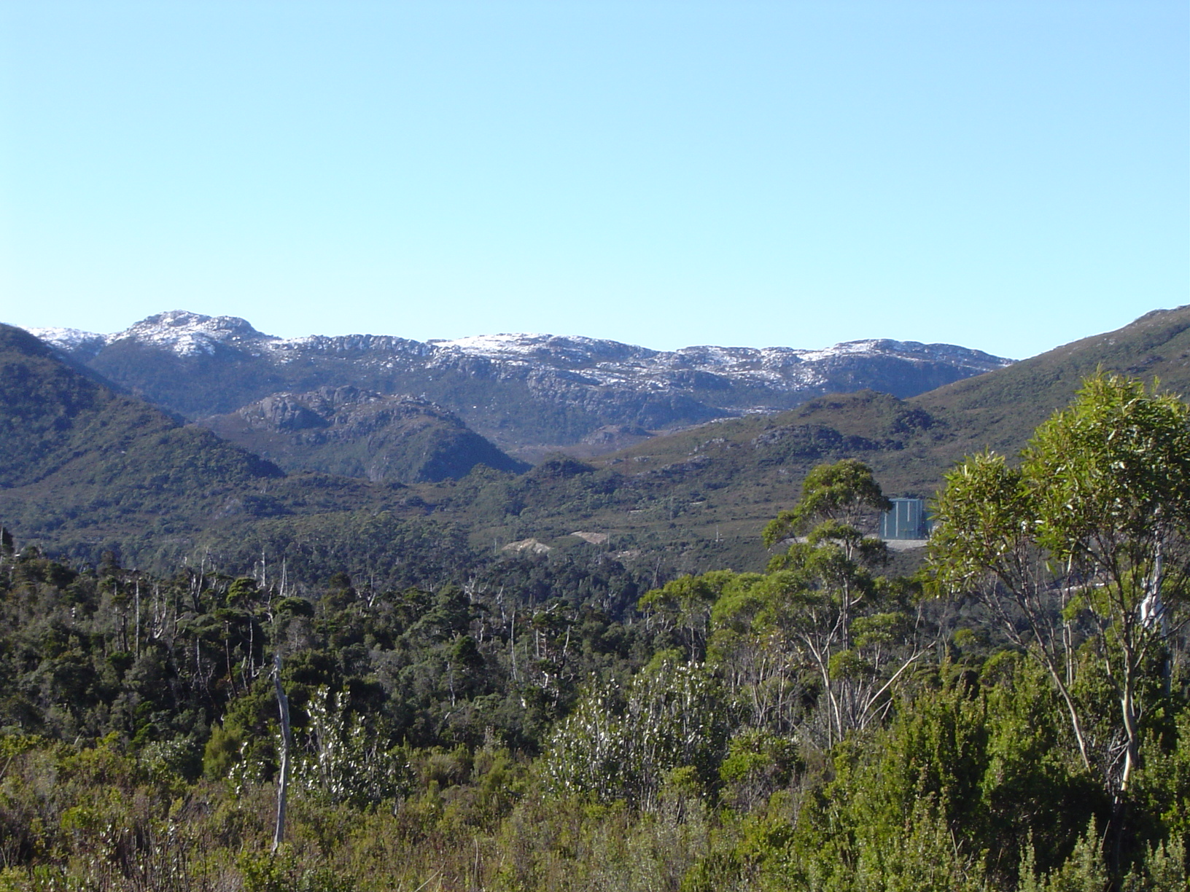
Looking further afield

Slide 21
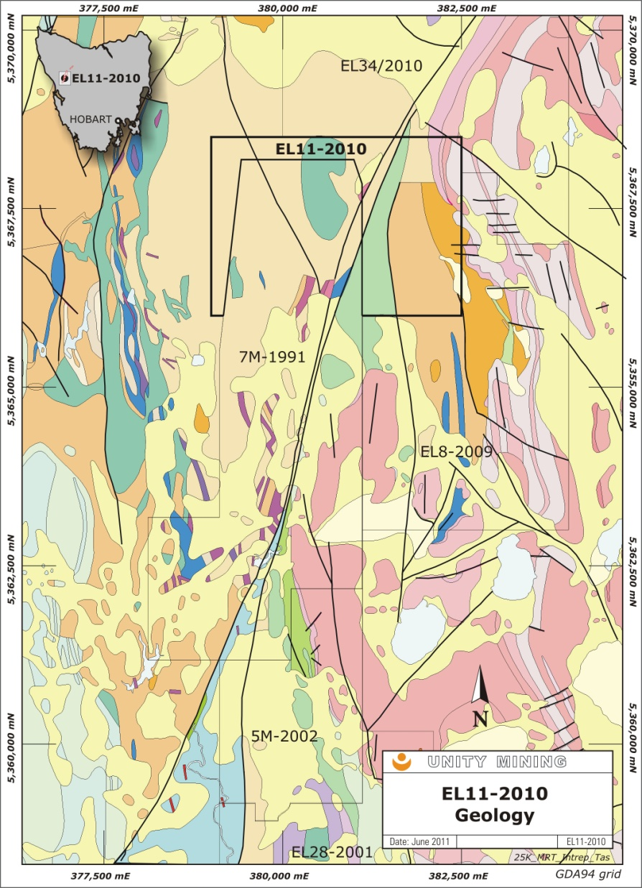
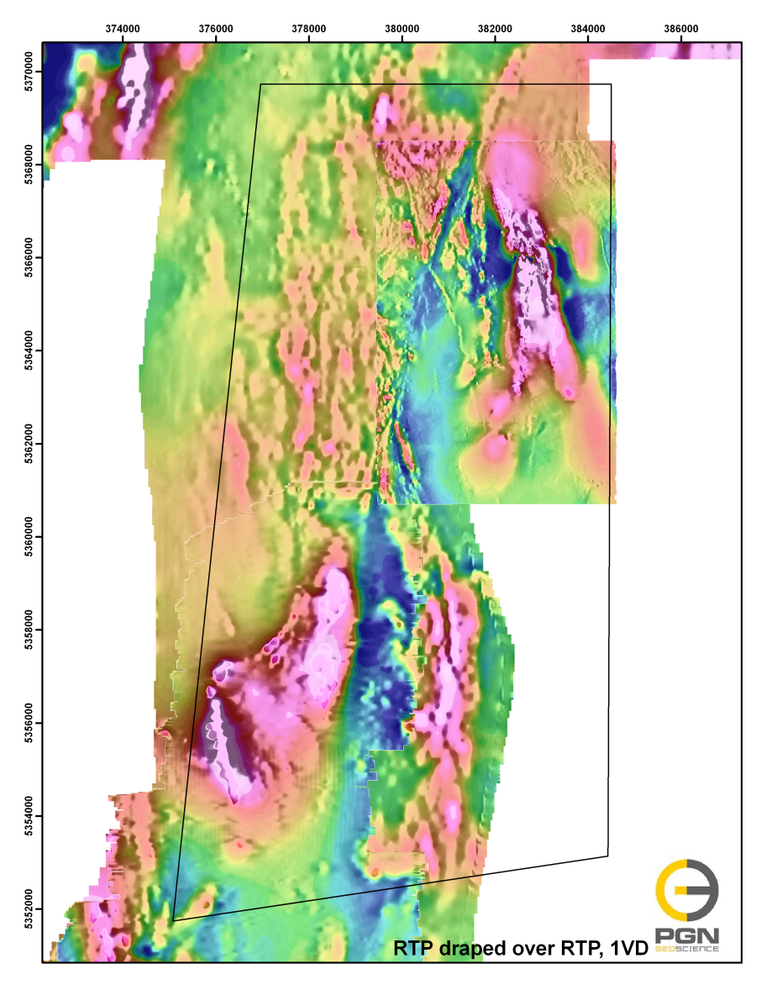
Geophysics – identifying Henty analogues i.e. Moxon

Slide 22
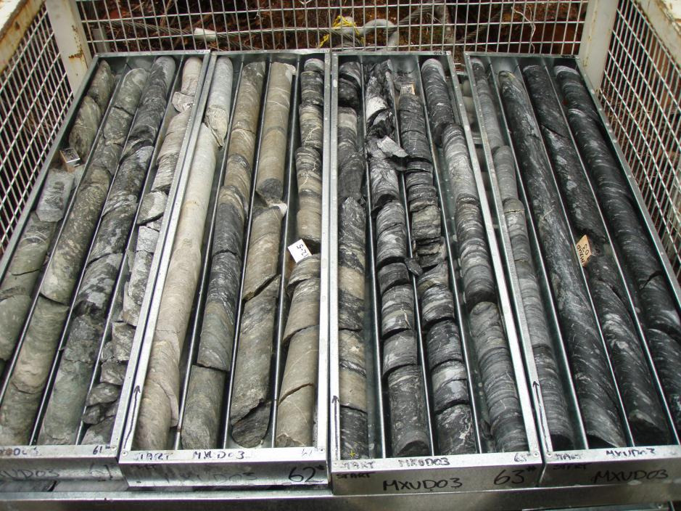
Moxon drill hole

Slide 24
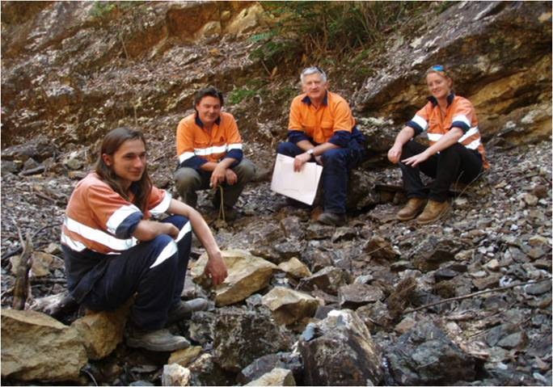
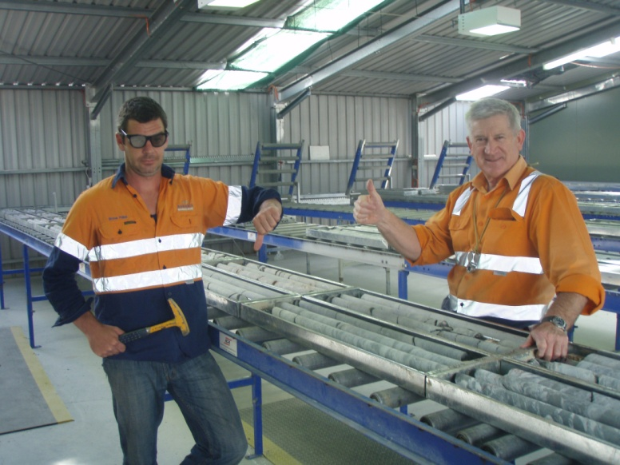
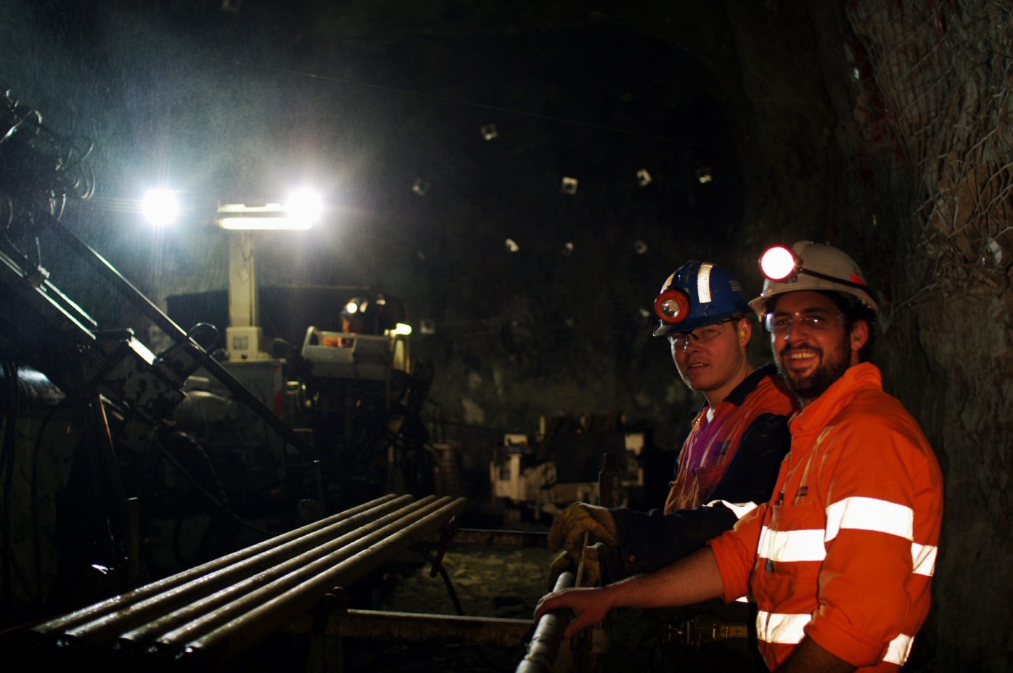
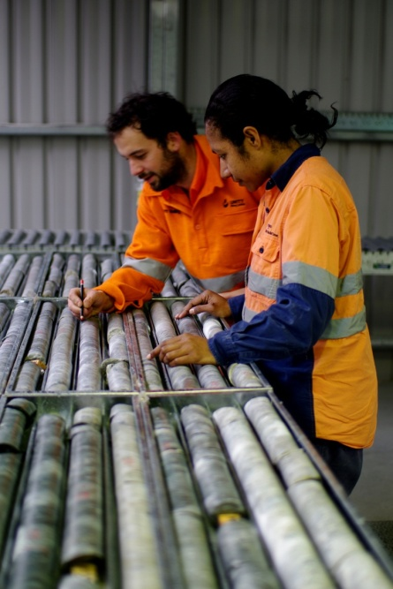
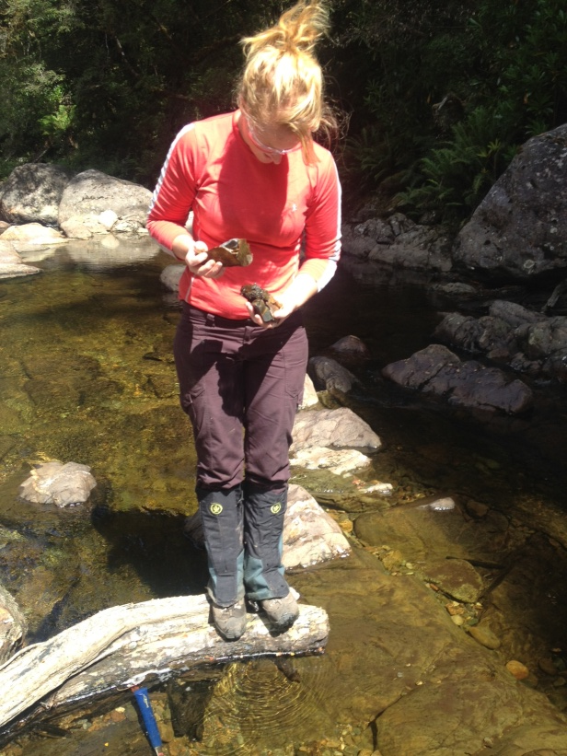
Teamwork

Slide 25
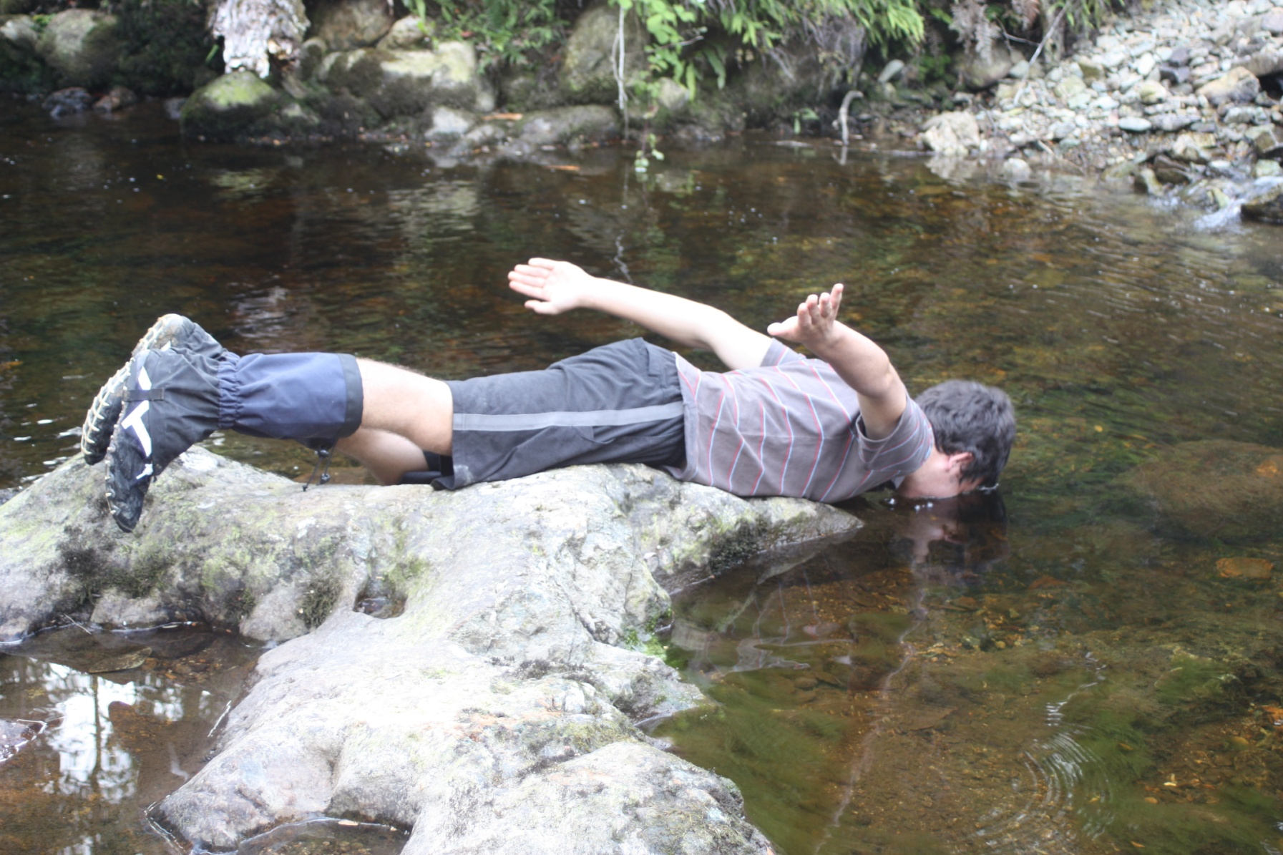
Henty? I’ll drink to that!

Slide 26
