Slide 1

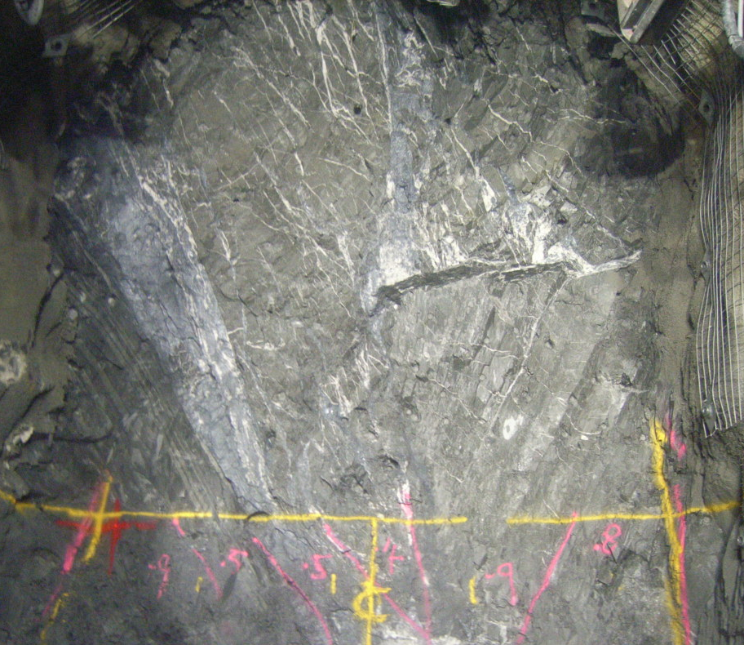
FOSTERVILLE GOLD MINE
Understandings of the Deposit and Exploration Potential Through Time
Presented by
Simon Hitchman
13th Sep 2013
TSX: CRK
OTCQX: CROCF
FRANKFURT: XGC

Slide 2
Disclaimer
This presentation contains forward-looking information under Canadian securities legislation. Forward-looking information includes, but is not limited to, statements with respect to the development potential and timetable of the projects; the Company’s ability to raise additional funds as necessary or on commercially reasonable terms; the future price of gold; the estimation of mineral resources and mineral reserves; conclusions of economic evaluation (including scoping studies); the realization of mineral resource and reserve estimates; the timing and amount of estimated future production, development and exploration; costs of future activities; capital and operating expenditures; success of exploration activities; mining or processing issues; currency exchange rates; government regulation of mining operations; and environmental risks. Generally, forward-looking information can be identified by the use of forward-looking terminology such as “plans”, “expects” or “does not expect”, “is expected”, “budget”, “scheduled”, “estimates”, “forecasts”, “intends”, “anticipates” or “does not anticipate”, or “believes”, or variations of such words and phrases or statements that certain actions, events or results “may”, “could”, “would”, “might” or “will be taken”, “occur” or “be achieved”. Forward-looking information is based on the opinions and estimates of management as of the date such statements are made. Estimates regarding the anticipated timing, amount and cost of mining at the projects are based on assumptions underlying mineral resource estimates and the realization of such estimates; results of previous mining activities at the projects, and detailed research and analysis completed by independent of the Company; research and estimates regarding the timing of delivery for long-lead items; knowledge regarding the factors consultants and management involved in building a mine and other factors described in the technical reports and Annual Information Form filed under the profile of the Company on SEDAR. Capital and operating cost estimates are based on results of previous mining activities, research of the Company and independent consultants, recent estimates of construction and mining costs and other factors that are set out in the scoping study. Production estimates are based on mine plans and production schedules, which have been developed by the Company’s personnel and independent consultants. Forward-looking information is subject to known and unknown risks, uncertainties and other factors that may cause the actual results, level of activity, performance or achievements of the Company to be materially different from those expressed or implied by such forward-looking information, including but not limited to risks related to: timing and availability of external financing on acceptable terms; unexpected events and delays during construction, expansion and start-up; variations in ore grade and recovery rates; receipt and revocation of government approvals; actual results of exploration and mining activities; changes in project parameters as plans continue to be refined; future prices of gold; failure of plant, equipment or processes to operate as anticipated; accidents, labour disputes and other risks of the mining industry. Although management of the Company has attempted to identify important factors that could cause actual results to differ materially from those contained in forward-looking information, there may be other factors that cause results not to be as anticipated, estimated or intended. There can be no assurance that such statements will prove to be accurate, as actual results and future events could differ materially from those anticipated in such statements. Accordingly, readers should not place undue reliance on forward-looking information. The Company does not undertake to update any forward-looking information except in accordance with applicable securities laws.
Investors are advised that National Instrument NI 43-101 of the Canadian Securities Administrators requires that each category of mineral reserves and mineral resources be reported separately. Mineral resources that are not mineral reserves do not have demonstrated economic viability. Due to the uncertainty of measured, indicated or inferred mineral resources, these mineral resources may never be upgraded to proven and probable mineral reserves.
Certain information contained herein may be considered to be future-oriented financial information, which was designed and approved by management of Crocodile Gold for the purposes of assessing the value of the acquisition. Readers are cautioned that such information may not be appropriate for their use, and readers should consult their financial advisors as appropriate.
Any unauthorized use of the presentation is strictly prohibited. Distribution of this information to any person is unauthorized, and any disclosure of any of such information without the prior written consent of Crocodile Gold is prohibited. Except as specifically provided herein, this presentation may not be copied or otherwise distributed, in whole or in part, by or to any person or in any medium whatsoever.
Cautionary Note to U.S. Investors Concerning Estimates of Measured, Indicated or Inferred Resources
The information presented uses the terms “measured”, “indicated” and “inferred” mineral resources. United States investors are advised that while such terms are recognized and required by Canadian regulations, the United States Securities and Exchange Commission does not recognize these terms. “Inferred mineral resources” have a great amount of uncertainty as to their existence, and as to their economic and legal feasibility. It cannot be assumed that all or any part of an inferred mineral resource will ever be upgraded to a higher category. Under Canadian rules, estimates of inferred mineral resources may not form the basis of feasibility or other economic studies. United States investors are cautioned not to assume that all or any part of measured or indicated mineral resources will ever be converted into mineral reserves. United States investors are also cautioned not to assume that all or any part of an inferred mineral resource exists, or is economically or legally mineable.
For information regarding mineral resource and reserve estimates, including parameters used to generate the estimates and depletion, please see the technical reports titled: NI43-101 TECHNICAL REPORT FOSTERVILLE GOLD MINE, VICTORIA, AUSTRALIA PREPARED FOR CROCODILE GOLD CORP dated April 29th, 2012. These documents are available on the company website and at www.sedar.com.

Slide 3
Talk Outline
Location
Mining History
Tectonic Setting & Regional Geology
Mine Lease Geology
  Host Rocks
  Mineralisation
  Fault- Bedding Relationships
  Exploration Drilling
    Geological Schematic Sections and Resource Growth
    Orebody Definition, Resources and Reserves
Mining
Processing
Current Operations
What’s Next

Slide 4
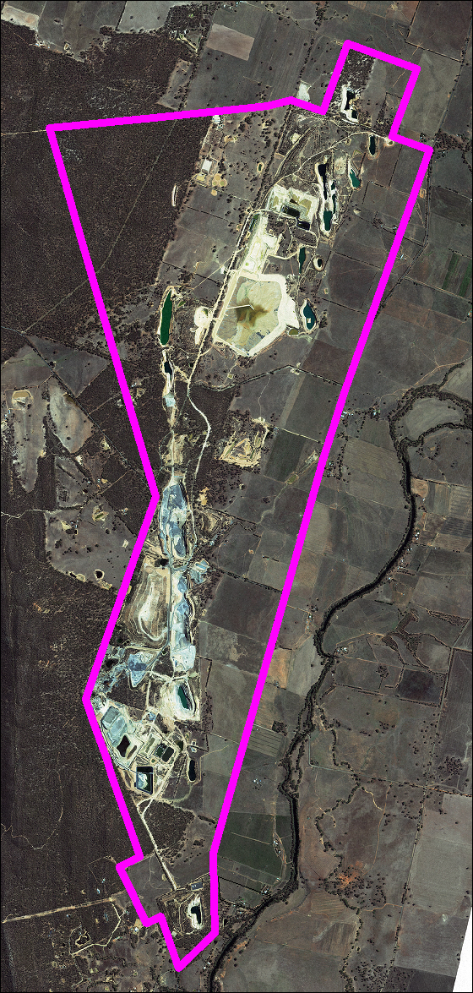
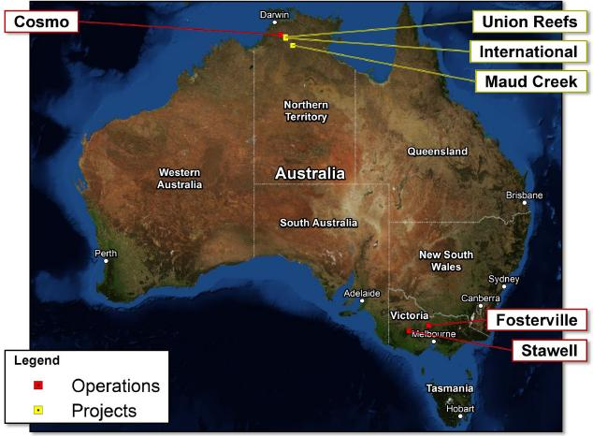
Fosterville Location
Flotation Tails
In-Pit Tails
Falcon Pit
9 km
Plant/Office
Ellesmere Pit
CIL Tails
Notes:
Tenement boundary

Slide 5
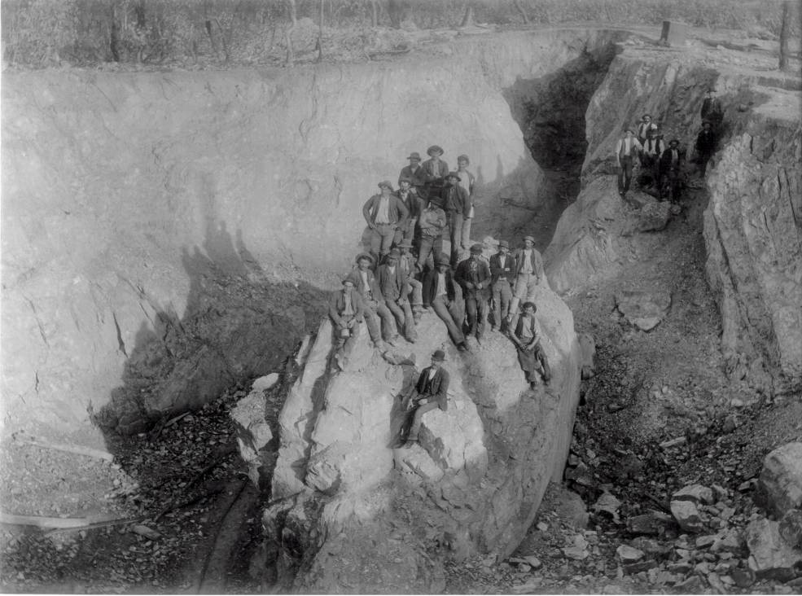
Fosterville Mining History
Discovery & Oxide Production (~313koz)
  1894 – 1903: Discovery and historical mining, 28koz total.
  1930’s & 1980’s: Minor tailings retreatment campaigns.
  1991 – 2003: Heap Leach Operations (PSV from 1992), 285koz total.
Sulphide Development & Production
  Sulphide resource growth from mid-2001,
  Feasibility Study completed Sep 2003.
  Construction and open pit mining began April 2004.
  First gold poured in April 2005, with 672koz sulphide gold to Dec 2012.
  UG Decline began March 2006, first stope in Dec 2006
  UG mining (open stoping and sub-level caving methods) has been the dominant source of mill feed since early 2008.
Ownership & Reserves
  PSV from 1992 to Feb 2008, Northgate/ AuRico Gold until May 2012.
  Now Crocodile Gold
  Dec 2012 Reserves: 1.7Mt @ 5.57g/t Au for 305koz of mineable gold.
Fosterville, 1901

Slide 6
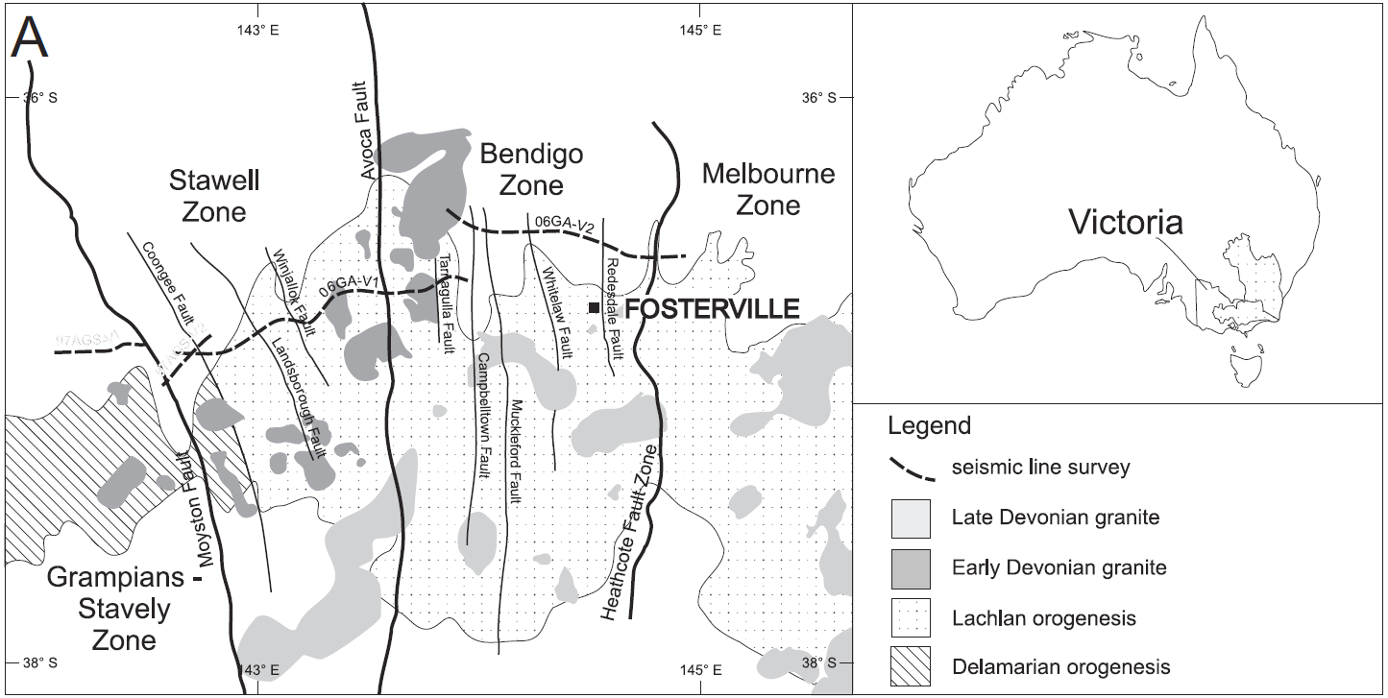
Tectonic Setting
Bendigo
Stawell
Maldon
Ballarat
Orogenic Events:
Cambrian Delamerian Orogeny (~520-490Ma)
Late Ordovician Benambran Orogeny (~455-440Ma)
Late Devonian Tabberabberan Orogeny (~380Ma)
(Adapted from Leader and Wilson, 2010)

Slide 7
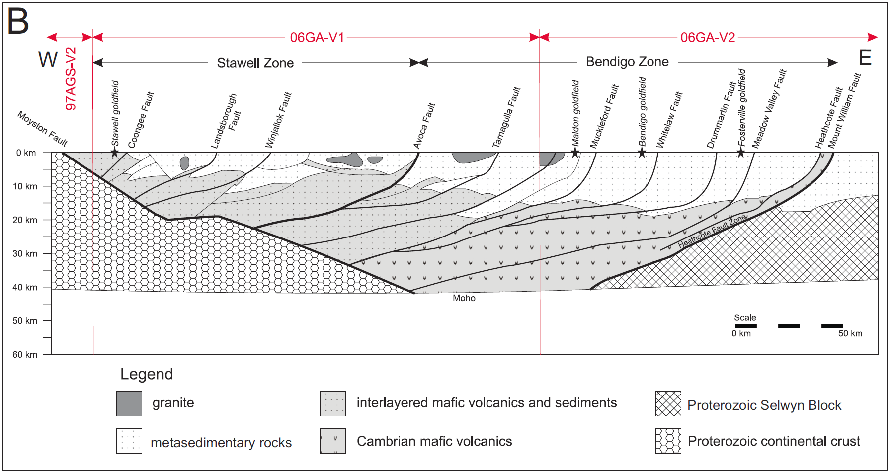
Tectonic Setting
5 Moz
1.8Moz+
22 Moz+
1 Moz+
Redesdale Fault
Mineralisation Events:
455-440Ma - Stawell, Bendigo, Castlemaine, Maldon and Daylesford
420-410Ma - Tarnagulla and Ballarat
380-370Ma – Fosterville, Costerfield and Woods Point
(Adapted from Leader and Wilson, 2010)

Slide 8
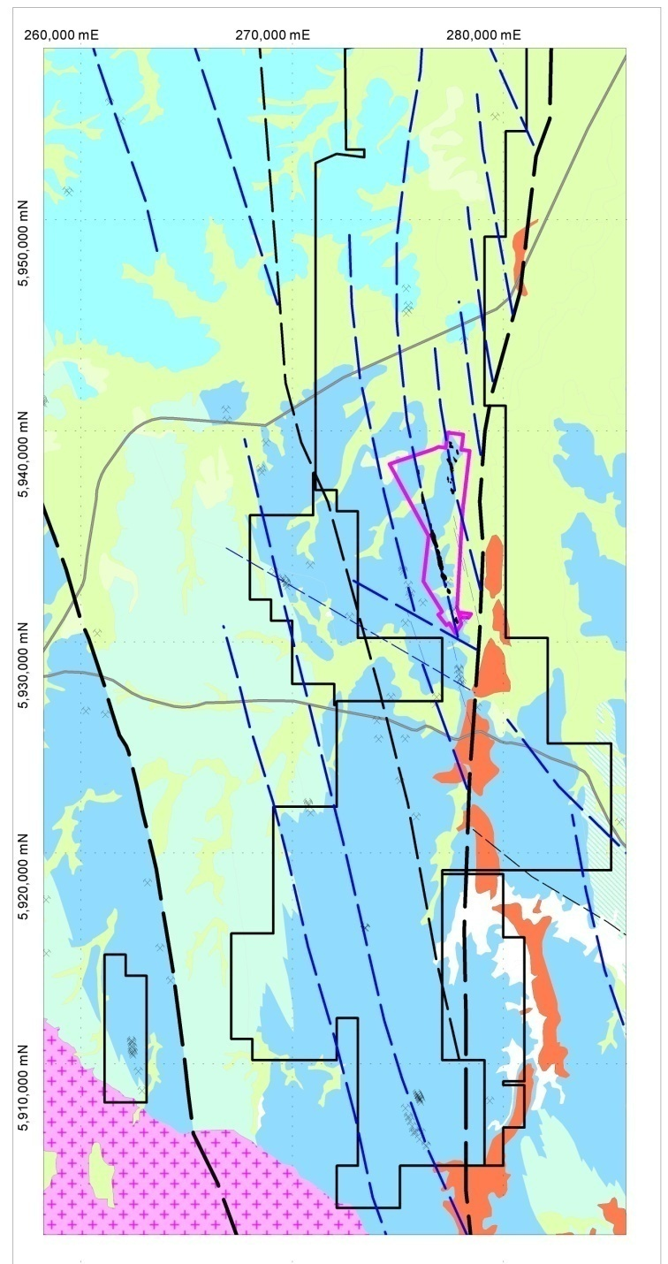
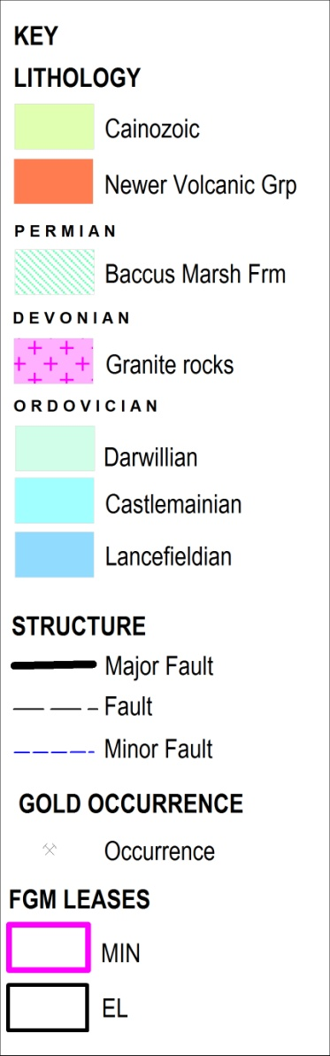
Regional Geology
Fosterville 20km east of Bendigo.
Fosterville Fault and other faults splay off the Redesdale Fault.
Ordovician Lancefieldian sedimentary host rocks
Gold mineralisation extends outside of the Fosterville Mine Lease.
Drummartin Fault
Redesdale Fault
Sugarloaf Fault
Fosterville Fault
O’Dwyer’s Fault
Fosterville
Yankee Creek Fault
Whitelaw Fault
10km
Background : GSV 1M Geology and Structure

Slide 9
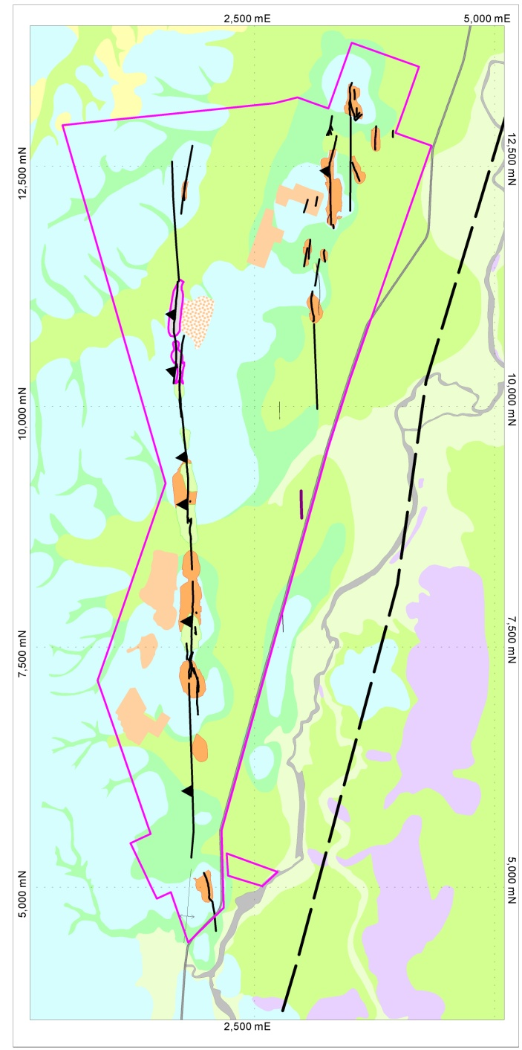




Mine Lease Geology
2.5 km
LITHOLOGY
Mine lease 8.5km along strike.
Goldfield 3km wide & total strike length of over 20km.
20+ shallow oxide open pits.
Ordovician turbidites on western and northern sections of mine lease, shallow cover on remainder.
Major controlling feature is the Fosterville Fault – north-south trend, steeply west dipping.
CAINOZOIC
Sharkey’s
Alluvium
Robbin’s
Hill
Prior Valley & Stream Backfill Deposits
Rehe’s
Colluvium & Gully Alluvium
O’Dwyer’s
South
Newer Volcanics
Hunt’s
Tertiary Sediments
Fosterville
PALAEOZOIC
Plunge
Culmination
Felsic Porphyry Dyke
Fosterville Fault
Ordovician Turbidites
Falcon
CULTURAL
Ellesmere
Tailings
Harrier
Waste Rock
John’s
Redesdale Fault
Lease Boundary
Other parallel structures (incl. felsic dykes) in the north-east also host mineralisation.
Fosterville
Grid
N
Magnetic
N
Daley’s Hill
Notes:
Plan Needs Changing lg

Slide 10
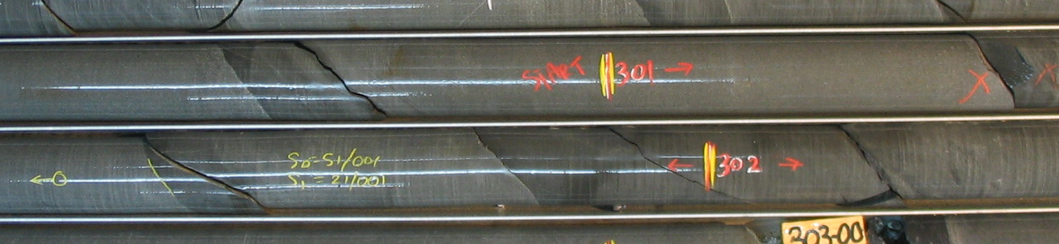
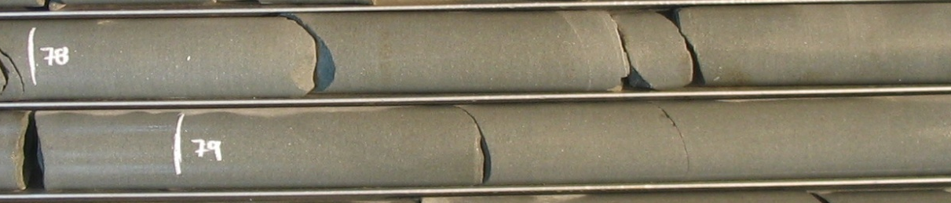
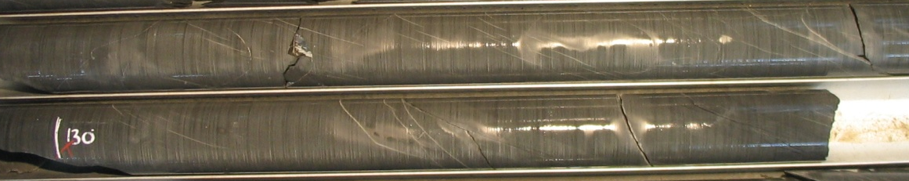
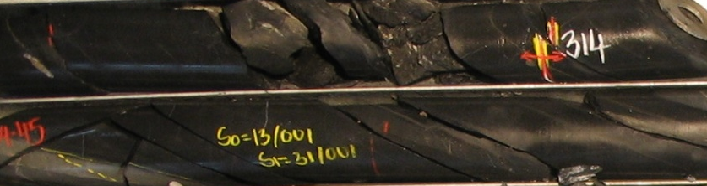
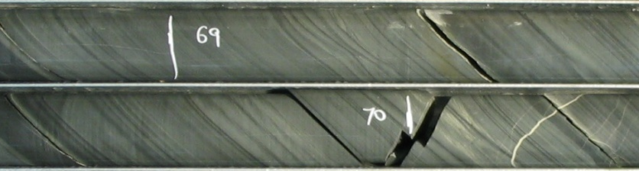
Host Rocks
Ordovician turbidites
Shale topped sandstone
SPD309
Massive Sandstone
RHD021
Shale
SPD303
Black
Shale
SPD292
Laminated
Shale
SPD283

Slide 11
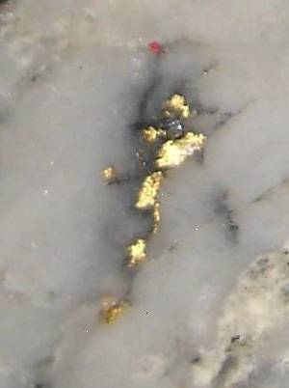
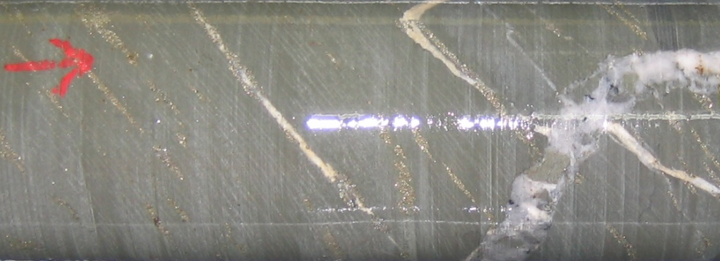
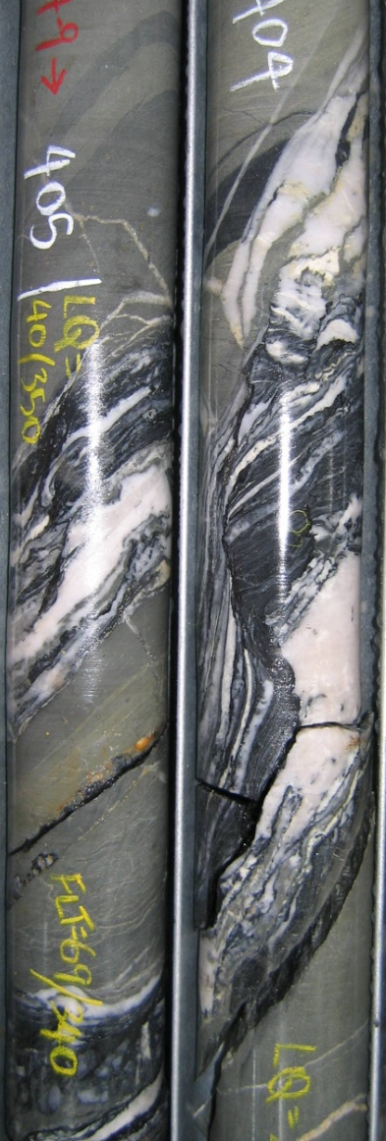
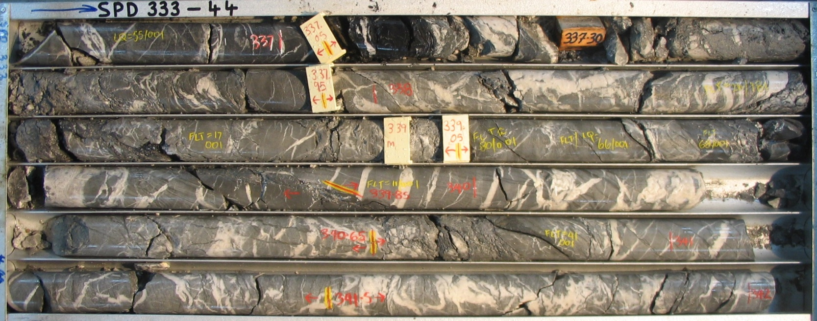
Mineralisation
Laminated
Quartz Veins
SPD336
Sulphides in cleavage SPD336
7mm
10cm
10cm
Free Gold DALD005
Fault Zone (Intersection of Fosterville & Harrier Faults) SPD333

Slide 12
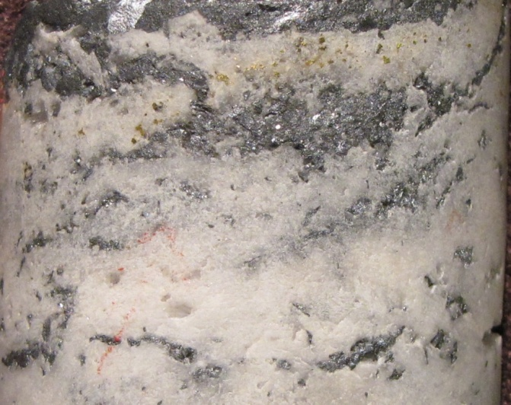
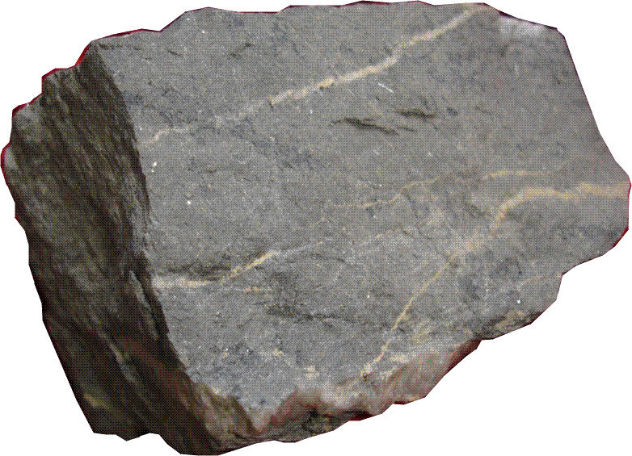
Sulphide Mineralisation
  Occurs as a halo surrounding a quartz-carbonate veinlet stockwork, localised on faults.
  Gold occurs in solid solution within sulphides – 80% arsenopyrite, 20% pyrite
    Arsenopyrite: 0.05-6mm acicular needles with no preferred orientation, typical gold content 100-5000ppm
    Auriferous pyrite: 0.1-2mm crystalline pyritohedrons, typical gold content of 10-100ppm.
Antimony occurs as coarse stibnite (Sb₂S₃), is spatially association with and replaces carbonate in qtz-carb veins, and may have proximal high-grade Aspy/ Py mineralisation. Stibnite is commonly associated with Phoenix Fault.
  Native gold (minor) occurs in quartz in close proximity to stibnite.
Carbon-enriched black shale units provide most significant metallurgical challenge – NCC is preg-robbing in CIL.
Fluid inclusion studies show low Temperature (270°C) and shallow depths (2.6 - 5.7 km).
Trace sulphide minerals:
    Sphalerite - ZnS
    Chalcopyrite – CuFeS₂
    Tetrahedrite – CuFe₁₂As₄S₁₃
    Bournonite - PbCuSb S₃
    Boulangerite - Pb₅Sb4S₁₁

Slide 13
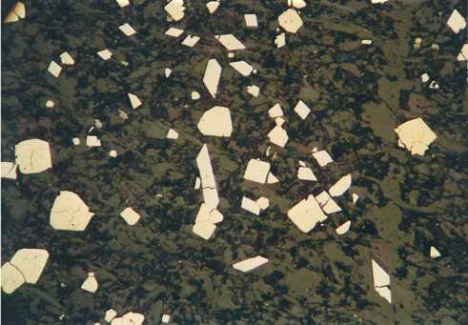
Sulphide Mineralisation
py
aspy
Reflected light, field of view 1.4 mm
Note:
Mineralisation overprints foliation and quartz vein

Slide 14
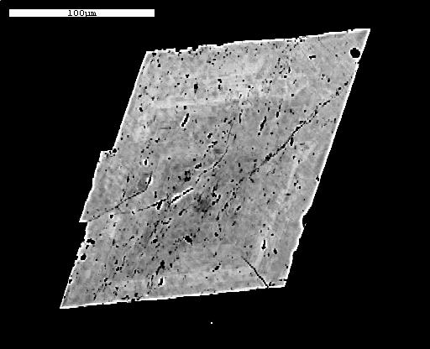
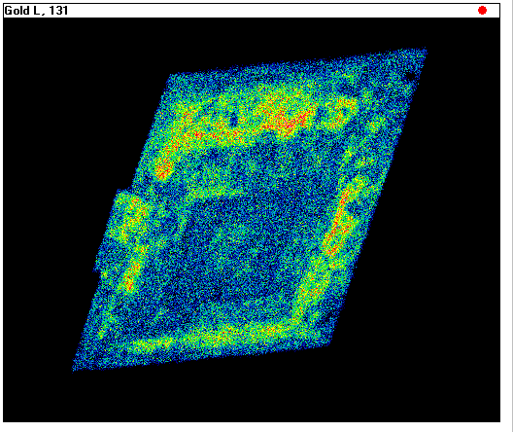
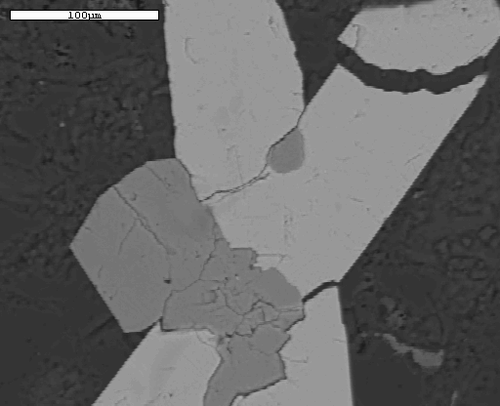
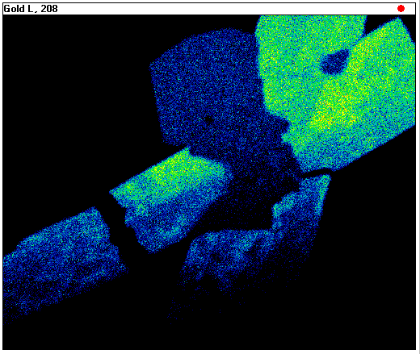
Arsenopyrite Mineralisation
100 μm
BSE Images of auriferous arsenopyrite grains
100 μm
Blue < 200 ppm Au
Green 200 – 800ppm Au
Red > 800 ppm Au

Slide 15
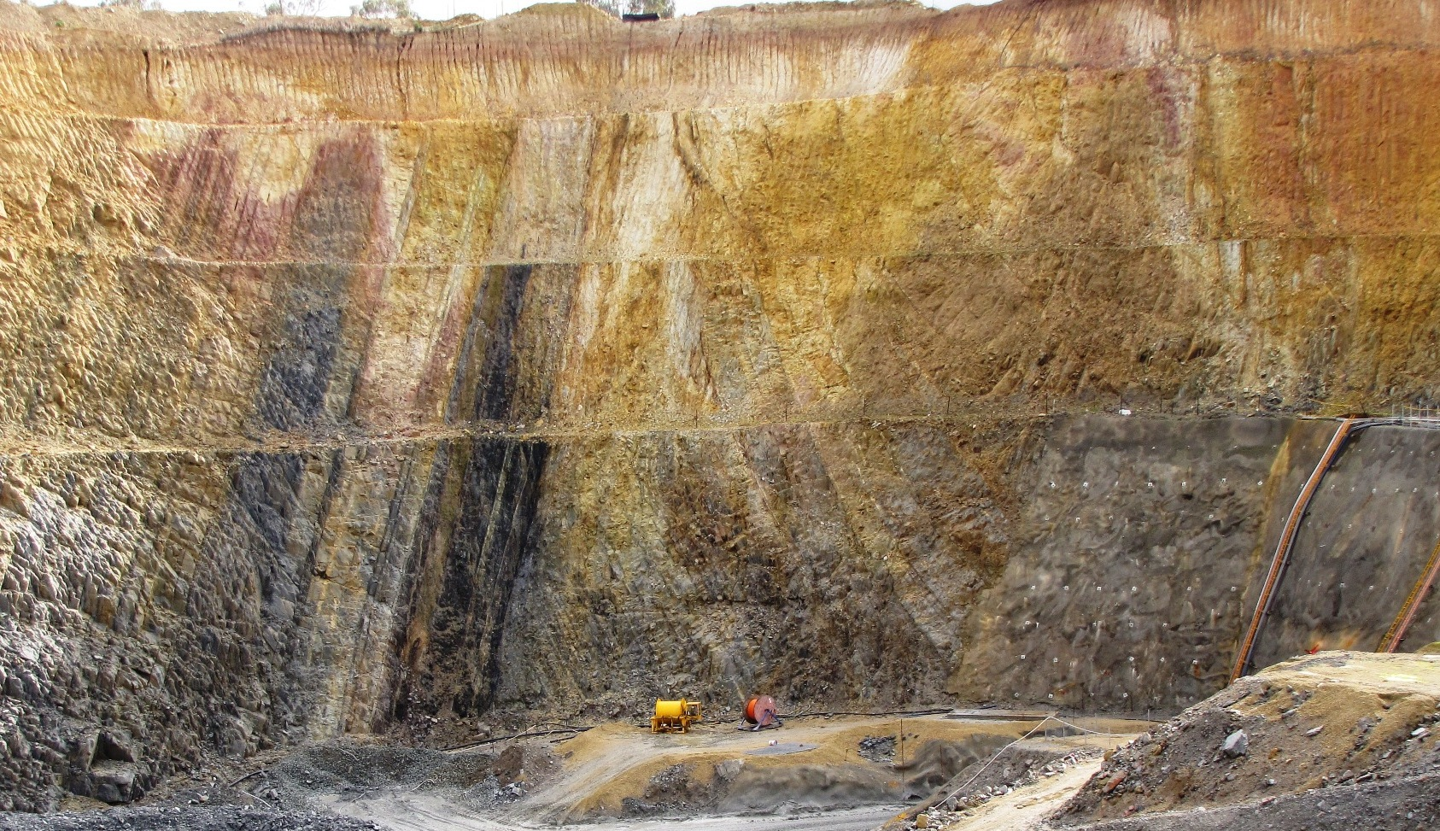

Fault – Bedding Relationships
40m
Ellesmere Decline Portal
Ellesmere Pit – Looking North
Discordant Bedding across Faults – E.g. Parallel/ Oblique structural setting.

Slide 16
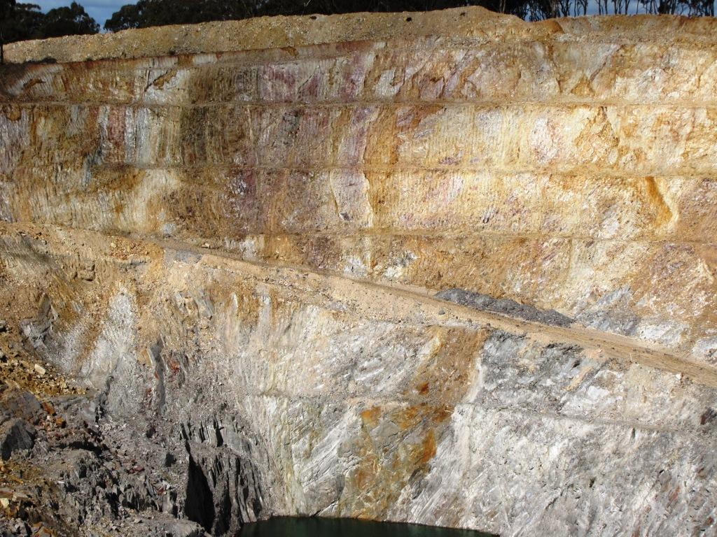
Faults - Bedding Relationships
Structural Settings are the primary control for gold mineralisation:
  Oblique/ Oblique.
    (minor)
  Parallel/ Parallel.
  Oblique/ Parallel.
    (well mineralised)
40m
Harrier Pit - Looking South

Slide 17
Exploration Drilling – 2001-2013
Early discovery of sulphide gold mineralisation for extraction by either UG or O/C methods – period of strong resource growth to 2003.
Building a geological framework from 2001: 150 to 300m spaced DDH sections.
  Logging of:
    Structures (bedding, cleavage, faults, veins, lineations)
    Structural zones
    Rock types (Sedimentary Grainsize after 2003)
    Qtz Veining,
    Sulphide mineralisation and
    Alteration
Targeting Mineralisation: 100m spaced DDH sections
  Focus drilling on oblique/parallel, P/O or O/O structural settings
  Target reverse faults with large displacements
  Assess bedding-cleavage intersection as proxy to fold plunges and therefore mineralisation plunge.
  Infill Drilling: Reduce Resource areas to 50m spaced DDH sections

Slide 18
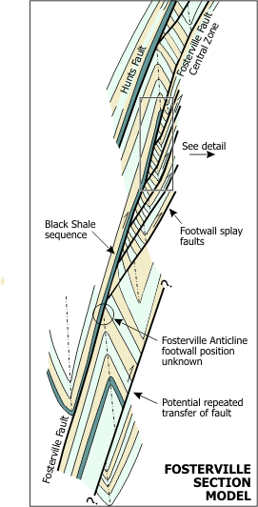
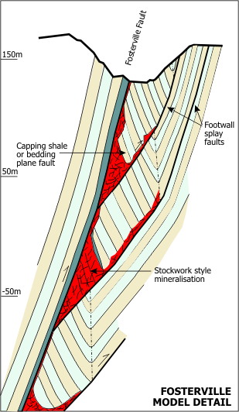
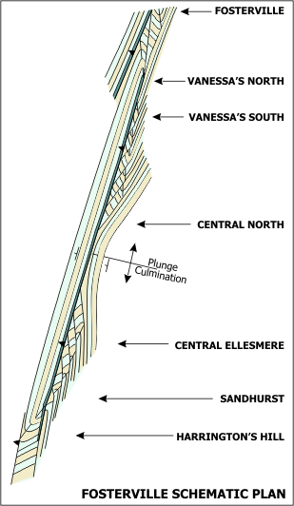
Geology Model (2003) – Fosterville Line
Diagrams from Perseverance Exploration 2003 Annual Report

Slide 19
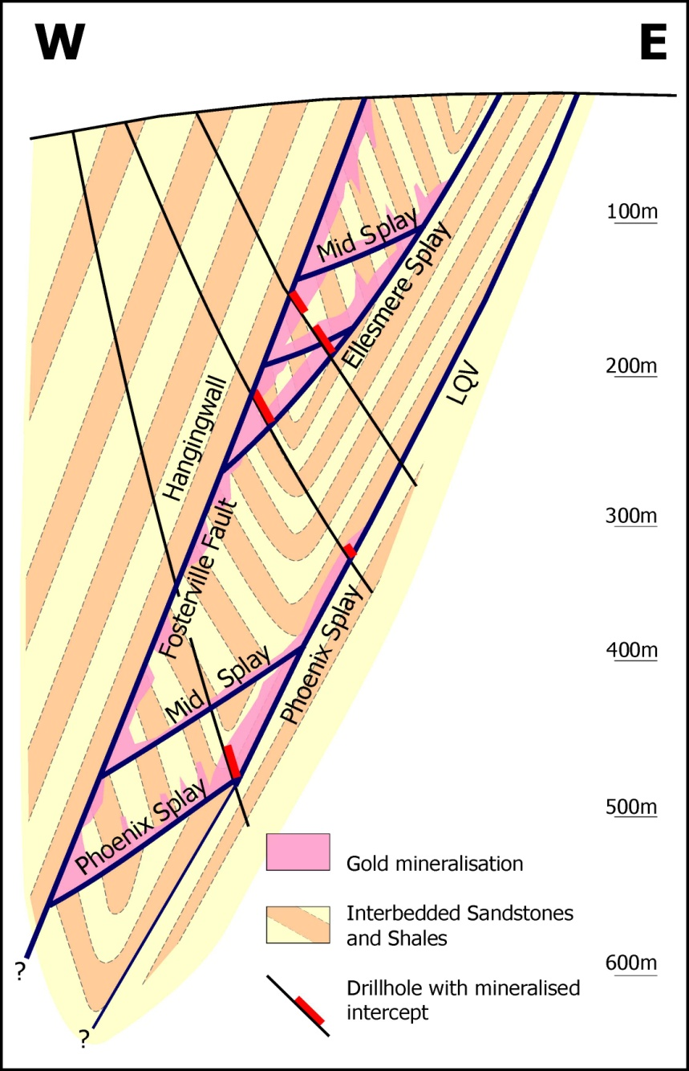
Schematic Section - 2003
Host turbidites (sandstones, siltstones and shales) metamorphosed to sub-greenschist facies.
E-W compression resulted in N-S folding.
  Early Ductile folding – bedding-parallel laminated quartz veins in shale.
  Late Brittle fracturing – steep west dipping reverse faults with footwall splays. Faulting links across to laminated quartz veins.
Sulphide Mineralisation controlled by late brittle faults:
  Best developed where discordant bedding across faults – Oblique/Parallel, P/O, O/O
  Typical geometries are steep to moderate west-dipping bodies with widths varying from 3-20 metres.

Slide 20
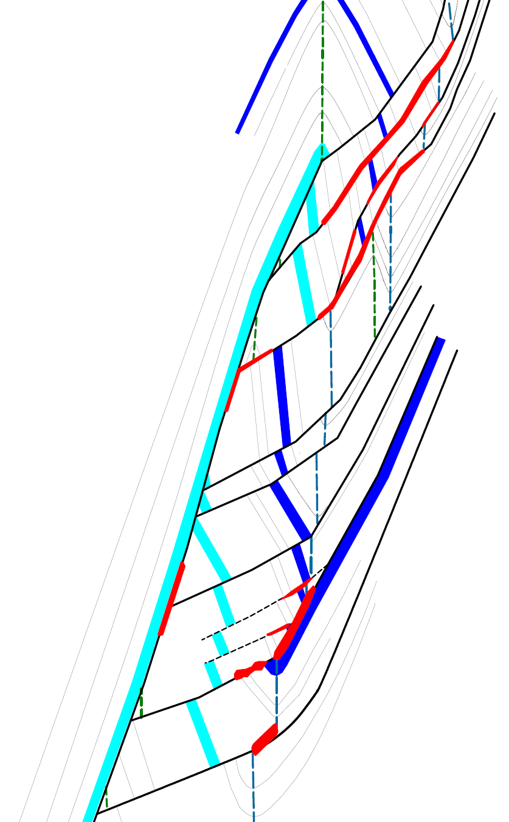
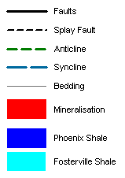

Schematic Section - 2011
Faults with large reverse movement important for increased brecciation and gold mineralisation:
  E.g. Phoenix and Harrier-Osprey orebodies
  Phoenix Faulting becoming more complex down plunge:
    Hangingwall splays more prominent, but less well mineralised.
  Harrier-Osprey thought to have dip-extensive mineralisation
  Mappable Turbidite Package.
Surface
OSPREY
HARRIER
Harrier-Osprey
KITE
ELLESMERE
HAWK
PHOENIX
KESTREL
FOSTERVILLE FAULT
Phoenix

Slide 21
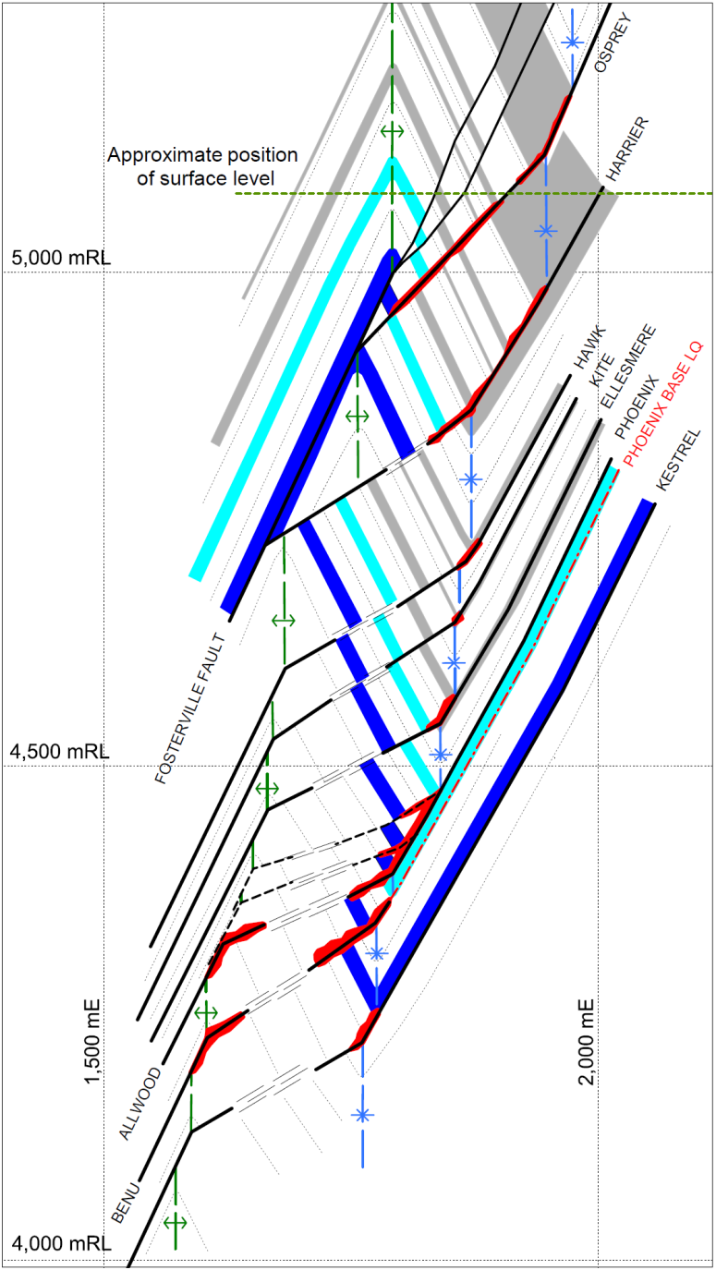
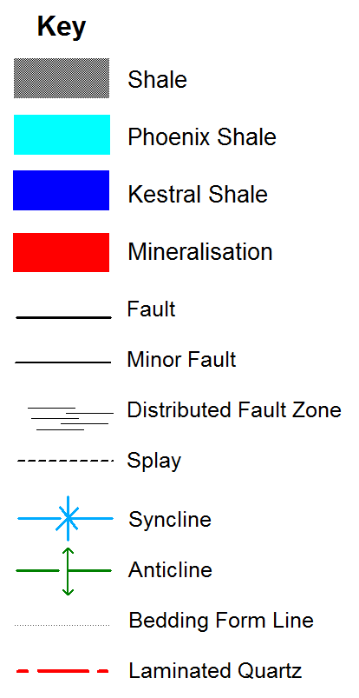
Schematic Section -2013
More drilling identified:
Harrier mineralisation to have limited continuous dip extent.
  Faulting that links from an anticline across discordant bedding to the well-drilled syncline.
    Segments of the Benu Fault is well-mineralised and is included in Fosterville ore reserves.

Slide 22
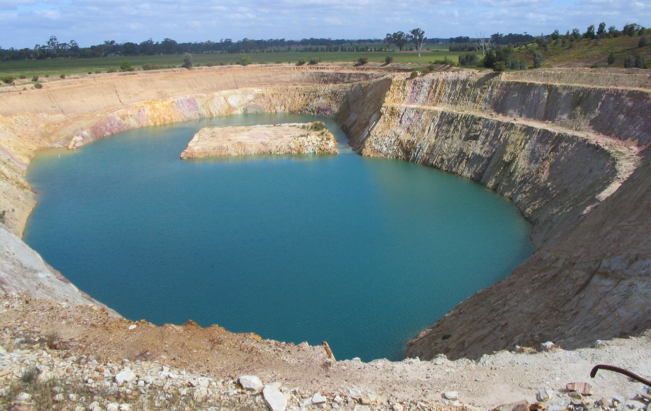
Exploration Drilling – 1990’s to 2001
Previous Exploration Oxide Gold Exploration Strategy (1990’s - 2001)
Shallow RC drilling along strike of historical pits
  Various 50m and 30m along strike pattern
  Infill to 20m and 10m centres
Minor diamond drilling for metallurgy and geotechnical purposes, sometimes towards the end of oxide pit life.

Slide 23
Long Projections
South
North
Central Resource Area
Exploration Progress 2001-2003
MAY 2001: 245,000 oz.
2.5 km
Fold culmination important control of mineralisation plunge.
Drilling progressed southwards to test higher structures.
JUNE 2002: 875,000 oz.
Eventual Harrier Pit
Falcon Pit
Grade Shell Cut-off
1.0 g/t Au
JANUARY 2003: 1,150,000 oz.
4.0 g/t Au

Slide 24
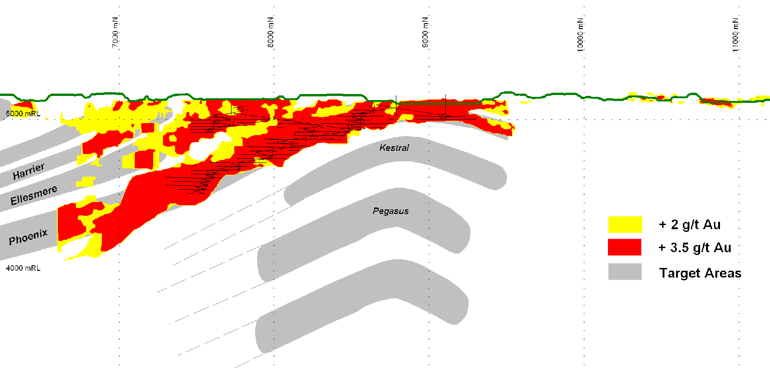
Central Resource Area
- Exploration Progress 2006
Identification of down-plunge extensions of known mineralisation
Consideration of structurally lower faults, i.e. Kestrel and Pegasus plus more.
Harrier
Ellesmere
Falcon
Hunts
? ? ?

Slide 25

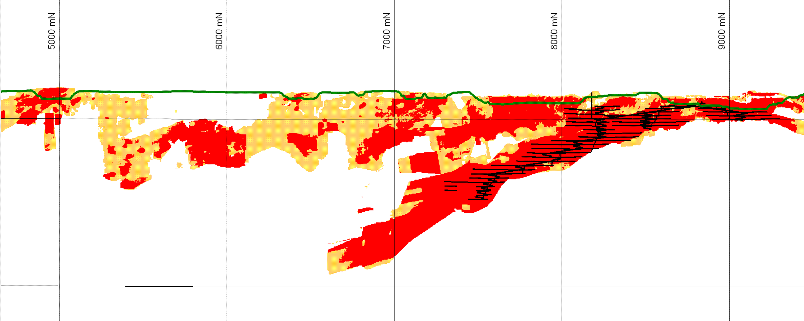
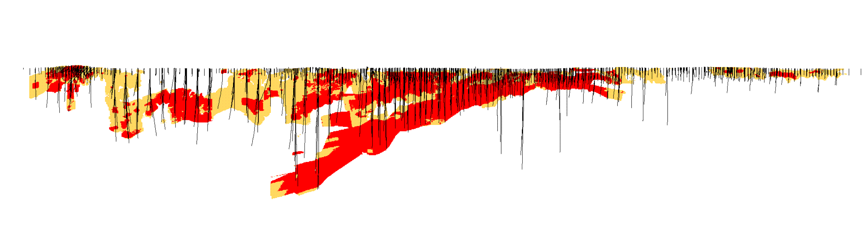
Fosterville Fault Zone
- Exploration Progress 2007
Daley’s Hill
Johns
Harrier
Ellesmere
Falcon
Harrier
Ellesmere
Kestrel
Phoenix
Pegasus
1km
8km
1-3 g/t Au
+ 3.0 g/t Au
Target Areas

Slide 26
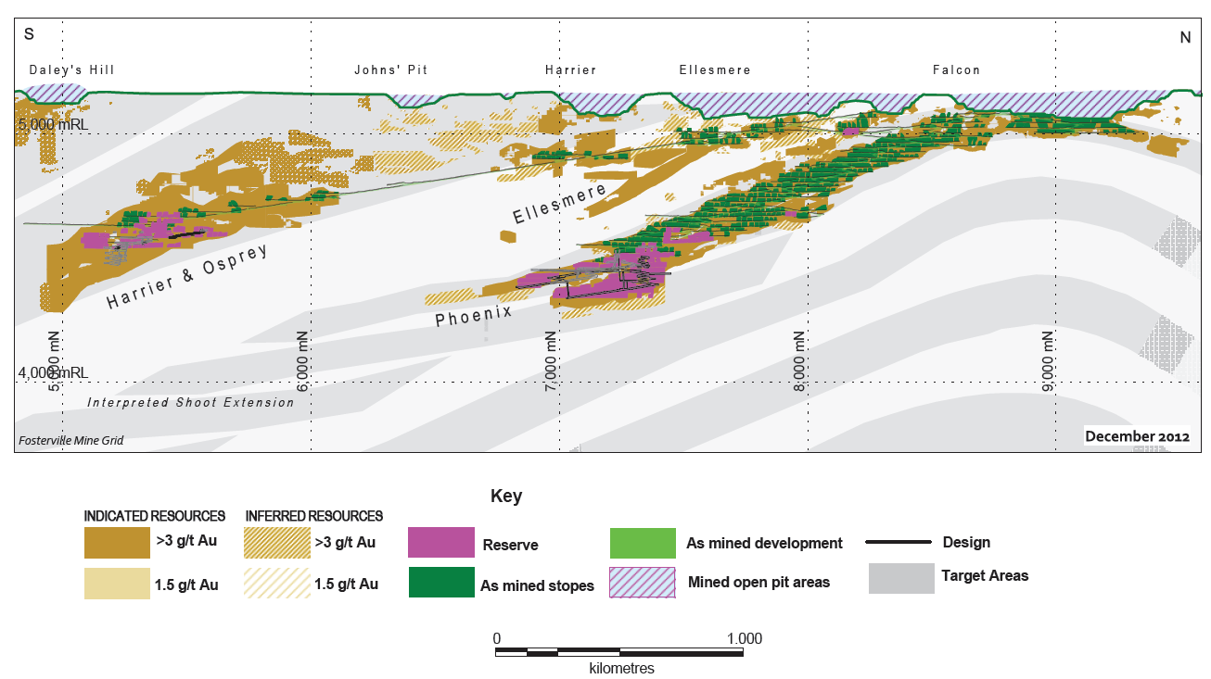
Fosterville Fault Zone
- Exploration Progress 2012
Notes:
2012 slide

Slide 27
Orebody Definition
One challenge early in the UG mine’s history was that the upper levels of Phoenix (above 5000mRL) – orebody was more discontinuous than indicated from surface drilling.
Definition Program was subsequently established:
  Phase 1 – 50m drill centres from surface or UG
  Phase 2 – 25m drill centres typically from hangingwall drill drives
  Phase 3 – Mapping, photographing and sampling of ore drives plus stope definition drilling from footwall drives/ore drives
Central concept is to have the right level of information in the right timeframe to allow for detailed mine planning and scheduling >> Phase 2 drilling needs to be a minimum of 12 months ahead of mining.

Slide 28
Resources & Reserves
Resource Methodology
  Construction of mineralised envelopes using a combination of structural, lithological and grade controls.
  Ordinary Kriging estimation.
  Modest nugget effects – relative variances of 20-40%
  Resource inventory is mostly 50-100mN x 50mE spaced drilling, which will be reduced to 25m or closer.
Resources (Measured, Indicated and Inferred) at end of 2012, exclusive of Reserves
  Above 100m depths: 7.3Mt @ 1.90g/t Au for 447koz contained gold
  Below 100m depths: 13.7Mt @ 5.36g/t Au for 1,092Koz contained gold
Reserves at end of 2012
  Proven + Probable = 1.7Mt @ 5.57g/t Au for 305Koz of contained gold.

Slide 29
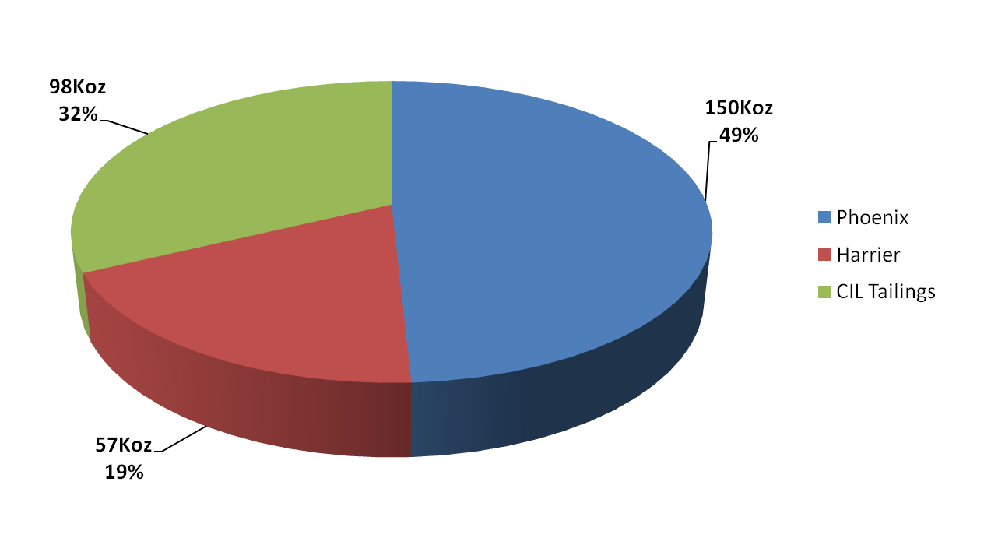
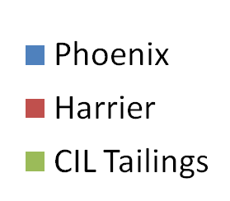
Orebody Reserve Statistics
Pie chart highlights the dominance of the Phoenix system (Phoenix, Benu, Raven and Robin), which still contains 49% of the reserve ounces.
Harrier contributes 19% of the reserve base and may grow in the future.
CIL Tailings (~9g/t Au) is growing and presently contributes 32% of reserve base.
Notes:
Dec 2010 slide:

Slide 30
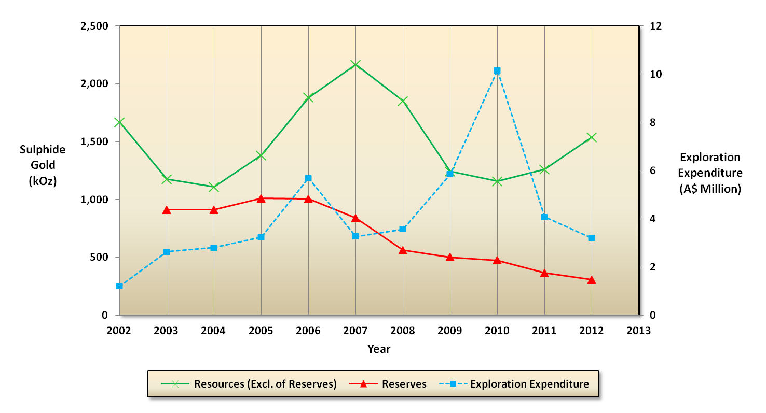
Resources & Reserves Over Time
Resource & Reserve Variations: Mining depletion, Cut-off grade & Discovery
Expenditure: Changing focus, Depth of targets, Surface/ UG Drill platforms

Slide 31
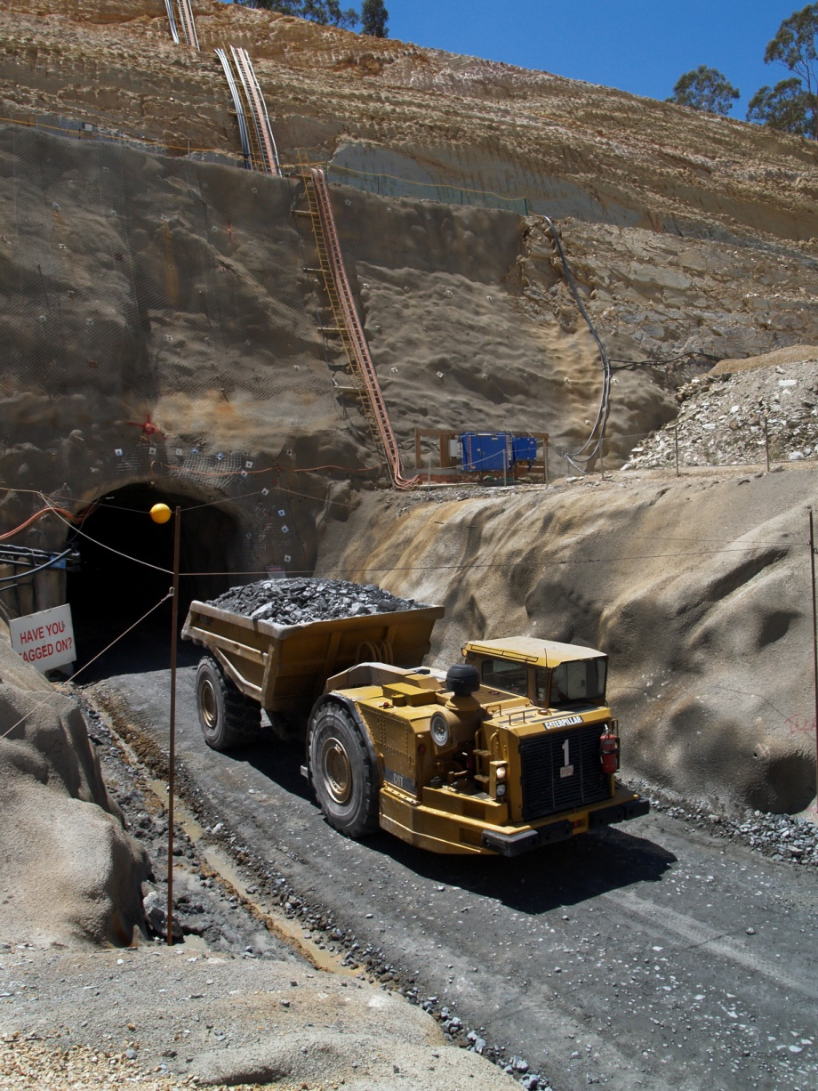
Mining
Decline/ramp access for all mine activities
Conventional underground mining methods – mainly transverse and longitudinal retreat open stoping.
Sublevel spacing of 20m, typical stope strike length of 15m.
  Combination of cemented rock fill and loose rock fill (with pillars) dependent on grade and geometry
Mine fleet consists of:
  Development drills (4)
  Production drills (2)
  Loaders (6)
  Trucks (5)
  Ancillary equipment

Slide 32
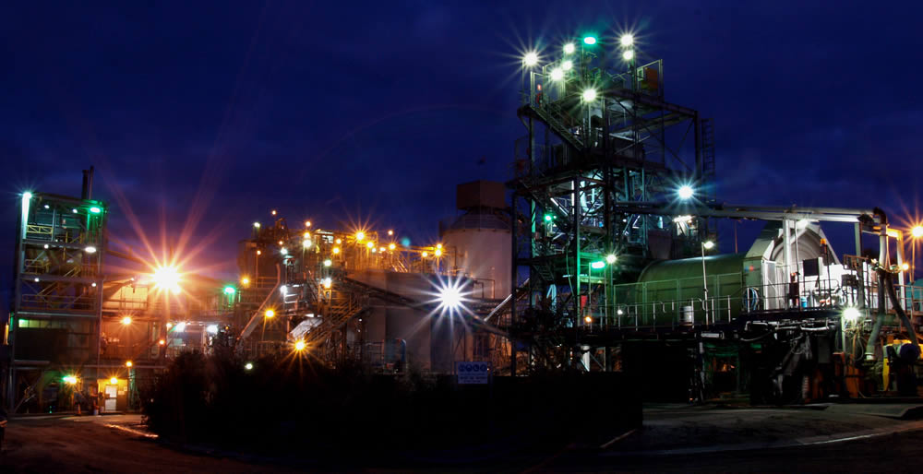
Processing
Processing flowsheet is relatively complex due to highly refractory ore
Circuit consists of:
  Crushing/grinding
  Flotation
  Bacterial oxidation (BIOX)
  CIL
  Heated Leach
  Elution circuit – gold room
Flotation tailings stored in :
Tailings dam &
In-pit tailings facilities (Hunts-Fosterville & O’Dwyer’s South Pit)

Slide 33
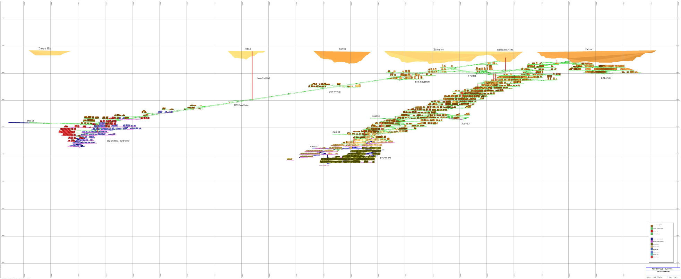
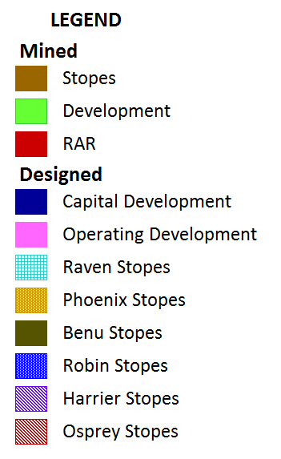
Current Operations
LOM plan extracts current reserve (1.7Mt @ 5.57g/t Au for 305koz) plus some assumed resource conversion over the next 4 years – at about 700ktpa milling rate (~90koz of gold).
UG development continues to advance to support bottom-up mining extraction.
4.8 km
SOUTH
Daley’s Hill
John’s
Harrier
Falcon
NORTH
Ellesmere
Ellesmere
Robin
Falcon
800 m
Vulture
Raven
Phoenix
Harrier/ Osprey
Benu

Slide 34
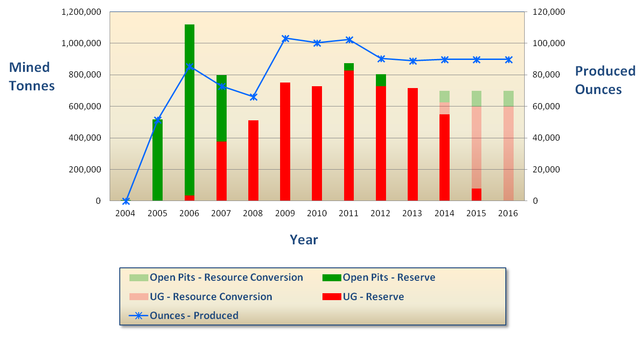
Production Profile & Life of Mine
Actual
Forecast

Slide 35
What’s Next
Mine Lease
  Orebody extension targeting and up/down plunge and down-dip for “Benu” like targets.
  Targetting structures below Phoenix (Kestrel and Pegasus) in Central Area as well as down-dip have associated gold and are close to existing development.
  Northern part of mine lease produced 50% of oxide ounces but has limited diamond drilling.
Regional
  Strong understanding of Fosterville-style controls will be invaluable for exploring along the Redesdale Fault Corridor.
  Acknowledgements To:
  All previous and current Fosterville Geologists and other technical disciplines for their contributions during Fosterville’s long history and varied corporate ownerships.

Slide 36
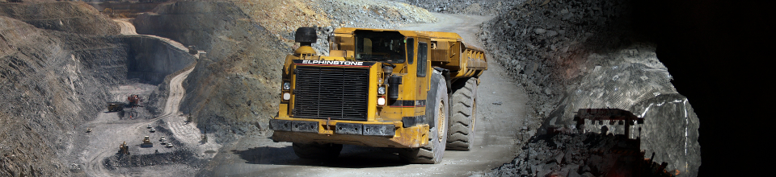
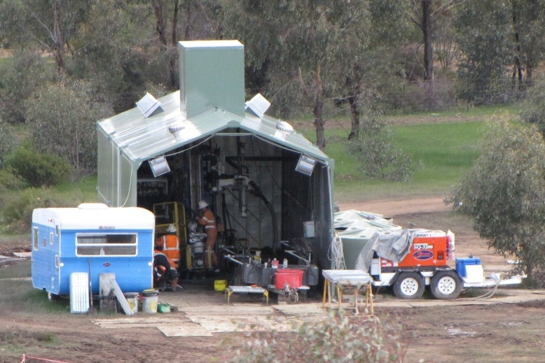


Thank You

