Slide 1
Exploration for breccia hosted gold deposits in north east Queensland
Nick Lisowiec¹, Gregg Morrison²
¹ Carpentaria Gold / Resolute Mining Ltd, Ravenswood, QLD
² Klondike Exploration Services, Townsville, QLD
Mines & Wines 2013

Slide 2
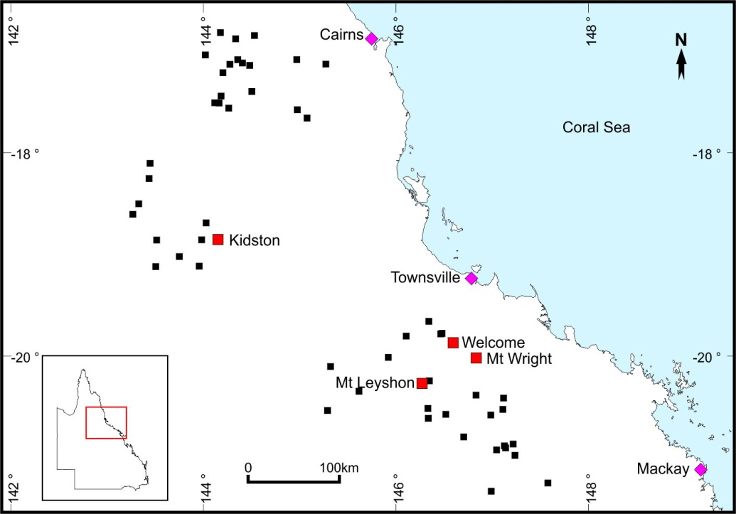
Introduction
Several significant Au deposits in NQ associated with hydrothermal/magmatic breccia pipes:
  Kidston (5Moz)
  Mt Leyshon (3Moz)
  Mt Wright (1Moz)
  Welcome (0.2Moz)
  Mungana (Au + BM)
Many other (>100) barren or weakly anomalous breccia systems identified.

Slide 3
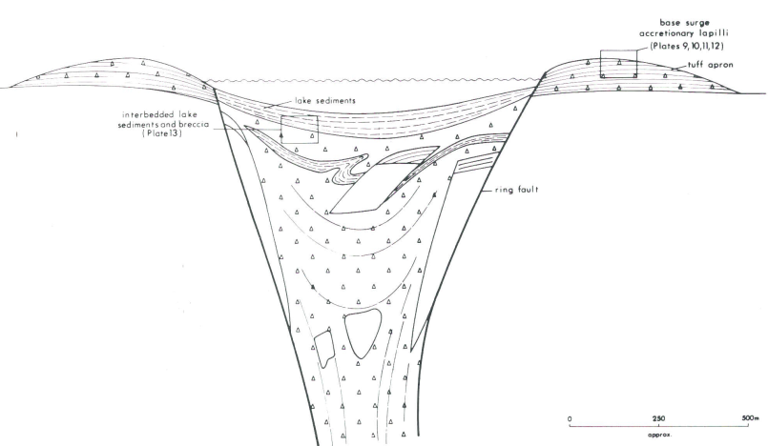
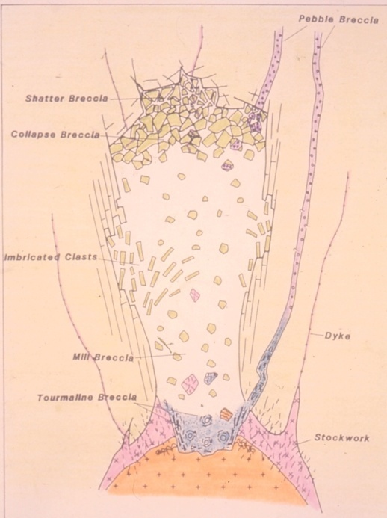
Background – Magmatic/Hydrothermal Breccias
  Maar / Diatreme / Volcanic complexes (e.g. Pueblo Viejo, D.R., Mt Success, QLD)
  Sub-volcanic Breccia Pipes
  (e.g. Kidston)
  Also fault related breccias with later hydrothermal/ magmatic input (e.g. Buck Reef, Ravenswood, QLD)
Mineralisation post-dates or less commonly synchronous with breccia formation.

Slide 4
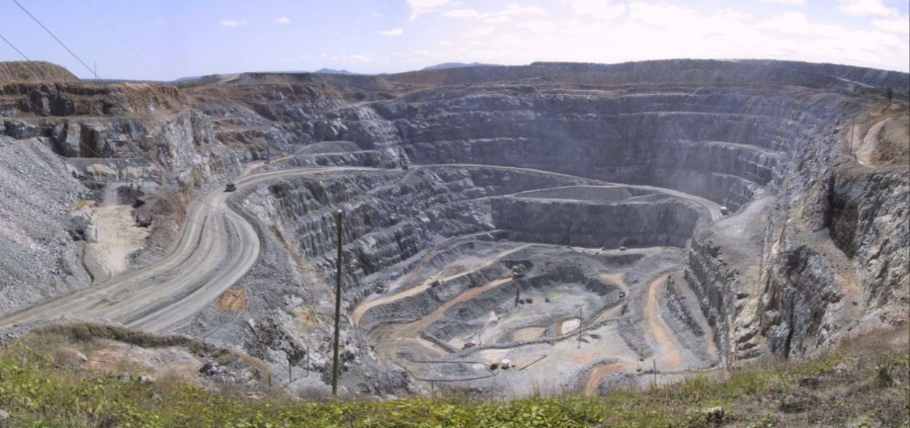
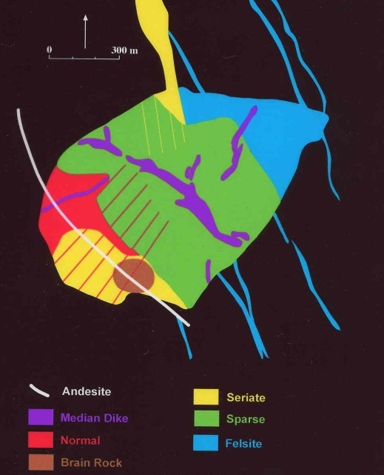
NQ Examples - Kidston
Discovered in early 1980’s
Mined from 1984-2000
5Moz total production
  80Mt @ 1.56g/t (Wises pit)
  29Mt @ 1.16g/t (Eldridge pit)
Hosted within 1100 x 900m breccia pipe – extends to at least 1300m deep.
Located adjacent to contact of middle Proterozoic Metamorphics and Sil-Dev. granodiorite.
Breccia related to intrusion of Carboniferous aged rhyolite dykes and plugs.
Eldridge Pit
Surface map

Slide 5
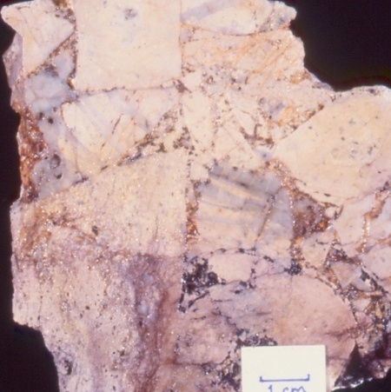
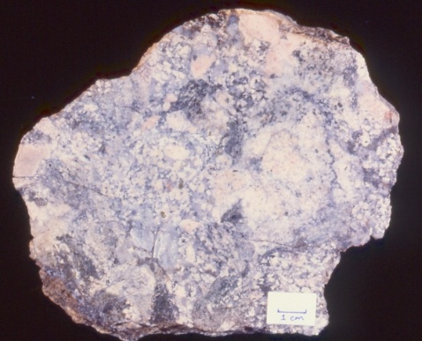
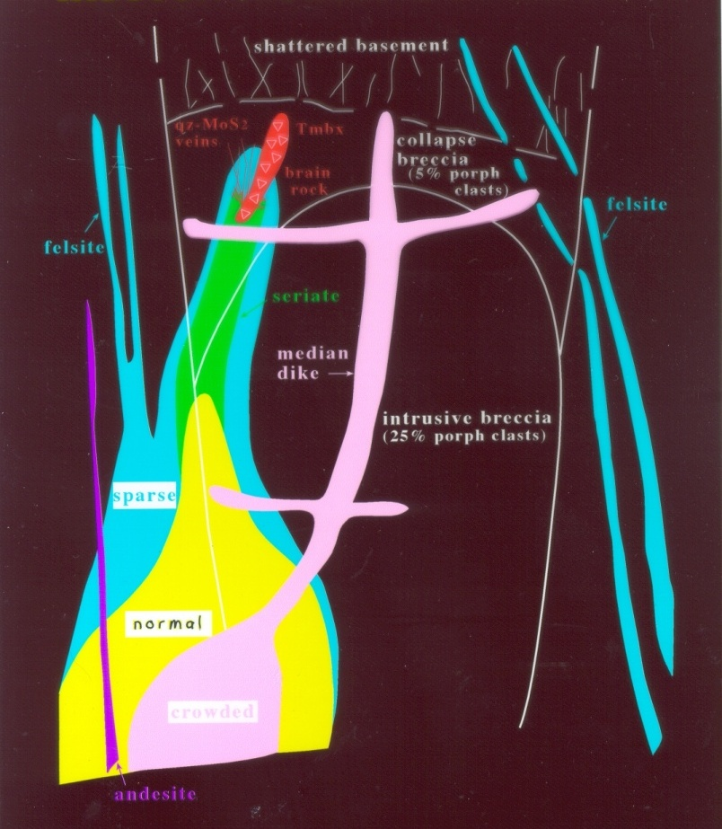
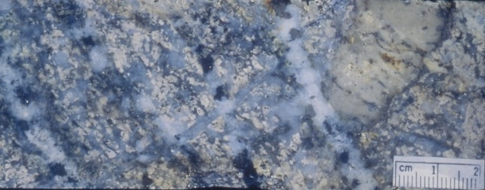
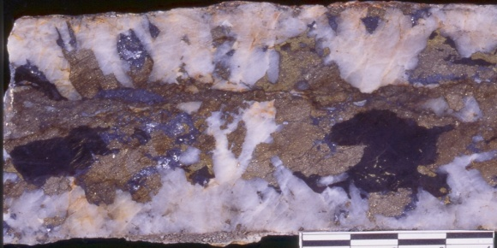
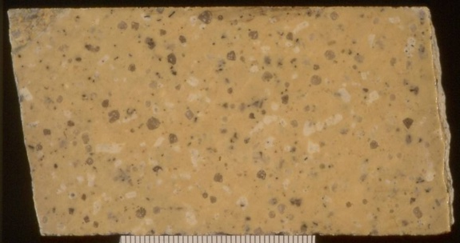
Kidston
Coarse BX
Fine BX
Sheeted veins
Sheeted veins
Median dyke

Slide 6
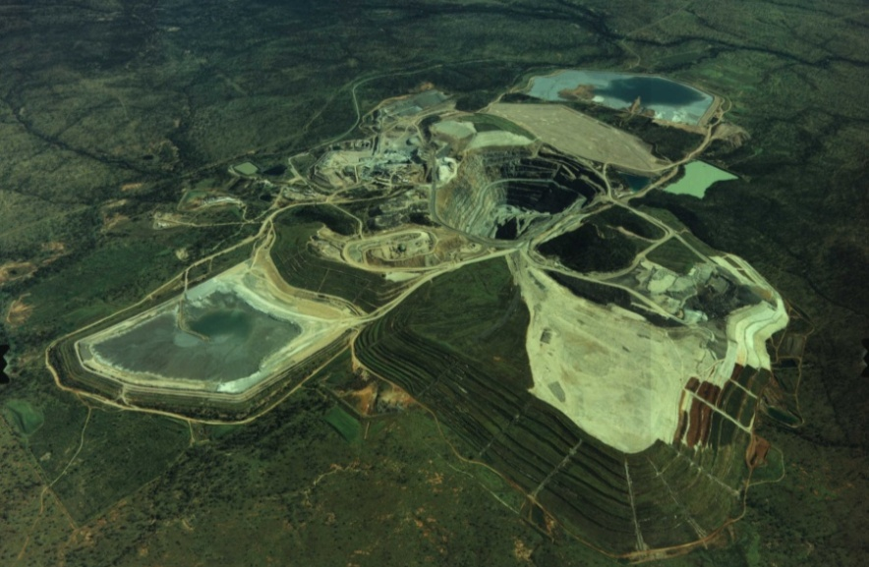
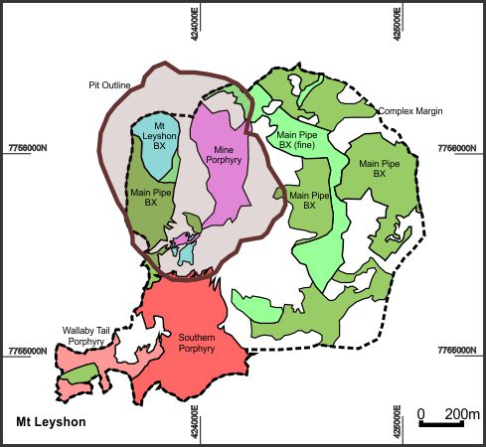
Mt Leyshon
Discovered in early 1980’s
Mined from 1987-2001
3Moz total production
  70Mt @ 1.43g/t
Occupies NW corner of 1.5km diameter breccia complex.
Located on contact between Cambrian meta-seds and Ordovician granite.
Breccia related to early dacite/rhyolite and late trachyte/trachy-andesite intrusions of Carboniferous-Permian age.
Surface map

Slide 7
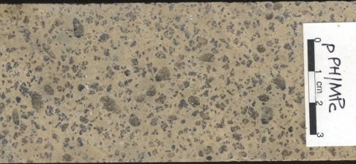
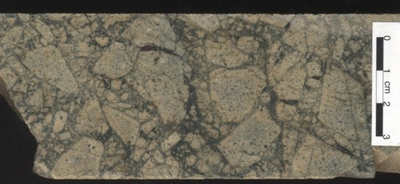
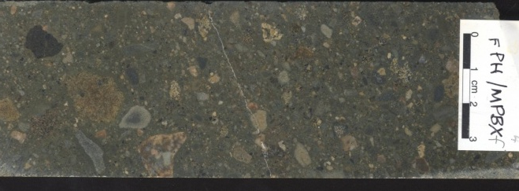
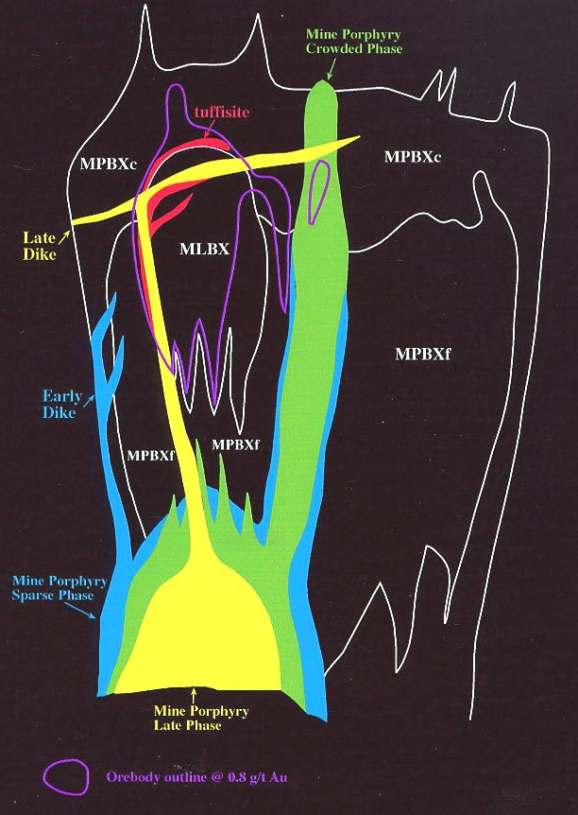
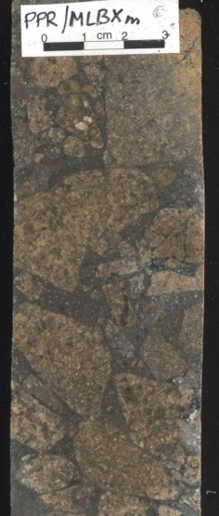
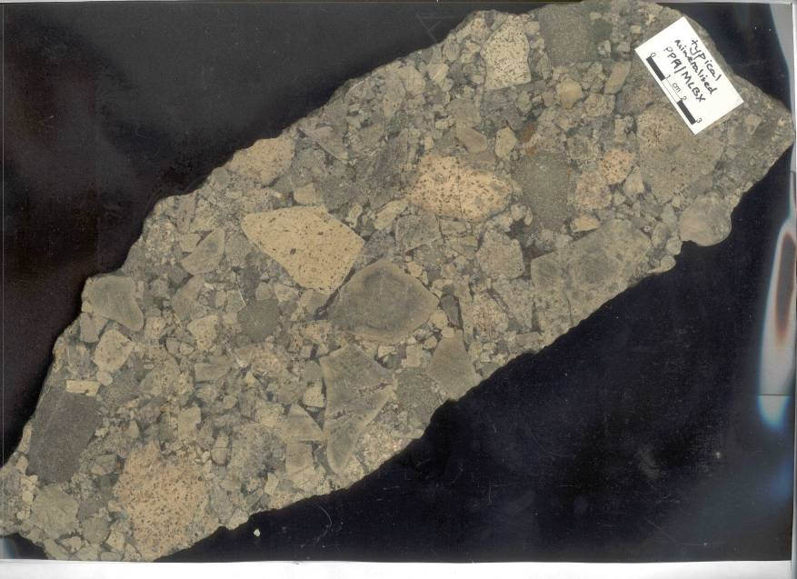
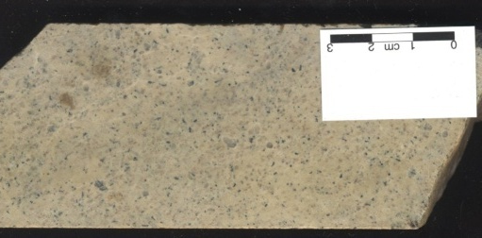
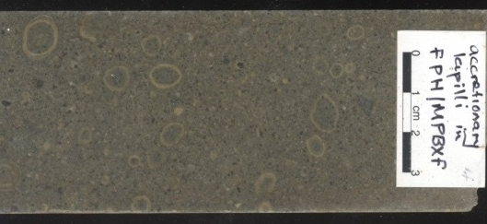
Mt Leyshon
Mine Porphyry
Main Pipe BX (coarse)
Main Pipe BX (fine)
Mt Leyshon BX (mineralised)
Late Dyke (Trachyte)
Tuffisite

Slide 8
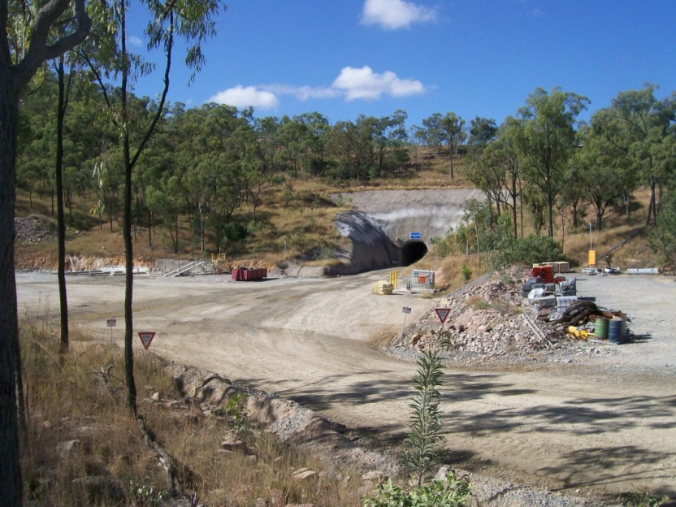
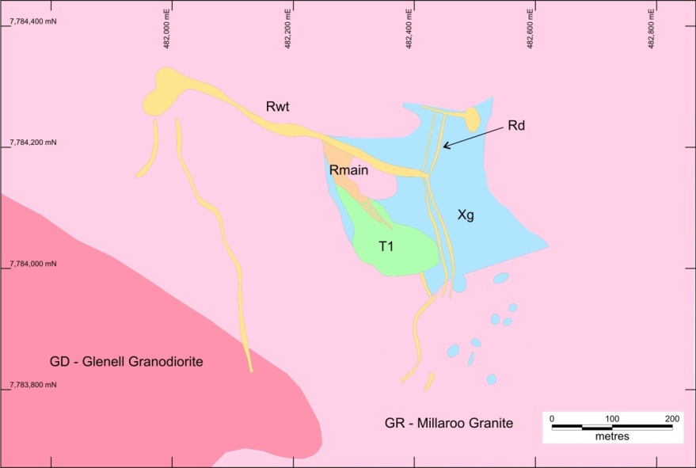
Mt Wright
Discovered in 1992 (main lode).
Mined from 2006-present (by RML).
1Moz total endowment
  5.6Mt @ 2.8g/t - 510koz (production to date)*
  3.3Mt @ 2.8g/t (Reserves)*
  1.7Mt @ 3.1g/t (Resources)*
Occupies SW portion of 300 x 300m breccia complex, extends to at least 1200m deep.
Located within Ravenswood Batholith near contact of Ordovician granite and granodiorite.
Surface map
* As of 30 June 2013

Slide 9
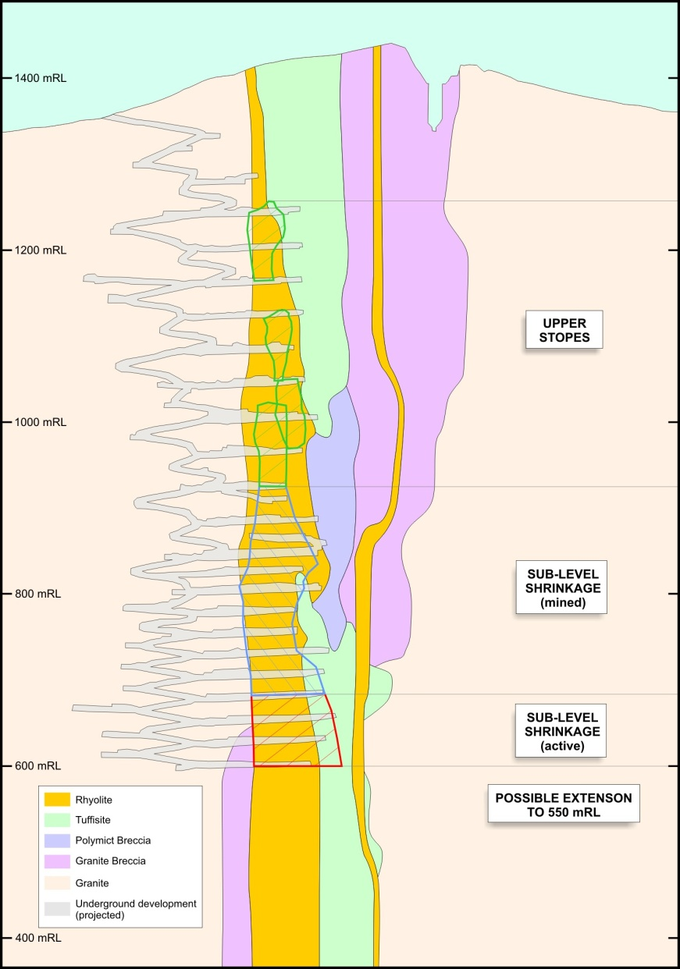
Mt Wright
Top of orebody approx 150m below the surface.
Upper levels mined by sub-level stoping.
Currently mined by sub-level shrinkage (caving) with continuous fill.
Current depth of mining approximately 700m below surface on 3 production levels.
141,846oz produced in 12/13 @ cash cost of $760/oz (AISC = $1,079/oz).
Exploration drilling ongoing.

Slide 10
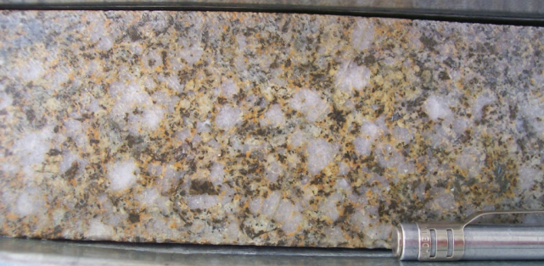
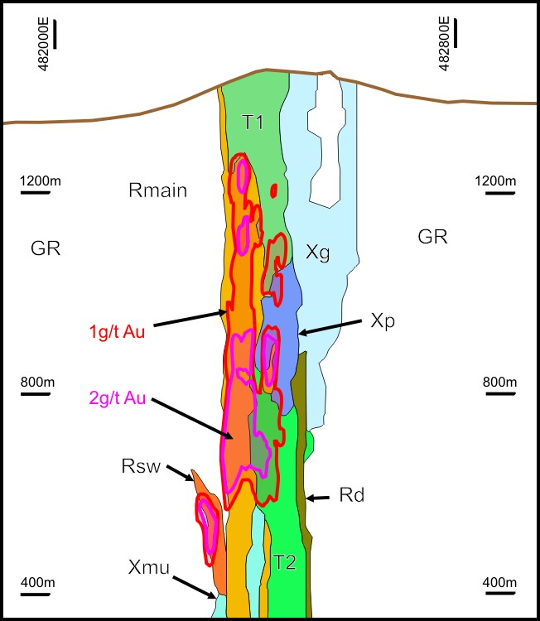
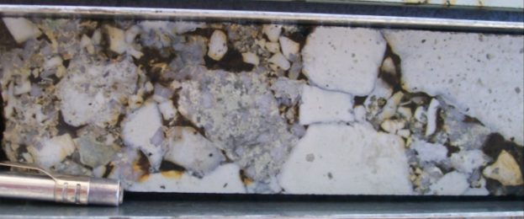
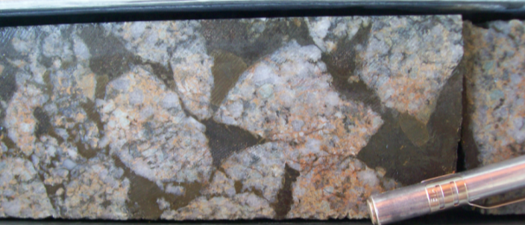
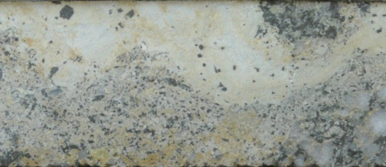
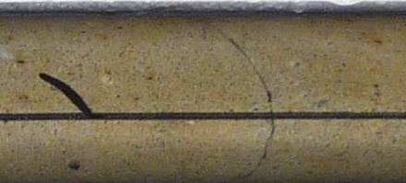
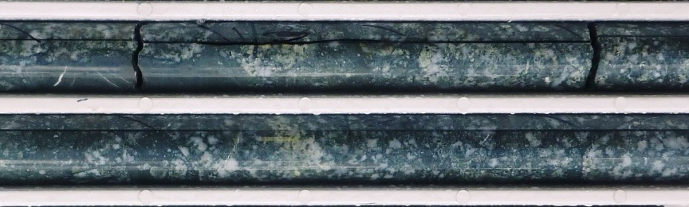
Mt Wright
Granite “mush” BX
Polymict BX
Granite BX (cavity fill)
Tuffisite w/ rhyolite BX
Tuffisite*
Granite “mush”
(deep)
*Tuffisite: Intrusive/hydrothermal units with
tuff appearance (ash-matrix, lapilli-sized clasts etc)

Slide 11
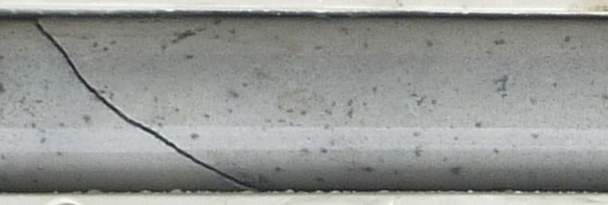
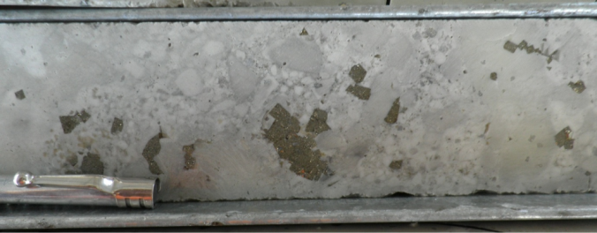
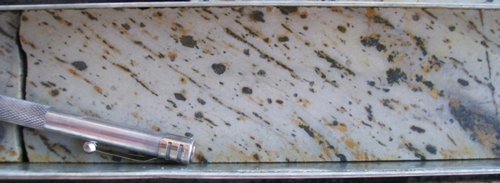
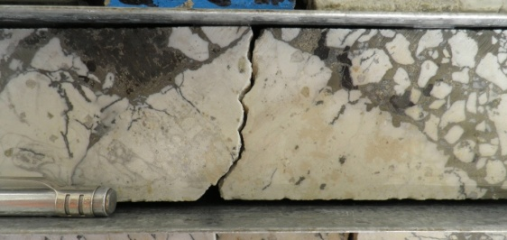
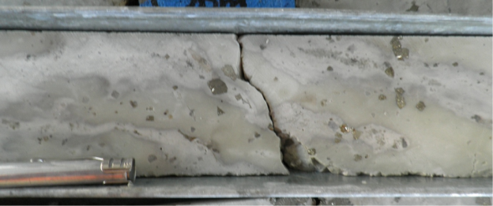
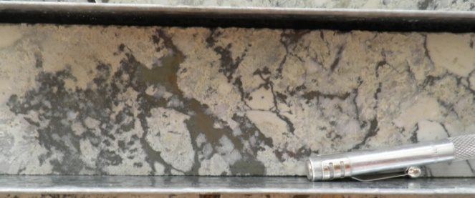
Mt Wright
Rhyolites – Core to Margin
Rhyolite Breccias
RM: Massive Rhyolite
RB: Rhyolite “Blobby BX”
auto-breccia in plastic rhyolite intrusions
RF: Flow Banded Rhyolite
RY: “Yoghurt Textured” Rhyolite
(Highly contorted flow banding)
RX: Rhyolite BX
Hydrothermal

Slide 12
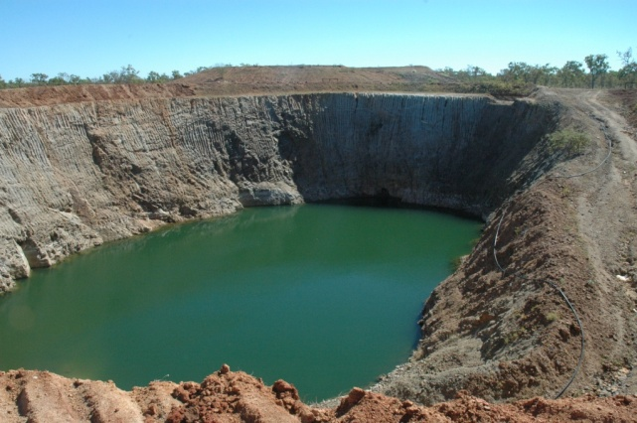
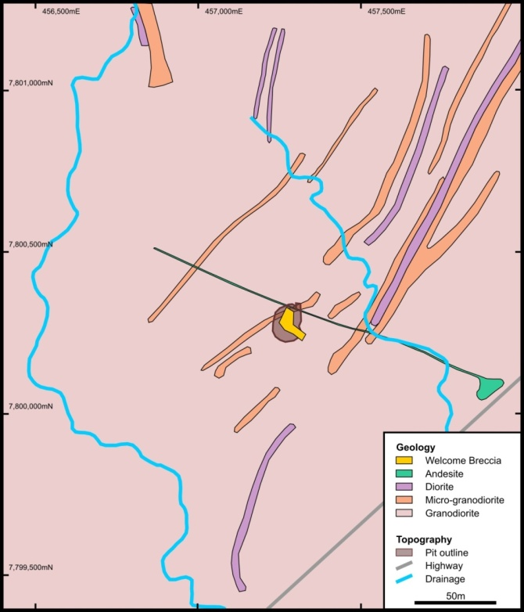
Welcome
First drilled in 1950’s – initial resource outlined in 1980’s.
  Au grade decreased below 50m depth.
  No drilling below 100m.
Mined in 1994.
  65,208t @ 1.87g/t Au (3,915oz).
RML signed JV with previous holder in 2009 and commenced three hole diamond drilling program.
Third hole (WED003):
  113m @ 7.7g/t Au from 316m.
Current Resource (inferred):
  2.04Mt @ 3.2g/t (210,000oz).
Scoping study completed in 2011.

Slide 13
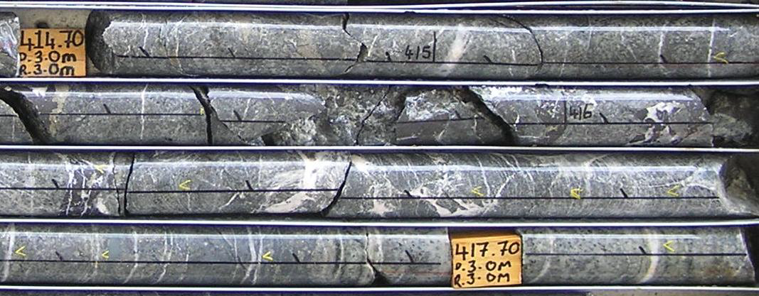
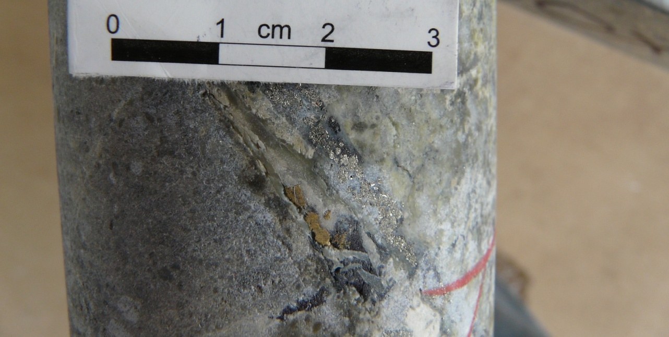
Welcome
Breccia pipe is only 50 x 20m across, but at least 600m deep.
Hosted in Ordovician granodiorite.
Breccia probably related to early faulting then intrusion of diorite / andesite – possibly in Devonian.
Mineralisation hosted in both breccia and vein array outside of pipe.
Mineralisation age still inconclusive.
Au

Slide 14
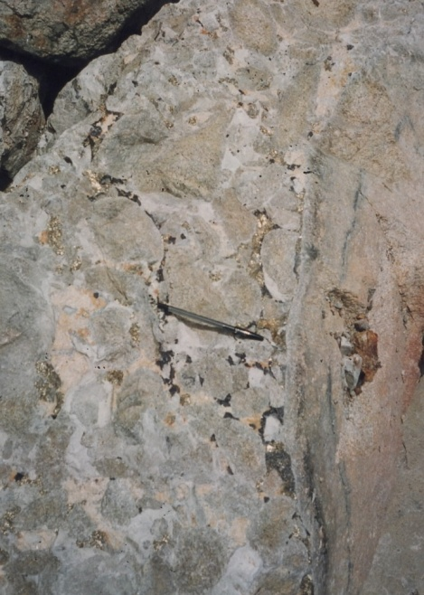
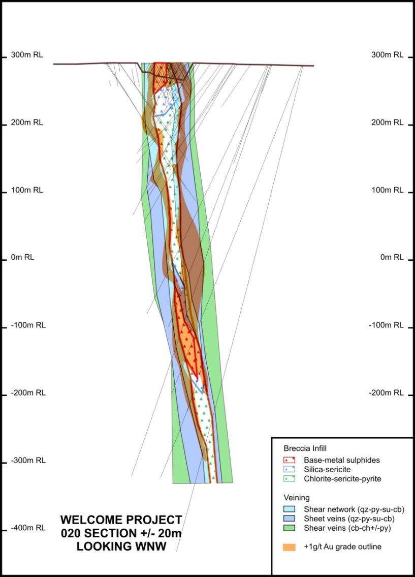
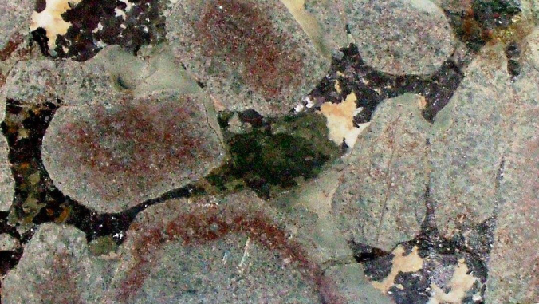
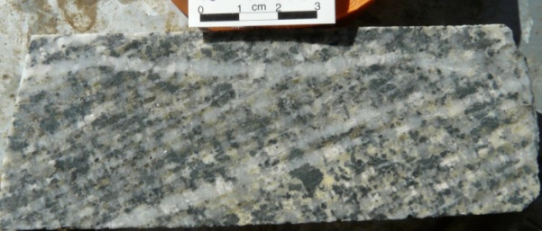
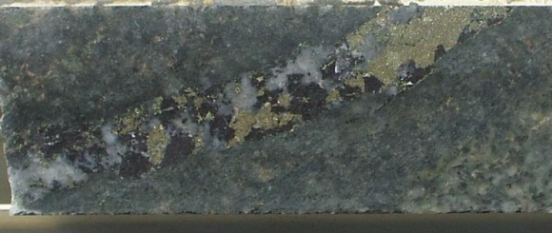
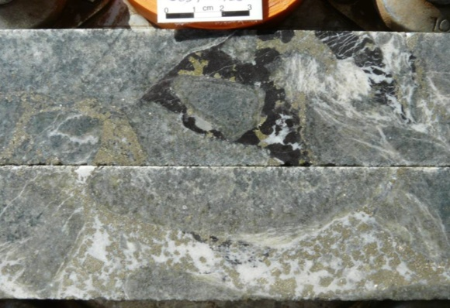
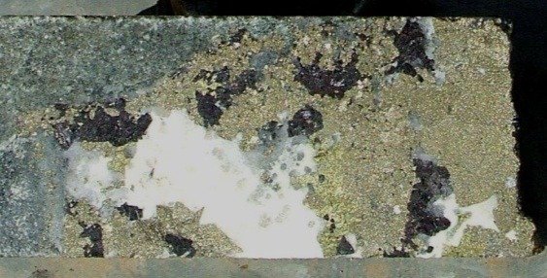
Welcome
10cm
Contact between
BX and GD
Breccias from pit
Sheeted veins
Deep breccias

Slide 15
Exploration Model for Breccia Hosted Au
Mineralised portions of the all the breccia complexes described was discovered and mined historically.
However, the main orebody is often offset or within a different part of the complex (e.g. Mt Wright) and/or deeper (e.g. Welcome).
As breccia-hosted systems have been a popular exploration target since the 1980’s numerous systems have been found – however few have turned into deposits.
Despite numerous differences, certain characteristics of the known breccia-hosted Au deposits in NQ, can be used as an exploration model for potentially mineralised systems.
This exploration model includes both early reconnaissance and advanced stage techniques.

Slide 16
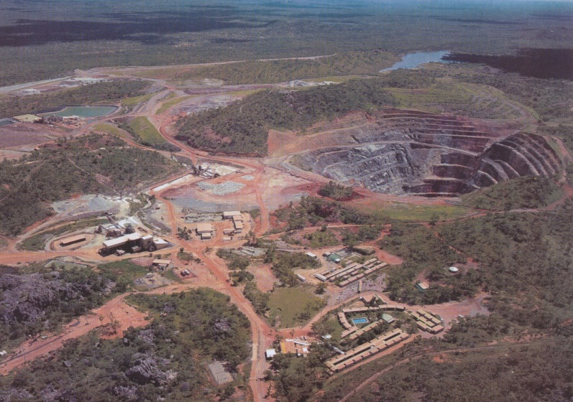
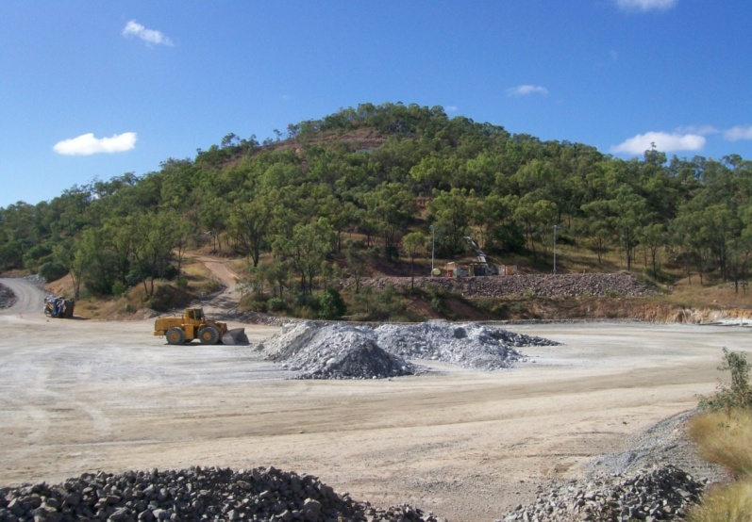

1. Topography
Kidston, Mt Leyshon and Mt Wright are/were distinct topographic highs.
Hydrothermal quartz alteration.
Airborne recon surveys in 80s-90s, identified numerous systems.
No good in areas of late cover – ambiguous if roof of system still buried (possible depression)?
Kidston – Eldridge Pit
Mt Wright
Seventy Mile Mount - Mt Leyshon corridor

Slide 17

2. Magnetics
Magnetic anomalies can be variable.
Ore stage alteration usually mag. destructive.
Complicated by other features such as:
  Intrusive plugs / dykes
  Pyrrhotite (or magnetite) mineralisation
  Low primary susceptibility of host
Mount Leyshon:
  Strong reverse polarised feature immediately south of deposit
  Related to bt-mt alteration/hornfels associated with southern porphyry
  Feature not directly related to mineralisation stage
Kidston:
  No obvious magnetic feature (at regional scale)
  Felsic intrusions in felsic host.
5km

Slide 18

2. Magnetics
Mount Wright:
  Strong reverse polarised feature
  Poorly understood.
  Could be related to dolerite dykes or early, high T potassic alteration (typically deeper in complex).
Welcome
  Demagnetised zone associated with sericite alteration with pipe.
  Too small to identify at regional scale.
2.5km

Slide 19


3. Orebody Relative to Breccia System
Orebody is often only a small percentage of the overall breccia system.
Important not to dismiss a system, just because the “exposed” part is not mineralised.
Use other criteria to assess...
Mt Leyshon
Mt Wright

Slide 20




4. Preferred Host - Breccia Facies
Mineralisation fluid typically postdates formation of breccia.
Clast supported breccia better host – more open space.
Matrix supported often relatively impermeable.
Mineralisation can also be controlled by cross-cutting structures – can be combination of breccia cavity and vein fill.
vs
Matrix supported BX (Mt Leyshon)
Clast supported BX
(Mt Leyshon)
Veins overprinting BX
(Mt Leyshon)

Slide 21


5. Pressure Release and Trap
Kidston
Breccias can be efficient fluid pathways.
Still need trap and mechanism for fluids to precipitate.
Controls (concentrates) grade.
Roof of breccia acted as trap at Kidston and Mt Leyshon.
Fluids precipitated via decompression boiling – result of gravitational collapse and/or magma retreat.
Clast supported BX
Roof (trap)
Matrix supported BX
Pressure release ->
Decompression boiling

Slide 22


5. Pressure Release and Trap
The Mt Wright rhyolite breccia is gradational towards the surface – no evidence of roof.
Fluids mostly confined to channel-way.
Ore probably precipitated via dispersion and cooling.
Could have been higher grades if trapped?
Welcome has deep high grade breccia trapped by silicified breccia “roof”. Also dispersion of fluids into veins.
~1g/t Au (veins)
< 0.5g/t Au (BX)
> 5g/t Au (BX)
Mt Wright
Welcome (Deep)

Slide 23


6. Geochemistry – Metal Zoning
Mt Leyshon
Kidston
Mt Wright
All intrusion-related systems are zoned.
Multi-element geochemistry important tool to vector towards potential ore.
Effect of dispersion (e.g. Mt Wright vs Mt Leyshon)

Slide 24
Conclusion
Breccia hosted deposits are an important sub-class of intrusion related Au systems in NQ.
Potential for world class deposits.
Important to not get too focused on the breccias themselves and look at the whole magmatic-hydrothermal system.
Possible that the breccia system hosting the next major discovery has already been located – just not yet adequately tested.

Slide 25
Thank you
DISCLAIMER
This presentation includes certain statements, estimates and projections with respect to the future performances of Resolute Mining. Such statements, estimates and projections reflect various assumptions concerning anticipated results, which assumptions may prove not to be correct. The projections are merely estimates by Resolute Mining, of the anticipated future performance of Resolute Mining’s business based on interpretations of existing circumstances, and factual information and certain assumptions of economic results, which may prove to be incorrect. Such projections and estimates are not necessarily indicative of future performance, which may be significantly less favourable than as reflected herein. Accordingly, no representations are made as to the fairness, accuracy, correctness or completeness of the information contained in this presentation including estimates or projections and such statements, estimates and projections should not be relied upon as indicative of future value, or as a guarantee of value of future results. This presentation does not constitute an offer, invitation or recommendation to subscribe for or purchase securities in Resolute Mining Limited.
The information in this report that relates to the Exploration Results, Mineral Resources and Ore Reserves is based on information compiled by Mr Richard Bray who is a Registered Professional Geologist with the Australian Institute of Geoscientists and Mr Iain Wearing, a member of The Australian Institute of Mining and Metallurgy. Mr Richard Bray and Mr Iain Wearing both have more than 5 years’ experience relevant to the styles of mineralisation and type of deposit under consideration and to the activity which they are undertaking to qualify as a Competent Person, as defined in the 2004 Edition of the "Australasian Code for Reporting of Exploration Results, Mineral Resources and Ore Reserves". Mr Richard Bray and Mr Iain Wearing are full time employees of Resolute Mining Limited Group and have consented to the inclusion of the matters in this report based on their information in the form and context in which it appears. All Reserves Resources as at 30 June 2013
In providing this presentation, Resolute Mining has not considered the objectives, financial position or the needs of the recipient. The recipient should obtain and rely on its own financial advice from its tax legal accounting and other professional advisers in respect of the recipients objectives financial position and needs. To the maximum extent permitted by law neither Resolute Mining nor its related corporations ,directors, employees or agents nor any other person accepts liability for any loss arising from the use of this presentation or its contents or otherwise arising in connection with it. You represent and confirm by attending and or retaining this presentation that you accept the above conditions.
rml.com.au

