Slide 1
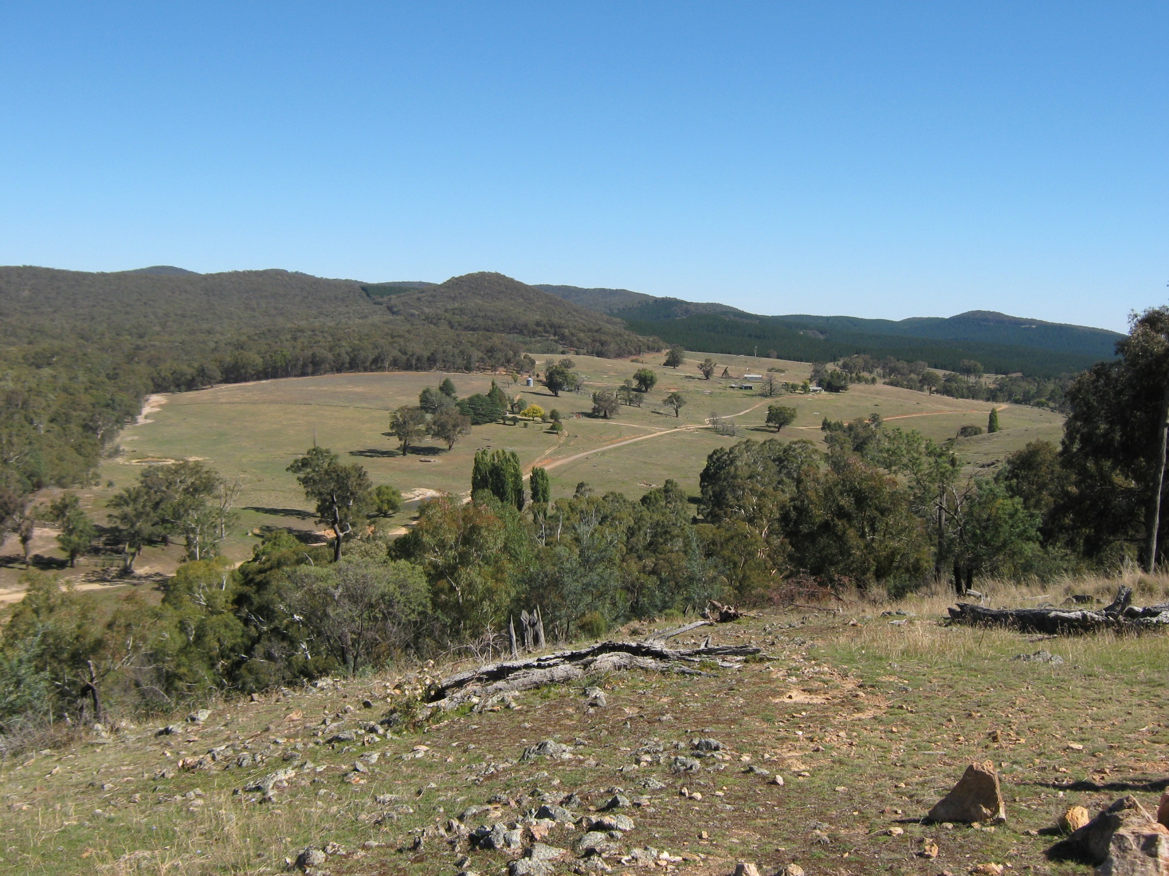
GEOLOGY OF KEMPFIELD SILVER-BARITE AND BASE METAL (Pb-Zn) VOLCANOGENIC MASSIVE SULPHIDE DEPOSIT (VMS), LACHLAN OROGEN, EASTERN AUSTRALIA
Vladimir David
Argent Minerals Ltd
“The Lodge”
Argent field office
BJ Zone
McCarron Zone
Quarries Zone

Slide 2
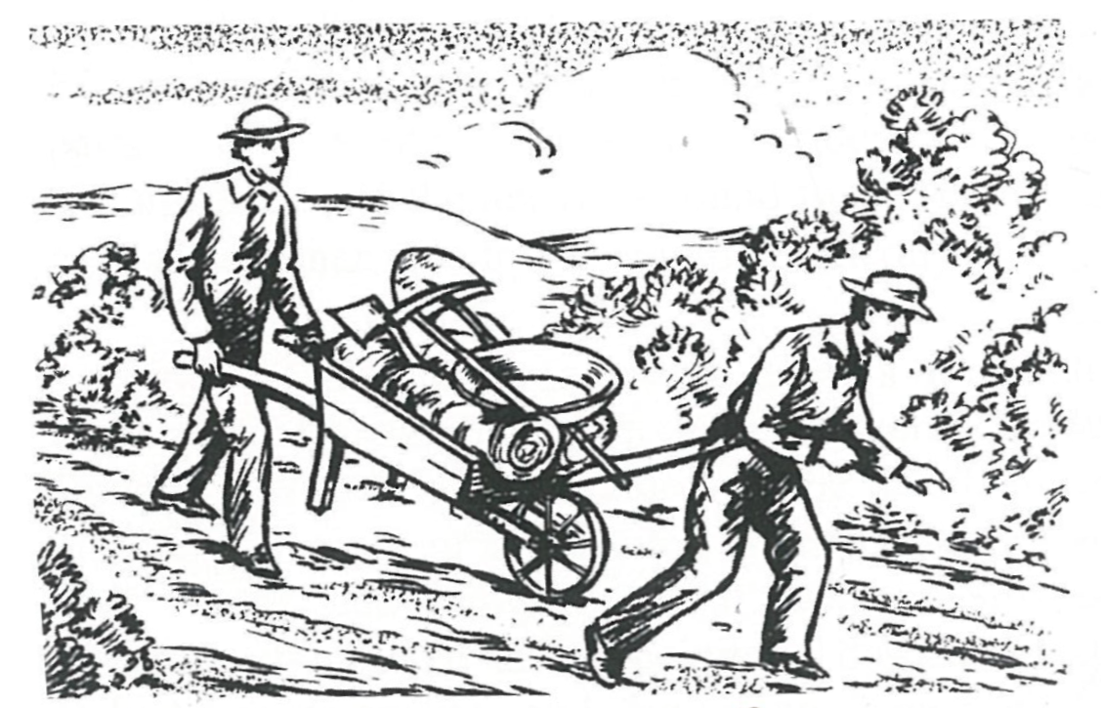
History of mining
Gold in Trunkey region (Abercrombie River) was found 1851 by E Hardgrave;
Gold mining started soon after and town of Trunkey was established 1869 under name Arthur (after Joe Arthur), mining lasted for several decades;
Town change name to Trunkey in 1988 inspired by a prospector with a particularly large nose;
Imperial Herald, 1898

Slide 3
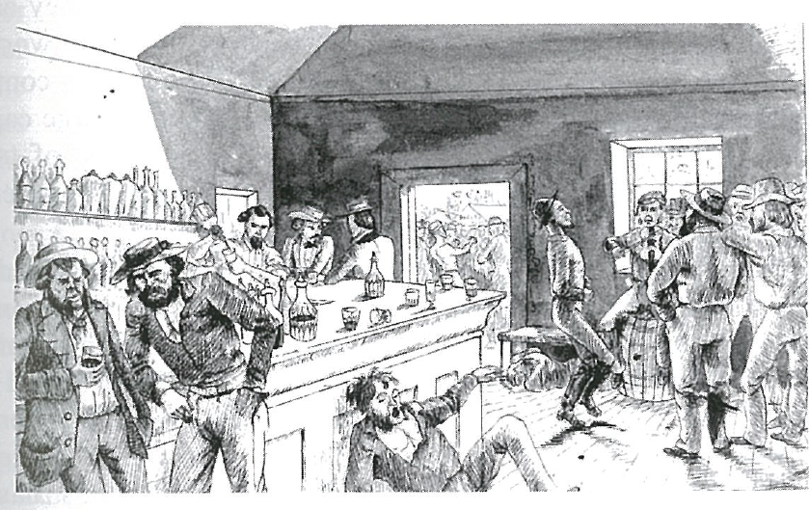
History of exploration
McIntyre Mines (Australia) Pty Ltd (1970-1971);
International Nickel Australia Ltd (1972 – 1975);
The Shell Company of Australia Ltd (1979 – 1983);
Jones Mining Ltd (1984 – 1985);
Golden Cross Resources (1988 – 2004); and
Argent Minerals Limited (2007 – recent).
Imperial Herald, 1898
Mineral Potential Prospectivity and Risk Analysis Workshop – Black Stamp Pub venue

Slide 4
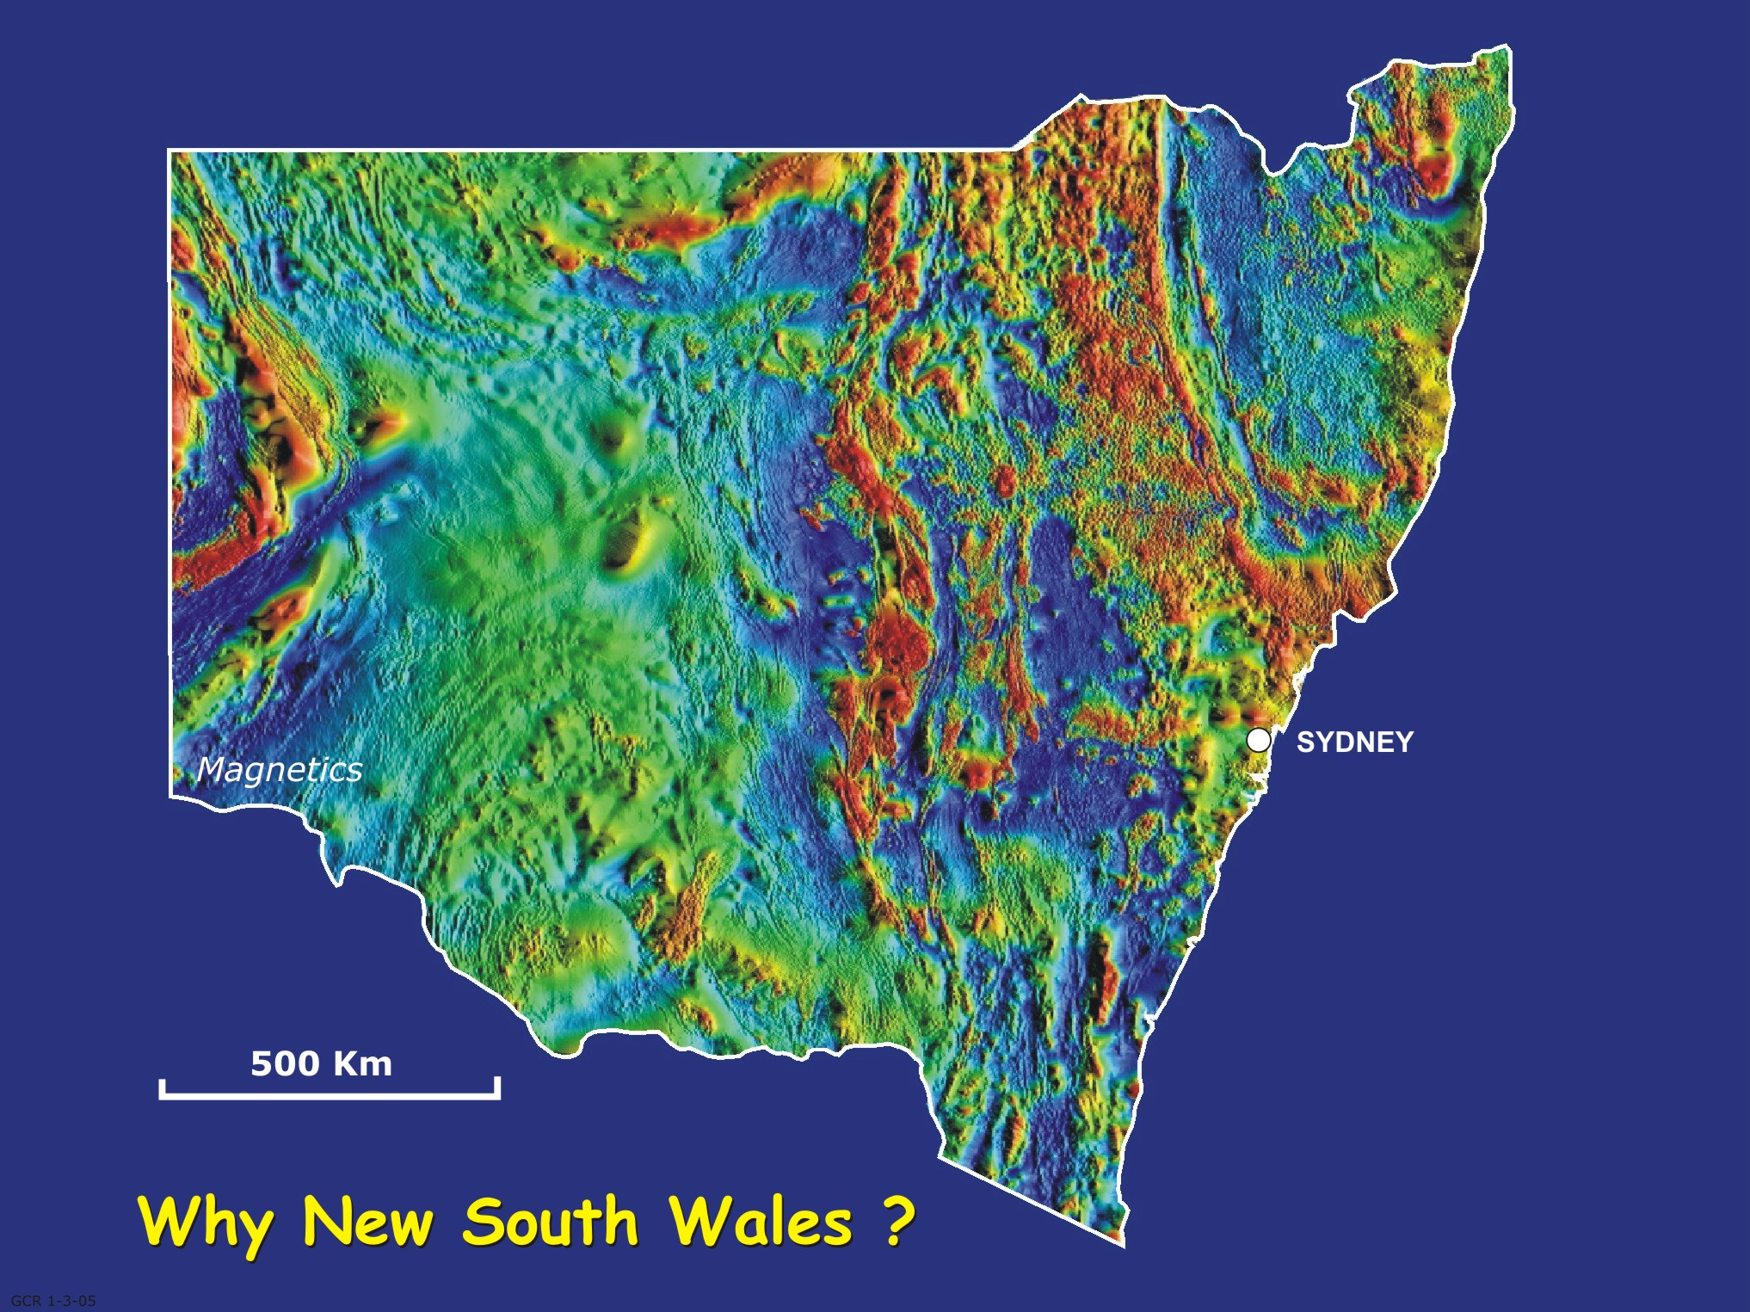
Geological setting
THOMSON OROGEN
NEW ENGLAND
OROGEN
SYDNEY – BOWEN
BASIN
CURNAMONA
PROVINCE
LACHLAN OROGEN
HET
Kempfield
WESTERN AND SOUTHWESTERN BELT
CENTRAL BELT
EASTERN BELT
TMI image

Slide 5
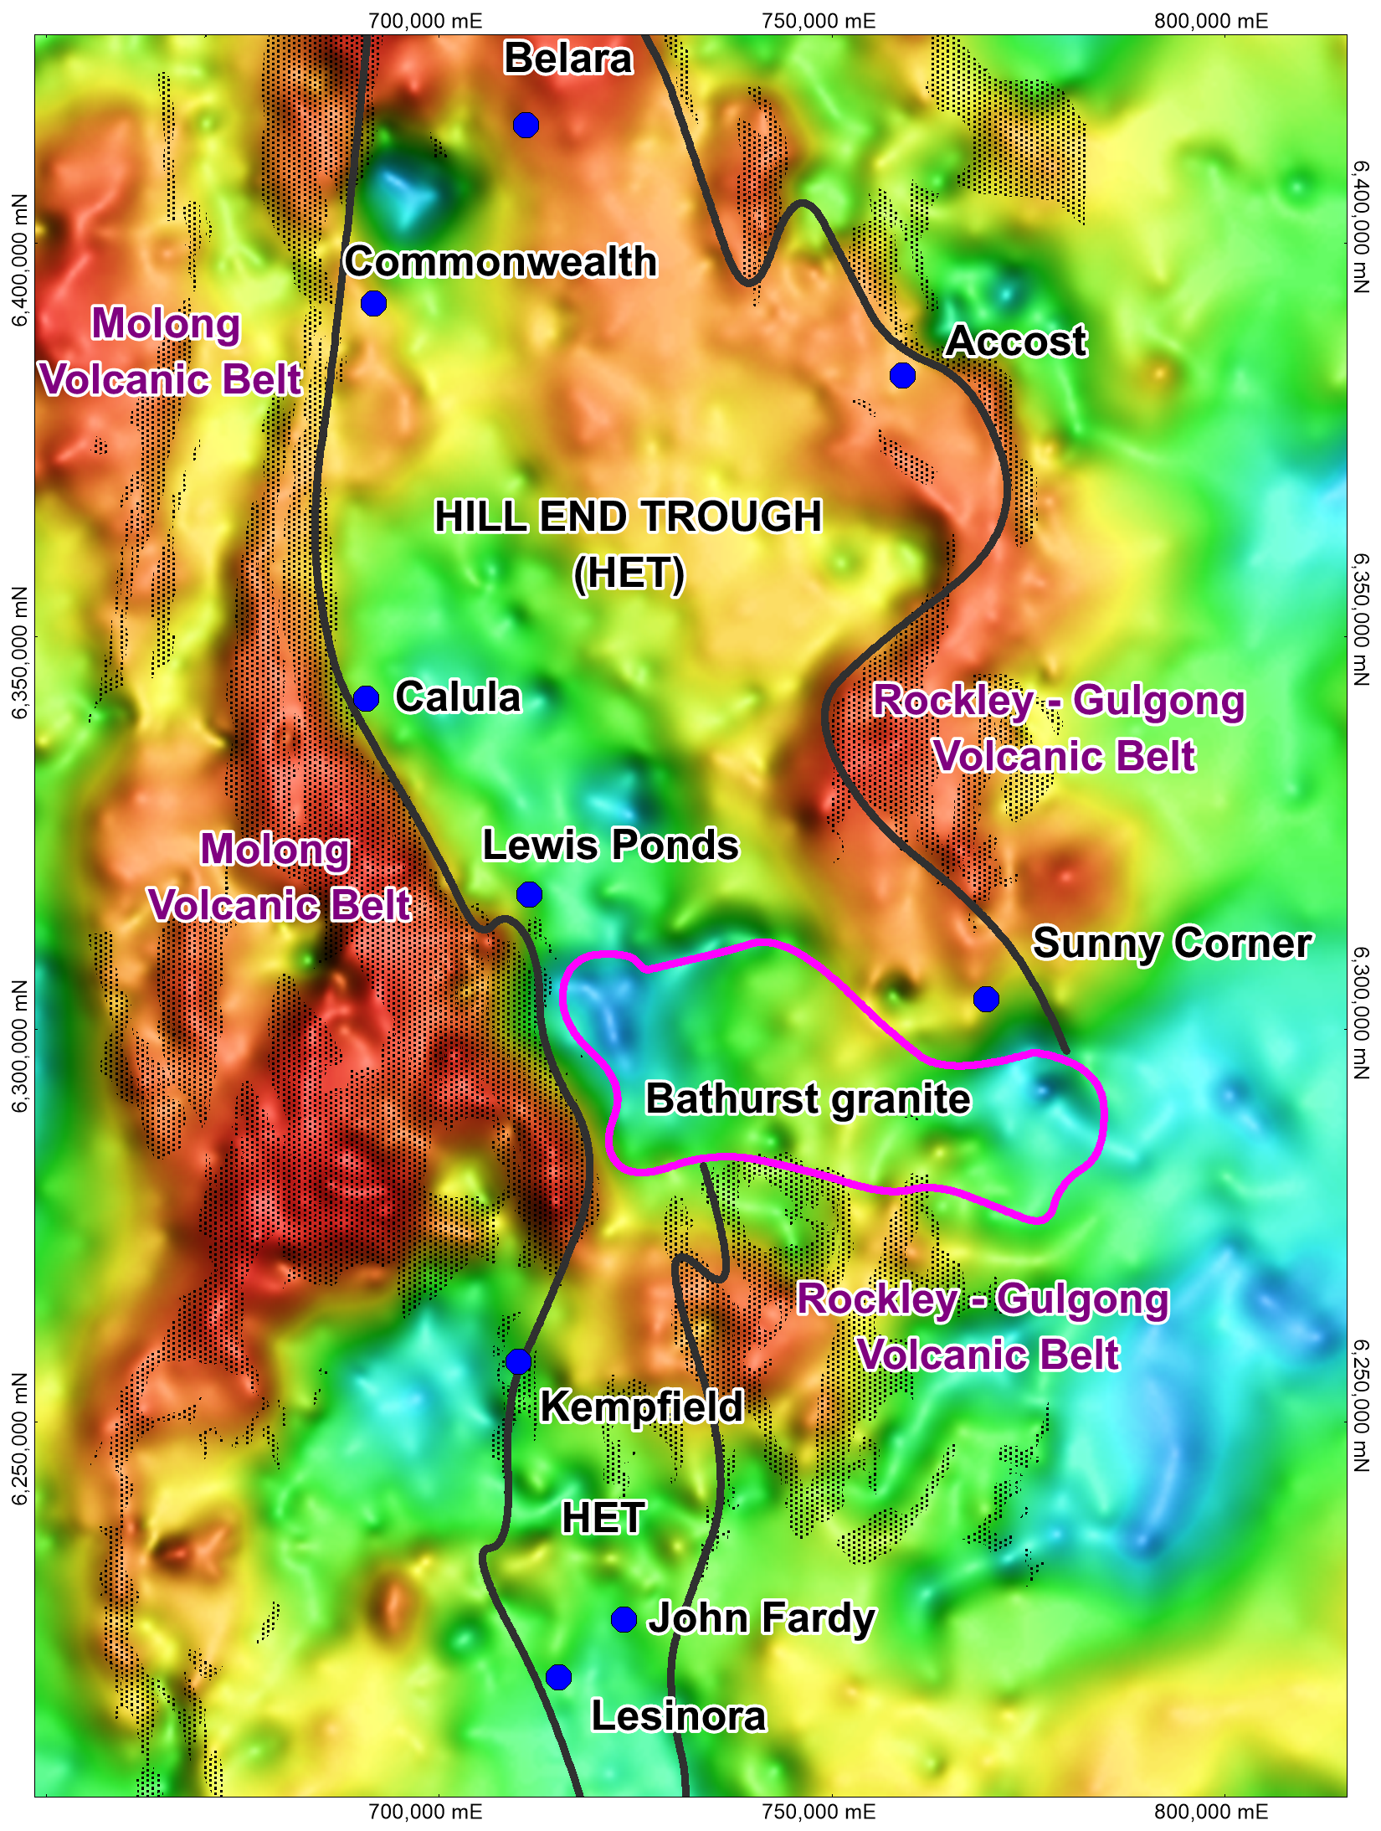
Hill End Trough
VMS deposits in
Hill End Trough
Resources
Deposit
Kempfield
Lewis Ponds
Sunny Corner
Commonwealth
21Mt @ 47g/t Ag, 0.12g/t Au and 1.92% Pb+Zn
6.35Mt @ 1.5g/t Au, 0.2% Cu, 68g/t Ag and 3.6% Pb+Zn
1.5Mt @ 0.3 g/t Au, 0.4% Cu, 24g/t Ag and 5.8% Pb+Zn
0.1Mt @ 6 g/t Au, 0.5% Cu; 250g/t Ag and 13% Pb+Zn
Bouger gravity

Slide 6
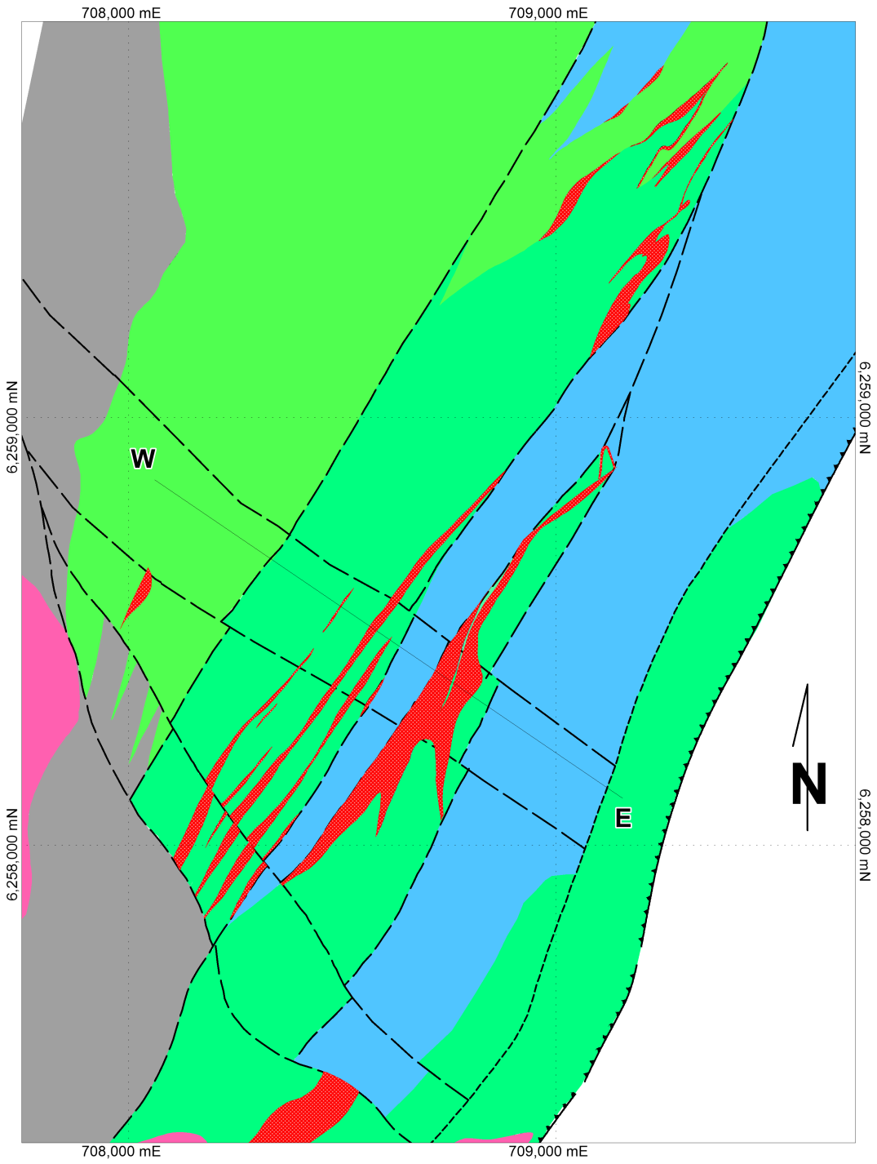
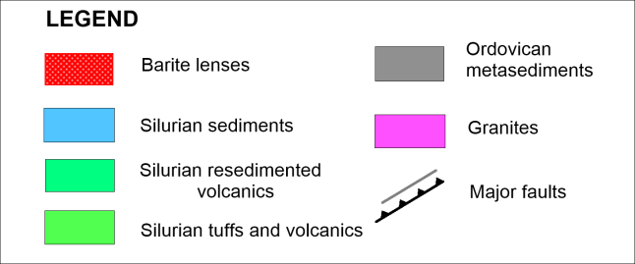
Exploration work
Geology
Structural-geological mapping and petrographic studies.
Quarries
Geochemistry
Conventional soil sampling.
Geophysics
Ground magnetics;
Gravity;
Ground EM (E-37 and SIROTEM)
Airborne magnetics – heliomag;
IP survey dipole-dipole survey;
IP survey – pole-dipole survey;
VTEM survey; and
DH electromagnetics and IP.
Causeway
Mather Zone
BJ Zone
South
Conglomerate
McCarron Zone
Drilling
491 holes (41,568m including 70 diamond holes 7,551m)
Hill Zone

Slide 7
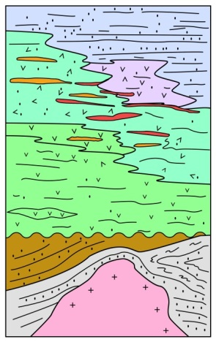
Kempfield Geology Column
Graphic log
Sequence
Lithology description
HILL END TROUGH
- sediments -unaltered barren siltstone with tuffaceous beds – hangingwall lithology
Kangaloolah Volcanics
volcanoclastic, re-worked volcanics and sediment (in upper part minor allochthonous crinoidal limestone/dolomite;
host rock for Ag-barite and Zn/Pb mineralisation
- felsic volcanics , rhyolithe porphyry and tuffaceous rocks – footwall sequence
unconformity
ORDOVICAN BASEMENT
- tremolite schists, biotite hornfels, a porphyritic andesite and black carbonaceous slate intruded with Silurian granites
Silurian
granite

Slide 8
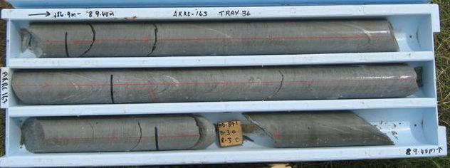
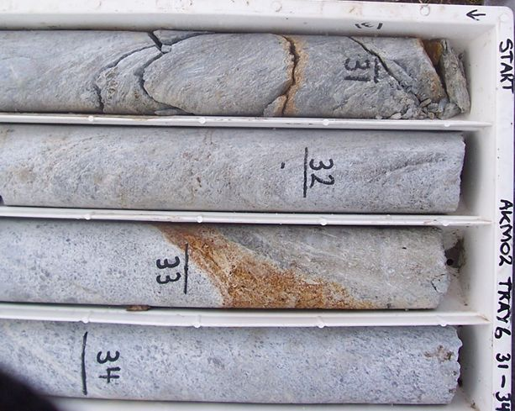
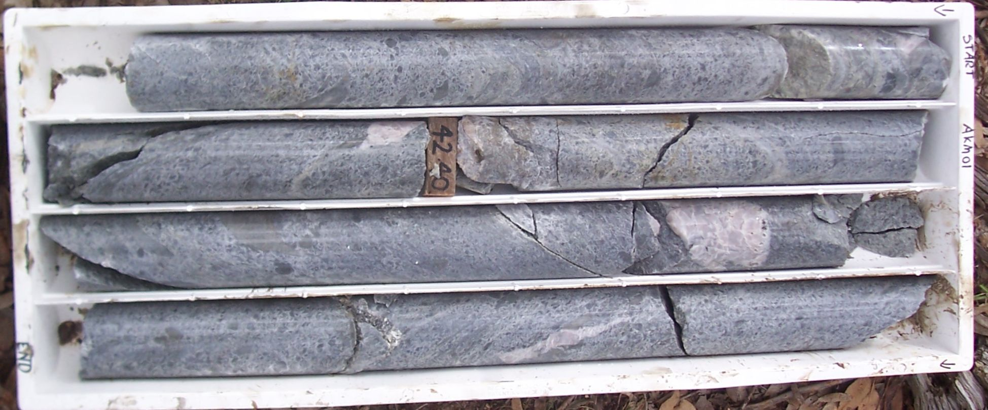
Kangaloolah Volcanics
Kempfield Geology - drillcore
- fine-grained sediments with minor felsic tuffs with crenulation cleavage; hangingwall sequence; (BJ Zone)
- banded barite with disseminated pyrite in intense sericite altered volcanoclastics
- volcanic breccia and re-worked volcanoclastics (sericite alteration with carbonate and barite veins, locally silicified);
mineralised unit; BJ Zone

Slide 9
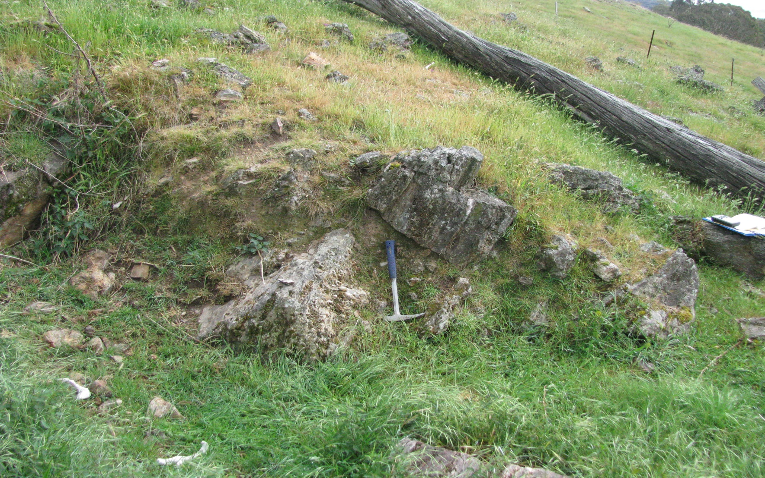
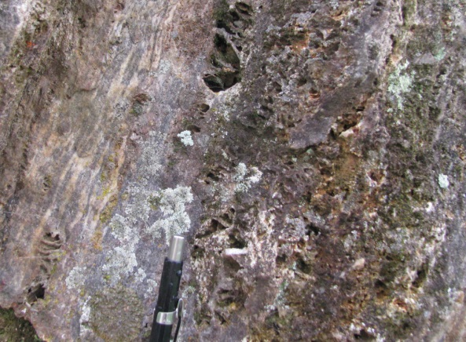
Kempfield Geology – barite lenses
Outcropping massive barite lens in volcanic units of Kangaloolah Volcanics (west of Kempfield deposit)

Slide 10
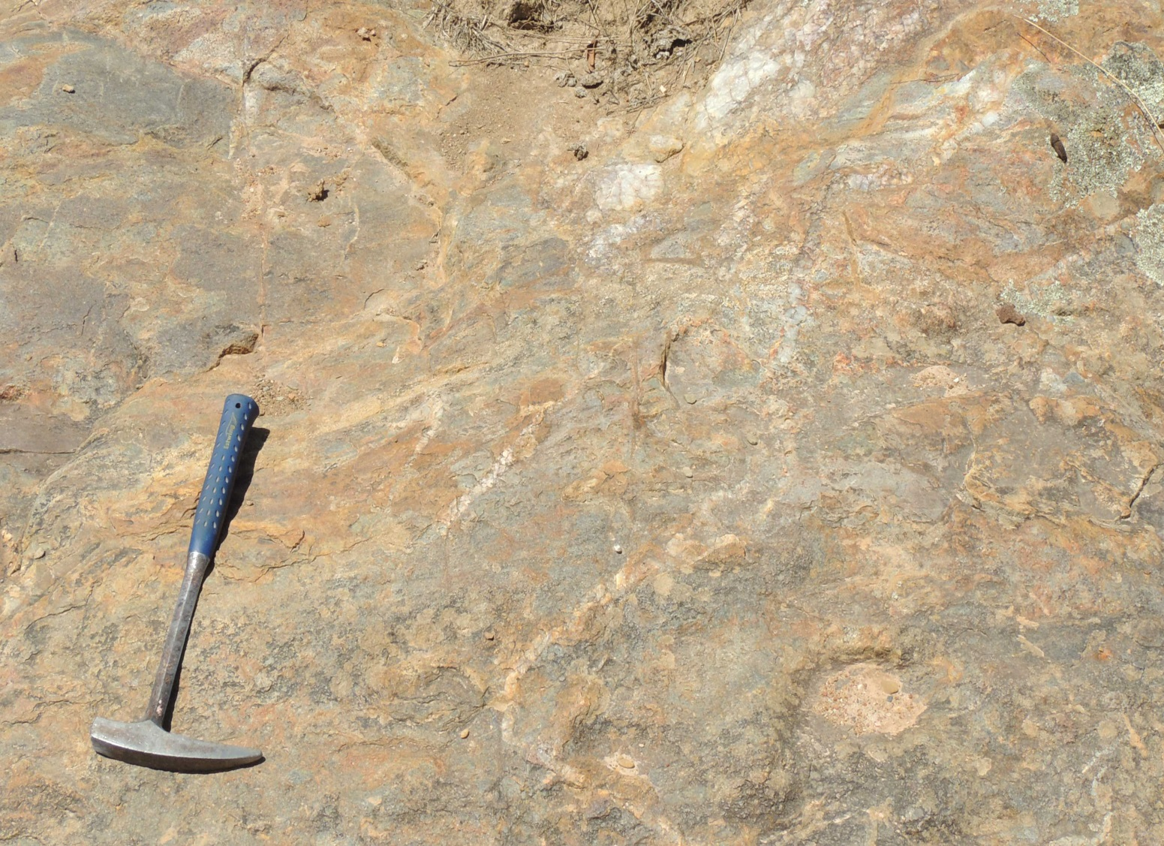
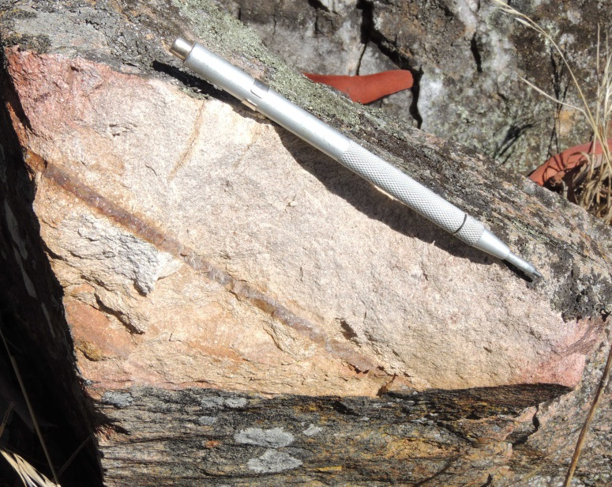
Kempfield Geology – outcropping volcanic unit
Sericite altered rhyolite; rhyolite agglomerate , locally silicified with quartz veins and disseminated pyrite
Outcropping rhyolite breccia in volcanic units of Kangaloolah Volcanics (Causeway)

Slide 11
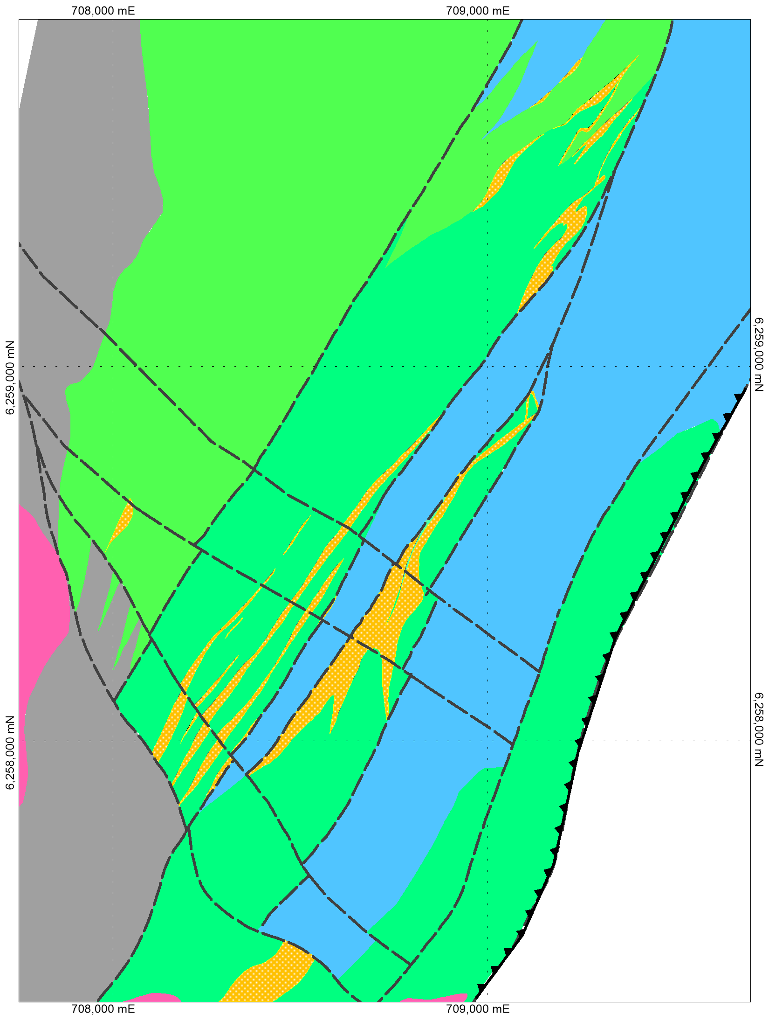
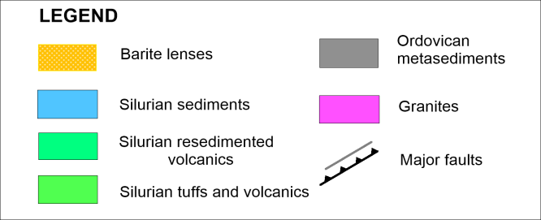
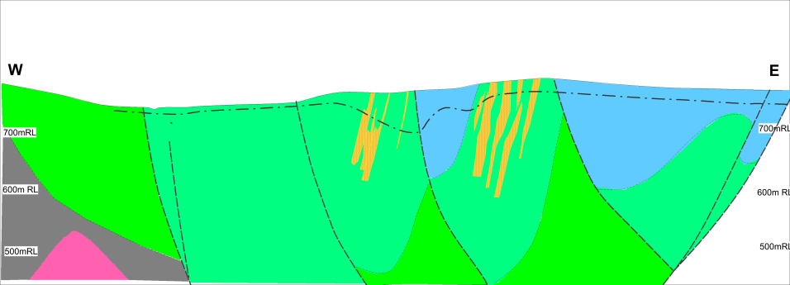
Geology Map
Quarries
Geological relation:
- Basin sequence increases thickness to east;
- Basin sequence increases thickens to the northeast (basin long axis is plunging 20 º to NE).
ORDOVICAN
BASEMENT
W
W
Structural pattern:
NE trending Copperhannia Thrust with associated steeply dipping antithetic faults;
NW trending faults are interpreted to be vertical with dip-slip and left-lateral sense of movement developed to accommodate differential displacement Copperhannia Thrust.
Causeway
HILL END TROUGH
BJ Zone
Mather Zone
MUMBIL
SHELF
E
South
Conglomerate
E
ORDOVICAN
BASEMENT
McCarron Zone
McCarron Zone
BJ Zone
Copperhannia Thrust
Hill Zone
500m
Copperhannia Trrust

Slide 12
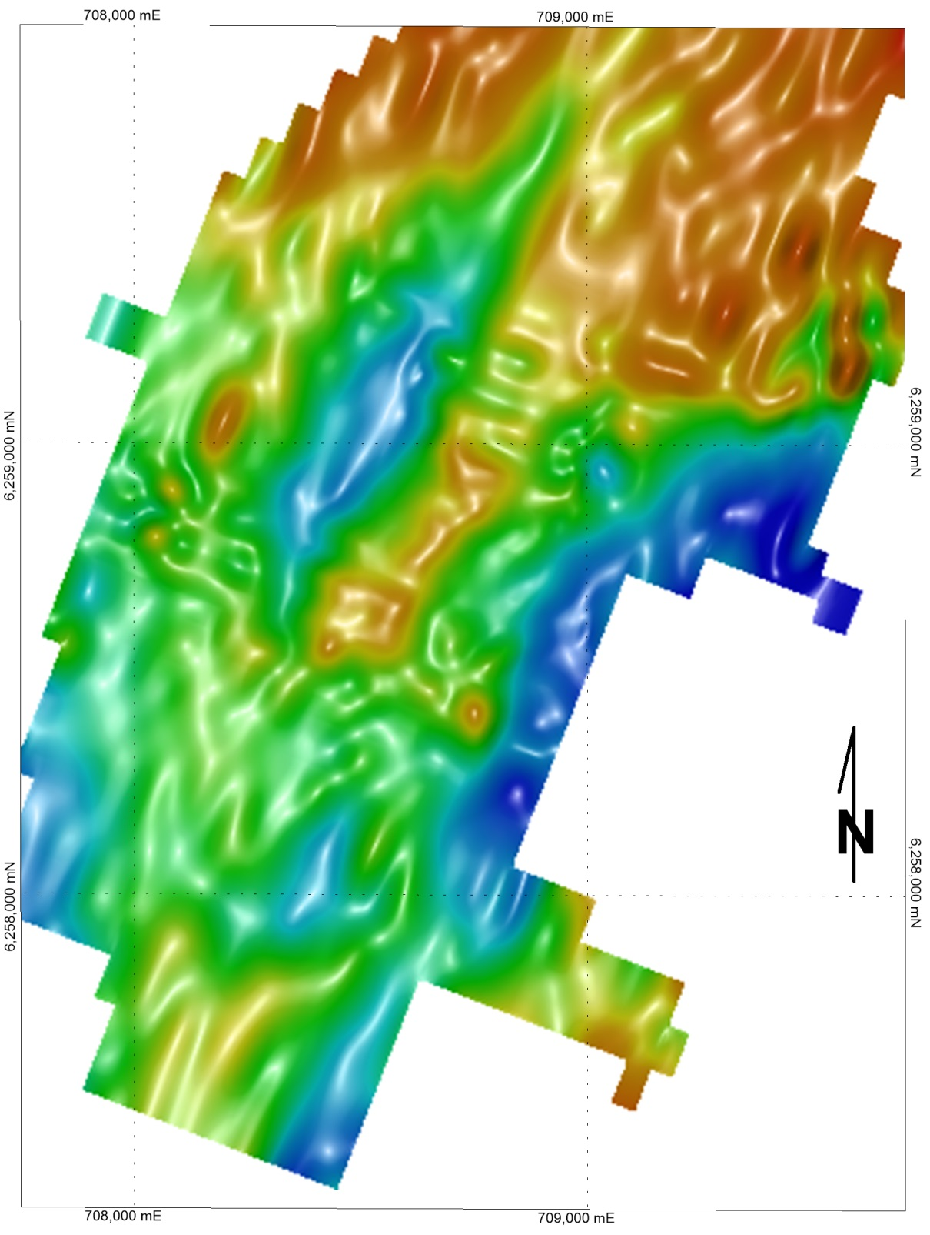

LEGEND
Geophysical signature
Mineralisation outlines;
> 10g/t Ag in fresh rocks
Major Faults
Quarries
Kempfield Gravity
- Identifies accumulation of barite masses associated with sulphides have gravity response;
- Response to basement architecture and mafic volcanics;
BJ Zone
- Gravity survey at 50m spacing on 100m apart lines;
- Survey conducted in two stages by Shell (1983) and Argent (2013);
Mather Zone
South
Conglomerate
McCarron Zone
- Bouger gravity terrain corrected;
Bouger correction density 2.67 T/m³
500m
Hill Zone

Slide 13
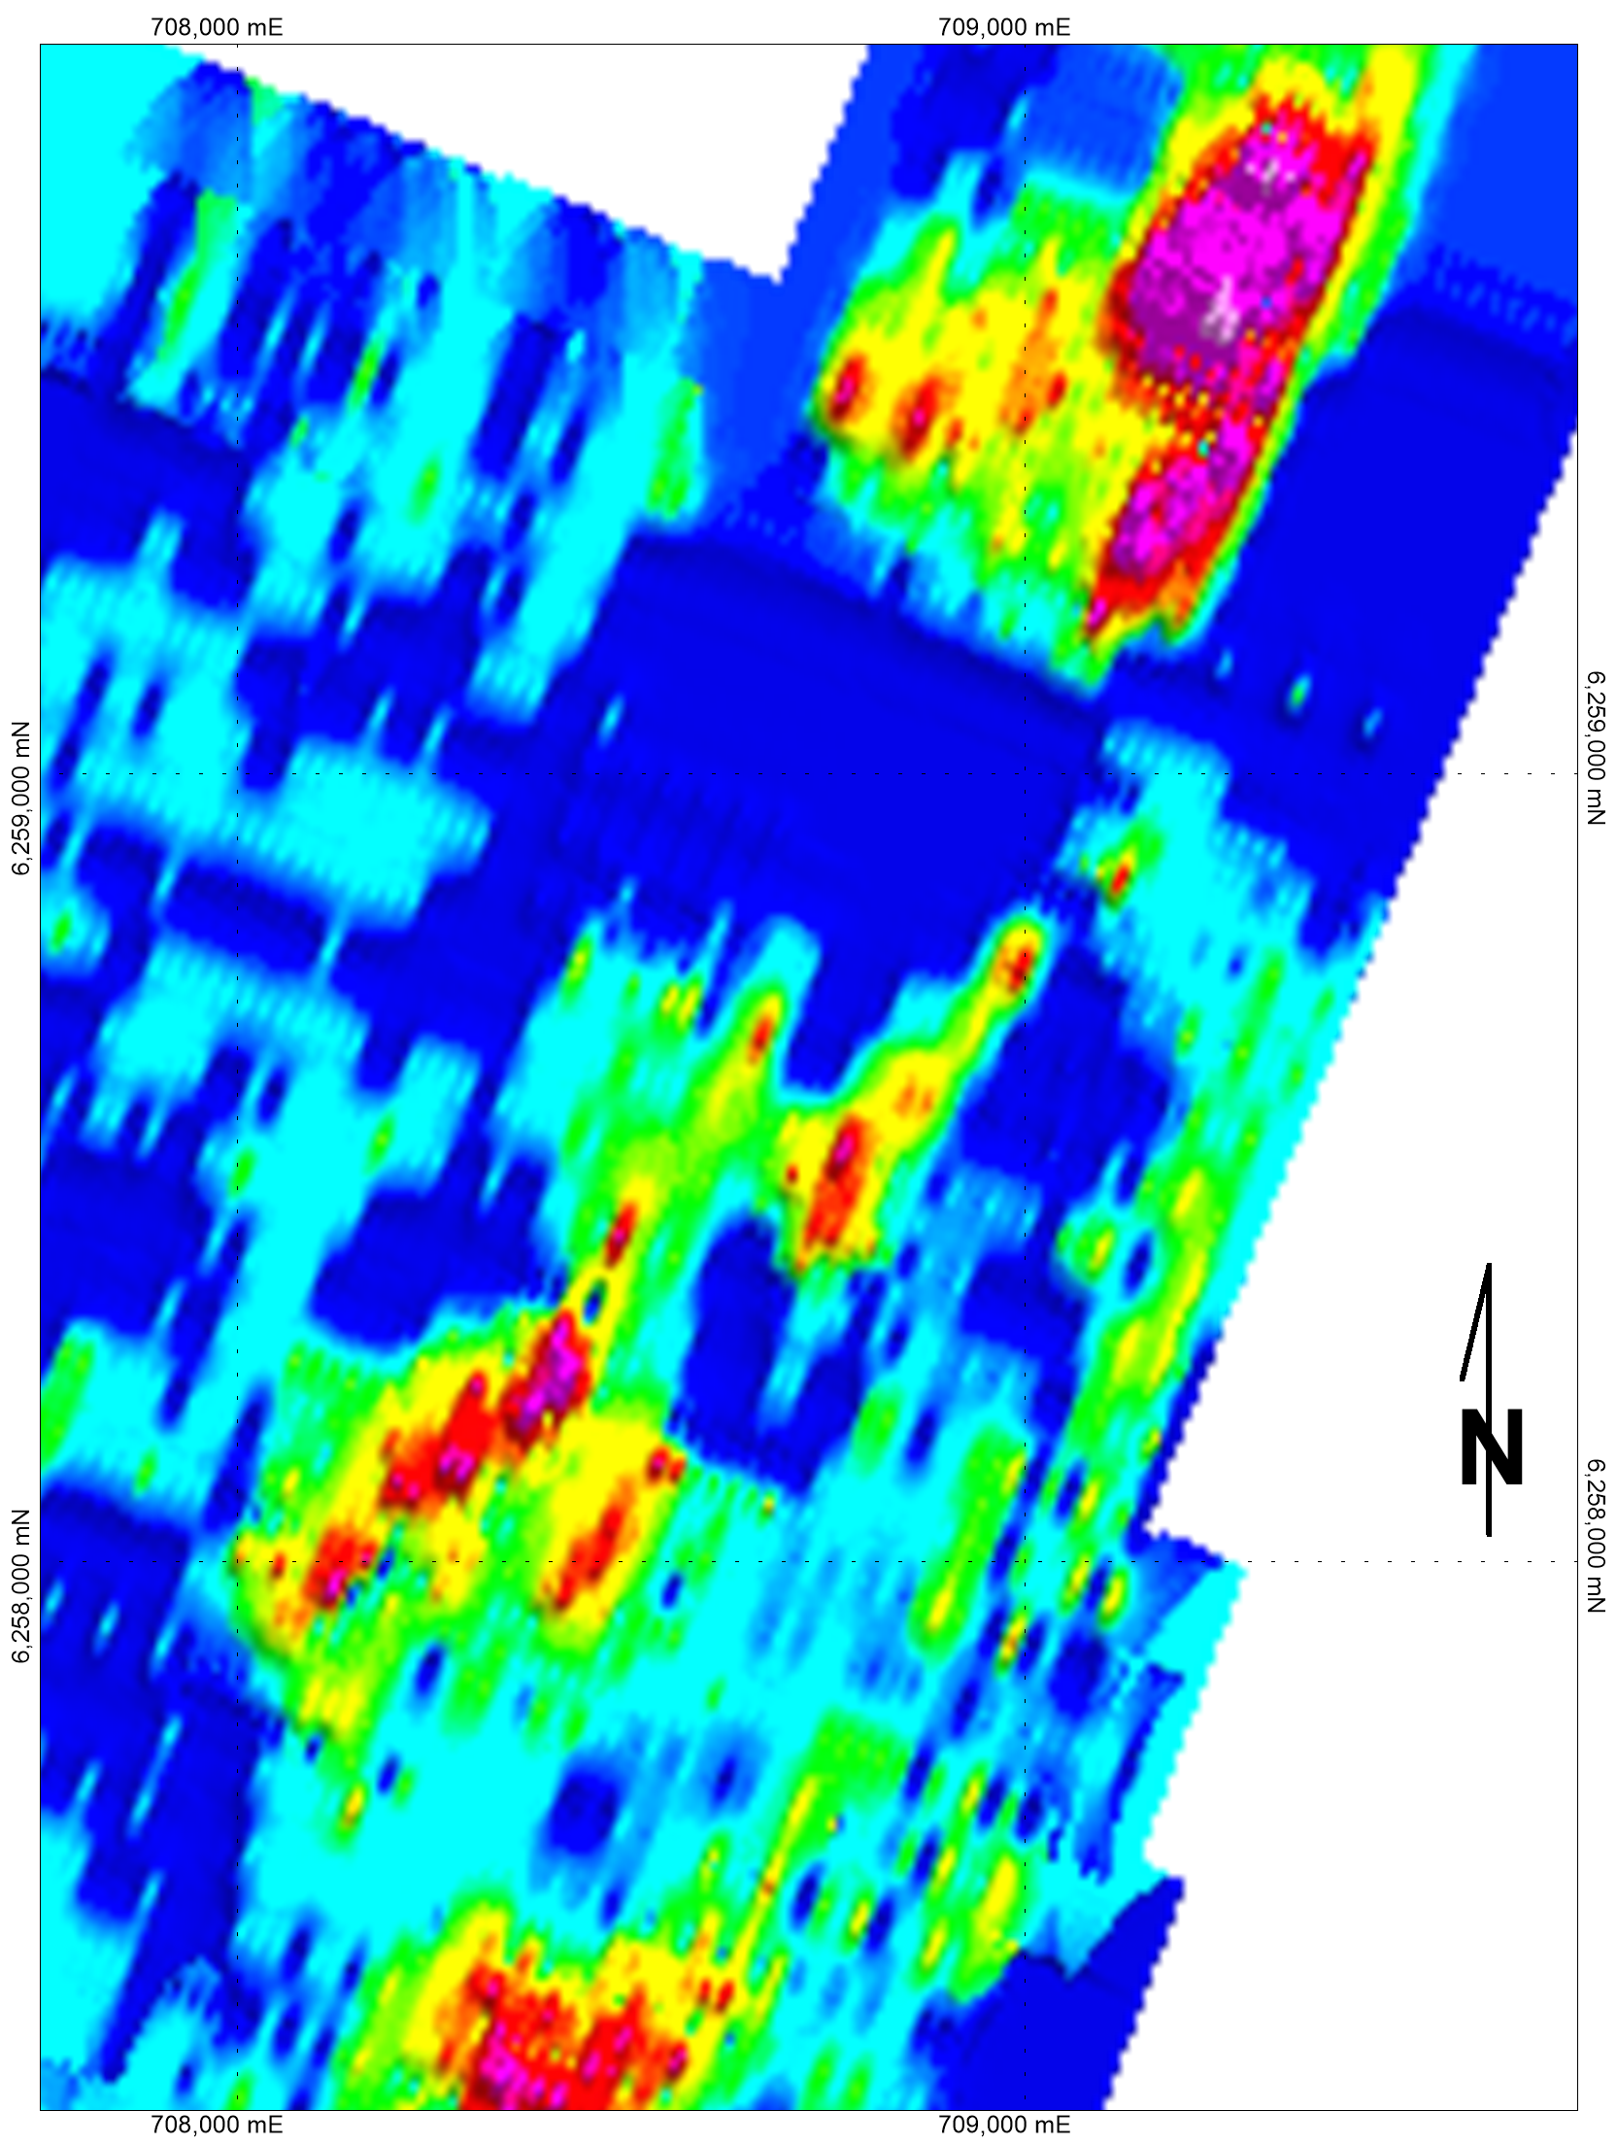
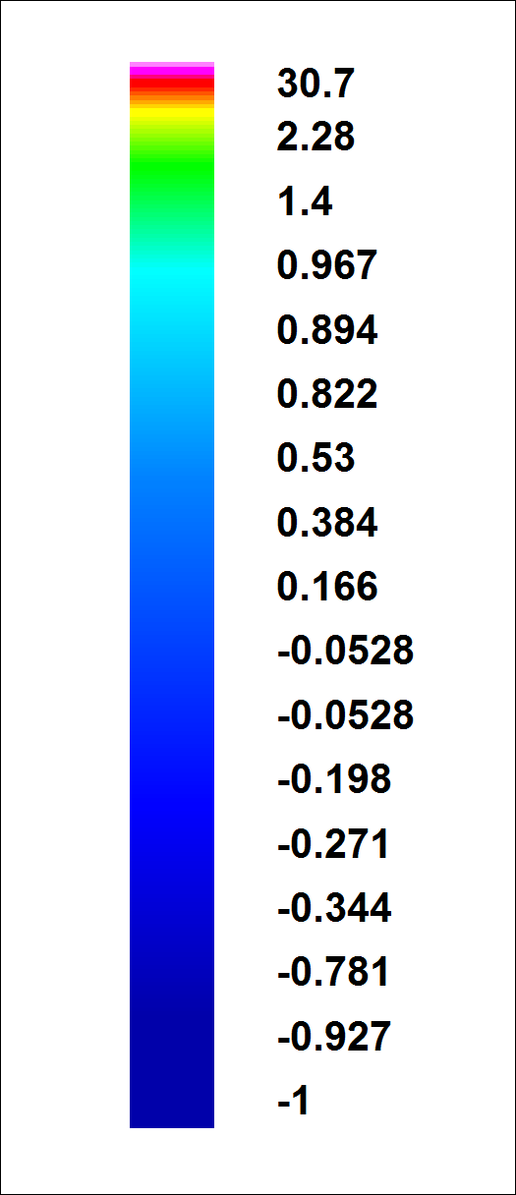
Geochemical signature
LEGEND
Mineralisation outlines;
> 10g/t Ag in fresh rocks
Major Faults
Quarries
Conventional soil
Ag
Conventional soil sampling had been used to identify outcropping and sub cropping mineralisation including alteration halo
Causeway
BJ Zone
Collected 3000 samples at 25m spacing on 100m apart lines by Shell, Golden Cross and Argent Mineral
Mather Zone
South
Conglomerate
Ag content is soil correlates very well with subcropping mineralisation.
McCarron Zone
Hill Zone
500m

Slide 14
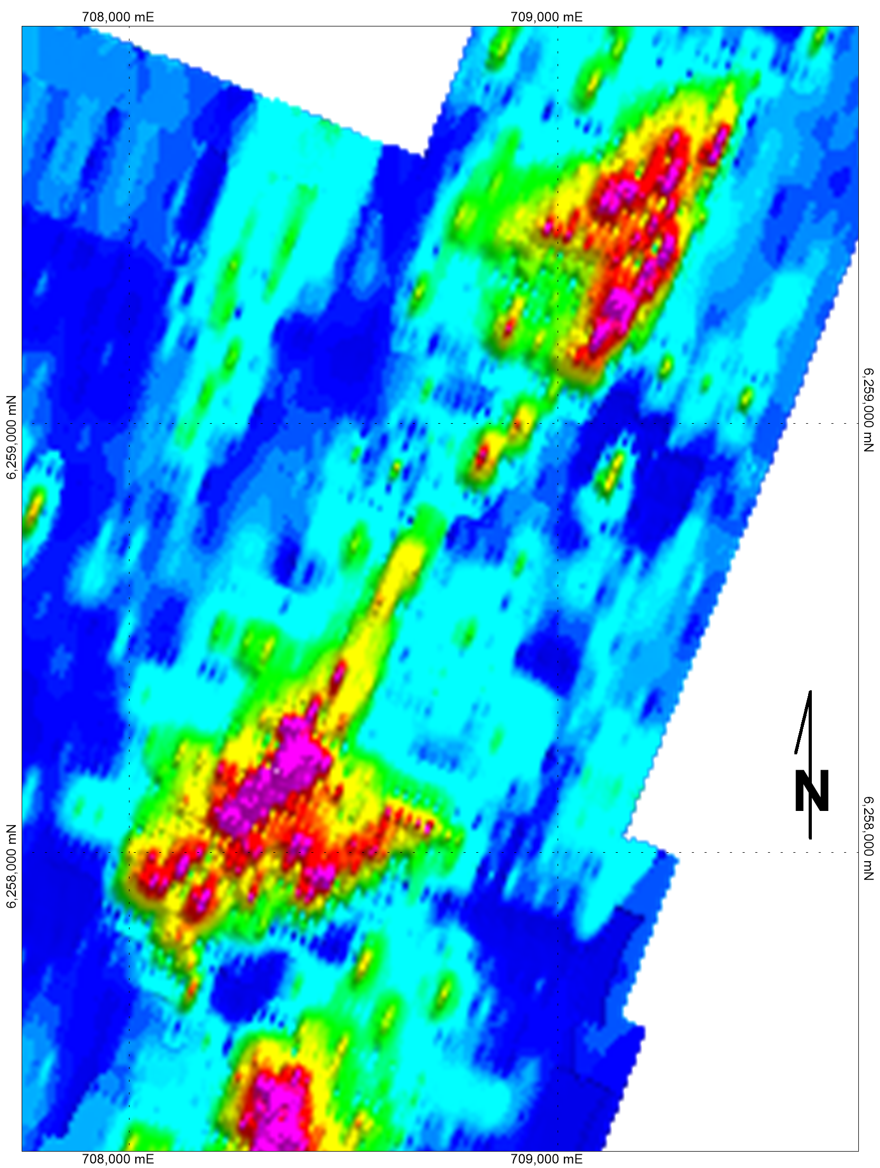
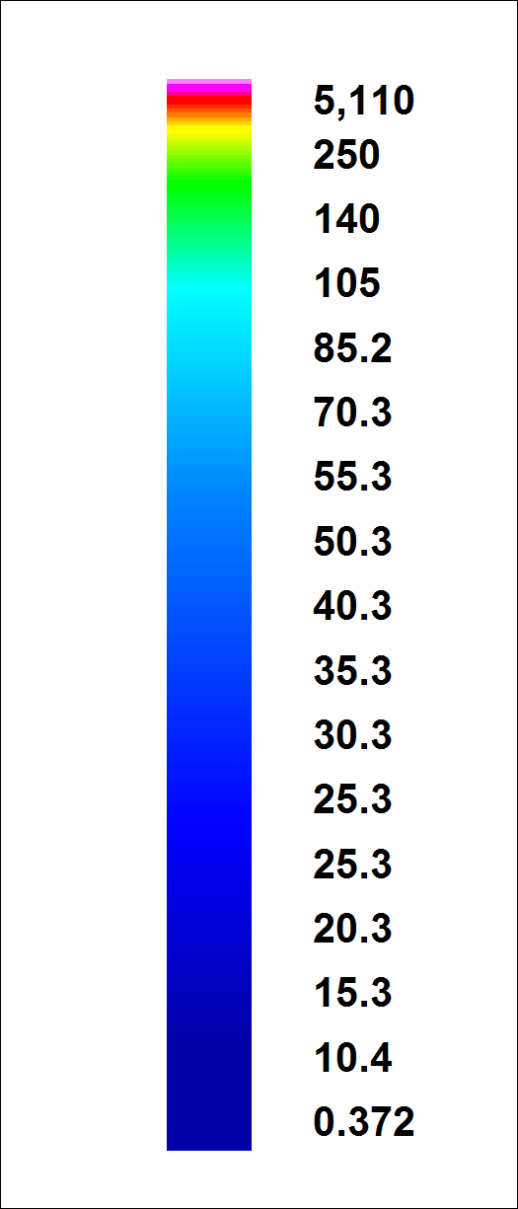
Geochemical signature
Quarries
Conventional soil
Pb
Causeway
correlates well with sub-cropping mineralisation at Quarry Zone and McCarron South;
cause false alarm at South Conglomerate and Hill Zone;
no response at BJ zone (cover of alluvial gravel)
BJ Zone
Mather Zone
South
Conglomerate
McCarron Zone
LEGEND
Mineralisation outlines;
> 10g/t Ag in fresh rocks
Mineralisation outlines;
> 0.5 % Pb in fresh rocks
Hill Zone
500m
Major Faults

Slide 15
Kempfield deposit geometry
LEGEND
Mineralisation outlines;
> 10g/t Ag in fresh rocks
Mineralisation outlines;
> 0.1 g/t Au in fresh rocks
Quarries
Three main and several small mineralised zones :
Mineralisation outlines;
> 0.5% Zn in fresh rocks
Mineralisation outlines;
> 0.5% Pb in fresh rocks
Main zones:
- BJ Zone - barite-silver rich zone;
McCarron Zone - disseminated Ag- Pb-Zn and barite locally massive Pb-Zn sulphide (Pb-Zn);
Quarries Zone (northern) – zone of high barite and silver.
W
Causeway
BJ Zone
Copperhannia Thrust
Mather Zone
E
Remaining zones:
South Conglomerate Zone (low grade Ag-barite);
Mather Zone (Pb-Zn mineralisation);
Hill Zone (high grade barite and low grade Ag);
Causeway Zone (low grade Au- mineralisation hosted in a sericite altered rhyolite).
South
Conglomerate
McCarron Zone
Hill Zone
500m

Slide 16
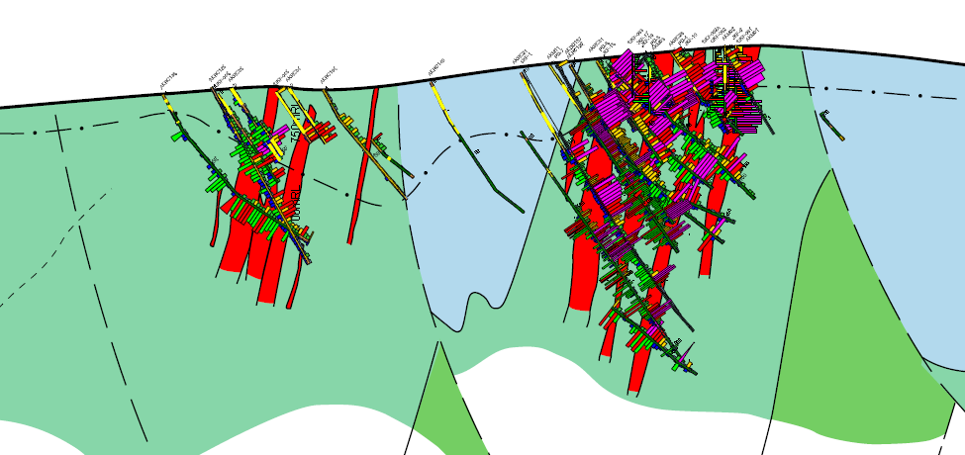
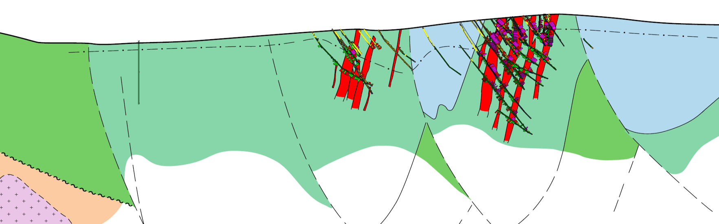
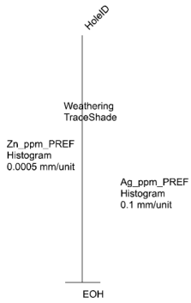
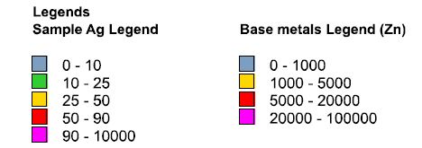
Kempfield Geology – Cross section
BJ Zone
W
McCarron Zone
E
base of weathering
750 m
750 m
sediments
volcanoclastics
700 m
700 m
sediments
increasing
Pb-Zn content with depth
mineralisation
650 m
increasing
Pb-Zn content with depth
mineralisation
volcanics
50m
Interpretation by Argent Minerals Ltd., 2013

Slide 17
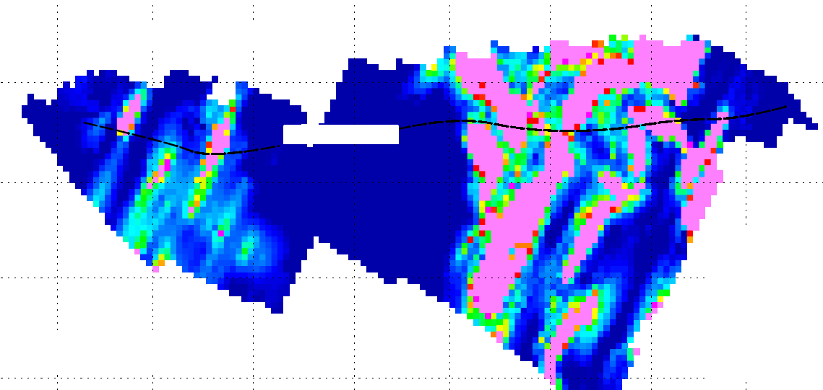
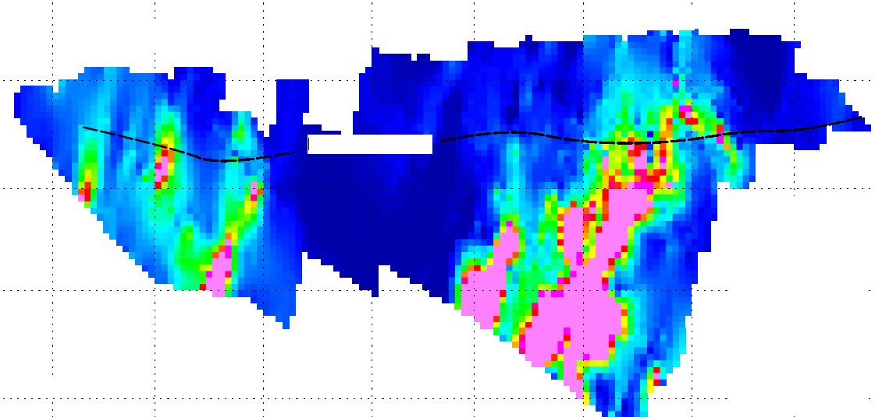
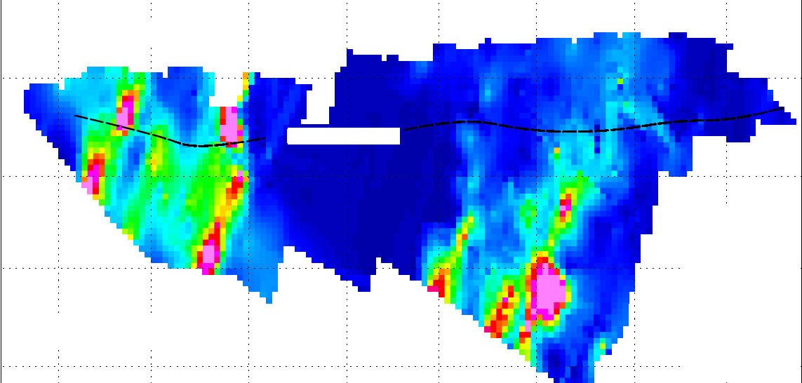
Kempfield – Cross section geochemistry
W
McCarron Zone
BJ Zone
E
W
McCarron Zone
BJ Zone
E
surface
surface
Base of oxidation
Base of oxidation
700 mRL
700 mRL
700 mRL
700 mRL
650 mRL
LEGEND
650 mRL
LEGEND
> 50 g/t Ag
> 1% Zn
Ag distribution
< 10 g/t Ag
Zn distribution
< 0.1% Zn
W
McCarron Zone
BJ Zone
E
- a trend of increasing base metals grades (Pb-Zn) is observed laterally from the BJ Zone (predominantly Ag-barite) in the east to the McCarron Zone in the west
surface
Base of oxidation
700 mRL
700 mRL
650 mRL
LEGEND
- barite and Ag grade are decreasing with depth, whilst Pb, Zn, Au are increasing in each individual ore system
> 1% Pb
Pb distribution
< 0.05% Pb

Slide 18
Kempfield alteration and mineralisation
Alteration assemblage at Kempfield deposit is dominated with pervasive barite, sericite/muscovite, chlorite and disseminated quartz, sulphides and a minor albite.
Mineralisation: oxide (Ag-barite) mineralisation and primary (sulphide)
Oxide mineralisation: goethite and jarosite associated with chlorargyrite, native silver and argentite in a barite gauge.
Base of oxidation (30m - 70m)
Primary (sulphide) mineralisation: pyrite is the main sulphide mineral, with Fe-poor sphalerite, argentite, native silver and Ag-sulphosalts (tetrahedrite, proustite-pyrargyrite), galena (containing pearceite-polybasite) and minor chalcopyrite.

Slide 19
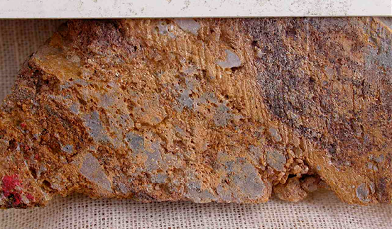
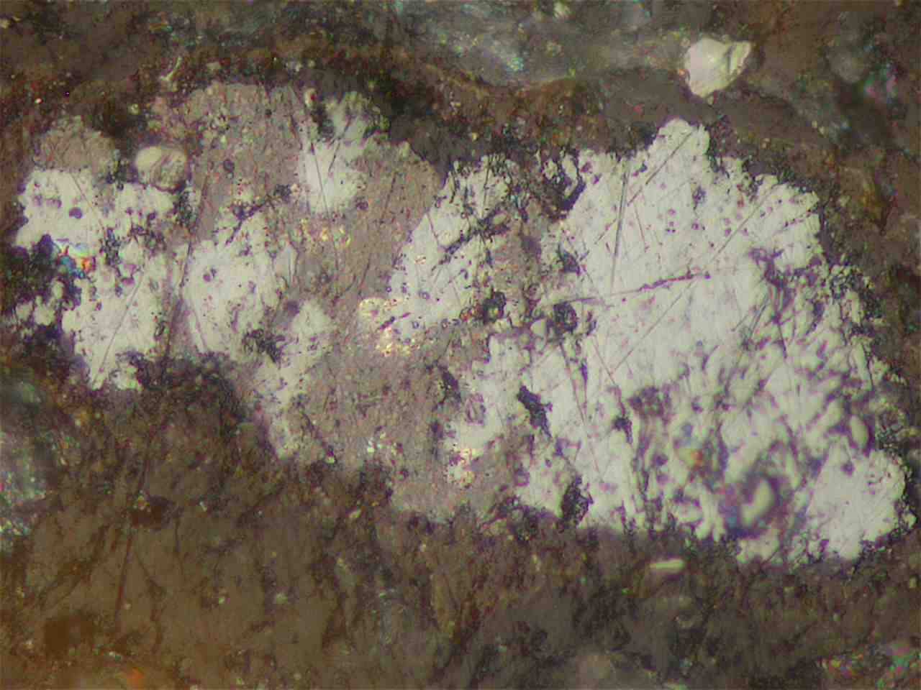
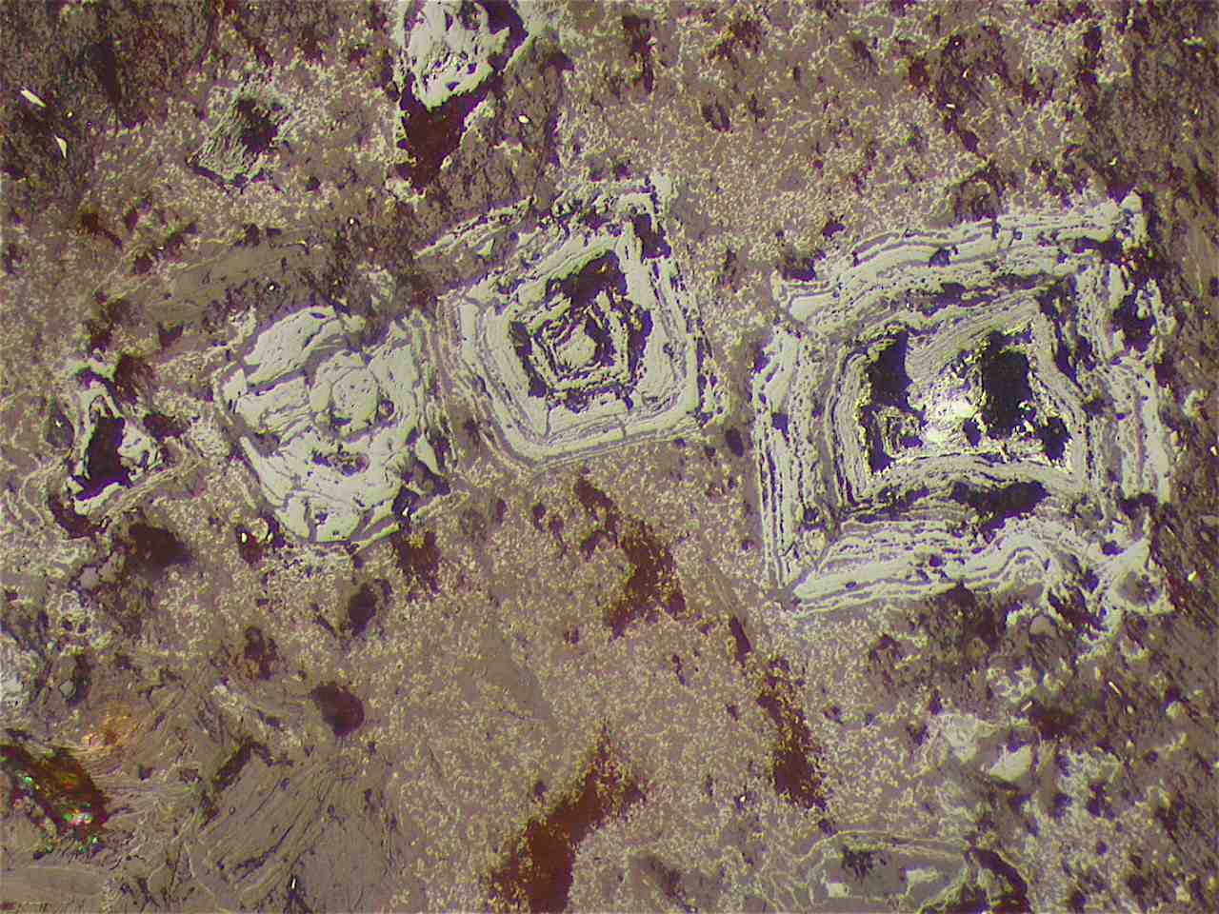
Kempfield Mineralisation
Oxide
Mineralisation
Slabbed drill core -weakly foliated, gossanous, goethite-impregnated talc-quartz rock. The pale grey aggregates are quartz and the darker brown zones contain considerable sulphide boxwork structures.
Curtsey of P. Ashley
View2.5 mm across
Curtsey of P. Ashley
view 1 mm across
Composite aggregate of argentite-acanthite (pale grey), Pb oxidate phase (brownish-grey) and tiny creamy grains of silver-electrum, in goethite-impregnated talc.
Relict boxworks after pyrite grains, hosted in clay-degraded, goethite-impregnated talc.

Slide 20
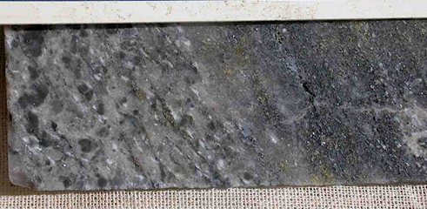
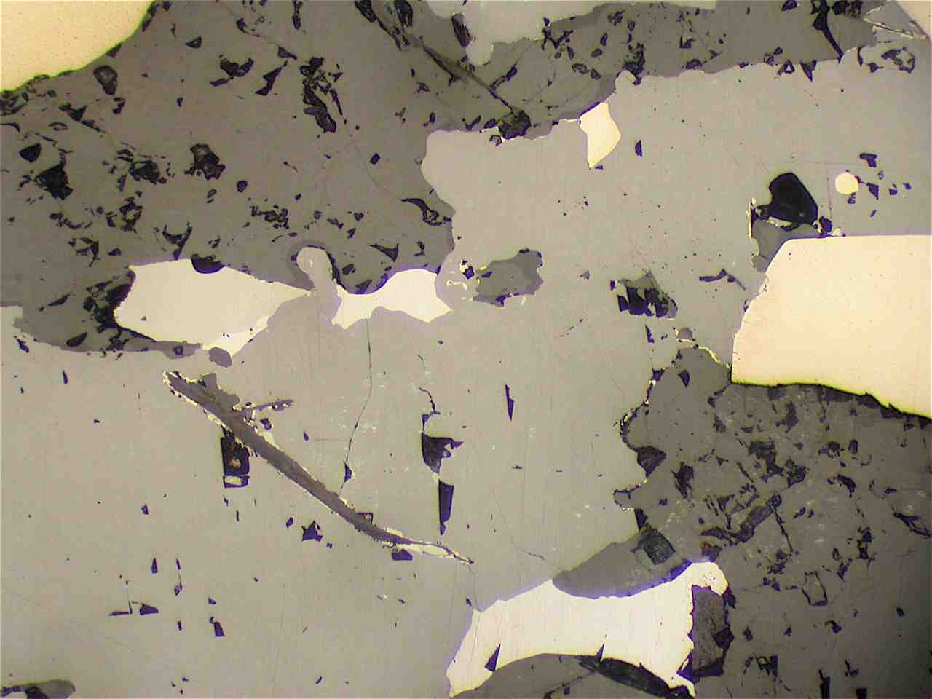
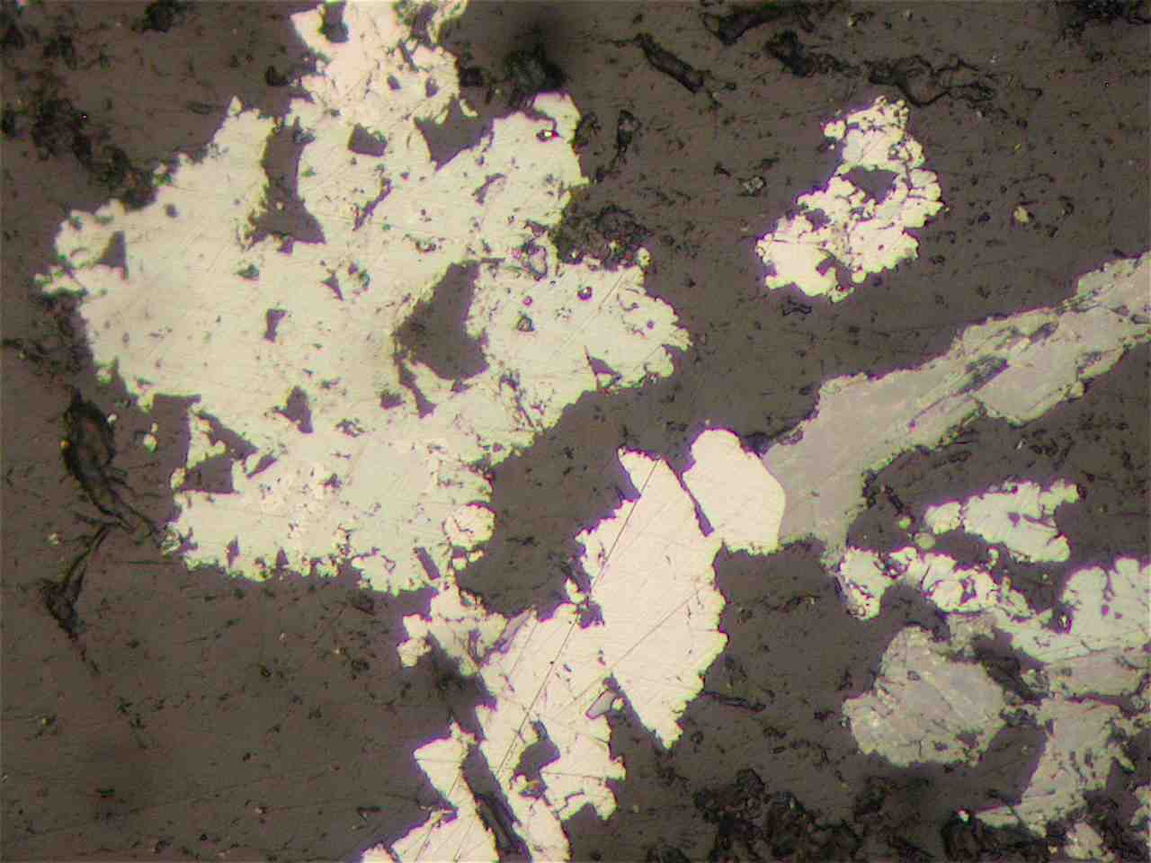
Kempfield Mineralisation
Sulphide
Mineralisation
Foliated barite-rich rock (slabbed drill core) with disseminated suplhides (sphalerite and pyrite).
Curtsey of P. Ashley
View2.5 mm across
Curtsey of P. Ashley
View2.5 mm across
Sulphide mineralisation - sphalerite (pale grey) and pyrite (pale creamy) grains in barite (darker grey). Galena (silvery) and a small grain of pale olive-grey tetrahedrite are associated with sphalerite.
Sulphide mineralisation - aggregate of argentite-acanthite (pale greenish-grey), galena (silvery grey) and sphalerite (mid grey) in a barite-rich matrix (dark grey).

Slide 21
Kempfield – deposit model
According to the structural geological relations and metal/alteration zonation, two possible genetic models can be applied:
Model 1
Deposit is a part of the spectrum of VMS deposits - a strabound barite-rich mineralisation with low grade zinc-lead-silver and it is at the low temperature end of the sea floor VMS spectrum defined by Large et al, (2001).
Model 2
Deposit is an outcropping distal part (Ag-barite) of a larger VMS system where the base metal rich feeder zone is buried at depth or eroded.
The apparent repetitions of mineralised barite horizons may be due to deformation and/or the presence of multiple mineralised layers within the original sequence.

Slide 22
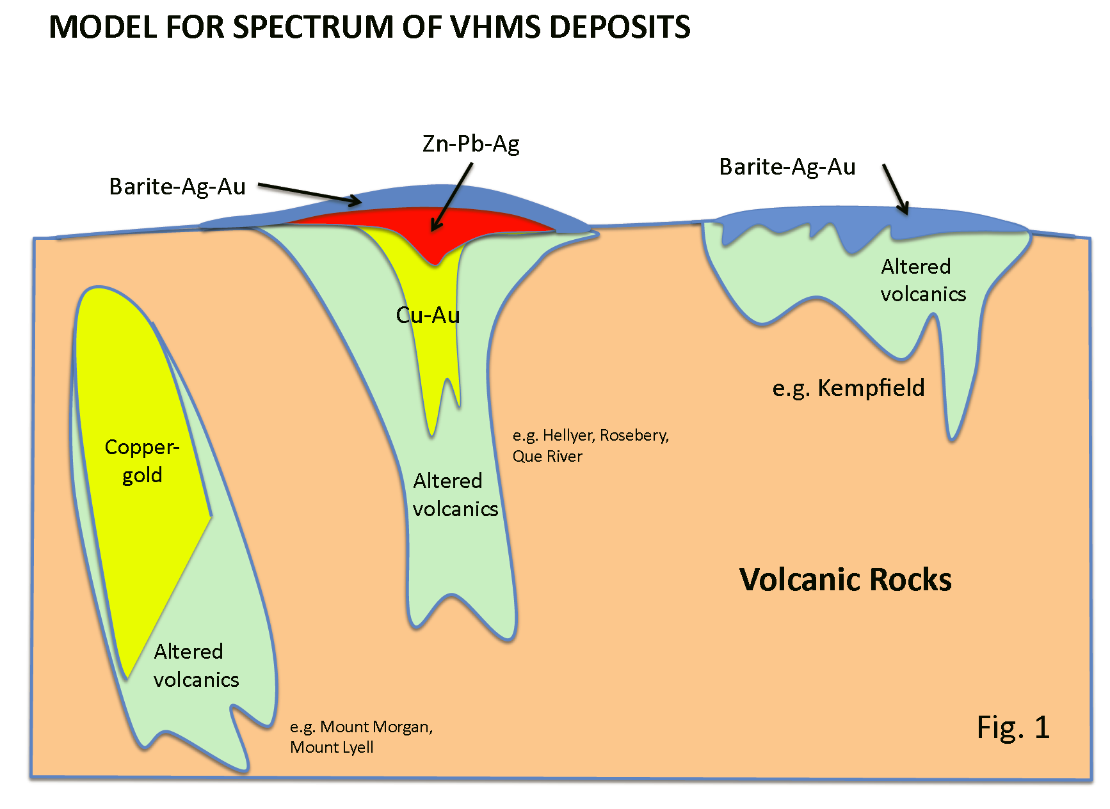
Kempfield ore deposit – Model 1
Sunny Corner,
Lewis Ponds,
Commonwealth
Kempfield
McPhillamy ??
After Large et al, 2001

Slide 23
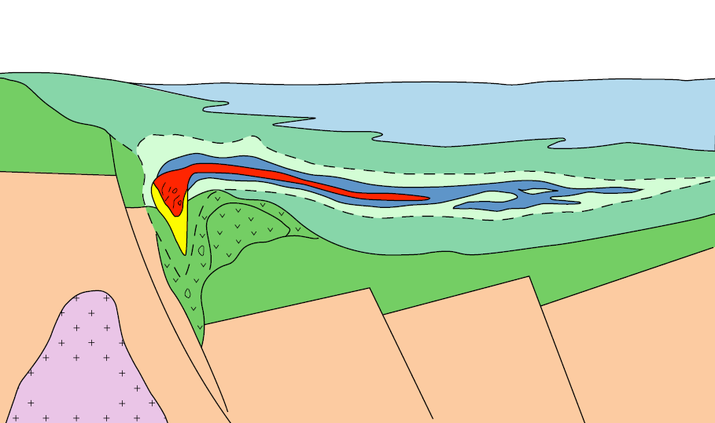
Kempfield ore deposit – Model 2
McCaron Zone
BJ Zone
sediments
volcanics
chlorite-sericte –pyrite
Sericite - chlorite –pyrite
Sulphide stringers
Zn – Pb - Ag
Massive barite and diss. Py + Ag
Massive sulphides
Zn – Pb – Ag – Ag - Cu
Ordovician
metasediments
Silurian
granite
Interpreted and restored precursor stratabound Kempfield deposit.
The deposit is deformed and distorted by antithetic normal faults developed at the hinterland of Copperhania Thrust as a result of extensional stress distribution and anticlockwise block rotation. The block rotation forms the apparent repetitions of mineralised lenses.

Slide 24
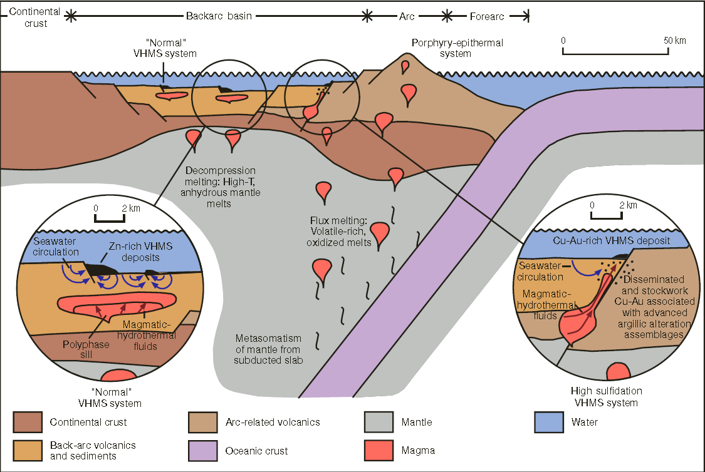
Kempfield ore deposit model
Kempfield ?
Diagram showing possible settings of VMS deposits in convergent margins (Huston et al 2010)

Slide 25
Disclaimer
This material contains certain forecasts and forward-looking information about possible or assumed future performance, exploration results, resources or potential growth of Argent Minerals Limited, industry growth or other trend projections.
Such forecasts and information are not a guarantee of future performance and involve unknown risks and uncertainties, as well as other factors, many of which are beyond the control of Argent Minerals Limited.
Actual results and developments may differ materially from those expressed or implied by these forward-looking statements, depending on a variety of factors.
Nothing in this material should be construed as either an offer to sell or a solicitation of an offer to buy or sell securities.

Slide 26
Acknowledgement to
Argent Minerals Limited

